Slide 1

WEEKLY PROGRESS BRIEFING · FALL 2026 CAPSTONE
AUtoMLy — Alabama Medicaid Policy Copilot
What we finished this week, November 5–12, 2026.
MILESTONE 3 REPORT
WALKTHROUGH VIDEO
PROGRESS LOG 3
GOVERNANCE PLAN
Final
7:19
Complete
Drafted
Seven pages, matched to the live eight-step workflow.
Published on AUM YuJa and GitHub, with captions.
One page, with reported hours, for Weeks 9‑12.
10 pages; meets every rubric section. Due Nov 22.
Milestone 3 is wrapped up, and the Implementation & Governance Plan is ready for review.
Where everything lives (pull all three at home)
Solution repo · private
Course repo · private
Deliverables repo · public
Code, plan builder, CURRENT.md and handoff
This deck and its builder
J.O.-only copies of the deck and reports
J.O. | INAI 6986 | Nov 12, 2026 | Status snapshot
01
Notes:
Framing for tonight: this week closed out Milestone 3 (report, walkthrough video, Progress Log 3) and produced the full draft of the Cross-Functional Implementation and Governance Plan (Assignment 6, due November 22). The plan targets a DGX Station as the production platform, with a low-cost GB10 box for testing and the pilot.
Evidence: git log of INAI_6986_AUtoMLy_solution and INAI6986_project_deliverables, Nov 10–12; m3-walkthrough-v4 releases; docs/turn-in/J_O_INAI6986_ImplementationGovernance.pdf
Snapshot: November 12, 2026. Slides prepared with AI assistance from recorded artifacts; student review required.

Slide 2
THIS WEEK
The Week in Five Steps
From a finished workflow to a finished Milestone 3 package and a deployment plan.
Nov 9
Planned the walkthrough video
Storyboard and plain-language narration script for a tour of every workflow path.
Nov 10
Recorded and released the video
Live dark-mode capture of each path; version 4 (7 min 19 s) released with captions.
Nov 10
Aligned the Milestone 3 report
Updated to the eight-step, confidence-routed design; expanded the student-contribution disclosure.
Nov 12
Finished the Milestone 3 package
Branded page-one screenshot, official AUM YuJa video link, and Progress Log 3 with reported hours.
Nov 12
Built the Implementation & Governance Plan
Platform, cost and return, people, rollout and governance, mapped to the rubric.
J.O. | INAI 6986 | Nov 12, 2026 | git history · release notes
02
Notes:
Commits: 11 in the private solution repository and 10 in the public deliverables repository between Nov 10 and Nov 12. The walkthrough went through four narrated versions (v1 Nov 9, v2–v4 Nov 10); v4 is the published one. Progress Log 3 records the student-reported 6 hours this week and 4 hours last week.
Evidence: git log --since 2026-11-04 (both repos); INAI6986_M3_walkthrough narration and deliverables folders; CURRENT.md
Snapshot: November 12, 2026. Slides prepared with AI assistance from recorded artifacts; student review required.

Slide 3
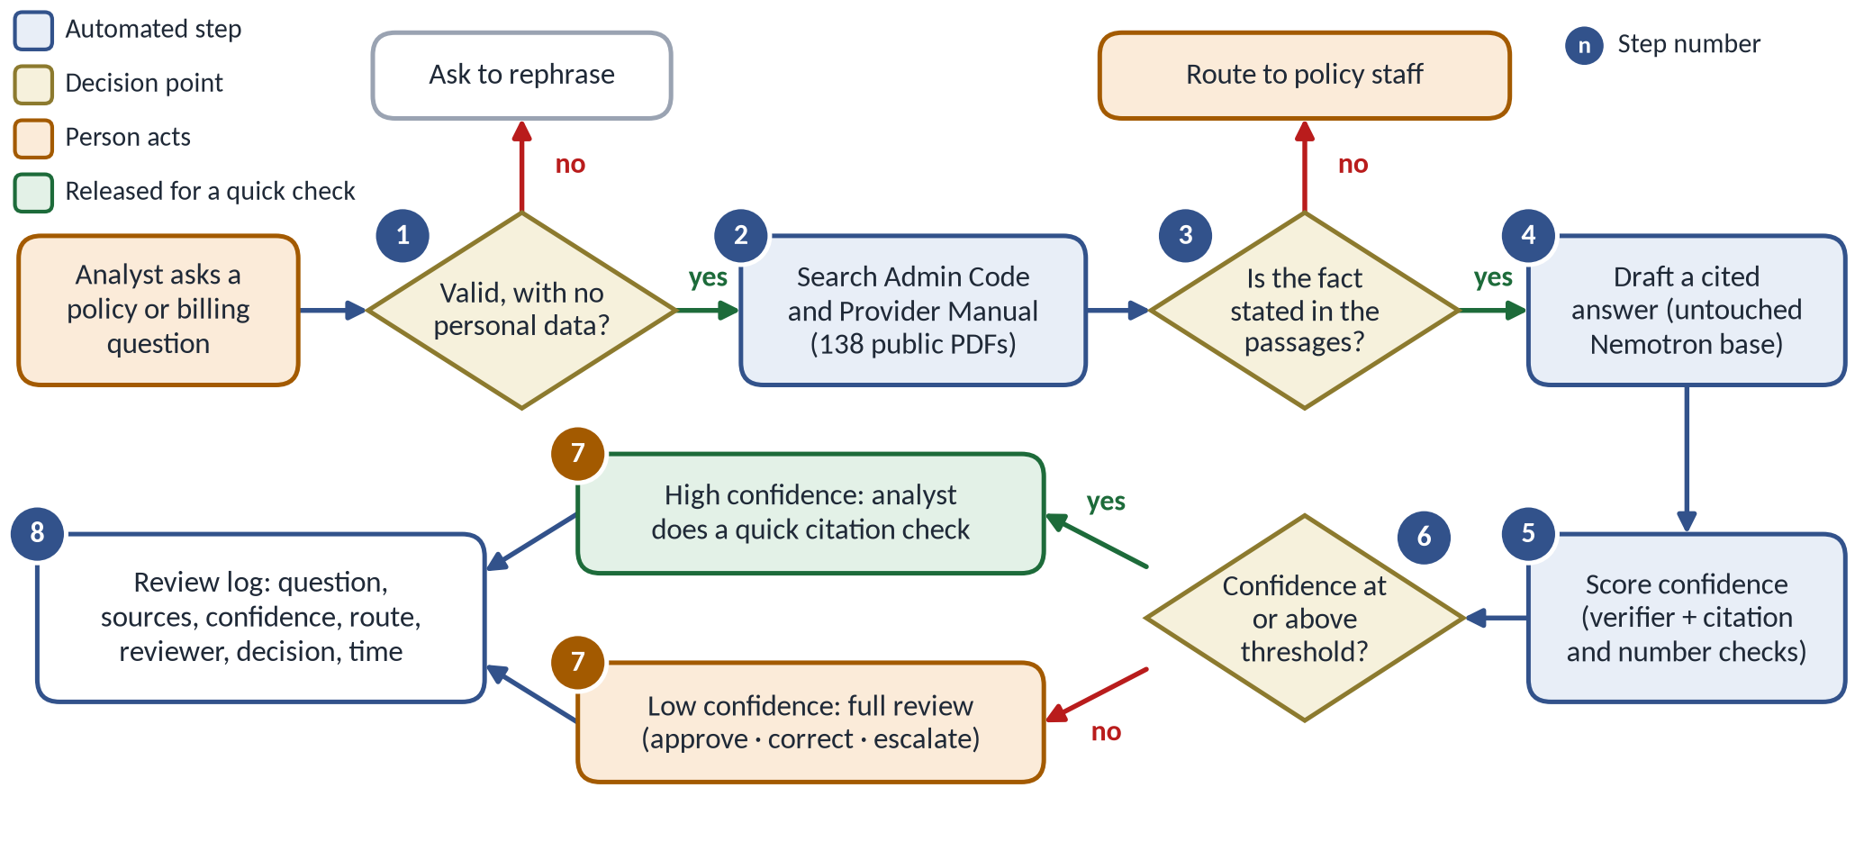
THE SYSTEM
How AUtoMLy Works: Eight Numbered Steps
The numbers match the working system, the Milestone 3 report and the new plan.
✓
Steps 1–6 and 8 are automatic
They take a few seconds per question.
✓
Step 7 is a person
An analyst checks every draft against the cited page.
✓
Clear exits
Unclear questions are rephrased; questions the manuals do not answer go to policy staff.
✓
Advisory only
It never decides anyone’s eligibility or payment.
J.O. | INAI 6986 | Nov 12, 2026 | Plan Figure 1 · M3 §2
03
Notes:
Steps: 1 check the question (length and personal-data screen); 2 search the Administrative Code and Provider Manual (138 PDFs, up to 8 passages); 3 evidence gate; 4 cited draft by the unchanged Nemotron base model; 5 confidence score; 6 review level from the threshold; 7 the analyst approves, corrects or escalates; 8 everything is written to the review log.
Evidence: docs/workflow/README.md (The Steps); Implementation & Governance Plan Section 1
Snapshot: November 12, 2026. Slides prepared with AI assistance from recorded artifacts; student review required.

Slide 4
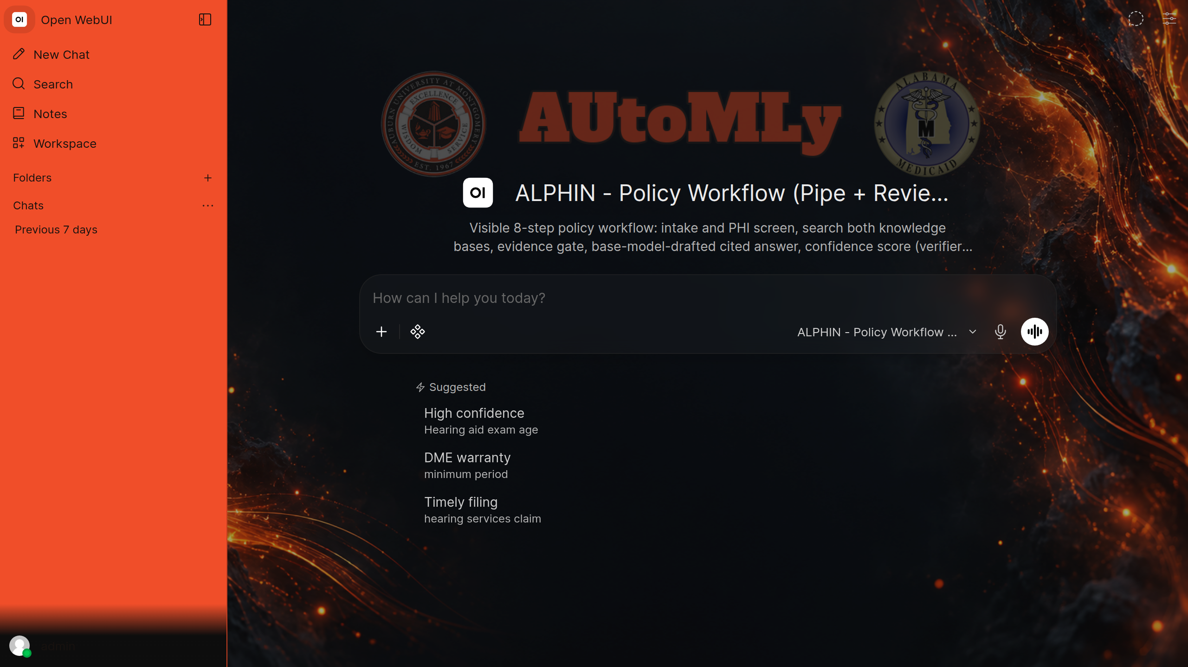
MILESTONE 3
Milestone 3 Report: Final and Aligned
The report now describes exactly what the live system does.
✓
Matches the eight-step workflow
Confidence routing replaces the older auto-clear rule.
✓
Real branded screenshot on page one
Dark mode, AUM-orange sidebar, current suggested prompts.
✓
Official video link added
AUM YuJa first; GitHub MP4 with captions as the backup.
✓
Clear authorship
Expanded disclosure of the student’s own contributions.
✓
Seven pages, clean layout
Page-one figure: the branded Open WebUI home screen with the ALPHIN workflow selected.
Sections 1, 2 and 3 start on pages 1, 2 and 3.
Ready to submit with the video link and Progress Log 3. Milestone 3 is due Sunday, November 15.
J.O. | INAI 6986 | Nov 12, 2026 | docs/turn-in · CURRENT.md
04
Notes:
Full-name Canvas copies of the report and Log 3 are in the OneDrive capstone folder; J.O.-only copies are in docs/turn-in of the solution repository and docs/ of the public deliverables repository. Both DOCX files validated.
Evidence: commits 0b22e19, b60519f, d66eb4c, 8d0236c, d8dac9c; docs/turn-in/build_milestone3.py
Snapshot: November 12, 2026. Slides prepared with AI assistance from recorded artifacts; student review required.

Slide 5
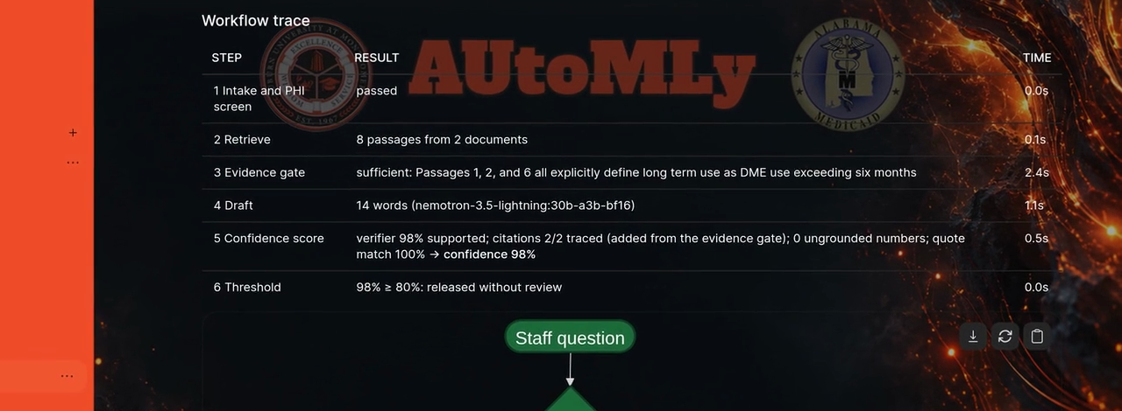
MILESTONE 3
Walkthrough Video: Published
A plain-language, captioned tour of every path through the workflow.
✓
High-confidence answer released (98%)
✓
Low-confidence answer (8%) held, then corrected
✓
Question not in the manuals sent to policy staff
✓
Personal-data and too-short questions stopped
Frame at 2:10: the workflow trace for a high-confidence answer (98%), released.
✓
Service failure handled, then recovered
LENGTH
CAPTIONS
WHERE
✓
Review history shown with /log
7:19
Built in
AUM YuJa
1280 × 720, 30 fps
Plus SRT and VTT files
Backup: GitHub release
Two GitHub copies: a full-attribution private release and a J.O.-only public release.
J.O. | INAI 6986 | Nov 12, 2026 | m3-walkthrough-v4 release notes
05
Notes:
Recorded live in dark mode on November 10. Narration is a locally generated synthetic voice; captions are verbatim to the narration script. The official presentation is on AUM YuJa; anonymous access has not been verified, so the public GitHub MP4 is the backup link in the report.
Evidence: INAI6986_M3_walkthrough/deliverables/RELEASE_NOTES_v4.md; GitHub releases m3-walkthrough-v4 (both repositories)
Snapshot: November 12, 2026. Slides prepared with AI assistance from recorded artifacts; student review required.

Slide 6
ASSIGNMENT 6
Implementation & Governance Plan: Drafted
Ten pages that answer how AUtoMLy would run, and how it would run responsibly.
Rubric criterion
Points
Where the plan covers it
Platform evaluation
15
Section 2: build, buy or partner, with scores and a hardware path
Cost, TCO and ROI
15
Section 3: three-year costs from the Milestone 2 result, with a low-end case
Cross-functional plan and rollout
20
Sections 4–5: roles, RACI, engagement record, change plan, four phases
Governance grounding and uses
20
Sections 6 and 9: EU AI Act tier, NIST mapping, allowed and banned uses
Operational governance
20
Sections 7–8: owners, shutdown times, incident steps, monitoring
Model card and recommendation
10
Appendix A and Section 11: deploy with eight checkable conditions
Every template section is covered, plus the required AI Use Disclosure.
J.O. | INAI 6986 | Nov 12, 2026 | Assignment 6 rubric · plan draft
06
Notes:
The plan is 9 pages plus the one-page model card, within the 7–9 page limit. Simple tables and diagrams throughout; the eight-step figure uses the same numbering as the working system. The full-name grading copy is in the OneDrive capstone folder. The J.O.-only copy and the full builder (cost model, figures, document) are in docs/turn-in of the solution repository.
Evidence: Rubric_INAI6986__Assignment_6 (Part C); docs/turn-in/implementation_governance/
Snapshot: November 12, 2026. Slides prepared with AI assistance from recorded artifacts; student review required.

Slide 7
PLAN · SECTION 2
Platform Choice: Build It, Starting Small
Scored on accuracy, data control, flexibility, skills, growth and cost (out of 18).
BUILD (RECOMMENDED)
BUY
PARTNER
15 / 18
11 / 18
10 / 18
Measured accuracy on these manuals; data stays in the agency
Microsoft 365 Copilot agent; lowest cost to start
A contractor builds and hosts it
The hardware path: the large purchase waits until the pilot proves its value
GB10 box · $6,950
Gate 2
DGX Station GB300 · $92,887
Test and pilot (Phases 0–2).
Kept afterwards as the backup.
Eight clean weekly audits and
at least 45 staff committed.
Supermicro, budgeted. HP ZGX Fury G1n
($132,000) is the premium option.
Optional faster test box: a workstation with one RTX PRO 6000 Blackwell GPU (about $22,000). The Station can be split into seven workspaces for other agency AI projects.
J.O. | INAI 6986 | Nov 12, 2026 | Plan Table 1 · hardware table · roi.json
07
Notes:
Three-year cost of computers and software: Build $210k, Buy $90k, Partner $215k. Build costs more than Buy but is the only option with measured accuracy on these manuals and keeps every question inside the agency. What would reverse it: a managed service that matches the local system on the same fresh Phase 0 test. The 64 GB GB10 is too small for the 63 GB model; choose 128 GB.
Evidence: roi.json platform_total; Plan Section 2 and sources [6]–[8]
Snapshot: November 12, 2026. Slides prepared with AI assistance from recorded artifacts; student review required.

Slide 8
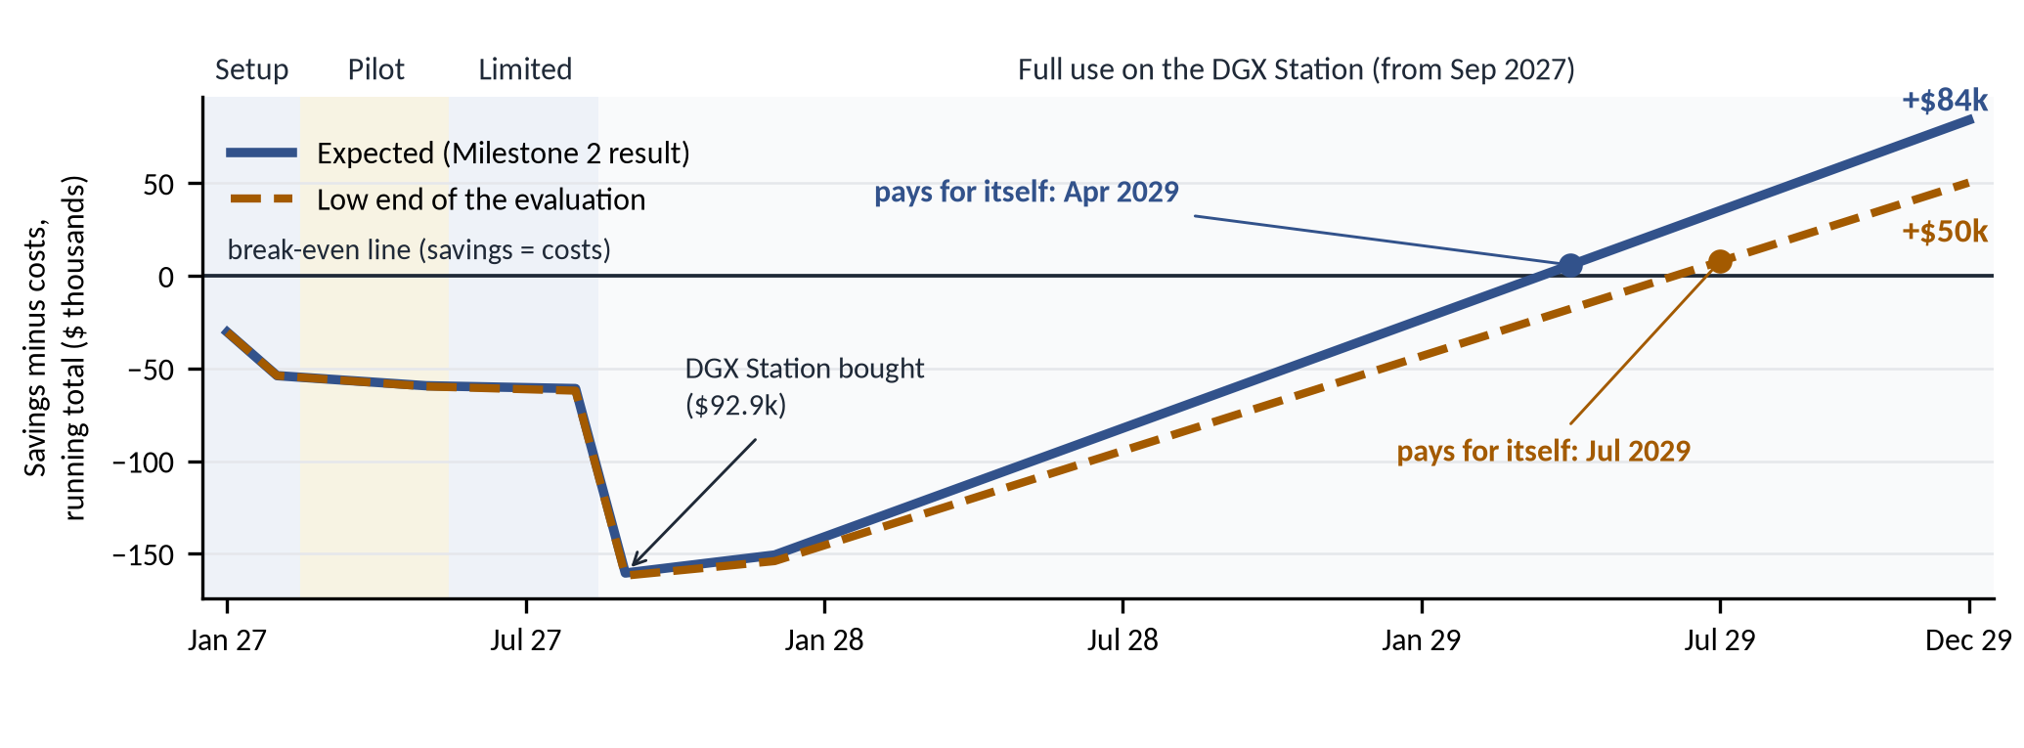
PLAN · SECTION 3
Cost and Return Over Three Years
Savings come from the Milestone 2 final-test result (138 of 150 drafts usable).
NET GAIN (3 YEARS)
PAYS FOR ITSELF
STAFF TO BREAK EVEN
+$84k
Apr 2029
About 37–41
Low end of the result: +$50k
Low end: Jul 2029
The plan grows to 50 users
Every 100 questions take about 140 analyst minutes by hand and about 61 with AUtoMLy, including checking every draft.
J.O. | INAI 6986 | Nov 12, 2026 | roi.json · Plan Figure 3
08
Notes:
Costs over three years: $485k expected, including both computers, setup, training, upkeep, oversight and the staff time to check every draft (the largest cost). Savings $569k. HP Station instead of Supermicro: +$45k expected, +$11k low end. Key assumptions to confirm: 50 users at full operation, 15 questions per user per day, 30 seconds to check a draft (measured in the pilot).
Evidence: roi.json (expected, low, expected_hp, low_hp, per100); BLS, EIA and vendor sources in the plan
Snapshot: November 12, 2026. Slides prepared with AI assistance from recorded artifacts; student review required.

Slide 9
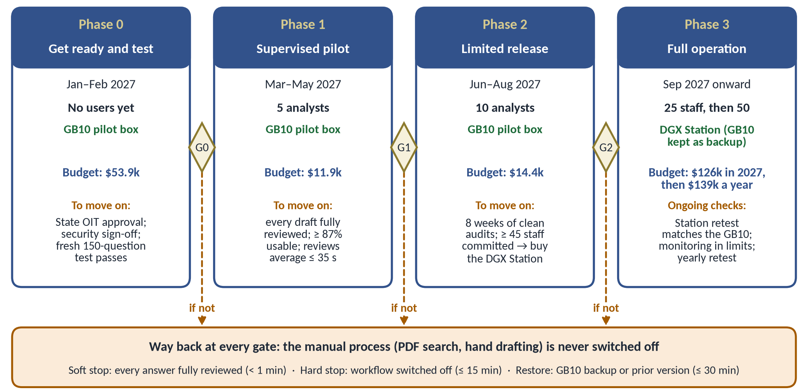
PLAN · SECTIONS 5–11
Rollout and Governance
Four phases, a written gate between each, and a way back at every step.
✓
EU AI Act: limited risk
Answers policy questions; never judges a person.
✓
NIST AI RMF
All four functions tied to project documents.
✓
Named owners
Soft stop < 1 min; hard stop ≤ 15 min.
✓
Watched every week
Audits, drift triggers and subgroup checks.
✓
Deploy with conditions
Eight conditions, each with a way to verify it.
Recommendation: deploy with conditions. It starts with a fresh 150-question test, and every draft stays under full review until it passes.
J.O. | INAI 6986 | Nov 12, 2026 | Plan Figure 4 · Sections 6–11
09
Notes:
Phase 0 (Jan–Feb 2027) readiness and a fresh 150-question test; Phase 1 (Mar–May) supervised pilot with 5 analysts; Phase 2 (Jun–Aug) limited release with 10 analysts; Phase 3 (Sep 2027 on) full operation on the DGX Station, 25 then 50 staff. The manual process is never switched off. Alabama OIT policies AI-GV-P1 and AI-GV-P2 apply directly.
Evidence: Plan Sections 5–11 and Appendix A
Snapshot: November 12, 2026. Slides prepared with AI assistance from recorded artifacts; student review required.

Slide 10
WRAP-UP
Status and Next Steps
Where each deliverable stands tonight.
Deliverable
Status
Due
Milestone 3 report and video
Final; ready to submit
Sun, Nov 15
Progress Log 3
Final; ready to submit
With Milestone 3
Implementation & Governance Plan
Draft complete; student review
Sun, Nov 22
Final Report
Reuses the plan’s budget, schedule and diagram
Tue, Dec 1
Final Defense
Planned on Microsoft Teams
Tue, Dec 8
Next: confirm the plan’s 50-user assumption and the Station vendor (Supermicro or HP), then submit.
J.O. | INAI 6986 | Nov 12, 2026 | Canvas due dates · rubrics
10
Notes:
Open decisions for the student: (1) the 50-user full-operation assumption that makes the DGX Station pay for itself (break-even is about 37–41 users); (2) Supermicro ($92,887, budgeted) or HP ($132,000 with a 3-year warranty). Final Defense date is planned and subject to the AUM final exam schedule. Canvas is the source of truth for dates.
Evidence: Rubric_INAI6986__Assignment_6, 7a and 7b; CURRENT.md
Snapshot: November 12, 2026. Slides prepared with AI assistance from recorded artifacts; student review required.

