Slide 1
Real Life Solution for Waste Management

Slide 2
Introduction
Waste management is essential for maintaining clean and healthy environments.

Slide 3
Problem Statement
Improper waste management leads to pollution and inefficient complaint handling.

Slide 4
Project Objectives
Improve waste collection, reduce pollution, enable complaint registration and tracking.

Slide 5
Module List
User Management, Complaint Registration, Complaint Tracking, Admin Dashboard, Reports.

Slide 6
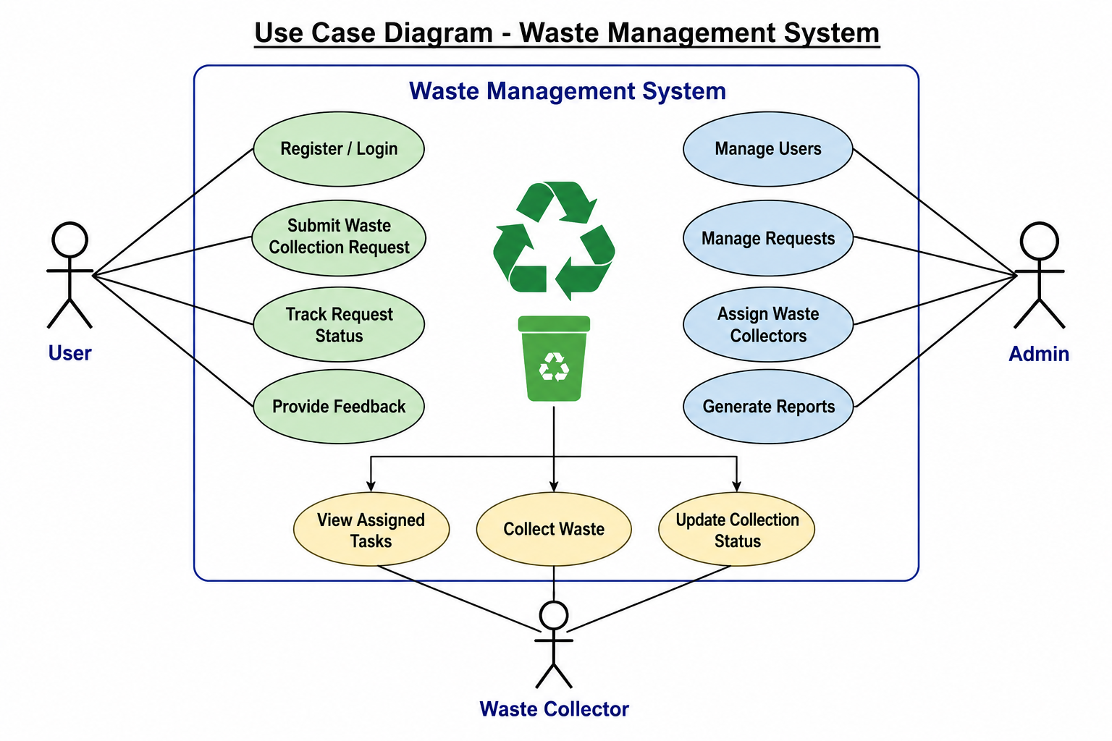
Use Case Diagram

Slide 7
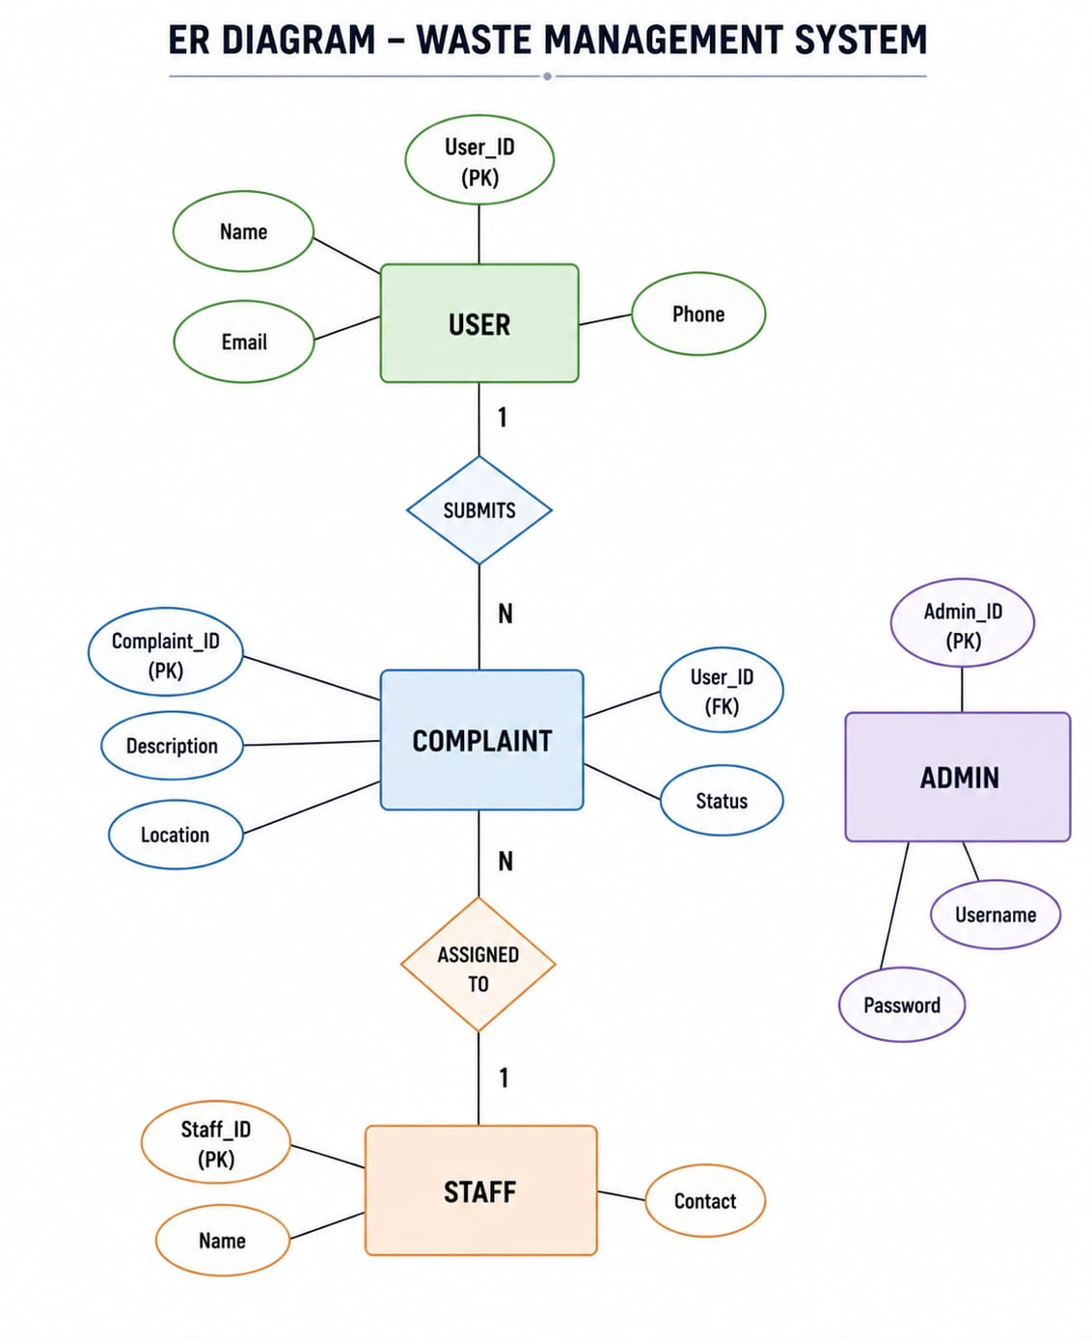
ER Diagram

Slide 8
Thank You

