Slide 1

https://www.leetcoin.com/api_info
RESTful, centralized hub utilizing hmac encryption/authentication.
Appropriate Game Architecture
Multiplayer, server authoritative. Think First Persron Shooters, Chess
Purely client side driven games not supported (as yet).
These slides are available here:
https://github.com/porkchop/leetcoin-api-slides

Slide 2
Simple, but highly flexible API
Easily implement a variety of wagering and incentivization mechanisms with two simple calls:
  CreateMatch
  UpdateMatchResults (aka End Match)
Coding Awesomeness: the leet API does not overburden you with structure that forces ungainly patterns on your wagering code.
You have the freedom to decide how opponents are interacting in the game world and attribute rewards, wager transfers to or from any player or group of players as needed via these two flexible calls.

Slide 3
Key Entity: The Server
A catch-all for an instance of continued game-play
  could be a free-for-all endless shooter instance
  or it could be a chess table, which may have several rounds of chess played on it and even several pairings of opponents over time, but it is only one table over time.
You might think of a server as a match and a match may have several subrounds or events which cause us to tally win-loss/wager results as they happen.
Authority Model
Users grant leetcoin enabled game servers permission to manipulate an amount of Satoshi on their behalf.

Slide 4
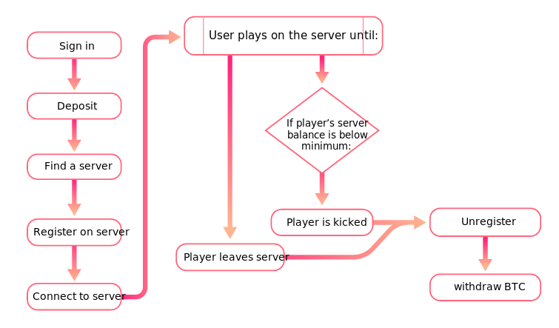
User Flow
https://www.leetcoin.com/api_info#basic_user_flow
https://www.leetcoin.com/api_info#basic_user_flow
User Authorizes
Server with >=
min Satoshi
for match

Slide 5
API Methods
https://www.leetcoin.com/api_info#calls
Create Server: Initiate a leetcoin server instance. This is a container for adding, removing players, and issuing match results (win-loss/reward results). Important aspects to note are the stake parameters like
  the minimumBTChold, which dictates how much a player must commit to the match in order to be permitted to play.
  the incrementBTC, which is actually the win value per win metric. For instance in a shooter, you would win or lose incrementBTC/kill
  serverRakeBTCPercentage: this is how much the game server collects per frag (It is actually a ratio, so use 0.01 to indicate 10%)
Get server info: Essentially an initialization/synchronization call. Uses:
  Making sure your internal tally matches leetcoin's
  Long running server wakes up, and needs infos about current player and wagering config. Use this call to determine these details.
  Should only need this if you actually have distributed servers or really long running servers that might actually sleep and then reawaken. These servers should have enough knowledge about themselves to request their current state as seen by leetcoin and act accordingly.

Slide 6
API Methods Continued...
Activate Player: Attempt to interlock a player with your game according to the stakes for the current match.
  will likely fail until a player actually commits the minimum amount of satoshi to play. As per the authority model, a player controls whether or not his/her funds can be used by any given server, so in the background while a player is moving through the authorization flow to access your game, it may be necessary to requery this until the player actually commits satoshi to your match via the leetcoin interface.
  Ideally, your game will provide navigation to allow a player to easily commit satoshi to your match at leetcoin's hub.
Match End/Update Match Results: Send match win/loss results so that leetcoin can issue stakes according to the configuration initially set in the create server call.
  Can be called repeatedly per server instance, so it doesn't necessarily end a match so much as it updates the current state of the wins and losses since either the game started or since the last Match end call was made.
  Up to the game server to know how many wins and losses per player/team have occurred since the last update was called or if no update has yet been made, since the game started.

Slide 7
API Methods Continued 2...
Deactivate Player: Formally remove a player from a match.
  When a player's minimum buy-in is too low, use this call to clean them out of your leetcoin match state.
  call this when a player chooses to leave so they no longer appear in your match as seen by leetcoin
Get match results: Get historical or current data to users about your past games or current games as they happen
Issue award: Use this to issue some kind of in game reward for achieving some kind of objective, like after 10 frags send someone a reward of 10000 satoshi.
  Realize that the amount you reward a player by must be available within the current match fee collection balance in order to be successful

Slide 8
How to get started integrating your own games
Get a developer key
Tie leetcoin into your game
When you have your game debugged, send leetcoin a request to make your game publicly playable via the developer pages

Slide 9
Example Integration: Tictactoe (Python)
Souce: https://github.com/LeetCoinTeam/lc_tactoe
Example Integration: Connect 4 (JavaScript)
Souce: https://github.com/porkchop/lc-connect4
Connect 4 utilizes the JavaScript Leetcoin convenience API wrapper:
NPM: https://www.npmjs.org/package/leetcoin
Github: https://github.com/porkchop/leetcoin-js
Example Integration: Math Quiz (JavaScript)
Souce: https://github.com/porkchop/lc-mathquiz

Slide 10
Specific Models
1. Per Frag Stakes
(WAGER LOGIC)
Players frag, server keeps tally
players[fragger.id].kills++;
players[died.id].deaths++;
Create Server
var server_deets = createServer({
title: 'Per Frag Match',
hostAddress: 'http://per.frag.com',
hostPort: 80,
GameKey: 'You api key'',
maxActivePlayers: 20,
minimumBTCHold: 100000,
incrementBTC: 10000,
serverRakeBTCPercentage: 0.01,
leetcoinRakePercentage: 0.01
});
Periodically (2-10 minutes) update leetcoin
setMatchResults(server_deets,
_.pluck(players, 'id'),
_.pluck(players, 'name'),
_.pluck(players, 'weapon'),
_.pluck(players, 'kills'),
_.pluck(players, 'deaths'));
Tally count zeroed out for all players
players.forEach(function(player) {
player.kills = 0;
player.deaths = 0;
});
Game over?
No
Yes
Clean up

Slide 11
2. Team Based
Same flow as Per Frag but wager logic might look like so when teams have the same number of players per side
(WAGER LOGIC)
// reward each team member whenever a member makes a kill
teams[fragger.team_id].players.forEach(function(player) {
player.kills++;
});
// deduct from each member when a member is killes
teams[died.team_id].players.forEach(function(player) {
player.death++;
});

Slide 12
3. Achievements
Spawn a random quad or difficult to reach weapon in the world after 10 Frags have been exchanged. Considering the stakes set out above, you have accumulated rake float of 10 * 0.01 * 100000 = 10000 satoshi! Send out a banner message that the first person to reach the quad wins 5000 satoshi (keeping half for yourself!)
When the item is grabbed:
issueAward(player.id, player.name, 5000, 'Got the Quad!');

Slide 13
Integration tips
Send game info in a wiresafe manner to clients
  don't send game state that could give anyone an unfair advantage
  goes without saying but don't send private info (emails, passwords, etc)
To implement in your particular language should understand the basic call structure encoding:
API.prototype._callLeetcoin = function(uri, params, secret, key, cb) {
params.nonce = Date.now();
params = FormUrlencoded.encode(params);
// Hash the params string to produce the Sign header value
var sign = crypto
.createHmac('sha512', secret) // your shared hmac secret known by you and leetcoin
.update(params)
.digest('hex');
var headers = {
'Content-type': 'application/x-www-form-urlencoded',
'Key': key, // your public leetcoin api key
'Sign': sign
};
request({
method: 'POST',
url: this.url + uri, // uri is the method being called like 'Create Server'
body: params,
headers: headers
}, cb);
}

Slide 14
Links, futher tools
The leetcoin api & dev section
  https://www.leetcoin.com/api_info
Python: tictatoe
  https://github.com/LeetCoinTeam/lc_tactoe
Javascript:
  Mathquiz
  https://github.com/porkchop/lc-mathquiz
  Connect4
  https://github.com/porkchop/lc-connect4
API wrapper: leetcoin-js
  https://github.com/porkchop/leetcoin-js
These slides available at
  https://github.com/porkchop/leetcoin-api-slides

