Slide 1
PUBLIC TRANSPORT OPTIMIZATION
IOT_phase 4:Development part 2

Slide 2
INTRODUCTION:
Public transport refers to shared passenger transportation services like bus , trains , metro, trolleybus etc.
There are many challenges that are faced by passengers while using public transportation . The main problem while using public transportation is the fare rate .
So ,In this project we have designed such a system where passenger themselves can monitor the fair based upon the distance traveled by them. If this system is installed in any public transportation then passenger should enroll their finger in the fingerprint sensor while entering the vehicle and should enroll it back while leaving the vehicle . When we enroll the finger while leaving the vehicle the display unit in the system shows the total distance traveled and the total fair to be charged based upon that distance traveled. Passenger should not negotiate with bus unit for the fair . We can also further improvement in this project by integrating online payment system in this project .

Slide 3
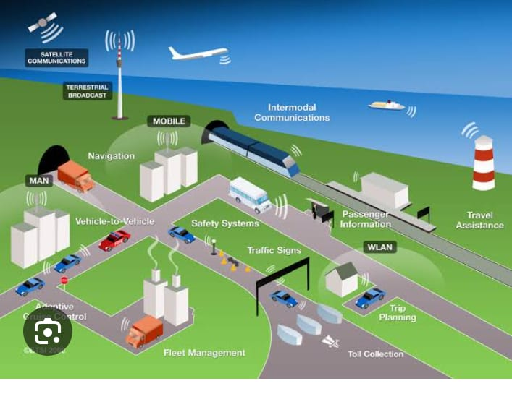

Slide 4
Components:
ESP 32
Ultrasonic distance sensor
LED
wires

Slide 5
Program :- python script:
#define BLYNK_TEMPLATE_ID "TMPL26V4fGv5q"
#define BLYNK_TEMPLATE_NAME "Test"
#define BLYNK_AUTH_TOKEN "XEHxNF_Ur1Nt2p7wB5B20dNI1ZUwj34P"
#include <WiFi.h>
#include <WiFiClient.h>
#include <BlynkSimpleEsp32.h>
int duration1 = 0;
int distance1 = 0;
int duration2 = 0;
int distance2 = 0;

Slide 6
int dis1 = 0;
int dis2 = 0;
int dis_new1 = 0;
int dis_new2 = 0;
int entered = 0;
int left = 0;
int inside = 0;
#define LED 2
#define PIN_TRIG1 15
#define PIN_ECHO1 14
#define PIN_TRIG2 13
#define PIN_ECHO2 12
BlynkTimer timer;

Slide 7
char auth[] = BLYNK_AUTH_TOKEN;
char ssid[] = "Wokwi-GUEST"; // your network SSID (name)
char pass[] = "";
#define BLYNK_PRINT Serial
long get_distance1() {
// Start a new measurement:
digitalWrite(PIN_TRIG1, HIGH);
delayMicroseconds(10);
digitalWrite(PIN_TRIG1, LOW);
// Read the result:
duration1 = pulseIn(PIN_ECHO1, HIGH);
distance1 = duration1 / 58;
return distance1;
}

Slide 8
long get_distance2() {
// Start a new measurement:
digitalWrite(PIN_TRIG2, HIGH);
delayMicroseconds(10);
digitalWrite(PIN_TRIG2, LOW);
// Read the result:
duration2 = pulseIn(PIN_ECHO2, HIGH);
distance2 = duration2 / 58;
return distance2;
}

Slide 9
void myTimer() {
Serial.println("100");
dis_new1 = get_distance1();
dis_new2 = get_distance2();
if (dis1 != dis_new1 || dis2 != dis_new2){
Serial.println("200");
if (dis1 < dis2){
Serial.println("Enter loop");
entered = entered + 1;
inside = inside + 1;
digitalWrite(LED, HIGH);
Blynk.virtualWrite(V0, entered);
Blynk.virtualWrite(V2, inside);
dis1 = dis_new1;
delay(1000);
digitalWrite(LED, LOW);
}

Slide 10
if (dis1 > dis2){
Serial.println("Leave loop");
left = left + 1;
inside = inside - 1;
Blynk.virtualWrite(V1, left);
Blynk.virtualWrite(V2, inside);
dis2 = dis_new2;
delay(1000);
}
}
}

Slide 11
void setup() {
Serial.begin(115200);
pinMode(LED, OUTPUT);
pinMode(PIN_TRIG1, OUTPUT);
pinMode(PIN_ECHO1, INPUT);
pinMode(PIN_TRIG2, OUTPUT);
pinMode(PIN_ECHO2, INPUT);
Blynk.begin(auth, ssid, pass, "blynk.cloud", 8080);
timer.setInterval(1000L, myTimer);
}
void loop() {
Blynk.run();
timer.run();
}

Slide 12
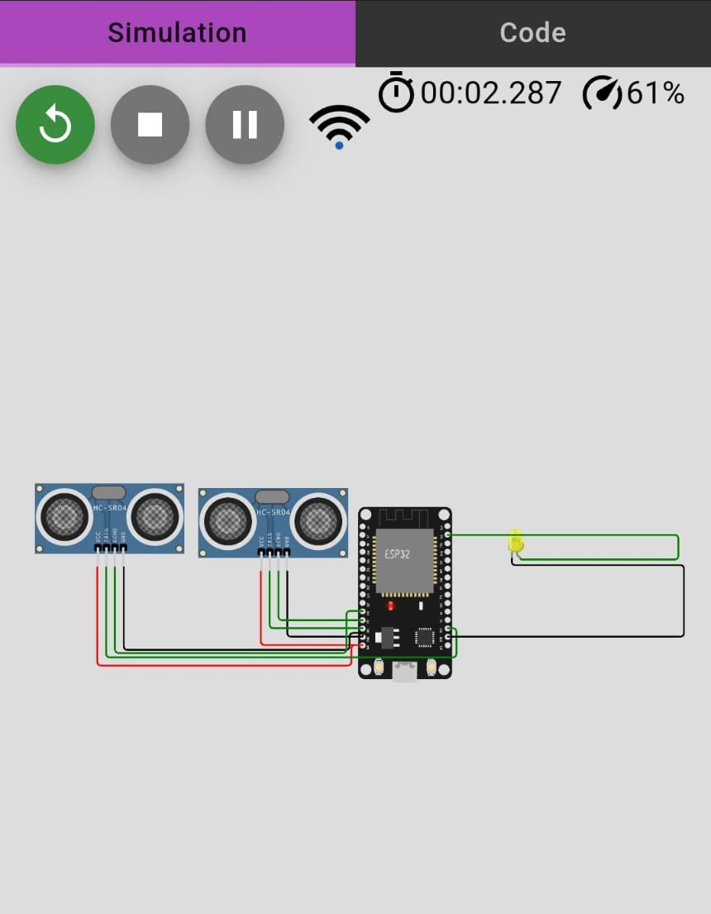

Output:
WOKWI PROJECT LINK :https://wokwi.com/projects/379629405188127745

Slide 13
COMPONENTS:
Arduino uno servo
Potentiometer
Breadboard
Resistor
LCD 16*2
PIR sensor

Slide 14
PROGRAM:
import 'package:flutter/material.dart';
import 'package:http/http.dart' as http;
import 'dart:convert';
void main() => runApp(MyApp());
class MyApp extends StatelessWidget {
Widget build(BuildContext context) {
return MaterialApp(
home: VehicleLocations(),
);
}
}

Slide 15
class VehicleLocations extends StatefulWidget {
_VehicleLocationsState createState() => _VehicleLocationsState();
}
class _VehicleLocationsState extends State<VehicleLocations> {
String locationData = "";
Future<void> fetchVehicleLocations() async {
final response = await http.get('http://your-python-server-url/get_vehicle_location?vehicle_id=bus1');
if (response.statusCode == 200) {
setState(() {
locationData = json.decode(response.body).toString();
});
}
}

Slide 16
Widget build(BuildContext context) {
return Scaffold(
appBar: AppBar(
title: Text('Public Transport Optimization App'),
),
body: Center(
child: Column(
children: <Widget>[
ElevatedButton(
onPressed: fetchVehicleLocations,

Slide 17
child: Text('Get Vehicle Location'),
),
Text(locationData),
],
),
),
);
}
}

Slide 18
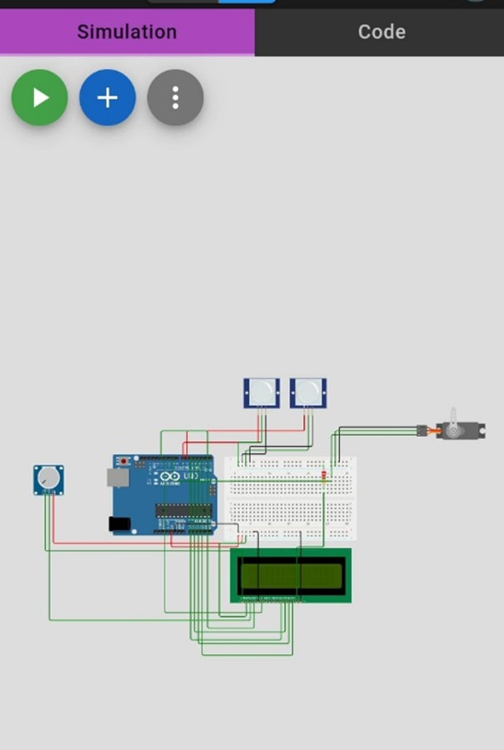
OUTPUT:

Slide 19

THANK YOU….

