Slide 1
PUBLIC TRANSPORT OPTIMIZATION
IOT_Phase 3

Slide 2
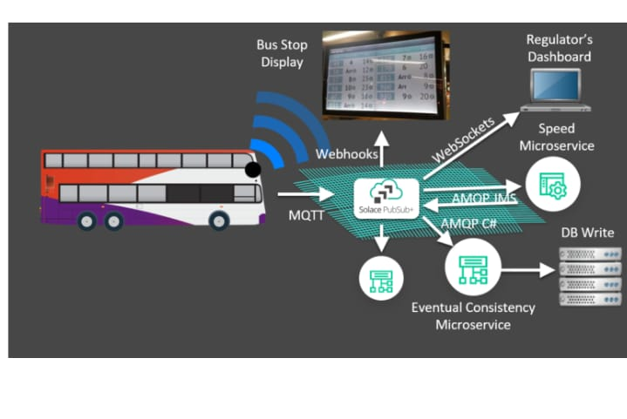
INTRODUCTION:
Population distribution within countries has been changing transportation service is the optimization of bus
routes. Buses share the road with other vehicles, contrary to
the metro which usually benefits from a dedicated track. This
means that a better route planning for each bus may have a
big impact in the cost and quality of the service.
Lisbon is a large city that suffers from many of the previously
mentioned issues. For this reason, the Lisbon municipality
aims to optimize its public transport infrastructure.
In order to optimize the bus routes, cities can collect data
regarding the number of people that enter/exit the bus in
each stop/area, we call this the demand. Using this data and
different Artificial Intelligence (AI) approaches we can try to
arrive at better routing for the bus service. In this project we

Slide 3
for some years now. As the opportunity for work decreases in
the countryside, people end up moving to large cities so they
can be closer to entertainment, heath services and schools.
Public transport infrastructure, which makes moving around
the city convenient, is an essential component of any modern
city. As more and more people choose to move to large cities,
the population density increases. This means that the number
of people using the bus public transportation service increases.
Public transport optimization is, therefore, crucial to keep up
with the increased demand, while keeping low operating costs.
One of the most impactful optimizations that can be done
will be contemplating some AI approaches to this problem.

Slide 4
Components:
ESP32
OLED
GPS
Sensor

Slide 5
Program using ESP32:
#include <Wire.h>
#include <Adafruit_GFX.h>
#include <Adafruit_SSD1306.h>
#include <TinyGPSPlus.h>
#include <HardwareSerial.h>
#define SDA_PIN 21
#define SCL_PIN 22
#define OLED_RESET -1
Adafruit_SSD1306 display(OLED_RESET);
HardwareSerial gpsSerial(1); // Use Serial1 for ESP32
TinyGPSPlus gps;
void setup() {
Serial.begin(115200);
gpsSerial.begin(9600, SERIAL_8N1, 16, 17);

Slide 6
if (!display.begin(SSD1306_PAGEADDR, SDA_PIN, SCL_PIN)) {
Serial.println(F("SSD1306 allocation failed"));
for (;;);
}
display.display();
delay(2000);
display.clearDisplay();
display.setTextSize(1);
display.setTextColor(SSD1306_WHITE);
}
void loop() {
while (gpsSerial.available() > 0) {
if (gps.encode(gpsSerial.read())) {
display.clearDisplay();
display.setCursor(0, 0);
display.print(F("Lat: "));
display.println(gps.location.lat(), 6);
display.setCursor(0, 10);
display.print(F("Lon: "));
display.println(gps.location.lng(), 6);
display.setCursor(0, 20);
display.print(F("Alt: "));
display.println(gps.altitude.meters());
display.display();
}
}}

Slide 7
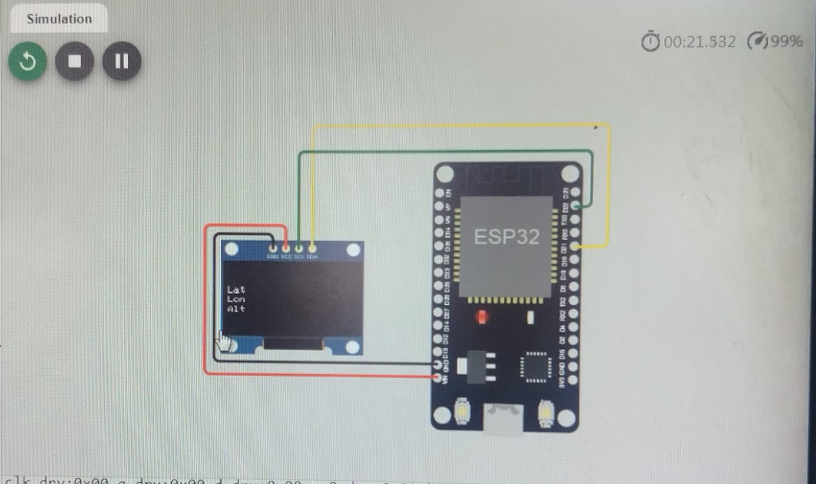
OUTPUT:

Slide 8
THANK YOU…

