Slide 1
SEGA:Variance Reduction via Gradient Sketching

Slide 2



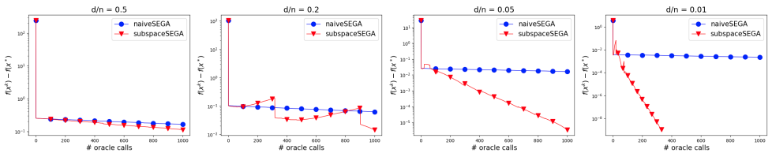
Which problem we solve
Empirical risk minimization with any regularization
Sketch (linear transformation) of the gradient
for example: Directional gradient
How proper sketches can speed up the algorithm.
Naive - coordinate sketches.
Subspace - rows of A

Slide 3
Why this method better than previous ones
variance reduced methods like SVRG, SAGA, SAG and other
randomized coordinate/subspace descent methods
They access unbiased gradient estimators. SEGA does not
They do not handle non-separable regularizers
SEGA’s sketches can be customized

Slide 4
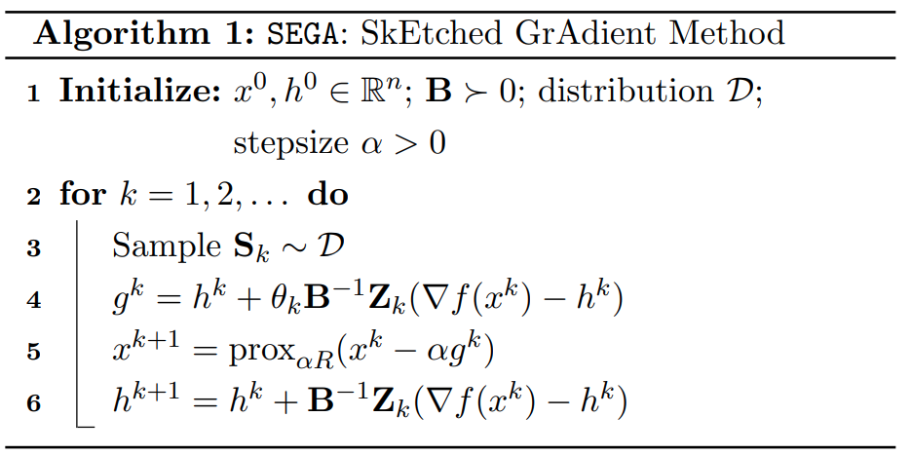
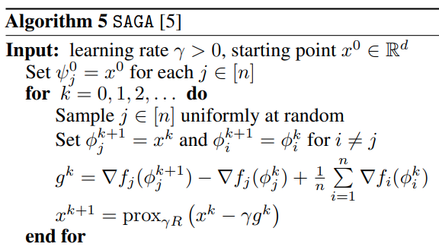
Algorithm, similarities with SAGA

Slide 5


How algorithm works
current estimate of the gradient
weight matrix
closed-form solution
biased

Slide 6



How algorithm works
Introduce new variable theta such that
We obtain unbiased gradient estimate
identity matrix in E
In expectation, g is the gradient

Slide 7





Convergence in general.
Assumption: Q-smoothness with respect to B
generalization of more common version - L-smoothness
common smoothness:
Given the following lyapunov function. Here we see, why method variance-reduced
If f is Q-smooth with respect to B, μ strongly convex, then with a,σ > 0 so that
Then we have linear iterates convergence

Slide 8
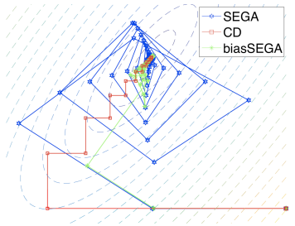
Extensions of the method
Create an accelerated SEGA for the general setup in the sense of Nesterov’s accelerated gradient descent
Biased gradient estimators (see Figure)
Applications to be researched:
Distributed training
Reinforcement learning

