Slide 1


Grammar-Based Procedural Generation of Programming Exercises
Pilipăuțanu Porfirie-Denissa
Military Technical Academy „Ferdinand I” of Bucharest, Romania
STUDENTS’ INTERNATIONAL CONFERENCE „CERC” Bucharest, May 12-13, 2022

Slide 2
Contents
Introduction
The general scheme of the generator
Grammar usage in the function generating process
Symbol table’s impact in generating a better output
Conclusions

Slide 3
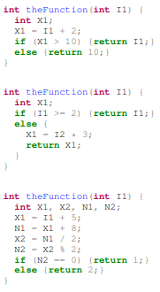
Introduction
Exercises for learning programming languages can be classified into the following two types:
syntax practices for understanding the grammar;
semantics practices for understanding the flow of a program.
Several prior studies have provided proper solutions for the first first type of exercises, but none of them provided a solution versatile enough for the second type.
In order to address this problem, I drew inspiration from a common text generating technique that makes use of grammars and I implemented other compiler design concepts to improve it.

Slide 4
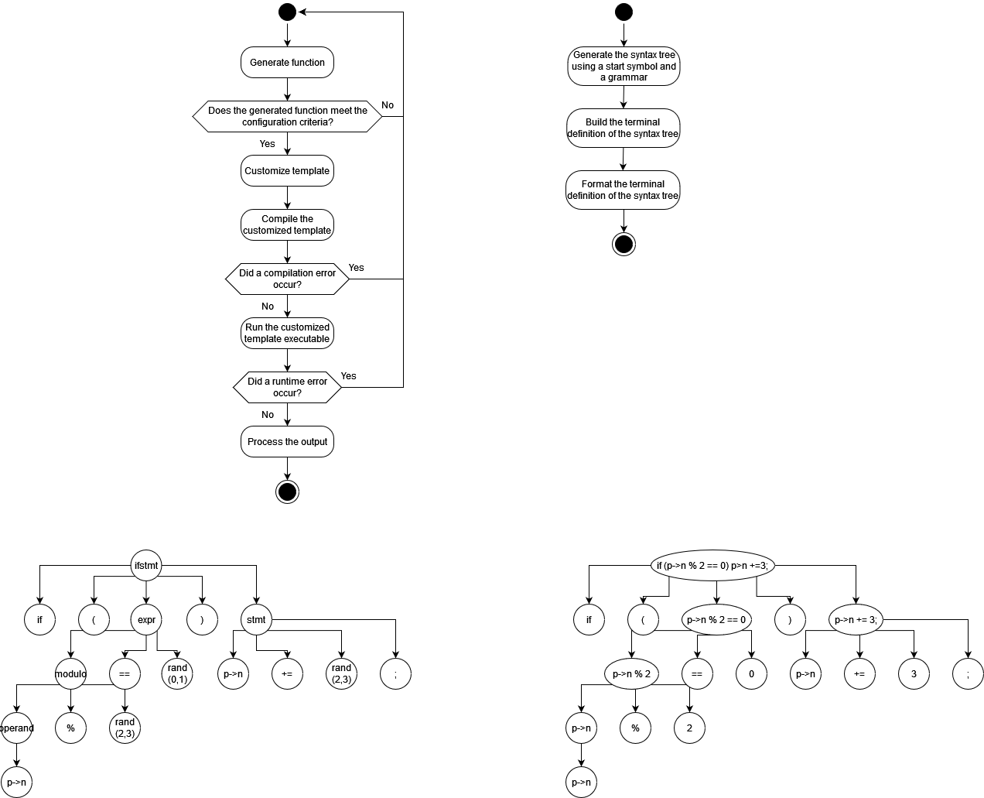
The general scheme of the generator
Grammar file
Question
Template file
Configuration file
Function code
Answer
Generator

Slide 5
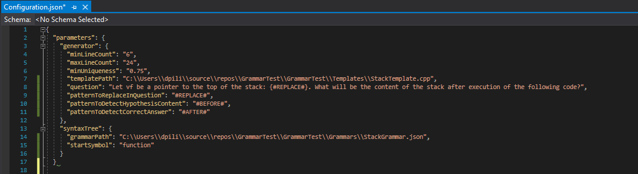
The configuration file

Slide 6
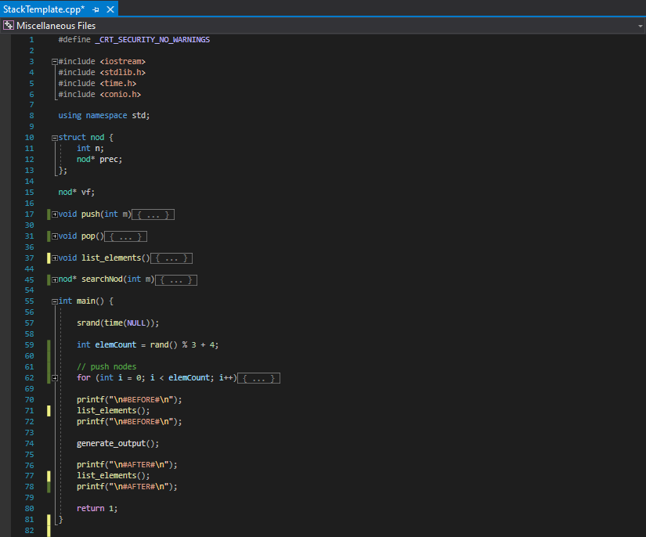
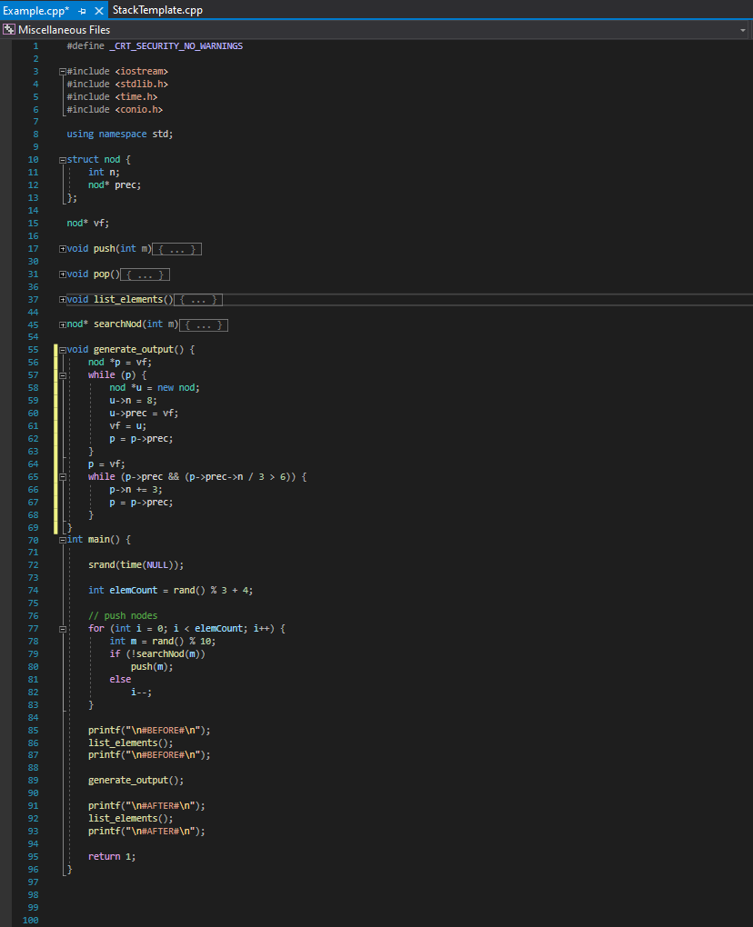
The template customization

Slide 7


Running the customized template executable

Slide 8
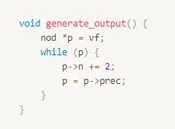
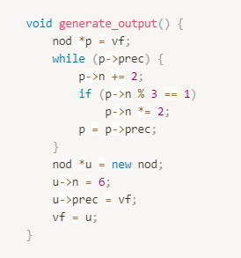
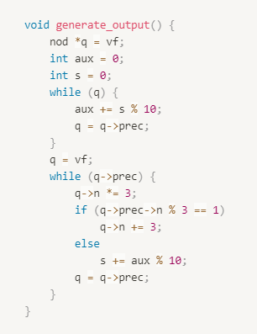
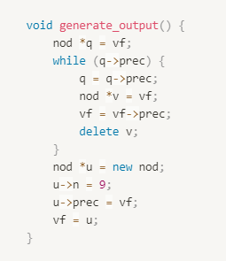
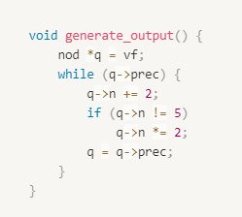
Function code examples

Slide 9
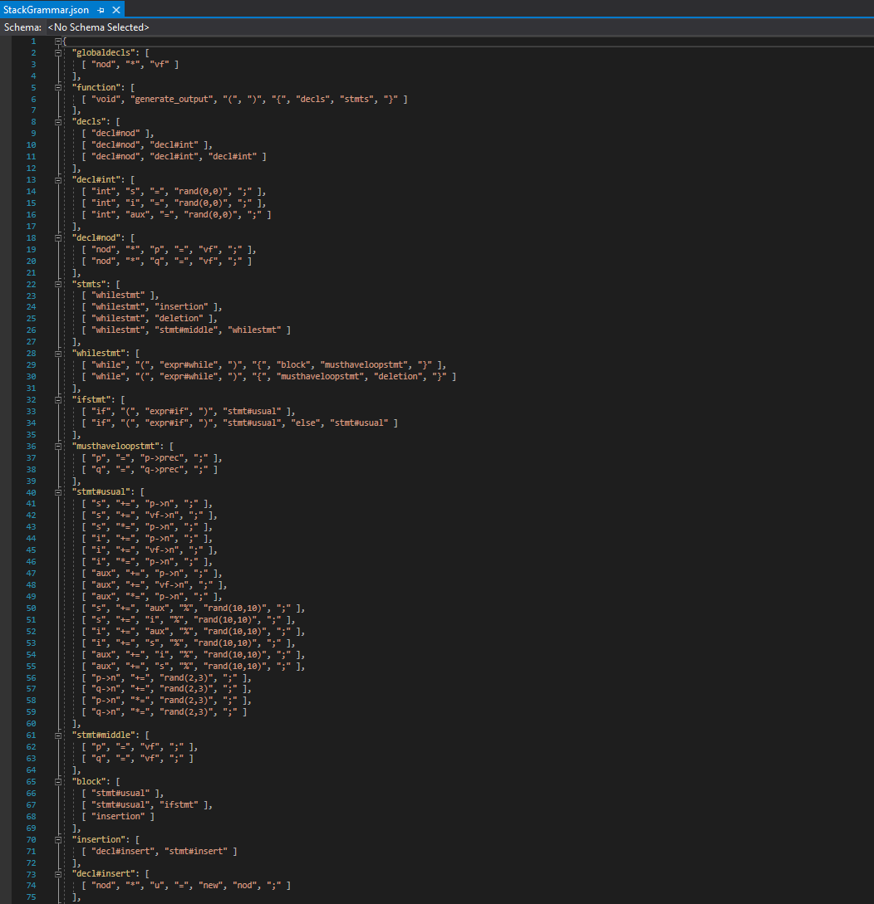
Grammar usage in the function generating process

Slide 10
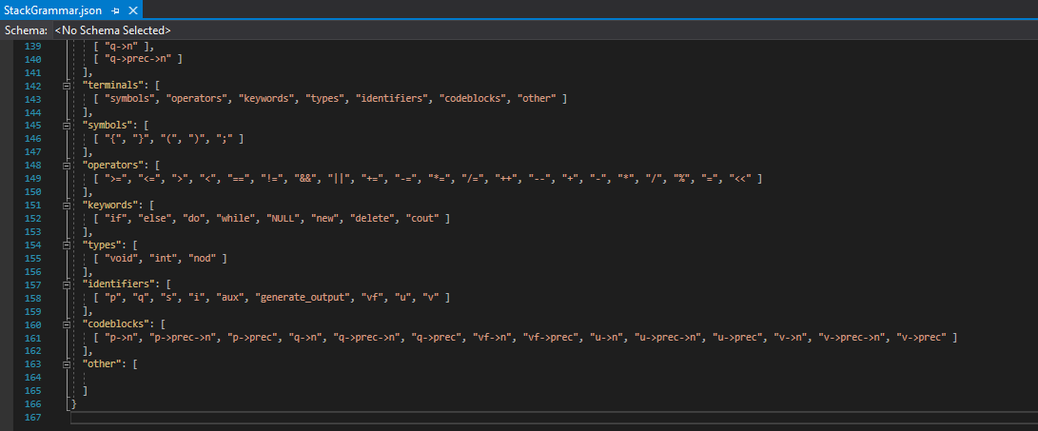

Slide 11
Generating an if statement - EXAMPLE
Generating the syntax tree using a
TOP-DOWN approach
Building the terminal definition using a
BOTTOM-UP approach

Slide 12

Symbol table’s impact in generating a better output
Type | Identifier
nod* | p
int | s
int | s
Type | Identifier
nod* | p
int | s
int | aux
Compilation error
Without a symbol table this set of declarations could be generated
With a symbol table the third declaration would be regenerated

Slide 13


If a generated statement uses undeclared variables, that would result in a compilation error.
The solution checks whether the variables used within the statement are declared or not.
If the variables are not declared, the statement would be regenerated until a proper statement is found.
Type | Identifier
nod* | p
int | s
int | aux

Slide 14
Conclusions
Implementing compiler design concepts greatly improves the quality and the versatility of the procedurally generated programming exercises.
As a result, this method represents a solution to the challenge the teachers regularly face: the challenge of producing new knowledge assessment content due to the publication of existing materials and open access to them.
Thomas James Tiam-Lee and Kaoru Sumi’ s results
(Procedural Generation of Programming Exercises with Guides Based on the Student’s Emotios)
My results

