Slide 1


Data Types & Expressions
INT101 Programming Fundamentals
Bachelor Science in Information Technology (B.Sc.IT)
School of Information Technology (SIT)
King Mongkut’s University of Technology Thonburi (KMUTT)

Slide 2
Data Types in Java
Boolean
Character
Integer
Floating Point
1 byte
8 bits
boolean
byte
2 bytes
16 bits
char
short
Primitive Data Types
boolean (true, false)
Unicode Character (≈ 16-bit unsigned integer): char ('a', 'b', '\n', '\u20AC', '\\', '\'', …)
Signed Numbers
Signed 2's Complement Integers: byte (8 bits), short (16 bits), int (32 bits), long (64 bits)
IEEE 754 Floating-Point Numbers: float (32 bits – single-precision), double (64 bits – double-precision)
Reference Type for referencing to Abstract Data Types – ADT (Objects)
Reference Type – 32 bits – 4 bytes for referencing to ADT: Array, String, …
4 bytes
32 bits
int
float
8 bytes
64 bits
long
double
https://docs.oracle.com/javase/specs/jls/se14/html/jls-4.html
Special Type: null type with null literal
https://docs.oracle.com/javase/tutorial/java/nutsandbolts/datatypes.html

Slide 3
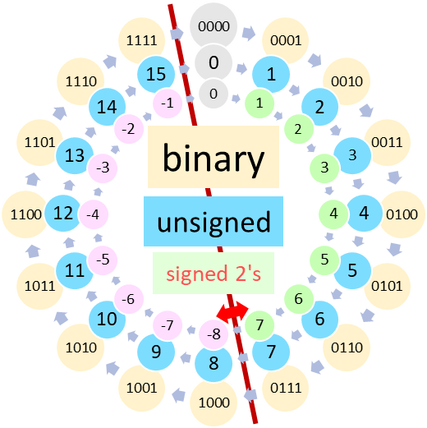
Java Signed 2's Complement Integers
Java has a special Unsigned Integer API support.
+,-,* operations are the same for both signed and unsigned.
/,%.<,>,<=,>= operations are different for signed and unsigned.
Java Integer Arithmetic & Casting
Wrap-around Overflow without warning

Slide 4
Numbers in Java

Slide 5
Type Conversion
(Type Casting)
Floating Point Numbers
double
±2¹⁰²⁴
52 sig.
widening / upcasting / implicit
float
±2¹²⁸
23 sig.
long
Integer Types
±2⁶³
63 sig.
int
±2³¹
long
may lose precision
31 sig.
narrowing / down casting / (explicit)
int
short
short
char
wrap-around overflow (for integer types)
15 sig.
±2¹⁵
byte
char
byte
±2⁷
0…2¹⁶
7 sig.
16 sig.
boolean
unsigned integer

Slide 6
Automatic Type Conversion
byte
short
char
int
long
float
double
String
Operations on Numeric Data Types
byte, short, char will be casted to int before performing any operation
Type widening will be performed before any operation between two different data types.

Slide 7
Literals for Primitive Data Types
true
'a', 'Z', '9', '+', '$'
boolean
false
char
'\n', '\t', '\'', '\\'
Escape C.
No literal form for byte and short.
'\u20AC', '\u0E01'
Unicode C.
78, 61_034_895
Decimal
845_8984L , 1l
0b101, 0b10_0011
Binary (0b…)
0b1010_1000L
int
long
0734, 067_203
Octal (0…)
04_067L
0x1AF7, 0xfff2
Hexadecimal (0x…)
0xb01dfaceL
6_502_483.9071
917.35f, 156.74F
double
1.79e308
3.40e38f
float
Scientific Notation (9.9e±9 or 9.9E±9)
2.48e-324
7.01e-46f

Slide 8
Operations on Data Types in Expressions

Slide 9
Precedence & Associativity in Expression
postfix
prefix
arithmetic
shift
^{relational}
bitwise / boolean
logical
ternary
assignment

Slide 10
Modifiers for
classes, variables, and methods
visibility
(access modifier)
public
protected
package-private (default)
private
static vs non-static
non-access modifier
final vs abstract vs none
…

Slide 11
public class – accessible by everyone
protected-private class – accessible by members in the same package onlyP
Each class contains members:
nested classes
fields (member variables)
methods (member functions)

Slide 12
Class vs Object
class variables
(static variables)
Shared by all objects in the class
class methods
(static methods)
Each object has its own copy
instance variables
(non-static variables)
accessibility
instance methods
(non-static methods)

Slide 13
Variables contain data of primitive types
OR
Variables contain references to objects
OR
Variables contain null (reference to nowhere)
Object is a collection of primitive data and/or references to objects

