Slide 1
PROSPECT 26-001
Proxmox SDN/BGP Integration
1
Discovery
Topology, access, versions, route scope
2
Design
Submission plan for controlled discovery, design, implementation, validation, and handoff.
SDN/BGP architecture and rollback
3
Implement
Proxmox SDN, BGP/EVPN, route filters
Estimated effort: 13-29 hours
Typical timeline: 2-4 working days
4
Validate
Peers, prefixes, workloads, logs
Core stance
Treat this as production network engineering: discovery and approval first, then staged change, validation, rollback, and documentation.
5
Handoff
Runbook, diagram, acceptance evidence

Slide 2
DELIVERY STANCE
Why this should be handled as a controlled network change
The value is not only making BGP come up. The value is avoiding route leaks, access loss, and undocumented production drift.
Phase 1
Phase 2
Phases 3-5
Discover before changing
Design the route boundary
Validate evidence, not hope
Confirm Proxmox versions, node count, uplinks, bridges, MTU, and current SDN state.
Define ASN plan, peer addresses, route targets, VNIs, exit nodes, and accepted prefixes.
Verify BGP sessions, advertised and received prefixes, guest connectivity, failover behavior, and logs.
Inventory router/firewall platform, existing FRR or manual routing config, and access path.
Use explicit route filters and rollback steps before production changes.
Deliver final runbook, topology diagram, config notes, and acceptance criteria.
Proxmox SDN/BGP Integration Proposal
02

Slide 3
CLARIFICATION QUESTIONS
The client discussion should resolve these decision areas first
These map directly to section 1 of the submission plan and give us clean references for follow-up.
1.1-1.3
Environment
1.4-1.8
Routing Design
Proxmox version and cluster shape
Peer router/firewall platform
Node count and interface roles
Private or public ASN/prefix scope
Plain BGP, EVPN/VXLAN, or both
Exit node and active/active behavior
1.9-1.12
Existing Controls
1.13-1.14
Delivery Model
Current FRR/router configs to preserve
VPN, bastion, and console access
Firewall/security policy boundaries
Configuration-only or full runbook/diagram handoff
Maintenance window and monitoring
Proxmox SDN/BGP Integration Proposal
03

Slide 4
REQUIREMENTS COVERAGE
Coverage across the technical surfaces that can break production
The plan covers both Proxmox SDN mechanics and the routing/security controls around them.
Plan Ref
Coverage Area
What We Complete
Client Evidence
4.1
Proxmox SDN Review
Cluster health, Linux bridges, bonds, VLAN-aware bridges, MTU, zones, VNets, subnets, IPAM.
Current-state notes and readiness findings.
4.2
BGP/EVPN Design
ASNs, router IDs, peers, route targets, VNIs, import/export behavior, failover model.
Approved target design and route plan.
4.3
Security Controls
Management isolation, prefix filters, peer policy, firewall boundary review, public route guardrails.
Explicit route/security policy decisions.
4.4-4.5
Implement + Validate
Backups, staged config, upstream coordination, BGP state, prefixes, workload traffic, logs.
Validation checklist and test results.
4.6
Documentation
Final-state diagram, key configs, validation commands, rollback, maintenance notes.
Runbook and handoff package.
Proxmox SDN/BGP Integration Proposal
04

Slide 5
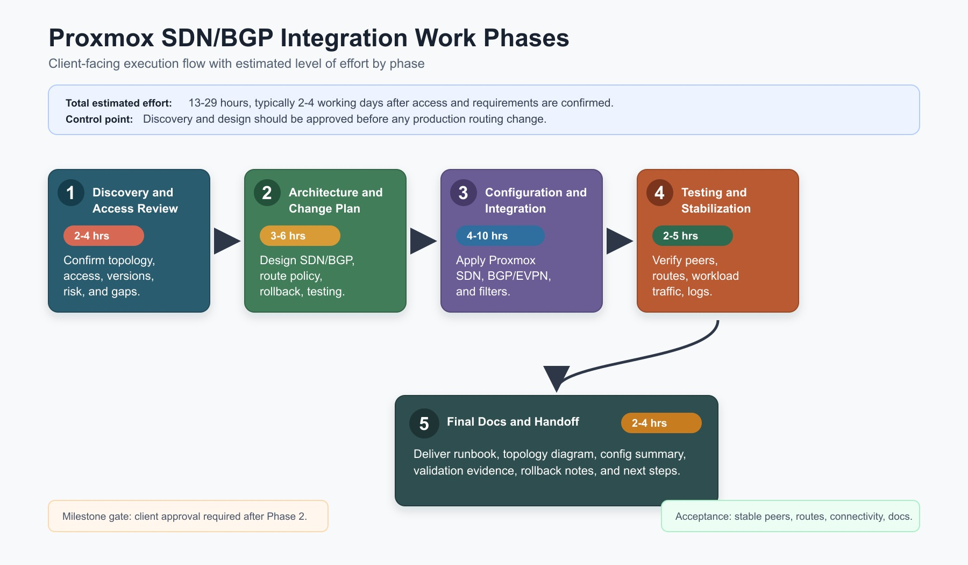
WORK PHASES
Execution flow with level of effort
The flow chart turns the proposal into a simple client-call discussion path.
Reference: Work phases from section 5, timeline from section 6.
Proxmox SDN/BGP Integration Proposal
05

Slide 6
PHASE DETAIL
Level of effort is concentrated where routing risk is highest
Configuration effort varies by cluster size, router complexity, and whether the client needs plain BGP or EVPN/VXLAN.
Ref
Phase
Effort
Primary Output
5.1
Discovery and Access Review
2-4 hrs
Access, topology, versions, risk notes, missing information
5.2
Architecture and Change Plan
3-6 hrs
Target design, route policy, change sequence, rollback, validation plan
5.3
Configuration and Integration
4-10 hrs
Proxmox SDN, BGP/EVPN peers, upstream coordination, route filters
5.4
Testing and Stabilization
2-5 hrs
Peer state, route advertisements, workload traffic, failover/log checks
5.5
Final Documentation and Handoff
2-4 hrs
Runbook, topology diagram, config summary, validation evidence
Total estimated effort
13-29 hours
Phase gate
Client approval required after design before production changes.
Proxmox SDN/BGP Integration Proposal
06

Slide 7
RISK CONTROLS
The plan is built to prevent the common failure modes
These risks are not theoretical in routing work, so the proposal makes them explicit before implementation.
9.1
Route leaks
9.2
Access loss
9.3
MTU mismatch
Explicit prefix filters, peer policy, and pre-approved route lists.
Console or out-of-band path, staged changes, and rollback commands.
Review physical, bridge, VNet, VXLAN, and guest MTU before rollout.
9.4
Config conflict
9.5
Asymmetric traffic
Decide whether Proxmox SDN or manual FRR owns each routing function.
Define exit-node policy, route preference, and test traffic paths.
Proposal guardrail: do not accept production implementation without discovery, route scope, access model, rollback, and maintenance window.
Proxmox SDN/BGP Integration Proposal
07

Slide 8
MILESTONES AND ACCEPTANCE
A clean close gives the client a way to approve the work
The strongest submission is a bounded project with objective acceptance criteria.
11.1
11.2
11.3
Discovery and Design
Implementation and Validation
Documentation and Handoff
Current-state review, target architecture, implementation plan, rollback plan.
Configured SDN/BGP integration, route exchange, connectivity validation.
Runbook, topology diagram, config summary, maintenance instructions.
Acceptance criteria
Stable BGP peers
Approved SDN prefixes advertised
Unapproved prefixes blocked
VM/LXC connectivity confirmed
Management/storage/migration isolated
Runbook delivered
Recommended next action: send the clarification questions first, then price discovery/design as Milestone 1 before committing to production implementation.
Proxmox SDN/BGP Integration Proposal
08

