Slide 1
Agenda
Installing Simula Systems
Demo: Simula Editor App
Compiler Overview
Switch Statement
Signering av 'setup.jar' ?
UTF-8 ?!
Java 11 ?
Status Project Loom

Slide 2
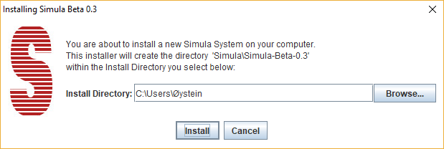
Installing Simula
I dette tilfelle får vi følgende directory struktur:
C:\Users\Øystein
\Simula ( This Directory is called 'Simula Home' )
\Simula-Beta-03
\rts ... ( Simula Runtime System )
\tst ... ( Simula Sample Programs )
simula.jar ( Executable .jar )
ReleaseNotes.txt

Slide 3
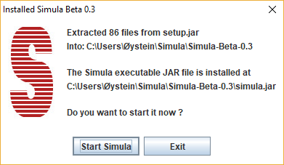
Installation Completed
The actual installation directory and executable simula .jar is reported.
Press [ Exit ] and the installation is finished
Press [ Start Simula ] and the executable simula.jar is started.
In this case without any arguments which will result in the Simula Editor being started.
See next page for details ....

Slide 4
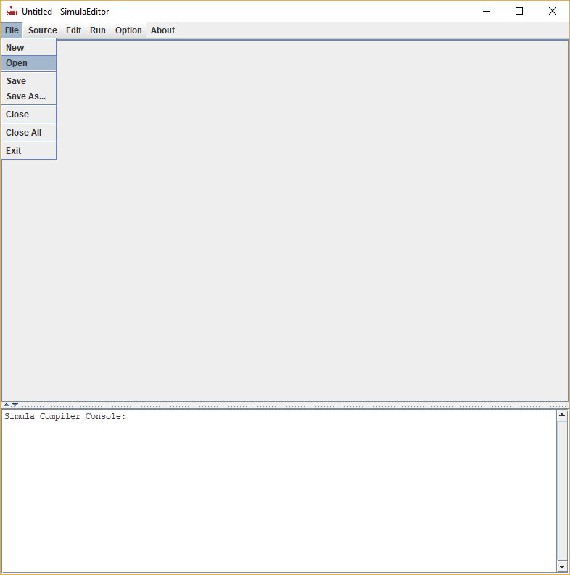
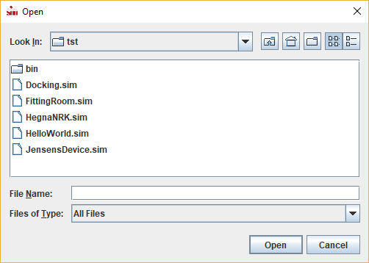
Simula Editor
Select [ File ] [Open] to open
a sample Simula Source File

Slide 5
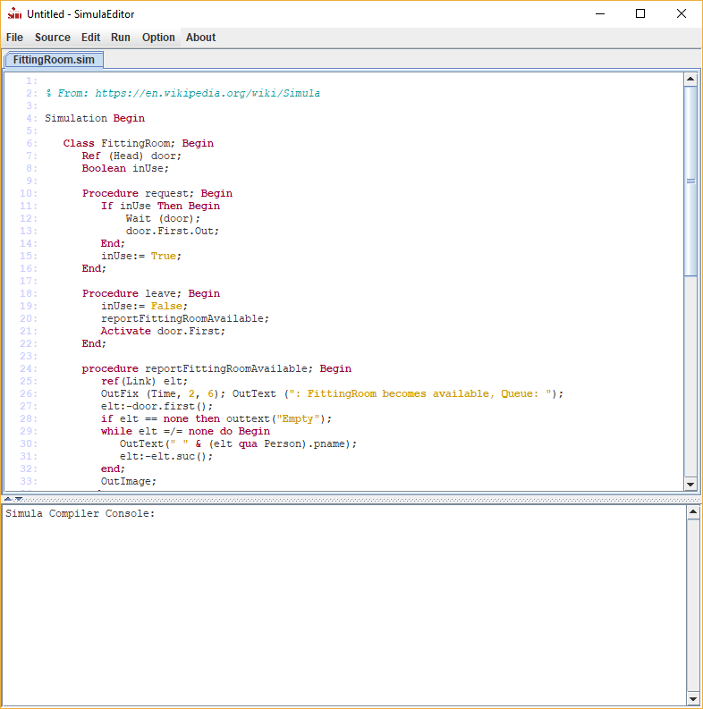
Context Sensitive Editing
This is a preliminary Editor you should use with care.
To Compile and Run select
[ Run ] [ Run ]
... enjoy

Slide 7
Directories during Compilation
Anta at Simula Systemet er installert i direktoriet <release-dir>
som typisk vil være C:\Users\Øystein\Simula\Simula-<version>\ på en Windows Maskin
Da vil <simula.home> være C:\Users\Øystein\Simula og dette er lagret i filen
C:\Users\Øystein\.simula/simulaProperties.prop
Anta videre at vi kompilerer en simula-source <source-dir>/simtest.sim
Og anta til slutt at <temp> er resultatet av kall på System.getProperty("java.io.tmpdir")
Følgende directories er da i bruk under kompilering:
SourceFile Dir: <source-dir>
TempDir for .Java: <temp>\simula\src\simprog/
TempDir for .Class: <temp>\simula\bin\simprog/
SimulaRtsLib: <release-dir>/rts/
OutputDir: <source-dir>/bin/
Hvis compiler option 'verbose' er satt vil disse verdiene bli skrevet ut ved oppstart av kompileren.

Slide 8
Compiler Steps
( see SimulaCompiler.java )
Set up directory files
- SourceFile Dir: <source-dir>
- TempDir for .Java: <temp>\simula\src\simprog/
- TempDir for .Class: <temp>\simula\bin\simprog/
- SimulaRtsLib: <release-dir>/rts/
- OutputDir: <source-dir>/bin/
Do Parsing
Read source file through the scanner building program syntax tree
Do Checking
Traverse the syntax tree performing semantic checking
Do JavaCoding
Traverse the syntax tree generating .java code
Call Java Compiler to generate .class files
Do ByteCodeEngineering updating .class files
Create executable .jar of program
Execute .jar file

Slide 9
S-Port Switch Statement
Utvidelse arvet fra S-Port Simula.
switch-statement = SWITCH ( lowKey : hiKey ) switchKey BEGIN { switch-case } [ none-case ] END
switch-case = WHEN <caseKey-list> do <statement> ;
none-case = WHEN NONE do <statement> ;
<caseKey-list> = caseKey { , caseKey }
caseKey = caseConstant | caseConstant : caseConstant
lowKey = integer-or-character-expression
hiKey = integer-or-character-expression
switchKey = integer-or-character-expression
caseConstant = integer-or-character-constant
Oversettes til et Java Switch Statement med break etter hvert enkelt <statement>
Forekommer i S-Port kompilatoren til Peter – men jeg har ikke funnet beskrivelse av semantikken.

Slide 10
Nytt Switch Statement i Java 12
In the following code, the many break statements make it unnecessarily verbose, and this visual noise often masks hard to debug errors, where missing break statements mean that accidental fall-through occurs.
switch (day) {
case MONDAY: case FRIDAY: case SUNDAY:
System.out.println(6); break;
case TUESDAY:
System.out.println(7); break;
case THURSDAY: case SATURDAY:
System.out.println(8); break;
case WEDNESDAY:
System.out.println(9); break;
}
We propose to introduce a new form of switch label, written "case L ->" to signify that only the code to the right of the label is to be executed if the label is matched. For example, the previous code can now be written:
switch (day) {
case MONDAY, FRIDAY, SUNDAY -> System.out.println(6);
case TUESDAY -> System.out.println(7);
case THURSDAY, SATURDAY -> System.out.println(8);
case WEDNESDAY -> System.out.println(9);
}
Se: https://openjdk.java.net/jeps/325
Morsomt å se at de nå foreslår nesten det samme Switch Statement som Peter hadde i S-Port. De mangler bare intervaller:
F.eks: case MONDAY : FRIDAY -> System.out.println('' ukedag '');

Slide 11
Signering av Setup.jar
MAC krever signering
Windows advarer pga. Manglende signering
Har vi tilgang til serfikat ?
Kan Eyvind gjøre dette ?
... men først når vi er på nivå – beta 1.0
Må også få på plass:
A newer version og Simula is available
do you want to download now ?

Slide 12
UTF-8 ?!
Blir standard i Java 13 planlagt ferdig ???
Målsetning: Use UTF-8 as the Java virtual machine's default charset so that APIs that depend on the default charset behave consistently across all platforms
Se: Use UTF-8 as default Charset
Dagens situasjon er rimelig rotete ihvertfall på Windows maskiner.
Jeg har tatt vekk en 'reflection' retting av 'DefaultCharset' da Java 10+ ikke synes noe særlig om den måten å patche !
Problematikken forklart her: Java May Use UTF-8 as its Default Charset
Utsetter setting av UTF-8

Slide 13
Java 11 ?
Naturlig å gå over til Java 11 nå ?
Isåfall – Java 11 under GNU GPL
Hva bruker dere nå ?
Mer info: https://jdk.java.net/11/

Slide 14
Project LOOM
Project Loom is to intended to explore, incubate and deliver Java VM features and APIs built on top of them for the purpose of supporting easy-to-use, high-throughput lightweight concurrency and new programming models on the Java platform. This is accomplished by the addition of the following constructs:
Fibers (lightweight user-mode threads)
Delimited continuations
Tail-call elimination
Ser ut til at ' Delimited continuations ' passer til Simula's Detach / Call / Resume
Det foreligger en implementasjon og vi kan prøve det.
Ingen tidsplan for inkludering i Java ennå ? Jeg har prøvd å spørre.
Mer info her: https://wiki.openjdk.java.net/display/loom
Source her: Continuation.java

Slide 15
LOOM: Delimited continuations
public class Continuation implements Runnable {
public Continuation(ContinuationScope scope, Runnable target)
public final void run()
public static void yield(ContinuationScope scope)
public boolean isDone()
....
}
A continuation object is constructed by passing two arguments to the constructor: a Runnable target that serves as the body of the continuation, and a java.lang.ContinuationScope. The scope is the delimited continuation's prompt, that allows continuations to be nested. One could think of such "scoped continuations" as nested try/catch blocks, where the scope is the type of the exception thrown, which determines the handler called.
A continuation is started by calling Continuation.run, which would start executing the body in the continuation's target, and returns either when the continuation terminates (the body runs to completion, and terminates either normally or abnormally), or when it yields on the continuation's scope. To query the reason for run returning, use Continuation.isDone, which returns true if the body has terminated, or false if it has yielded.
A call to the static Continuation.yield suspends the current continuation and all enclosing continuations up until the innermost one with the scope passd to yield, causing the run method of that continuation to return.
The Continuation class is implemented natively in Hotspot (except for scoping; that is implemented in Java). Every continuation has its own stack. From the perspective of the implementation, starting or continuing a continuation mounts it and its stack on the current thread – conceptually concatenating the continuation's stack to the thread's – while yielding a continuation unmounts or dismounts it.

Slide 16
Jfokus Developers Conference
4-6 February 2019
Stockholm, Sweden
Link: https://www.jfokus.se/jfokus19/
Min mann, Rafael Winterhalter, i Java-miljøet sier:
- Jeg skal på java language summit i stockholm starten av februar.
- De fra LOOM teamet er alle der.
- Skal sikkert finne ut noe om det. ellers kom deg en tur, da introduserer jeg deg
Er det noen som har lyst/kan dra dit ?

