Slide 1
LAB 8
Switch Virtual Interface - SVI
Aseel Khalaf 1160689
TODO

Slide 2
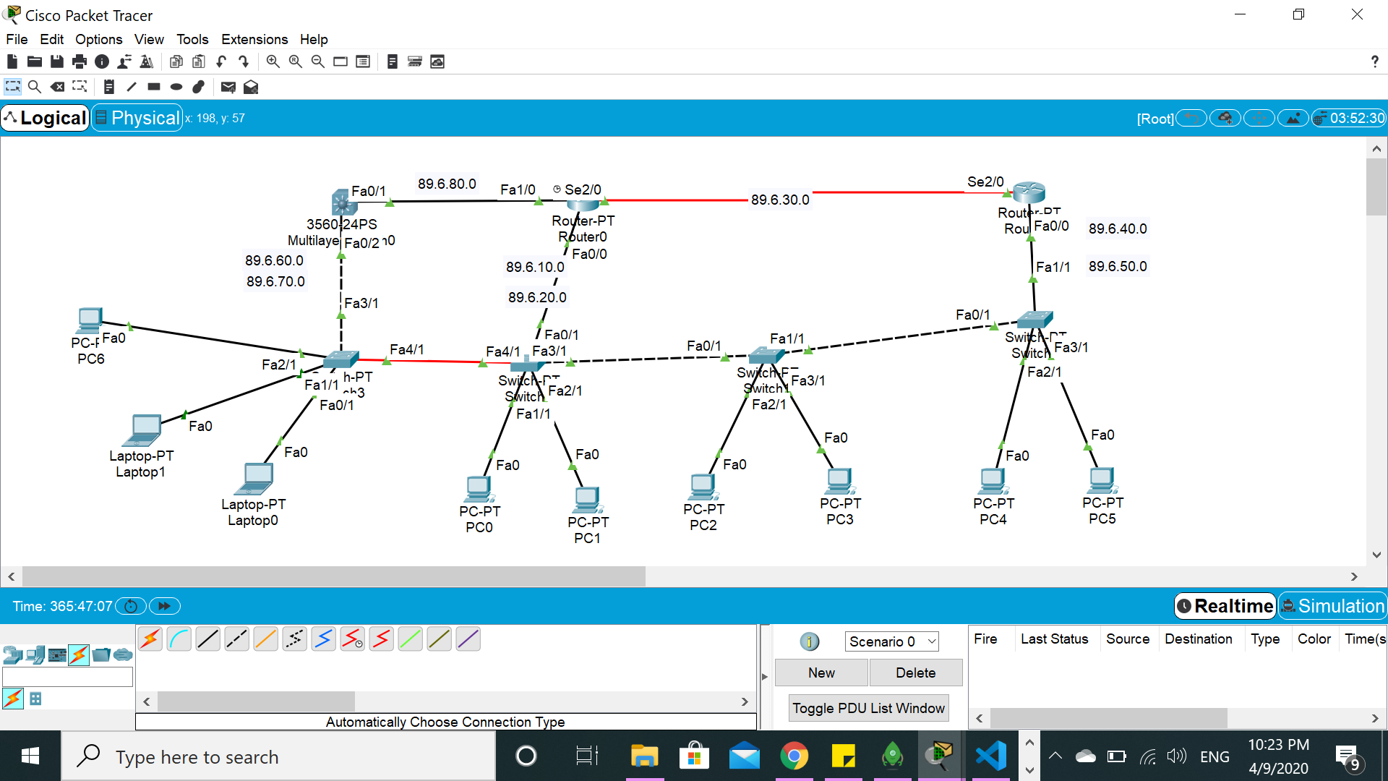

Slide 3
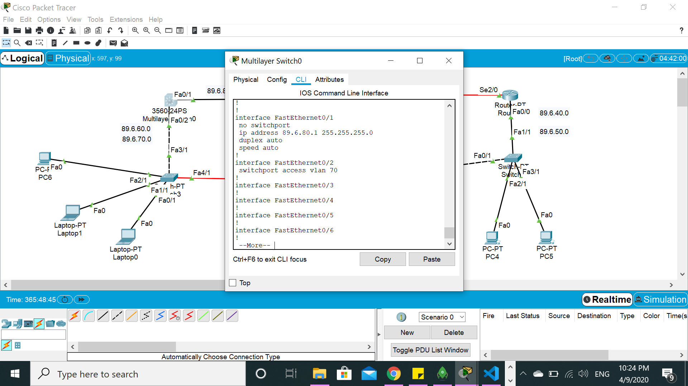

Slide 4
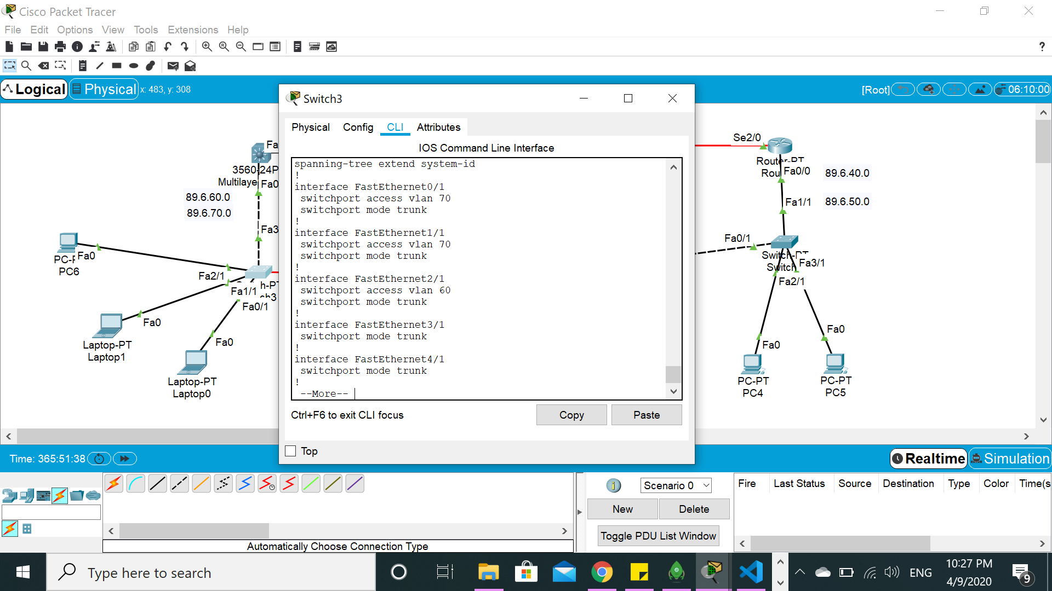

Slide 5
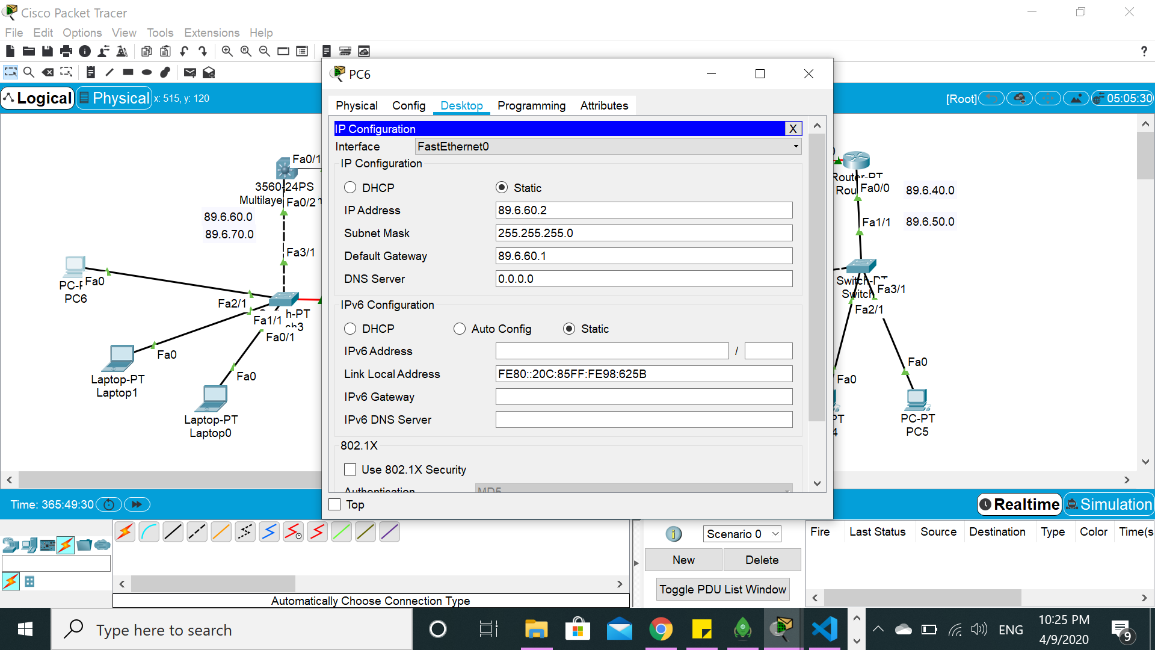
IP FOR PC6

Slide 6
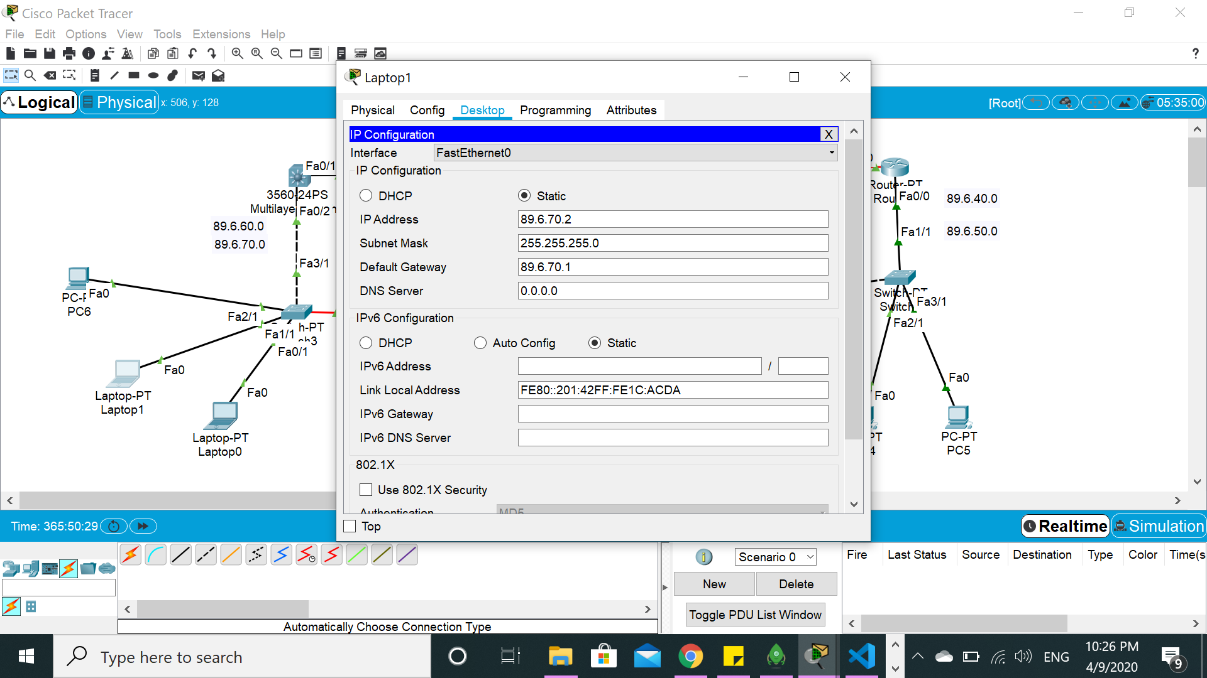
IP FOR laptop1

Slide 7

IP FOR laptop0

Slide 8
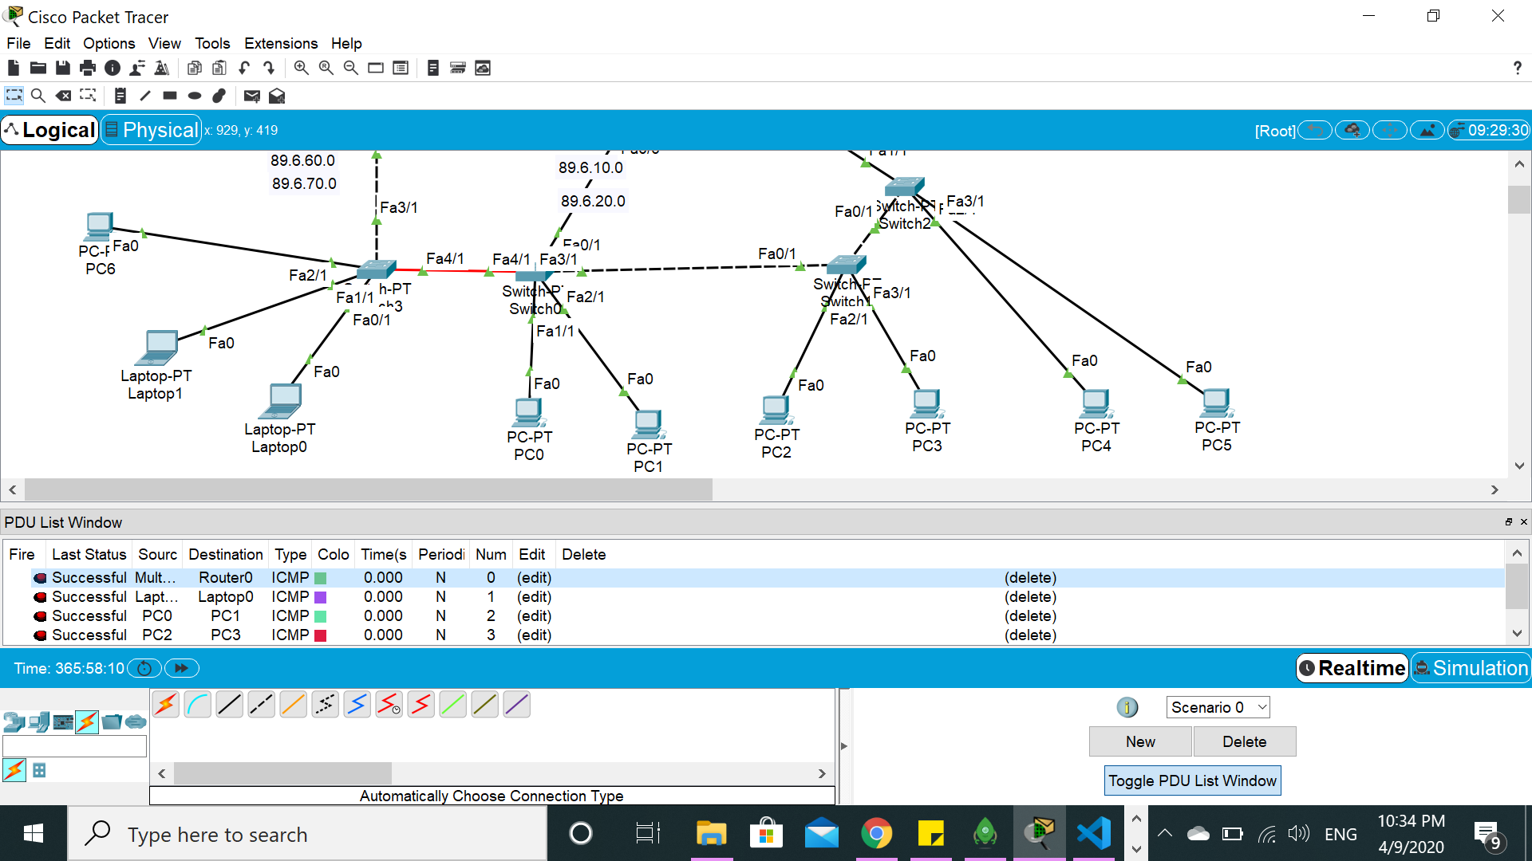
PING

