Slide 1
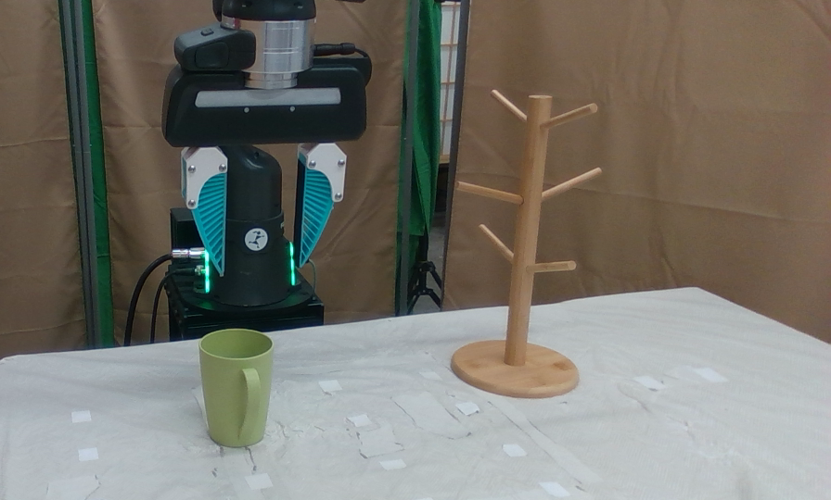
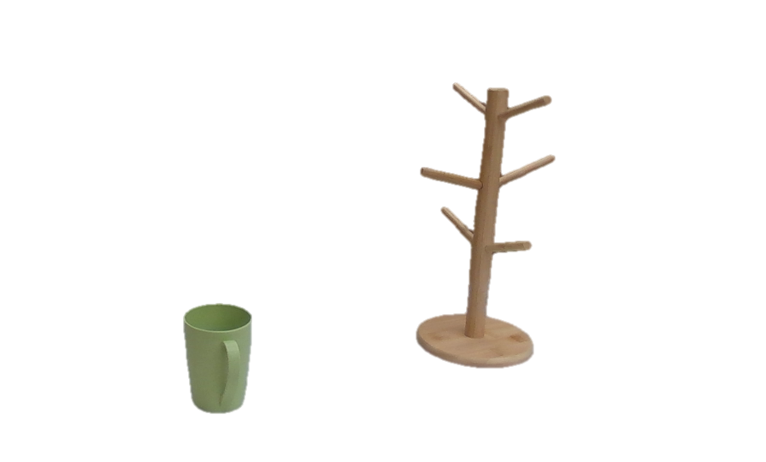
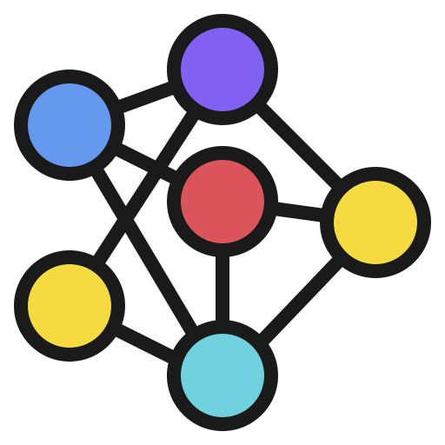
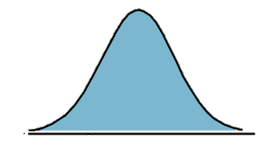
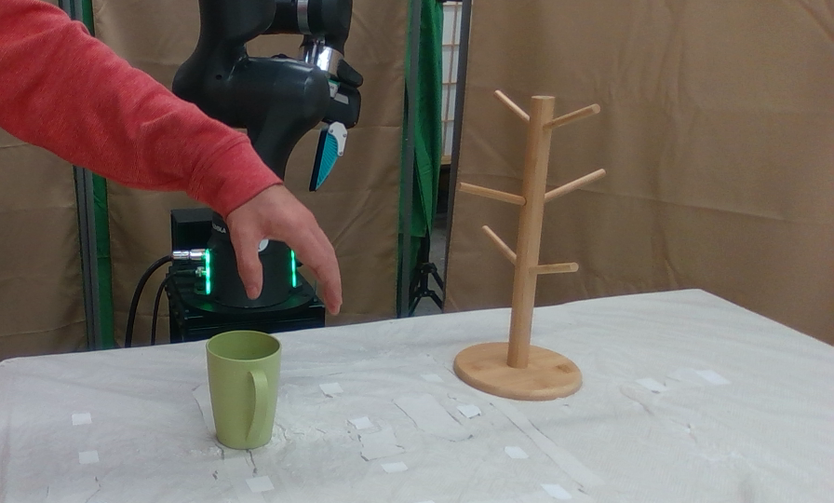
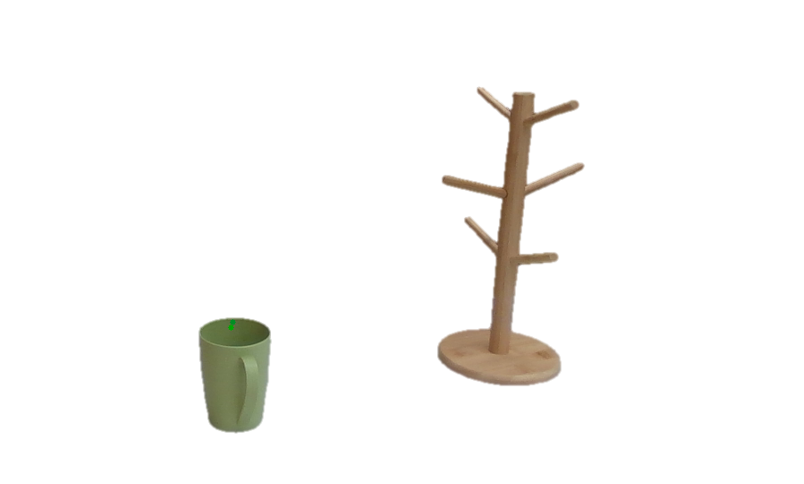
Learn to denoise actions
Diffusion
Policy
Robot
🤖
…
…
Robot
Add Gaussian noise to actions
Human-robot classifier
SAM2
Tracker
🙋‍♀️
🗑️
…
Human
Discard
Human
Cross-embodiment data
Unified representation
Noised actions
Cross-embodiment diffusion learning

