Slide 1
Gaël's Game Project
Here is the explanation of the Gaël's Game Project.

Slide 2
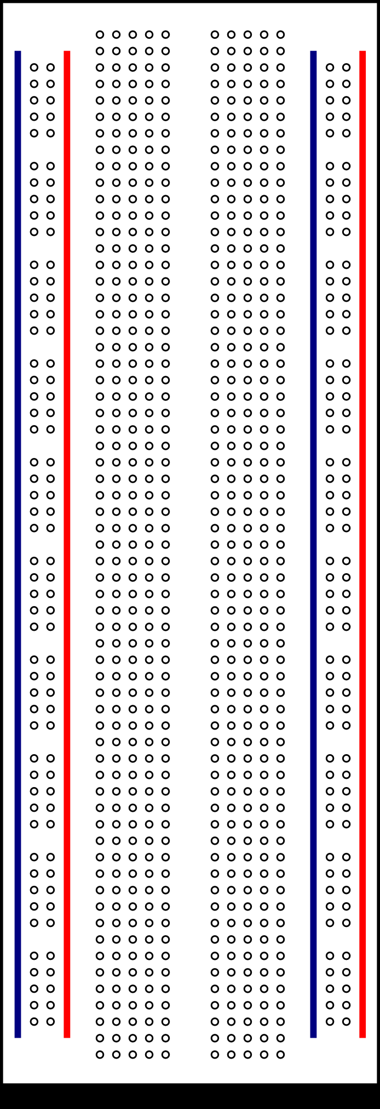
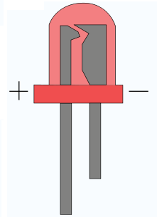
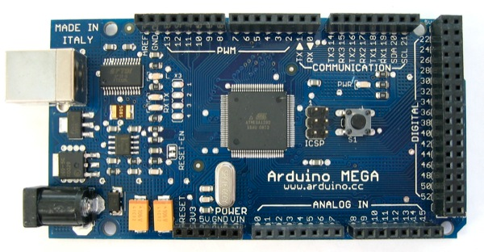
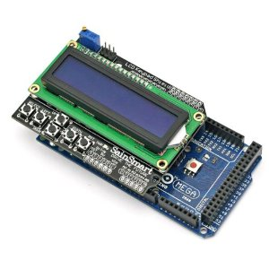
Hardware Design
Material used :
  Arduino Mega 2560
  Sain Smart LCD Keypad Shield
  4 Leds
  1 Resistance 100Ω
GND

Slide 3
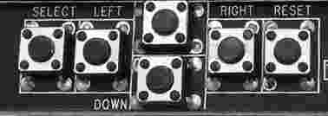
User Guide
When the game starts : choose the game difficulty usign the select button (easy, medium, hard).
Easy means a combination of 10 lights ON successively
Medium means a combination of 20 lights ON successively
Hard means a combination of 30 lights ON successively
- After the player chose the difficulty, the game starts.
- One of the four lights will switches ON for 500ms then switch OFF. At this point, the player will have to click on the corresponding button (see below the symmetry between leds and buttons). DELAY TO ANSWER ?

Slide 4
User Guide
A first led switches on, if the corresponding answer is correct, the same led switches on then a second one. if the answer was incorrect he will start the sequence from the beginning. Here's an example.
In the third step, he failed because I pressed Up while down was ON.
So the step 4, restart the game from the beginning and with the same sequence.
If the full sequence is done correctly, the player wins the game. Music and switch all the lights ?
LED switched on | User action | Results
01 - Up | 01 – Up | OK
02 – Up - Left | 02 – Up - Left | OK
03 – Up – Left - Down | 03 – Up – Left - Up | KO
04 - Up | 04 - Up | OK
05 – Up - Left | 05 – Down - | KO
06 - UP | 06 - UP | OK

