Slide 1
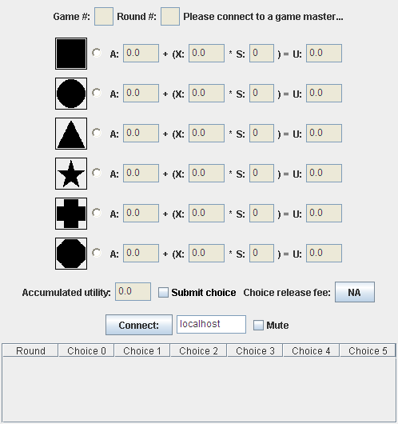
Choose item
Prompt
Item
Utility formula:
A & X set by Master, S = # players choosing this item
Submit choice to Master
Pay this to change choice
Your game “score”
Game history
Master host address
Messages from Master (not shown)

Slide 2
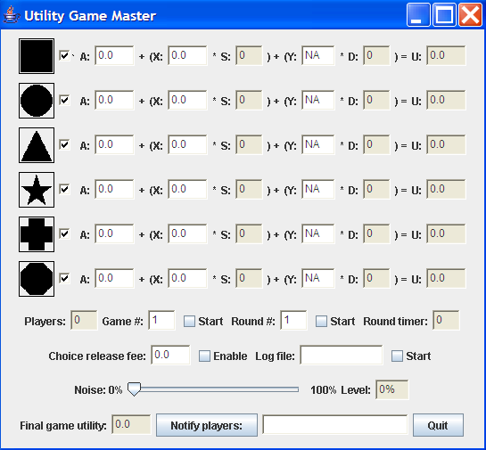
Make item available for choosing
Utility formula:
A & X & Y set by Master, S = # players choosing this item, D = # players not choosing item
Item
Start/ stop game
Allow players to pay to change choice
Start/ stop round
Distort player information
Log game activity
Total for all players
Broadcast messages to players

Slide 3
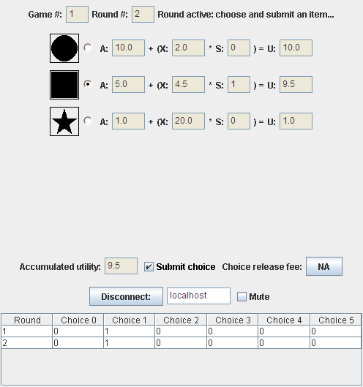

Slide 4
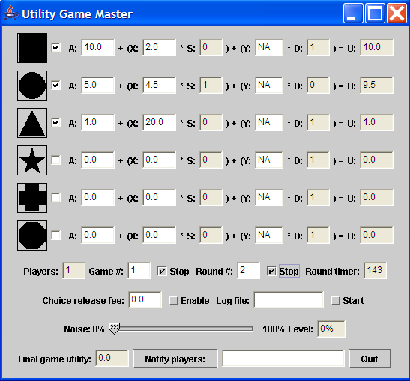

Slide 5
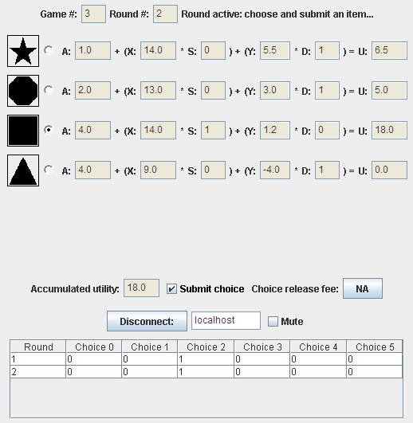

Slide 6
