Slide 1
Technology Adoption in the Presence of Network Externalities: A Web-Based Classroom Game
Tom Portegys and James R. Wolf, Jr.
Illinois State University

Slide 2
Background
Network externalities exist when the value of a product or service to a consumer depends on the number of other people using a compatible product or service.
Network externalities can result in the dominance of one technology even if it is inferiority to an alternate technology.
For example, MSN Messenger users can only send instant messages to others using the MSN Messenger software.
Externalities may be direct or indirect.

Slide 3
The Utility Game
A customizable web-based classroom game which can be used to demonstrate the effects of network externalities on the adoption of new technologies.
A web-based adaptation of Ruebeck et al.'s (2003) network externalities game.

Slide 4
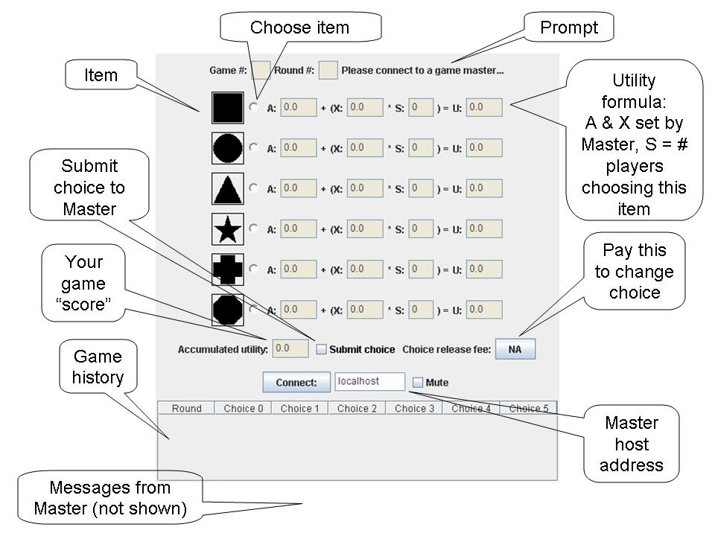
The Player Applet

Slide 5
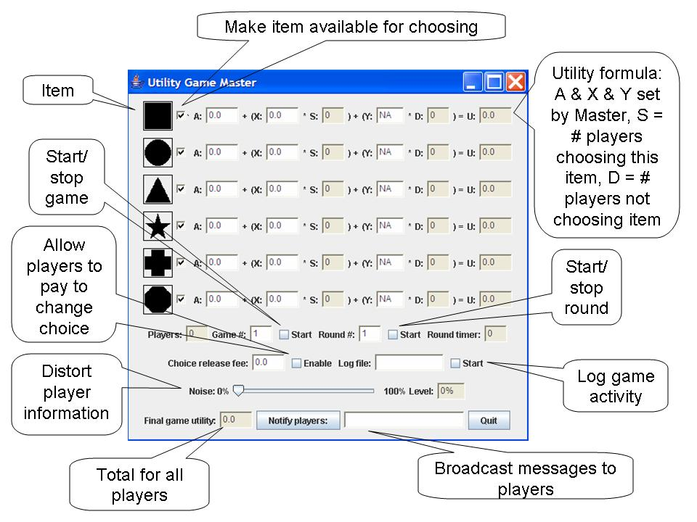
The Master Application

Slide 6
Game 1 – Simultaneous Choice
Participants choose one of a number symbols and their one time choice determines their utility for 10 rounds.

Slide 7
Game 2 – Sequential Choice
In this game, participants can now decide in each period whether to choose a symbol or not.
However, once a symbol is chosen, participants cannot change their choices.

Slide 8
Game 3– Sequential Choice with a Noisy Signal
This game is only different from game 2 in the information participants receive each period about the number of people who have chosen each technology.
After each round participants will be shown a “noisy” summary of all participant choices.

Slide 9
Game 4– Sequential Choice with Changing Utilities and Switching Costs
After the third period, one of the symbols will be randomly chosen to provide a higher utility than the other.
If a participant has chosen a symbol, they can change to another symbol but must pay to do so.

Slide 10
Game 5– Sequential Choice with a Universal Technology
One of the technology choices will have a utility function in which participants’ utility for choosing that technology will be affected by the by the number of people who have chosen the same technology and by the number of people that have chosen a different technology.

Slide 11
References
Katz M. L., and C. Shapiro, “Network externalities, competition, and compatibility,” American Economic Review 75: 424-440, 1985.
Ruebeck,C, S. Stafford, N. Tynan, W. Alpert, G. Ball and B. Butkevich "Network Externalities and Standardization: A Classroom Demonstration," Southern Economic Journal, Vol. 69: 1000-08, 2003

