Slide 1
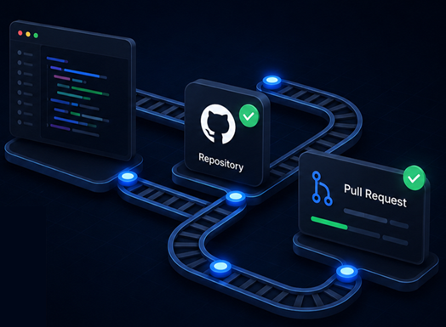
A
AGENTRAIL
Put AI coding
agents
on rails.
Developer productivity tools for engineering teams adopting AI coding agents.
▣
Start AI projects
✓
Harden repositories
↯
Issue-to-PR
Brand presentation · AgentRail

Slide 2

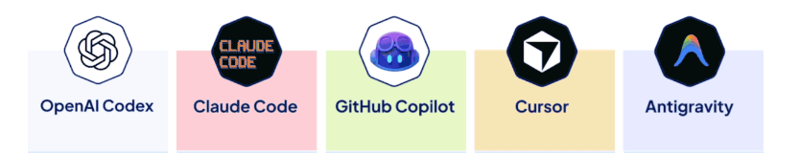
A
AGENTRAIL
BUILDING (COMPLEX)
SOFTWARE WITH AI AGENTS
?
?
?

Slide 3
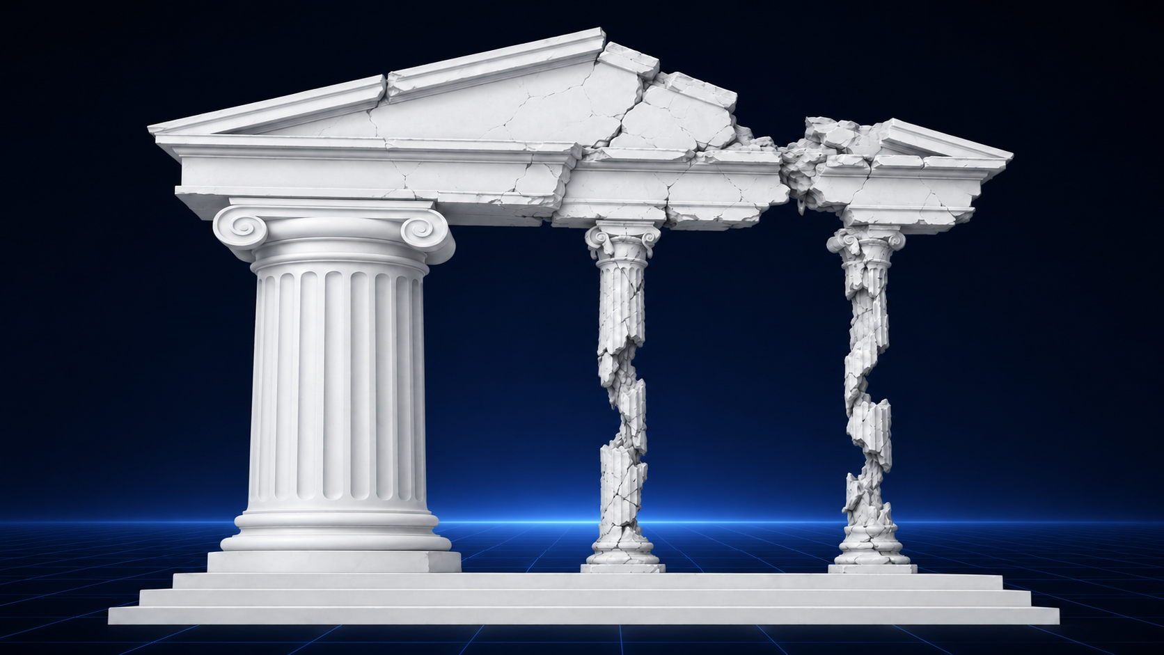
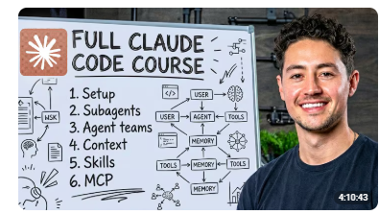
A
AGENTRAIL
BUILDING (COMPLEX)
SOFTWARE WITH AI AGENTS

Slide 4
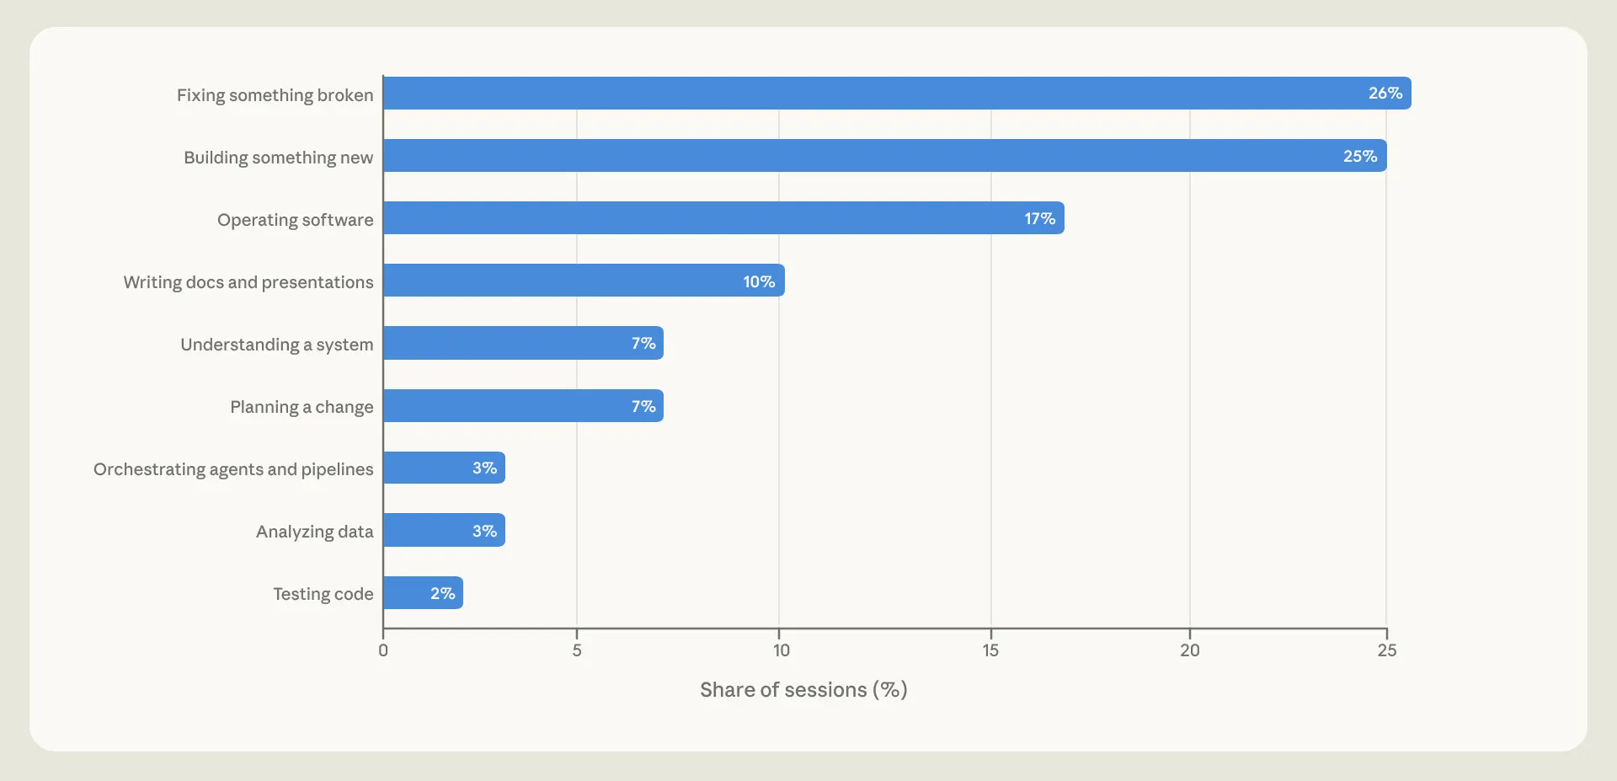
A
AGENTRAIL
What Claude Code sessions do?
Source: https://www.anthropic.com/research/claude-code-expertise 16. Juni 2026

Slide 5
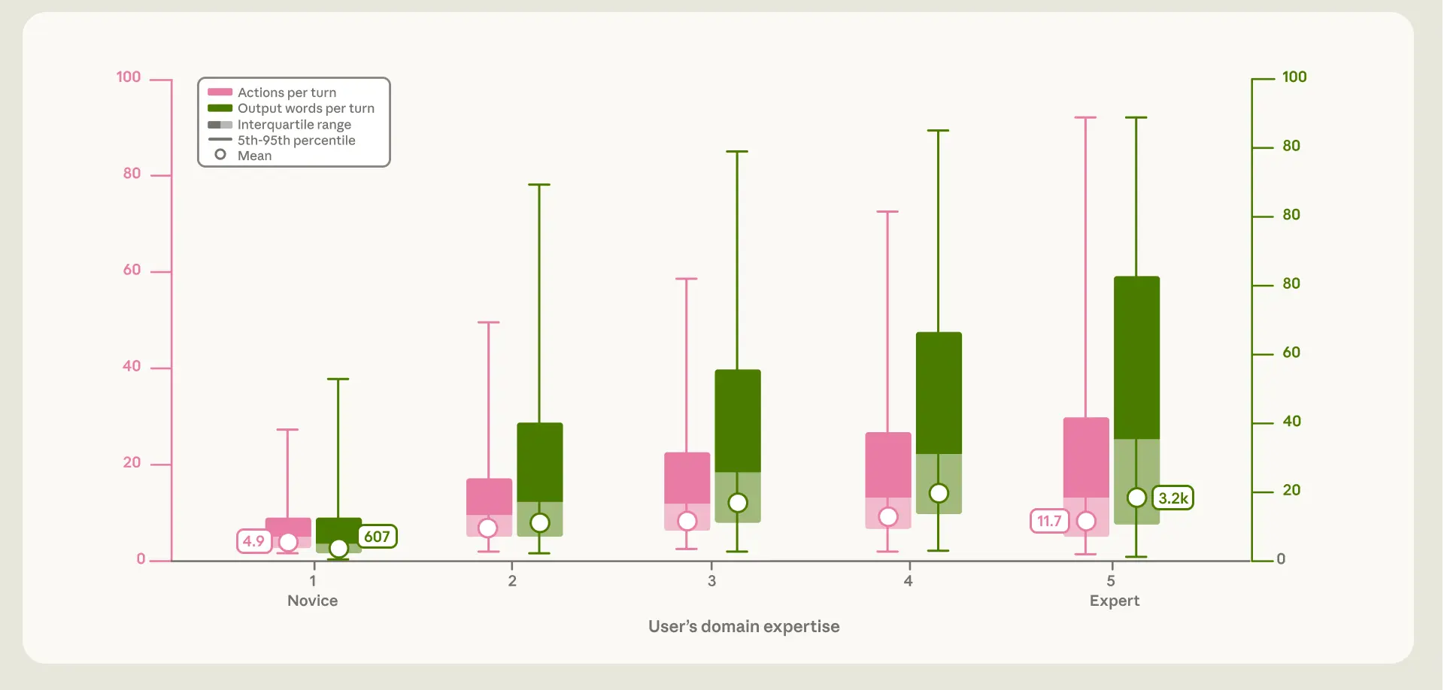
A
AGENTRAIL
What do experts Claude code experts do?
Source: https://www.anthropic.com/research/claude-code-expertise 16. Juni 2026

Slide 6
A
AGENTRAIL
BUILDING (COMPLEX)
SOFTWARE WITH AI AGENTS
🤖 Agent Use 👷
Guide the AI with scope, tests, and review
🏗️ Codebase
Make the project easy to understand and check
⚙️ Operations
Control risk with permissions, CI, and ownership
Start · Harden · Ship

Slide 7
A
AGENTRAIL
Pilars software for AI assisted SW development
🤖 Agent Use 👷
Guide the AI with scope, tests, and review
🏗️ Codebase
Make the project easy to understand and check
⚙️ Operations
Control risk with permissions, CI, hooks and ownership
🎯 Clear goal and success criteria
🧭 Plan before changing anything
✅ Use tests as the agreement
🧠 Give only the right context
🍰 Work in small slices
🔎 Review the actual changes
👥 Split planner, builder, reviewer
🧾 Ask for structured answers
📌 Track decisions and progress
⚡ Fast checks that catch mistakes
🗂️ Clear project layout
🧱 Small, separate building blocks
✅ Tests that describe expected behavior
📘 Simple instructions for the project
🔒 Rules enforced by code, not memory
🔍 Easy to debug when something breaks
🏷️ Clear labels and conventions
🧹 Clean, relevant project context
🚦 Choose safe tasks for agents
🛡️ Limit what agents can change
♻️ Use repeatable environments
🔐 Protect secrets and data
🚧 Block merges unless checks pass (test, lint, format…)
📄 Make pull requests easy to review
👤 Keep humans accountable
🧰 Pick the right tool for the task
💸 Match effort to risk
🔁 Learn from repeated mistakes
⚖️ Check licenses and source of code

Slide 8
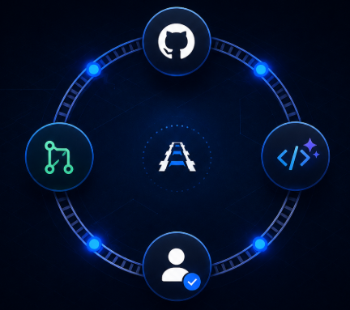
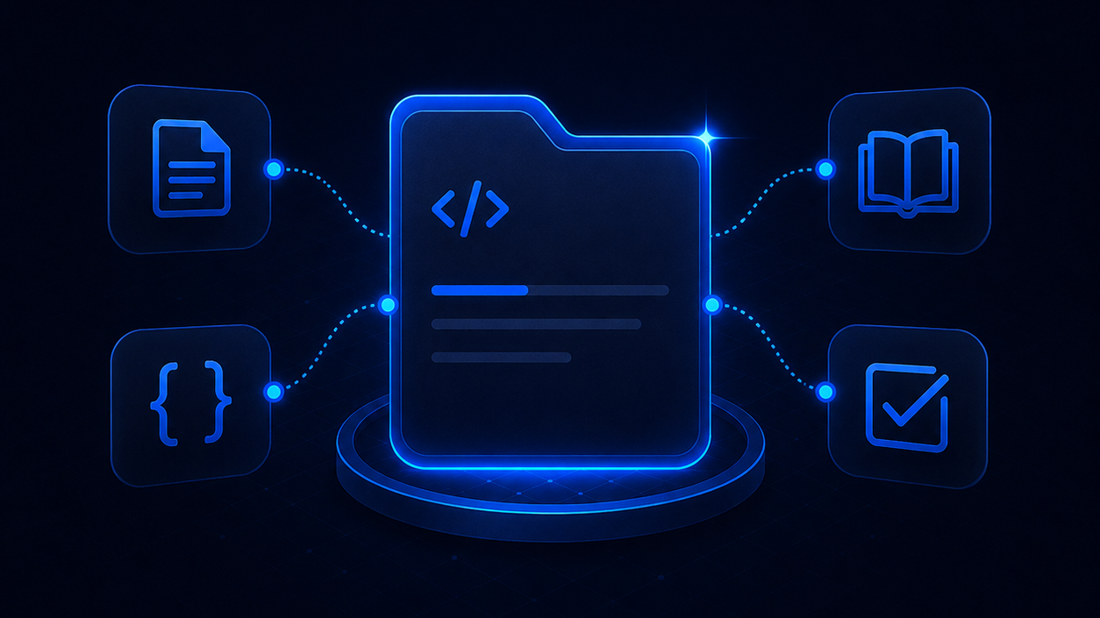
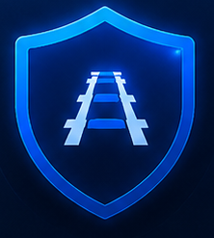
A
AGENTRAIL
Three tools for three software moments
1
AI Project Templates
2
Safe Project
Improvement System
3
Agentic Loop PR
Start new AI projects with a solid structure.
Improve existing repositories so AI agents can work on them more safely.
Run controlled AI-assisted implementation from issue to pull request.
Notes:
The three projects support different moments in the software lifecycle: starting new AI projects, improving existing repositories, and running controlled AI-assisted work through pull requests.

Slide 9

A
AGENTRAIL
📁templates/
📁simple-llm-call-template/ ├── README.md ├── PROJECT_SPEC.md ├── AGENTS.md ├── .env.example ├── Makefile ├── verify.sh ├── pyproject.toml ├── 📁.github/ │ └── 📁 workflows/ │ └── verify.yml ├── 📁docs/ │ ├── architecture.md │ ├── runbook.md │ ├── limitations.md │ └── evaluation.md ├── 📁src/ │ └──📁 simple_llm_call/ │ ├── config.py │ ├── schemas.py │ ├── llm_client.py │ ├── workflow.py │ ├── storage.py │ ├── 📁prompts/ │ │ └── generation.md │ └── web/ │ └── app.py └── 📁 tests/ ├── 📁 fakes/ ├── 📁 fixtures/ └── test_*.py
AI Project Templates
Starter architectures for new AI software projects.
Simple LLM integration
Agentic: LangChain
RAG
Agentic: LangGraph
MCP
Agentic: Agent & Human in the loop
Shared backbone:
config -> schemas -> prompts -> llm_client -> workflow/agent/graph -> storage -> web -> tests
https://github.com/portero-aylagas/AI_project_templates
Notes:
This project is useful when a company is starting a new AI application and wants the basic architecture to be correct before the project grows.

Slide 10
A
AGENTRAIL
Safe Project Improvement System
Skill for making existing repositories safer for AI-assisted development.
Improvement system:
inspect -> characterize -> verify setup -> audit -> backlog -> one patch -> verify
MODE | Use when
Review Mode | You want an audit, assessment, plan, or prioritized backlog.
Local Safe Refactor Mode | You want one local improvement made safely.
Full Automation Mode | You explicitly approve branch, commit, push, pull request, and CI follow-up work.
https://github.com/portero-aylagas/agent_skill_safe_project_improvement_system
Notes:
This is not a new-project template. It is used when the company already has a repository and wants to make it safer for future AI-assisted work.

Slide 11
A
AGENTRAIL
Analyse the architecture and file structure of this project.
Check:
- Whether each file has a clear purpose
- Whether responsibilities are separated correctly
- Whether main.py only orchestrates
- Whether business logic is outside the UI layer
- Whether imports suggest circular dependencies or bad -coupling
- Whether the current structure will scale if the project grows
Return:
- Current architecture summary
- Problems in the structure
- Recommended file structure
- What code should move where
- Minimal changes needed now
- Changes that would be overkill at this stage
Safe Project Improvement
System
SW ENGINEERING AUDIT | AI SYSTEM AUDIT
General Software Architecture | AI Software Architecture
Function Responsibility | Prompt Quality
Error Handling | Dynamic Prompting
Testability | Structured Output
Software Delivery Testing | LLM/API Integration
Reproducibility And Dependency Discipline | RAG And Retrieval
CI Maturity | AI Evaluation And Testing
Data And JSON Validation | Agents And Tools
Artifact/File Collision Safety | Workflow Automation
User-Controlled File/Path Safety | Speech Pipelines
Repository Hygiene | Cost And Usage
Process And Reviewer Evidence
Security And Secrets
Notes:
This is not a new-project template. It is used when the company already has a repository and wants to make it safer for future AI-assisted work.

Slide 12
A
AGENTRAIL
Configurable policy: max_review_cycles: 2 max_findings_per_cycle: 25 stagnant_cycles: 2 max_changed_files: 20 max_diff_lines: 1000
Agentic Loop
Programmatic flow:
1
Issue
2
Plan
3
Implement
4
Review
5
Remediate
6
Handoff
Intake
Scope
Code
Check
Fix
Human
Agents:
🧠 Orchestrator
🧑‍💼📝 Planner
🧑‍💻🛠️ Implementer
🕵️🔎 Reviewer
🧑‍⚕️💊 Remediator
https://github.com/portero-aylagas/agentic-loop-PR
Notes:
This slide explains the operational value: teams get a repeatable issue-to-PR workflow with role separation, review loops, audit state, protected paths, and human merge responsibility.

Slide 13


Slide 14


Slide 15


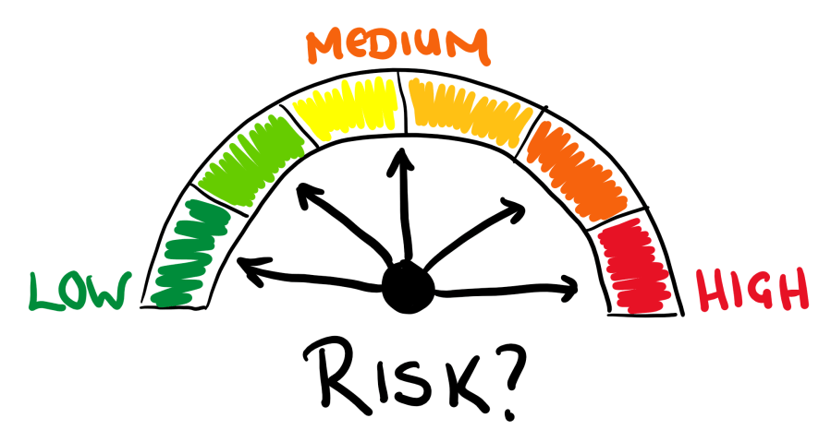
A
AGENTRAIL
Strategic Plan & ROI & Risk Assessment
Open source
+
Paid Support
Value:
Productivity increase
Time and tokens saved
Poor adoption
Overtrust in AI outputs
Overengineering
Notes:
This slide explains the operational value: teams get a repeatable issue-to-PR workflow with role separation, review loops, audit state, protected paths, and human merge responsibility.

Slide 16


A
AGENTRAIL
EU AI data act & GDPR
Limited Risk / transparency-relevant
Main controls:
human review
audit trail
verification checks
clear usage boundaries
ransparency that AI may assist with code or PR content
Open-source GitHub-based framework
Main controls:
data minimization
no secrets
redacted examples
limited retention
access control
private security reporting
reassessment by downstream users.
Notes:
This slide explains the operational value: teams get a repeatable issue-to-PR workflow with role separation, review loops, audit state, protected paths, and human merge responsibility.

