Slide 1
A-Team Arvind Thorat programmer at NIC Delhi
THEME SELECTED : THEME1

Slide 2
Problem Statement
Bank Loan Defaulter Analysis using previous record In the above project we have to find the defaulter in loan process or persons who has bad record of repaying the loan. we have to create model that can find the defaulter in loan process using machine learning and Data processing.

Slide 3
SOLUTION
1. It is machine learning Model in which I use the machine learning Algorithm Random Forest
2. With the help of Random Forest Algorithm , I create a regressor or model which helps up to find the predicted probability
3. First , I clean the model then after that I extract different files by combining different results .
4 Finally I got the results .
5. you can see the source code file in the project files.

Slide 4
METHODOLOGY
1. Data Interpretation
2. Data Cleaning
3. Data pre-processing
4. Model Building
5. Flask-api
6 Streamlit-application
7. results are save in FINAL RESULTS FILE

Slide 5
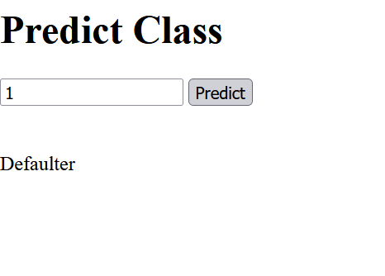
Project Related Images

