Slide 1




Digital portfolio

Slide 2
STUDENT NAME:A.ANUSUYA
REGISTER NO AND NIMD:222411460/8977869C70FBF25A2134B90EDA0B8939
DEPARTMENT:BSC.COMPUTER SCIENCE
COLLEGE:MANGALAM COLLEGE OF ARTS AND SCIENCE/UNIVERSITY OF MADRAS

Slide 3
PROJECT TITLE
INTERACTIVE DIGITAL PORTFOLIO USING FRONT END DEVELOPMENT

Slide 4
AGENDA
Problem statement
Project overview
End users
Tools and technologies
Portfolio design and layouts
Features and funtionality
Results and screenshorts
conclusion
github link

Slide 5
PROBLEM STATEMNET
Many students struggle to present their skills, projects, and achievements in a well-organized and professional way. Traditional resumes or scattered documents don't fully showcase their potential. There is a need for a digital platform where students can display their work in one place. A digital portfolio helps create a strong online presence and makes it easier to share their profile with employers or colleges. It should be easy to use, visually appealing, and mobile-friendly. This can improve how students present themselves in academic or professional settings.

Slide 6
PROJECT OVERVIEW
This project is a personal digital portfolio that acts as an online résumé and professional showcase. It provides a centralized space to present an individual's background, skills, and achievements in a clean and organized format. The portfolio is designed to help users stand out when applying for jobs, internships, or academic programs by offering a strong and professional online presence.
The portfolio includes the following sections:
About Me – A brief introduction and personal background
Education – Academic qualifications and details
Skills – Technical and soft skills listed clearly
Certificates – Relevant certifications and accomplishments
Contact – Easy-to-use contact information for communication
The platform is responsive, user-friendly, and designed to be updated easily as the user progresses in their career or education.

Slide 7
WHO ARE THE END USERS?
Students – Who want to showcase their academic background, skills, and projects online.
Job Recruiters / Employers – Who are looking to quickly understand a candidate’s qualifications and past work.
College Admission Committees – Who may use it to evaluate a student's profile for higher studies.
Internship Providers – Who want to assess a student's capabilities and experience before offering internships.
Clients (for freelancers) – Who may want to see previous work before hiring.
Personal Network – Teachers, mentors, or peers who want to learn more about the student’s work and background.

Slide 8
TOOLS AND TECHNOLOGIS
HTML – To structure the content of the web pages
CSS – For styling and layout design
JavaScript – To add interactivity and dynamic elements
VS Code – Code editor used for writing and editing code

Slide 9
PORTFOLIO DESIGN AND LAYOUTS
HOME
ABOUT ME
SKILLS
PROJECTS
ACHIEVEMENTS
CONTACT
RESPONSIVE NAVIGATION WITH HAMBURGER MENU
RESPONSIVE LAYOUT(MOBILE,DESTOP VIEW)

Slide 10
FEATURES AND FUNCTIONALITY
About Me Section: Provides a brief introduction and personal background.
Education Section: Lists academic qualifications and relevant details.
Skills Section: Displays technical and soft skills using easy-to-read formats like lists or progress bars.
Certificates Section: Showcases earned certificates and achievements with descriptions or images.
Contact Section: Includes a contact form or direct contact information for easy communication.
Responsive Design: The portfolio adapts smoothly to different screen sizes (mobile, tablet, desktop).
Easy Navigation: A simple menu or navigation bar allows users to jump between sections quickly.

Slide 11
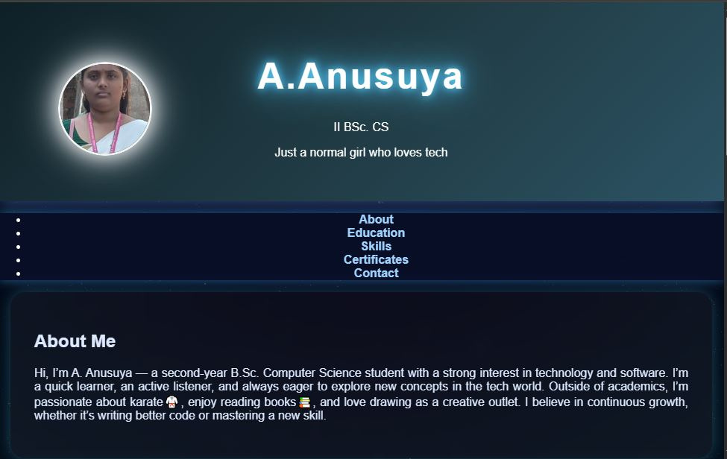
RESULTS AND SCREENSHORTS(destop view)

Slide 12
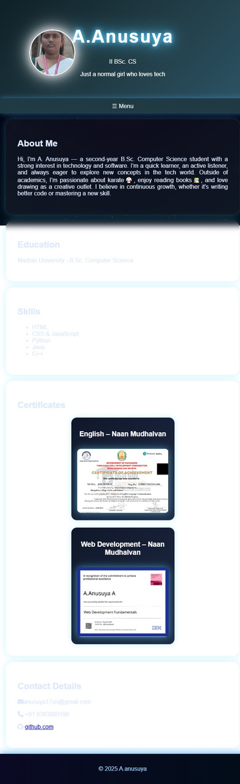
RESULTS AND SCREENSHORTS(mobile view

Slide 13
Conclusion
Highlights
Showcases skills, education, certificates, and contact info in one place
Responsive and easy-to-use design
Professional and clean layout
Final Summary
The digital portfolio is an online résumé that helps individuals present their achievements clearly and professionally, making it easier to connect with employers and educators.
Benefits to Society
Helps improve digital skills and online presence
Makes hiring and admissions simpler
Supports career growth and opportunities

Slide 14
GITHUB LINK
https://portfolio125.github.io/Anusuya.A/

Slide 15
Thank
You

