Slide 1
































Slide 2


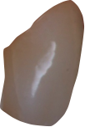


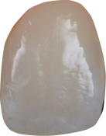
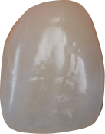






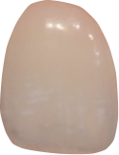
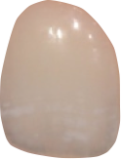

Oval
Dominant Centrals
Rounded cusps
Delicate laterals
Round Arch
Sensible
Melancholic
Organized
Perfectionist
Artistic
Abstractive
Timid
Reserved

Slide 3









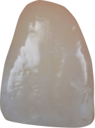
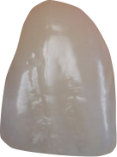


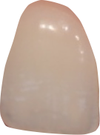
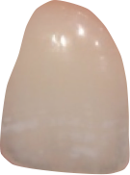

Triangular
Dynamic
Ascendant Smile Line
Converging Axis
Incline cusps
Sanguine
Extroverted
Communicative
enthusiastic
Dynamic
Impulsive

Slide 4










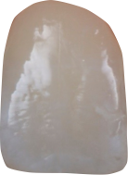
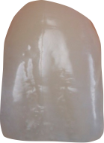
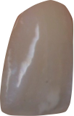
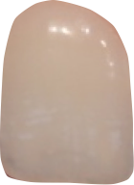
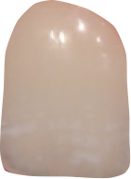
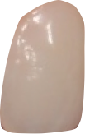
Rectangular
Strong
Dominant Centrals
Flat incisal edge
Aggressive Cusps
Vertical Axis
Choleric
Determined
Objective
Explosive
Intense
entrepreneur
Passionate

Slide 5



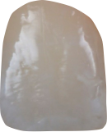
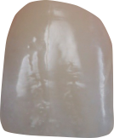
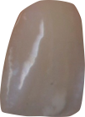





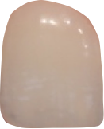
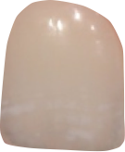
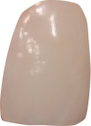


Square
Calm
Lack of Dominance
Diverging Axis
Horizontal arrangement
Phlegmatic
Diplomatic
Pacific
Mystic
spiritualized
Conformist
Discreet

Slide 6


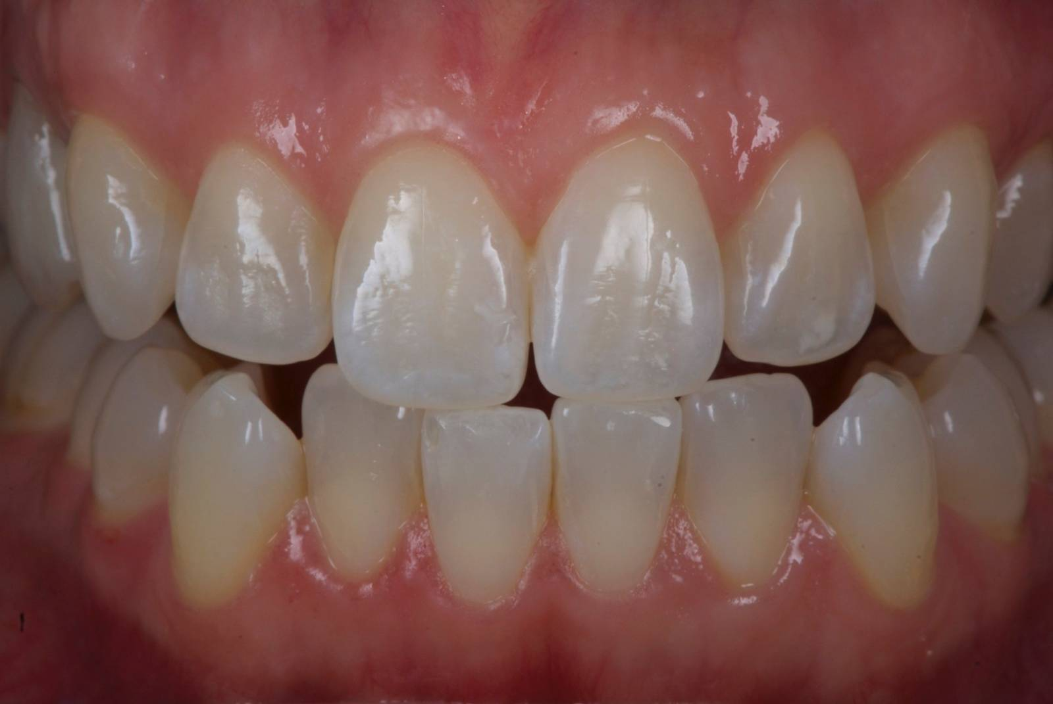







DSD - Database Elements

Slide 7
Morpho psychology - Visagism
Sensible
Dynamic
Strong
Calm
Melancholic
Sanguine
Choleric
Phlegmatic
Oval
Triangular
Rectangular
Square
Organized
Perfectionist
Artistic
Abstractive
Timid
Reserved
Extroverted
Communicative
enthusiastic
Dynamic
Impulsive
Determined
Objective
Explosive
Intense
entrepreneur
Passionate
Diplomatic
Pacific
Mystic
spiritualized
Conformist
Discreet

Slide 8
Morpho psychology - Visagism
Oval
Triangular
Rectangular
Square
Dominant Centrals
Rounded cusps
Delicate laterals
Round Arch
Ascendant Smile Line
Converging Axis
Incline cusps
Dominant Centrals
Flat incisal edge
Aggressive Cusps
Vertical Axis
Lack of Dominance
Diverging Axis
Horizontal arrangement

