Slide 1

Actors
Software architect
Paradigmas y lenguajes
de programación iii
By: Portillo augusto
2019

Slide 2



Slide 3
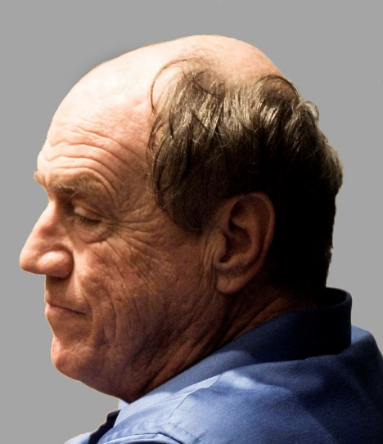
History
The actor model originated in 1973. It has been used both as a framework for a theoretical understanding of computation and as the theoretical basis for several practical implementations of concurrent systems. The relationship of the model to other work is discussed in Actor model and process calculi.
Its development was “motivated by the prospect of highly parallel computing machines consisting of dozens, hundreds, or even thousands of independent microprocessors, each with its own local memory and communications processor, communicating via a high-performance communications network.” Since that time, the advent of massive concurrency through multi-core and manycore computer architectures has revived interest in the actor model.

Slide 4
What is an Actor?
An actor is the primitive unit of computation. It’s the thing that receives a message and do some kind of computation based on it.

Slide 5

An Actor:
What time is it?
23:00 Hs
Is an Object with an identify
Has a behavior
Only interacts using asynchronous message passing.
Actors decides how they respond to the message, and if it should create a child actor to manage the request

Slide 6
What can actors do?
When an actor receives a message, it can do one of these 3 things:
Create more actors
Send messages to other actors
Designate what to do with the next message

Slide 7


Slide 8
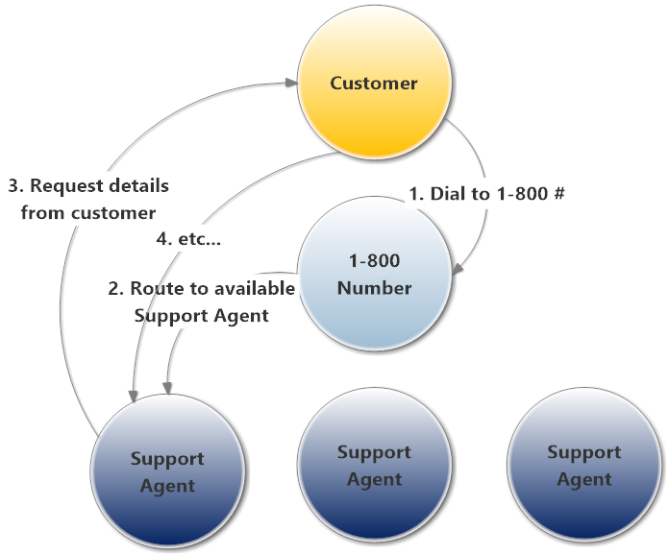

Slide 9
All Messages Sent to An ActorReference Are Placed In A “Mailbox” That Belongs to the Actor
When you send a message to an actor, the message doesn’t go directly into an actor’s OnReceive method.
The message is placed into a “mailbox” that is sorted in FIFO order, just like an regular Queue<T> data structure. The mailbox has a really simple job - accept and hang onto messages until the actor is ready to process them.
When the actor is ready to process a message, the mailbox will push the message into the actor’s OnReceive method and run the actor’s message-processing methods.

Slide 10
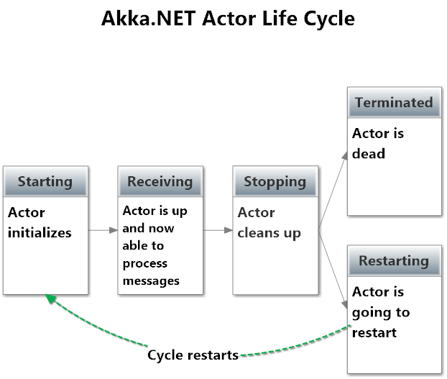
Actors Have A Well-defined Life Cycle
Notes:
Antes de que los actores puedan
Los actores se crean y comienzan, y luego pasan la mayor parte de sus vidas recibiendo mensajes. En el caso de que ya no necesite un actor, puede rescindir o "detener" a un actor. comenzar a procesar mensajes desde su buzón, deben ser instanciados por el sistema de actores y ejecutar su ciclo de vida.

Slide 11
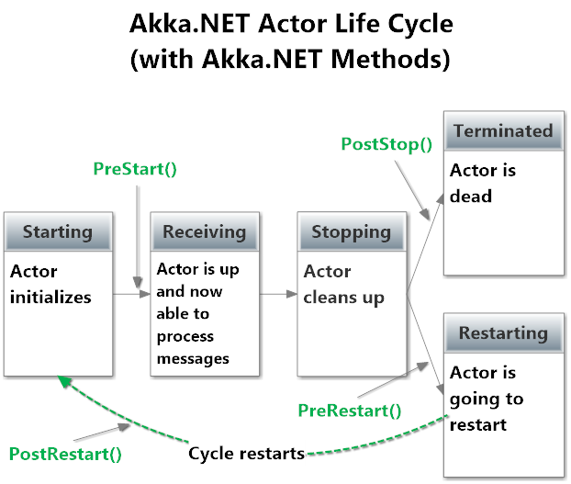
Notes:
PreStart- esta lógica se ejecuta antes de que el actor pueda comenzar a recibir mensaje.
PreRestart- si su actor falla accidentalmente (es decir, arroja un objeto sin control Exception), el padre del actor lo reiniciará.
PostStop- recibe una llamada una vez que el actor se ha detenido y ya no recibe mensajes.
PostRestart- recibe una llamada durante los reinicios después PreRestart pero antes PreStart. Este es un buen lugar para hacer cualquier informe adicional o diagnóstico sobre el error que causó el bloqueo del actor, más allá de lo que Akka.NET ya hace por usted.

Slide 12
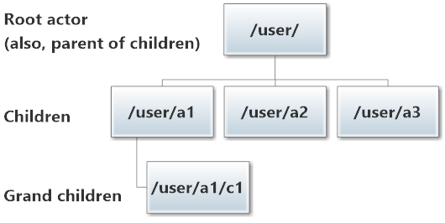
Every Actor Has A Parent, And Some Have Children

Slide 13
Parents Supervise Their Children
Every parent actor receives special “Help, I’m crashing!” messages from their children.
Parents can make one of the following three decisions:
Restart the failed actors, which the parents will do by default unless the child has failed repeatedly over a small period of time, like 60 seconds;
Stop the failed actors, which permanently terminates them; or
Escalate the supervision to the grand-parent actor.
When a Restart or Stop directive is issued, all children of the affected actor will themselves be restarted or killed too. In effect, you can reboot the entire part of the actor family tree that’s been failing all at once.
This is a really powerful concept for reliability and self-healing systems, which we’ll cover in more detail in the future.

Slide 14
Actors Are Cheap!!!
According to our benchmarks on the Akka.NET website, you can fit 2.5 million actors into a single Gigabyte of RAM. We’ve actually made some significant memory optimizations since then, so we can probably fit a lot more into memory now.
But the point is - actors are inexpensive and you can use a lot of them.

Slide 15

Actors Are Lazy
If there aren’t any messages to process, the actor doesn’t do any work. All of the other actors who actually have messages to process are the ones who’ll actually use threads and your server’s processing power.
This is one of the reasons actors are so cheap and thus, scale out well.

Slide 16
Actors as a mailboxes
It’s important to understand that, although multiple actors can run at the same time, an actor will process a given message sequentially. This means that if you send 3 messages to the same actor, it will just execute one at a time. To have these 3 messages being executed concurrently, you need to create 3 actors and send one message to each.
Messages are sent asynchronously to an actor, that needs to store them somewhere while it’s processing another message. The mailbox is the place where these messages are stored.
Notes:
Es importante entender que, aunque varios actores pueden correr al mismo tiempo, un actor procesará un mensaje dado secuencialmente.
Esto significa que si envía 3 mensajes al mismo actor, solo se ejecutará uno a la vez.
Para que estos 3 mensajes se ejecuten simultáneamente, debe crear 3 actores y enviar un mensaje a cada uno.
Los mensajes se envían de forma asíncrona a un actor, que necesita almacenarlos en algún lugar mientras procesa otro mensaje.
El buzón es el lugar donde se almacenan estos mensajes.

Slide 17
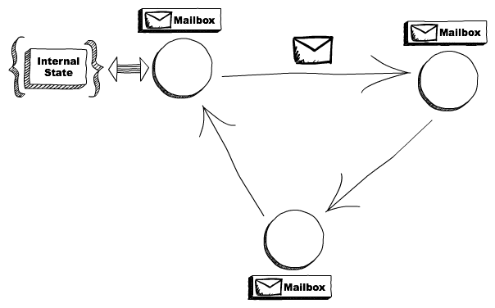
Notes:
Los actores se comunican entre sí mediante el envío de mensajes asincrónicos. Esos mensajes se almacenan en los buzones de otros actores hasta que se procesan.

Slide 18
Distribution
Another interesting aspect of the actor model is that it doesn’t matter if the actor that I’m sending a message to is running locally or in another node.
Think about it, if an actor is just this unit of code with a mailbox and an internal state, and it just respond to messages, who cares in which machine it’s actually running? As long as we can make the message get there we are fine. This allows us to create systems that leverage multiple computers and helps us to recover if one of them fail.
Notes:
Otro aspecto interesante del modelo de actor es que no importa si el actor al que le envío un mensaje se ejecuta localmente o en otro nodo.
Piénselo, si un actor es solo esta unidad de código con un buzón y un estado interno, y solo responde a los mensajes, ¿a quién le importa en qué máquina se está ejecutando realmente? Mientras podamos hacer llegar el mensaje , estamos bien. Esto nos permite crear sistemas que aprovechan múltiples computadoras y nos ayuda a recuperarnos si uno de ellos falla.

Slide 19
Why use Actor Model
Consider the challenges faced in building a concurrent distributed system
When you communicate within multiple components, how to make them fault tolerant
When a component failed to execute a command in a different thread, how to communicate it back to the main thread
Managing locks when multiple threads accesses a shared resource within a component
Actor implementation of Akka solves these challenges without us worrying about managing all the code ourselves.

Slide 20
Applications
The Actor model can be used as a framework for modeling, understanding, and reasoning about a wide range of concurrent systems. For example:
Electronic mail (e-mail) can be modeled as an Actor system. Accounts are modeled as Actors and email addresses as Actor addresses.
Web Services can be modeled with SOAP endpoints modeled as Actor addresses.
Notes:
Las cuentas se modelan como actores y las direcciones de correo electrónico como direcciones de actores.
Los servicios web se pueden modelar con puntos finales SOAP modelados como direcciones de actor.

Slide 21
Bibliography
https://www.brianstorti.com/the-actor-model/
https://en.wikipedia.org/wiki/Actor_model#Fundamental_concepts
https://rubikscode.net/2017/05/28/actor-model-and-using-of-akka-net/
https://dotnetcorecentral.com/blog/akka-in-net-core-part-1-creating-an-akka-actor/
https://petabridge.com/blog/akkadotnet-what-is-an-actor/
https://www.youtube.com/watch?v=1_dkLcY-kbs

