Slide 1
Pricing Exotic Interest Rate Derivatives

Slide 2
Team
Mentor: James Stephens
Parth Mahajan
Harshil Zaveri
Jesse Cheng

Slide 3
Types of Interest Rate Models
Interest rate models
Vanilla Models
Term Structure Models
Short Rate Models
Market Models
One Factor Model
Multi Factor Models

Slide 4
Vanilla Models
Used when underlying can be priced with the distribution of 1 or more variables (joined by copulae) at a specific time
Most applicable for vanilla payoffs like Cap/Floors or swaptions
Term Structure Models
Models the evolution of a specified rate, such as Zero-coupon bond prices as a stochastic model
Useful for pricing more complicated interest rate derivatives that depend on future rates at a prior time.

Slide 5
Short Rate Models
These models assume that the entire term structure of interest rates can be derived from the evolution of a single short rate.
Fundamental quantity is the instantaneous spot rate r(t). _{β}
LIBOR Market Models
Directly models the market quantities needed. For example, all of the LIBOR fixings in an exotic swap
Fundamental quantity is the term forward rates F(t, T_{i-1}, T_{i})
T₁ to T
L(T_{i}, T_{i+6})

Slide 6
One Factor Models
Only one driving diffusion process models the short rate
Only capable of simulating parallel shifts in the yield curve
Zero-coupon curve implied from this at any two points will have a correlation of 1
Ex Ho-Lee, Vasicek model
Two Factor Models
Two driving diffusion processes models the short rate
Can be used to simulate yield curves of varying shape
Observed correlation between two stochastic processes is close to -1
Ex : G2++ Model

Slide 7

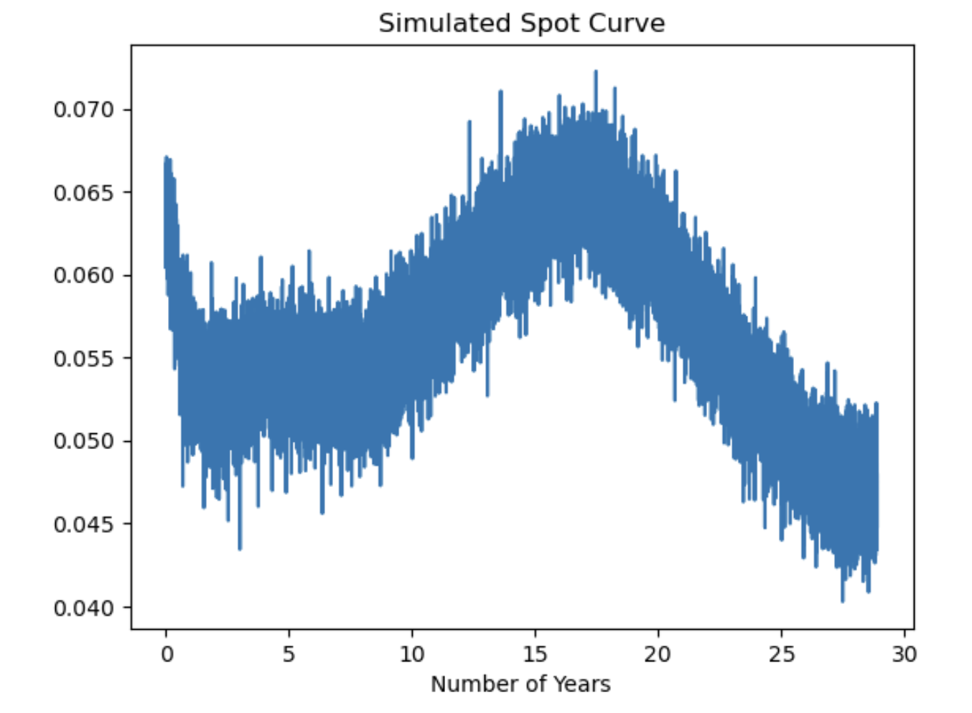
One factor models
Models the instantaneous spot rate
Yield curve is modelled using the spot rate at time t
This curve implied from this at any two points will have a correlation of 1
Ex Ho-Lee, Vasicek model
Notes:
Since the short rate represents at each instant the initial point of the yield curve, one-factor short-rate models assume the evolution of the whole yield curve to be completely determined by the evolution of its initial point. This is clearly a dangerous assumption, especially when pricing products depending on the correlation between different rates of the yield curve at a certain time.
The equation is linear and can be solved explicitly, the distribution of the short rate is Gaussian, and both the expressions and the distributions of several useful quantities related to the interest-rate world are easily obtainable.
Since the short rate represents at each instant the initial point XX Preface of the yield curve, one-factor short-rate models assume the evolution of the whole yield curve to be completely determined by the evolution of its initial point. This is clearly a dangerous assumption, especially when pricing products depending on the correlation between different rates of the yield curve at a certain time

Slide 8

Exogenous Models

Slide 9

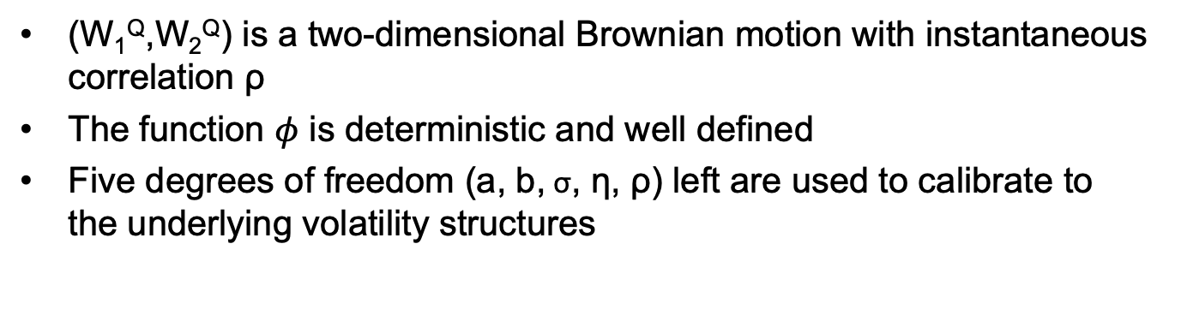

G2++ Model
$$r\left(t\right)=x\left(t\right)+y\left(t\right)+φ\left(t\right)$$
$$dx(t)=−ax\left(t\right)dt+\text{σ}dW1\left(t\right), x\left(0\right)=0$$
$$dy(t)=−by\left(t\right)dt+\text{η}dW2\left(t\right), y\left(0\right)=0$$
(W₁^{Q},W₂^{Q}) is a two-dimensional Brownian motion with instantaneous correlation ρ
The function $φ$ is deterministic and well defined
Five degrees of freedom (a, b, $\text{σ}$, $\text{η}$, ρ) left are used to calibrate to the underlying volatility structures

Slide 10
Exogenous v/s Endogenous
Exogenous models take the initial yield curve as an input to the model by using a time varying coefficient
Remaining degree of freedoms are used to calibrate to underlying volatility structures

Slide 12
Exotic Interest Rate Derivatives
Swaptions
Range Accruals
Ratchets

Slide 13
Pricing Methodology
Import market data
Interpolate to make a term structure
Make a gaussian short rate model to sample required rates
Run a Monte Carlo simulation to find out the expected payoff

Slide 14
Explore Various Derivative Types and Models
Advantages of Analytically Tractable Models
Methodologies for Pricing Exotic Derivatives

Slide 15
Contract Specifications
The underlyings are L(Ti, T_{i+6}) which belongs to the filtration T_{i}.
The exercise date is T.
The cash flows are from $T_1$ to $T_\beta$.

Slide 16
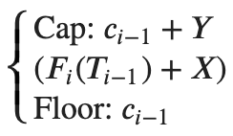
Floating Coupon Structure
Notes:
`

Slide 17
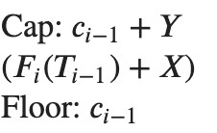

Receives
Pays

Slide 18
Vasicek
Extended Vasicek
One factor Gaussian Short Rate

Slide 19
Ratchet floaters deliver a return that increases gradually from one period to the next.
Coupon payments never drop below the level of the preceding coupon payment.
Useful for issuers who expect implied forward rates to increase over time.
Beneficial when actual rates are expected to stay above the floor level.

Slide 20

Results
Coupon Payments
Floor set at the preceding coupon payment
Cap equal to the preceding coupon plus some incremental
Typically pegged to LIBOR (3/6-month). For example, a ratchet floater may be structured so that it is linked to 6-month LIBOR, while its floor is readjusted on resetting dates with a 20 basis points as incremental margin.

