Slide 1
Local PCA (LPCA) Filtering of Diffusion Weighted MRI Data
Andreas Badea
Implementation of
Manjón JV, Coupé P, Concha L, Buades A, Collins DL, Robles M (2013) Diffusion Weighted Image Denoising Using Overcomplete Local PCA. PLoS ONE 8(9): e73021. doi:10.1371/journal.pone.0073021

Slide 2
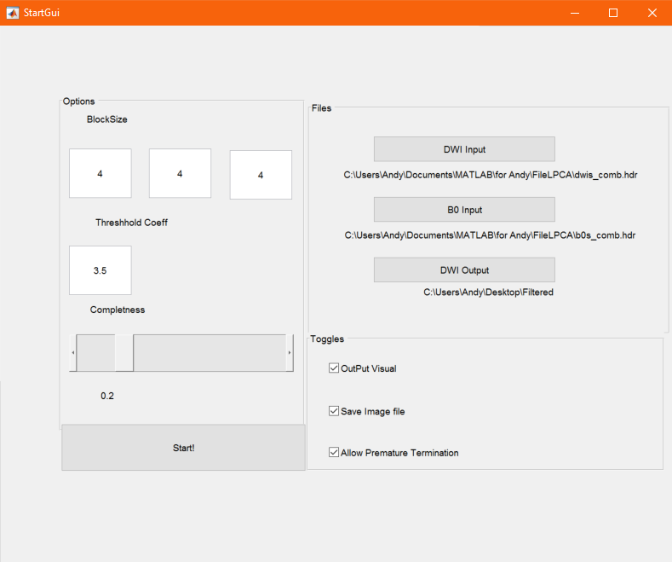
StartGui
Editable Block Size used as the proccesing block
An Editable Coefficient that determines the minimum eigenvalue required to be retained in the filtered image. The threshold is set by taking the Standard deviation of the difference between the B0s and the DWI data and dividing by the coefficient provided as input
Completeness can be changed, a completeness of 1 results in maximal redundancy, while a completeness approaching 0 results in no redundancy with each voxel only processed once. Completeness linearly correlates with run time. Any completeness level over 40% is not very useful as results afterwards see little improvement.
Some Toggles are present to allow or disallow premature termination, (which if done correctly preserves data) write to a .hdr file rather than a simple .mat, or output a visual in the MatLab interface
There also exists a file selection interface to read from and write to ANALYZE and nifti formats.

Slide 3
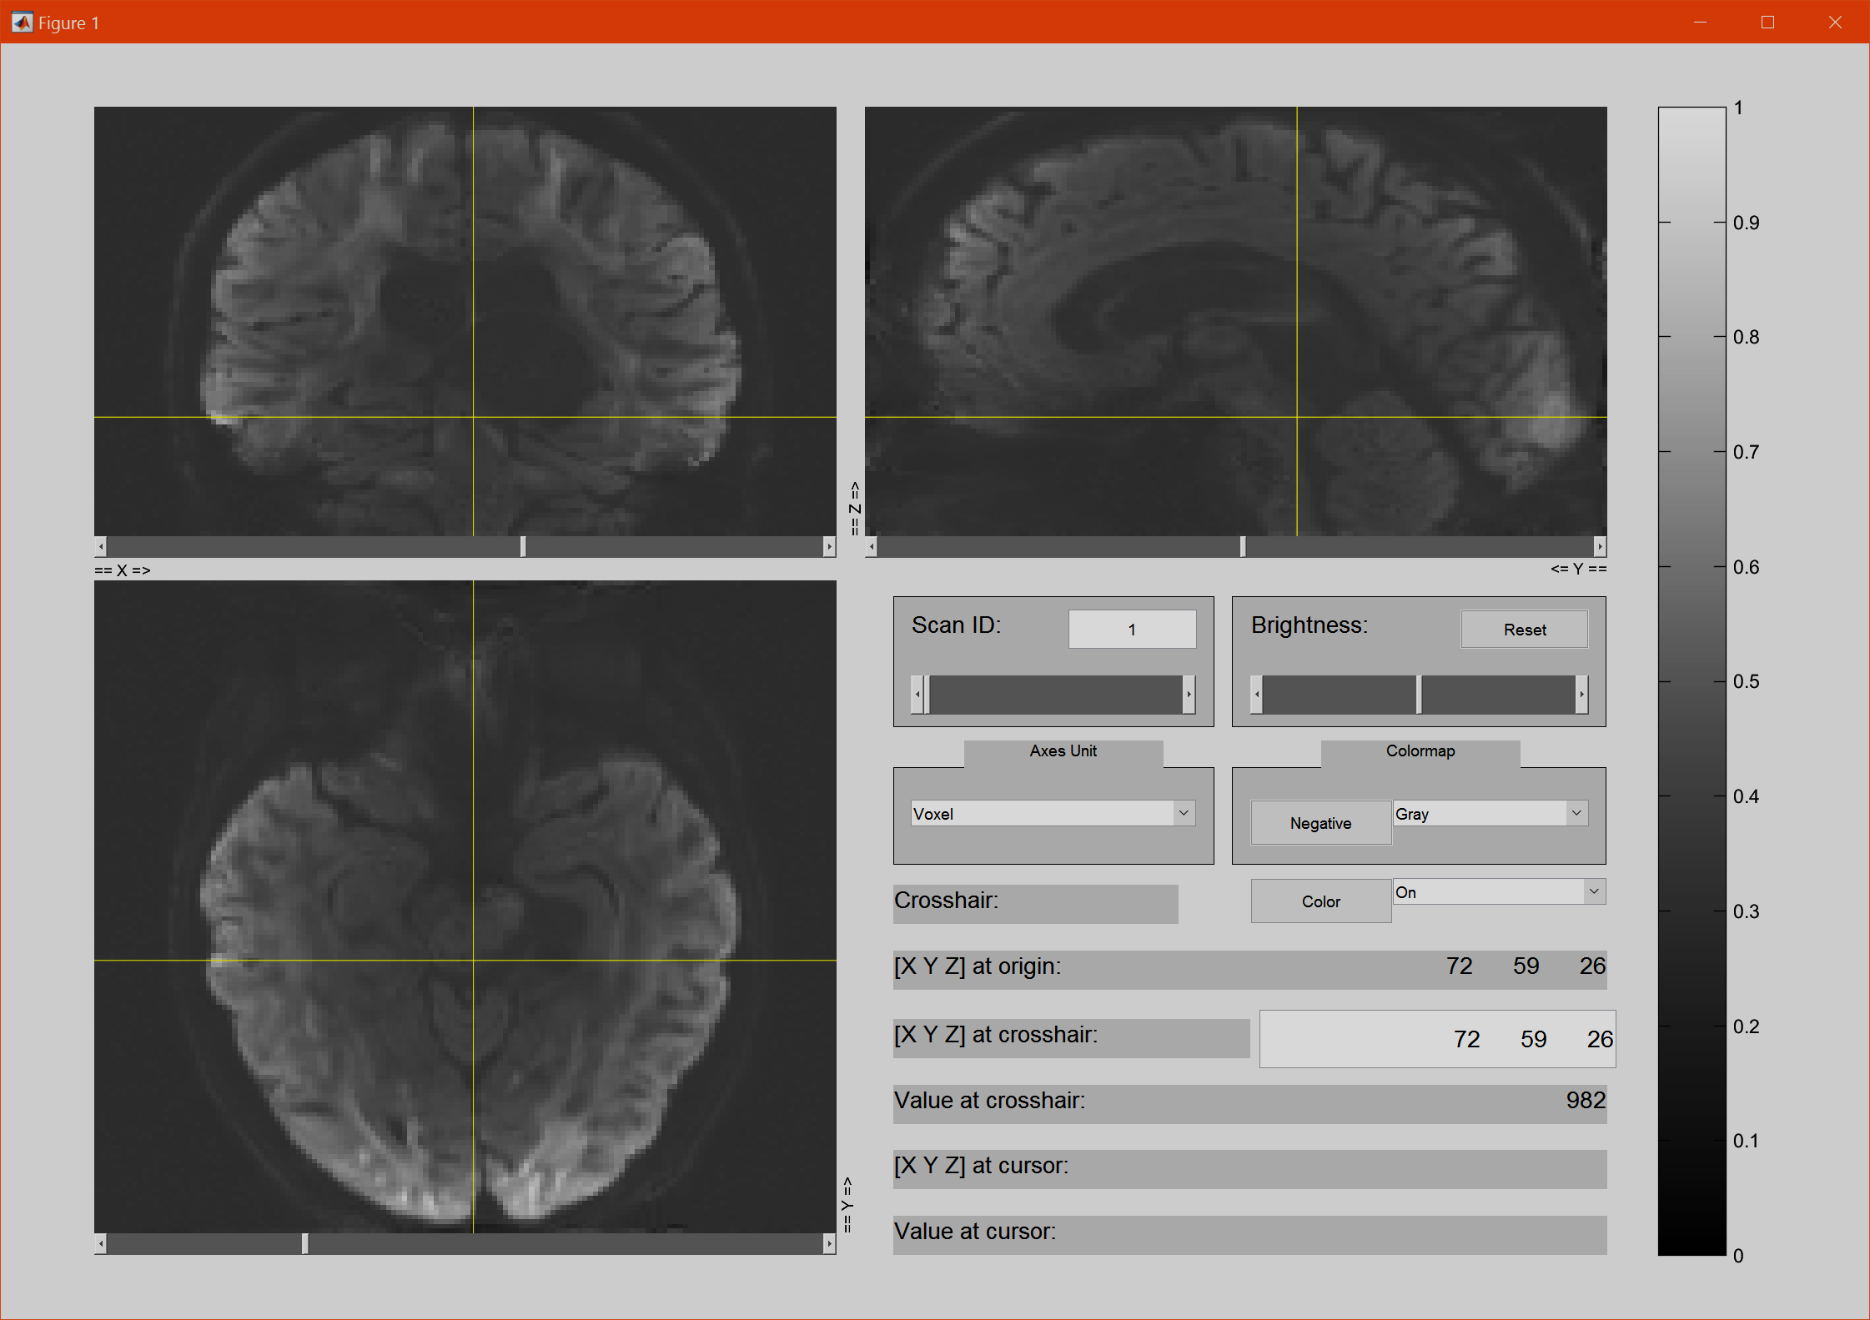
GUI for Displaying Results
Visual for Displaying results within MatLab environment view_ni()i from Jimmy Shen’s Tools for NIfTI and ANALYZE image on File Exchange
https://www.mathworks.com/matlabcentral/fileexchange/8797-tools-for-nifti-and-analyze-image

Slide 4
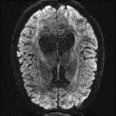
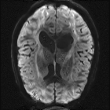
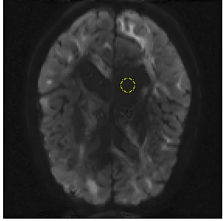
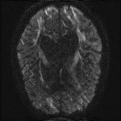
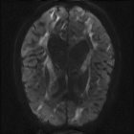
Results
Unfiltered DWI | Filtered 20% Completeness
77% Reduction of coefficient of variance in with a roi ventricles
Clear Reduction in Noise
ROI

Slide 5
LPCA Denoising
In each step the image is broken up into many non-overlapping blocks of the Image, the noise reduction occurs locally within the blocks
For each level of redundancy (determined by the Completeness) the image is again broken up into another set of non-overlapping blocks with an offset origin.
After processing the blocks are stitched back to their original images and averaged with their redundant counterparts
Using multiple non overlapping blocks gives us a greater control of redundancy as well as lessened memory demands as opposed to a overlapping block scheme

Slide 6
LPCA Denoising Cont.
Each individual 4D Block is rearranged into a 2D matrix where each Voxel appears as one row with all its corresponding DWI directional values occupying that row.
This data is then normalized to a mean of Zero (by subtracting the mean) and a standard deviation of 1 (by dividing by the Std)
Then we take the Eigen Vectors and Values of the covariance matrix, which is equivalent to finding+ the Principle Components

Slide 7
LPCA Denoising
In Parallel The Matching B0 chunk is subtracted from the current block to produce a rough approximation of the noise present in the image; the noise variance is estimated by taking the variance of this difference
Eigenvectors are kept or rejected based on their corresponding Eigen values as opposed to only deeming the first n as significant components, we instead use an adaptive threshold equal to the local noise variance multiplied by the input threshold coefficient (see GUI)
We then reconstruct the image using only the significant Eigenvectors

Slide 8
LPCA Denoising
After reconstructing the blocks we de-normalize the data by adding back the mean and multiplying back the by original STDev
Each block is assigned and multiplied by a weight proportional to the number of eigenvalues higher than the threshold used in that block; this is so that the ones with the most significant data are preserved more.
The blocks are then summed and averaged according to their weights

