Slide 1
AI Portfolio Board - Overview: Why?
Portfolio ID: # VP&C AI Use Cases | Use Case: Agent Marketplace | Ask of the AI Board: Approval to deploy into Production
Problem statement
Benefit
Data needs
VP&C builds AI agents in several places at once: Copilot Studio, supplier platforms, Looker, Vodafone services on GCP.
Nobody can see the full set, so nobody can say what is running, who owns it, what data it reaches or what it costs.
Teams duplicate work that already exists, and good agents built by one team reach only that team.
Pilots have no defined route to becoming supported production services.
One front door: discover every VP&C agent, try it, and request access, in one place.
A live register of what is running and who owns it, which is the control this Board has been asking for.
Duplicate builds caught at intake, by searching the task rather than the product name.
A published monthly score (impact 40, adoption 30, satisfaction 20, community 10) that promotes one pilot to production.
Agent catalogue, taxonomy and classifications.
Submissions, access requests, notifications.
Votes and feedback (pseudonymised).
Activity and audit records.
Users and application role mappings.
Vodafone employee work email, name and role. No customer and no supplier personal data.
What bounds this assessment
The marketplace is a catalogue and a front door, not a runtime. Agents keep running on their own platforms under their own approvals. No supplier record, contract, purchase order, invoice, price or spend figure is read, stored or transmitted on any path, and SAP, Ariba and Datasphere are not integrated. This is an architectural property, not a policy promise.
Classification: Confidential Encryption: CMEK Owner: Procurement AI Operations Environments: lab / non-live / live Pattern: Reusable AIB architecture
Notes:
Ask: approval to deploy into production. The key point for the Board is the exclusion: the sensitive procurement data that makes neighbouring use cases high risk is architecturally out of scope here. This use case is also itself a governance instrument: it is the register of the rest of the portfolio.

Slide 2
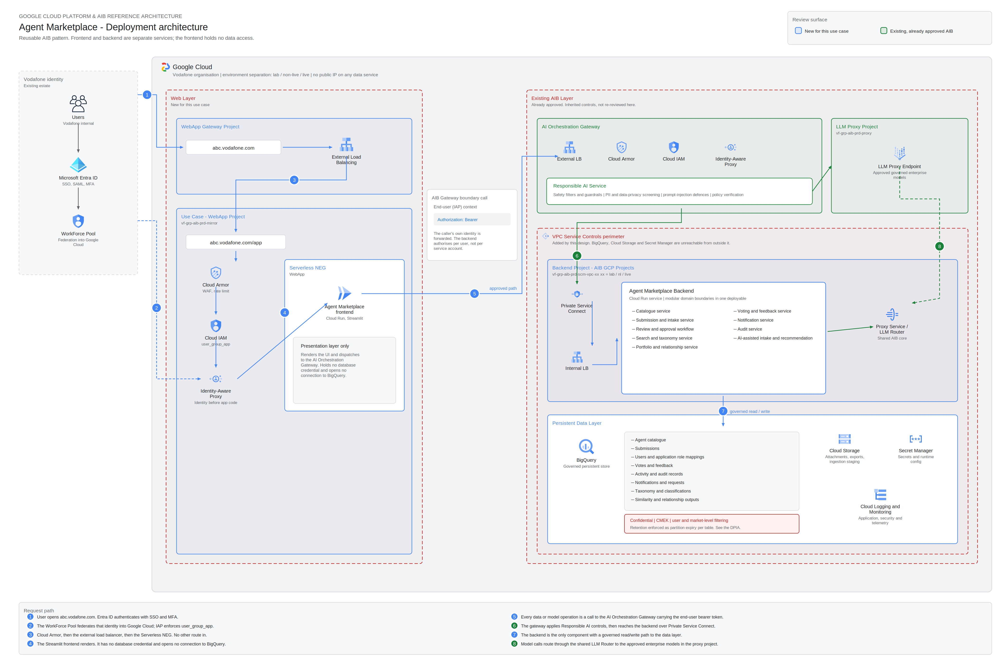
AI Portfolio Board - Overview: How?
Portfolio ID: # VP&C AI Use Cases | Use Case: Agent Marketplace | Ask of the AI Board: Approval to deploy into Production
Block architecture
Two tiers. The Streamlit frontend renders only; it holds no database credential and has no data path.
Every operation crosses the existing AI Orchestration Gateway carrying the end user's own bearer token, so authorisation is per person.
The backend is the only component with a governed read and write path to BigQuery.
Model access is brokered through the shared LLM Router to approved enterprise models. No direct endpoint, no model credential held by this app.
Responsible AI screening, prompt-injection defence and PII screening are inherited from the approved AIB layer.
New for this use case: the web tier, the backend service, the data model, and a VPC Service Controls perimeter around both.
Full pack: HLD, DPIA, security control matrix, API contract, BigQuery DDL and five diagrams.
Notes:
The review surface is the blue components. The green ones are existing approved AIB infrastructure whose controls we inherit rather than rebuild. The security control matrix sets that out control by control.

