Slide 1
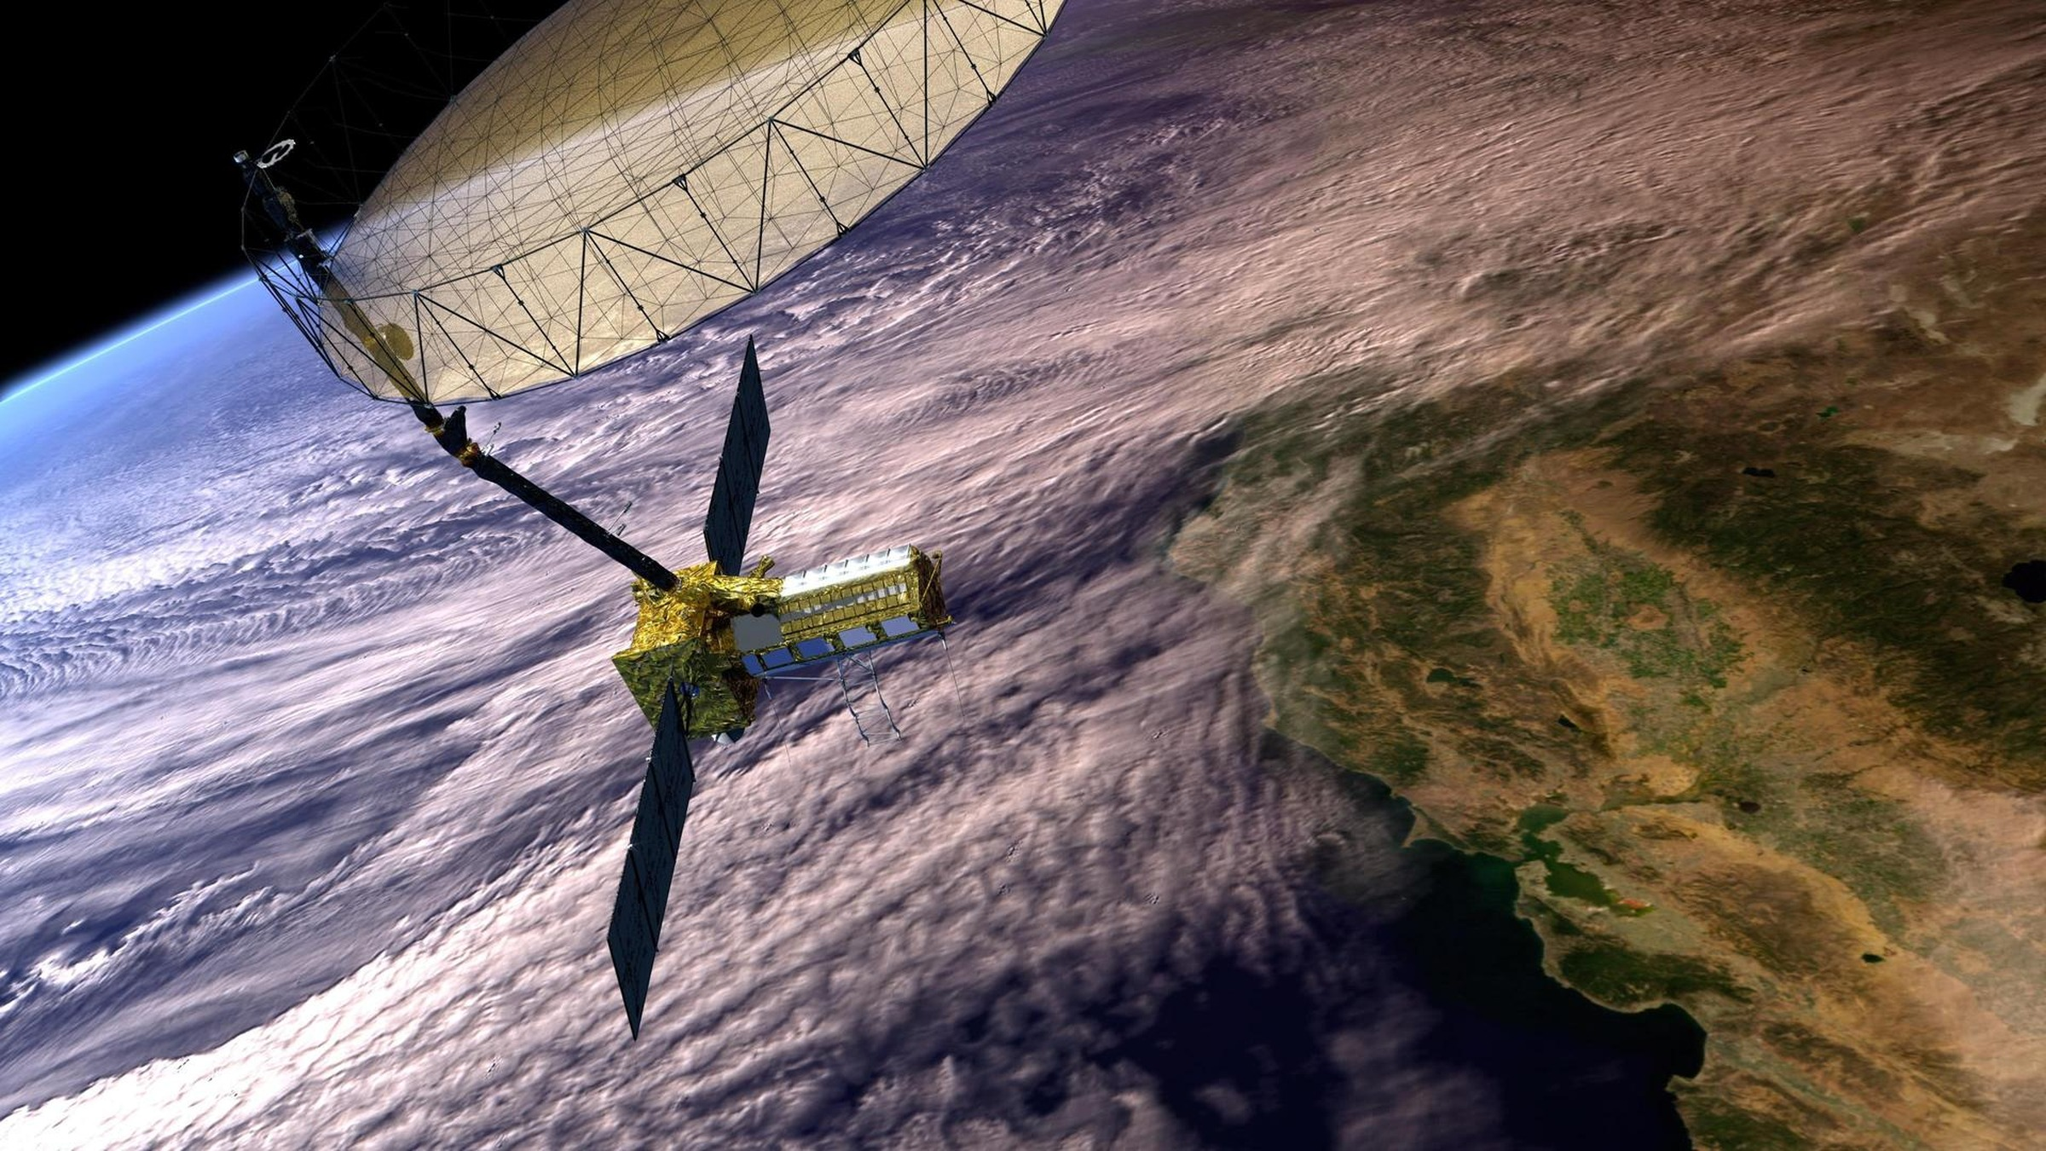
UNIVERSITY OF TEHRAN
Faculty of Electrical & Computer Engineering · M.Sc. Control Engineering
Fault-Tolerant Attitude Control of Nanosatellites Using Reinforcement Learning
From spacecraft attitude-control fundamentals to the research gap
Pouria Zarei
Supervisor: Prof. Mohammad Javad Yazdanpanah
Seminar I · 2026
Image: NASA/JPL-Caltech, NISAR in Earth orbit (artist’s concept), image PIA26285.
Fault-Tolerant Attitude Control of Nanosatellites Using RL · Seminar I
1 / 15
Notes:
0:00 Good morning. I am Pouria Zarei, M.Sc. control engineering. Today: why attitude control of a nanosatellite is hard, what my thesis proposes, three recent papers, and where the gap is. (~30 s)

Slide 2
ROADMAP
From the engineering problem to the research question
01
02
03
04
05
The problem
The proposal
Related research
Gaps & new ideas
Conclusion
What a spacecraft must control, and why it fails
A learned controller that is allowed to fail safely
Three recent directions of the state of the art
What is still missing, and what this thesis adds
Why the direction is worth pursuing
Ten minutes, five questions — one argument.
Fault-Tolerant Attitude Control of Nanosatellites Using RL · Seminar I
2 / 15
Notes:
0:30 The talk follows five questions: the physical problem, the proposal, three papers, the gap, and the conclusion. (~20 s)

Slide 3
01 · THE PROBLEM
Attitude control: a loop that never stops
Point
hold the payload axis on its target — nadir, a star, a ground station.
Sensors
gyro · ST · sun · mag
Estimation
attitude & rate
Controller
control law
Actuators
3 RW + 3 MTQ
Spacecraft
rigid-body dynamics
Rotate
slew between targets inside torque and rate limits.
sensor faults
actuator faults
disturbances
Reject
state feedback
gravity gradient, drag, solar pressure, residual magnetic dipole.
ADCS estimates the attitude and acts on it — continuously, onboard, with limited power and computing.
Faults enter the loop in two places: the measurements and the torque. A fault-tolerant ADCS has to survive both.
Sources: NASA, State-of-the-Art of Small Spacecraft Technology — Guidance, Navigation and Control (2026); NASA SSRI Knowledge Base, Attitude Determination and Control.
Fault-Tolerant Attitude Control of Nanosatellites Using RL · Seminar I
3 / 15
Notes:
1:00 Three jobs: point, rotate, reject disturbances. The ADCS closes the loop. Faults enter at two places - measurements and torque. That picture is the thesis. (~60 s)

Slide 4
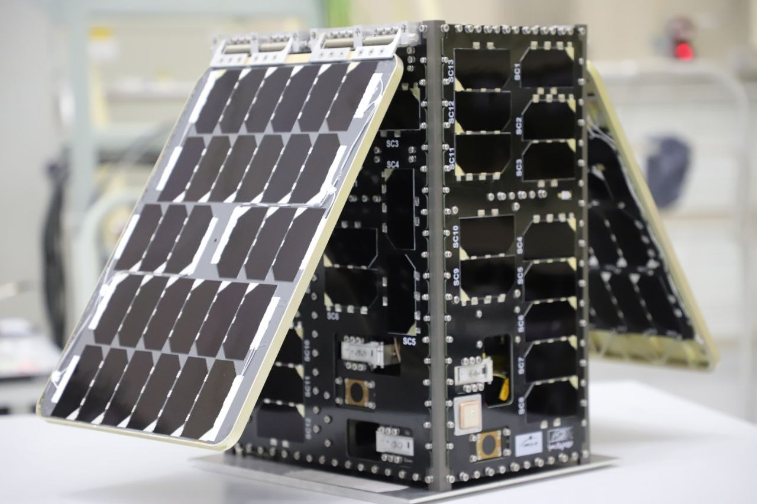
01 · THE PROBLEM
Why fault tolerance is the hard part
Nanosatellites cannot be repaired, and they fly on commercial off-the-shelf parts.
1–12 kg
Mass and volume budgets shrink actuators, computing and redundancy.
COTS
Commercial parts cut cost, but widen uncertainty and failure rates.
No servicing
A fault in orbit must be survived by software, not by a repair crew.
FAULT MODEL
τ_{applied} = h · τ_{cmd,} h ∈ [0, 1]
continuous loss of authority — 20 %, 50 % or total — not a binary switch
24U CubeSat (KOSAR1.5) — the class this thesis targets.
Wheel friction · torque loss · encoder fault · wheel lock · sensor bias · dropout
Image: NASA/JPL-Caltech, RainCube 6U CubeSat, image PIA22457.
Fault-Tolerant Attitude Control of Nanosatellites Using RL · Seminar I
4 / 15
Notes:
1:55 Three reasons why fault tolerance is the hard part: tiny mass and power budgets, commercial parts, and no servicing. The fault is continuous - h between 0 and 1 - which is the model used here. (~55 s)

Slide 5
01 · THE PROBLEM → 02 · THE PROPOSAL
Can reinforcement learning deliver adaptive, fault-tolerant attitude control for a nanosatellite — and still keep pointing accurate when the system is not the one it trained on?
Unseen faults
Safety guarantees
Onboard feasibility
Verifiable behaviour
A controller is only useful if it survives the fault it did not expect.
Fault-Tolerant Attitude Control of Nanosatellites Using RL · Seminar I
5 / 15
Notes:
2:50 This is the question. Not 'can RL control a satellite' - that is established. The question is whether it stays accurate when the system is not the one it trained on. (~45 s)

Slide 6
02 · THE PROPOSAL
A learned controller that is allowed to fail safely
Objective. Drive a nanosatellite from a random attitude and rate to nadir pointing — fast and precisely — and keep that performance when a reaction wheel degrades, locks, or fails in a way the policy never saw.
Sensors & estimator
attitude, rate and health estimate
RL policy πθ(s)
desired body torque
1
Learn
Safety governor
physics-based check
rejects unsafe actions, hands over to LQR
PPO / SAC on a nonlinear plant with random inertia, disturbances and noise.
2
Never assume health
Fault-tolerant allocator
redistributes the torque
redistributes torque over healthy wheels + MTQs
The policy sees the estimate ĥ — never the true health h.
3
Fail safely
3 RW + 3 MTQ
actuation
A physics-based governor plus an LQR fallback — never a second network.
Fault-Tolerant Attitude Control of Nanosatellites Using RL · Seminar I
6 / 15
Notes:
3:35 The proposal in one architecture. The policy outputs a desired torque, never actuator commands. A physics-based governor can veto it and hand over to LQR. An allocator maps torque onto wheels and magnetorquers, so a dead wheel becomes a redistribution problem. (~60 s)

Slide 7
02 · THE PROPOSAL
Validated in four stages — and tested on faults it never saw
MIL
Fault-aware
training
SIL / compression
HIL
model-in-the-loop
simulation
random inertia, noise,
degraded wheels
quantise, prune,
measure latency
ESP32-S3 + real
sensors and actuators
Scenario
In training
Held out
WHAT IS MEASURED
Healthy spacecraft
trained
tested
settling time to nadir lock
pointing error and success rate
control effort and wheel saturation
inference latency and memory on the target MCU
Wheel at 50 % torque
trained
tested
Wheel dead / locked
—
key test
Unseen severity & combinations
—
key test
The claim is not “RL beats LQR”. The claim is graceful degradation where classical control has none.
Fault-Tolerant Attitude Control of Nanosatellites Using RL · Seminar I
Fault-Tolerant Attitude Control of Nanosatellites Using RL · Seminar I
7 / 15
7 / 15
Notes:
4:35 Four stages: simulation, fault-aware training, compression for the target processor, then hardware-in-the-loop. The evaluation is deliberately split: faults seen in training versus held out. The dead-wheel row is the one that matters. (~55 s)

Slide 8
03 · RELATED RESEARCH
Three papers, three complementary answers
PAPER 1
PAPER 2
PAPER 3
Yang, Jin & Rao
Lu et al.
Nagano & Schaub
Journal of the Franklin Institute, 2025
Aerospace Science and Technology, 2026
AAS 25-637, 2025
RL adapts online when the spacecraft model is unknown and actuators fail.
Safe RL keeps agile tracking inside operational constraints and actuator faults.
Fault-aware training keeps mission scheduling resilient after wheel failures.
Adaptation
Safety
Resilience
Common question: how can a learned controller remain useful when the real spacecraft does not behave as modelled?
Papers: Yang, Jin & Rao, J. Franklin Inst. 362 (2025); Lu et al., Aerosp. Sci. Technol. 168 (2026); Nagano & Schaub, AAS 25-637 (2025).
Fault-Tolerant Attitude Control of Nanosatellites Using RL · Seminar I
Fault-Tolerant Attitude Control of Nanosatellites Using RL · Seminar I
8 / 15
8 / 15
Notes:
5:30 Three papers, each answering a different part: adaptation, safety, resilience. (~30 s)

Slide 9
03 · RELATED RESEARCH | PAPER 1 OF 3
Reinforcement Learning Based Attitude Fault-Tolerant Control of Spacecraft with Unknown System Model
PROBLEM
Classical fault-tolerant control needs an accurate model and known actuator behaviour — which real nanosatellites do not provide.
WHAT IT LEAVES OPEN
fault severities never seen in training
sensor faults, not only actuator faults
safety of the learned action itself
cost of running the adaptation onboard
METHOD
Offline: RL with optimal control gives a nominal policy.
Online: a neural observer estimates the unknown dynamics and input gain.
Recursive least squares updates the critic; a feed-forward term compensates additive faults.
RELEVANCE TO THIS THESIS
Closest to this thesis in problem statement — and furthest from its deployment claim.
The policy adapts online to actuator faults without a known system model.
Yang, S., Jin, L. & Rao, J. (2025). Journal of the Franklin Institute, 362, 107741. doi:10.1016/j.jfranklin.2025.107741
Fault-Tolerant Attitude Control of Nanosatellites Using RL · Seminar I
9 / 15
Notes:
6:00 Paper one. Offline RL plus an online neural observer and RLS, so the policy adapts when the model is unknown. Strong on adaptation, but the fault set is the simulated one, and nothing is said about a flight processor. (~50 s)

Slide 10
03 · RELATED RESEARCH | PAPER 2 OF 3
Safe Reinforcement Learning Based Agile Satellite Attitude Control for Non-Cooperative Target Tracking with Operation Constraints and Actuator Faults
PROBLEM
Agile tracking must respect forbidden pointing zones, rate and torque limits — while an actuator is losing effectiveness.
WHAT IT LEAVES OPEN
computational weight for an embedded target
verification of the safety claim
faults outside the training distribution
migration from workstation to flight hardware
METHOD
Fault identification estimates effectiveness loss and additive fault.
The task is written as a constrained Markov decision process.
A worst-case soft actor-critic solves it, with faults inside the constraint set.
RELEVANCE TO THIS THESIS
Shows that performance without constraints is not a result — constraints belong in the design.
Fault tolerance, operational constraints and safety in one learned controller.
Lu, W. et al. (2026). Aerospace Science and Technology, 168, 111238. doi:10.1016/j.ast.2025.111238
Fault-Tolerant Attitude Control of Nanosatellites Using RL · Seminar I
10 / 15
Notes:
6:50 Paper two moves from 'can RL control it' to 'can it obey constraints while doing so'. Constrained MDP, worst-case SAC, with fault identification. This is the safety argument I borrow. (~50 s)

Slide 11
03 · RELATED RESEARCH | PAPER 3 OF 3
Enhancing Fault Resilience in RL-Based Satellite Autonomous Task Scheduling
PROBLEM
At mission level, wheel faults cut agility: reduced manoeuvres, safe-mode transitions and missed imaging targets.
WHAT IT LEAVES OPEN
it is a scheduler, not an attitude controller
no continuous-control stability argument
simulation-only evidence
METHOD
Fault-injected training: policies are trained inside a faulty environment.
Fault information is added to the observation vector.
Recurrent networks use temporal history to infer fault signatures.
RELEVANCE TO THIS THESIS
Directly motivates this thesis’s train/test split: nominal vs fault-aware training, then unseen faults.
Resilience must be designed into training — not added after it.
Nagano, Y. & Schaub, H. (2025). AAS 25-637, Enhancing Fault Resilience in RL-Based Satellite Autonomous Task Scheduling.
Fault-Tolerant Attitude Control of Nanosatellites Using RL · Seminar I
11 / 15
Notes:
7:40 Paper three is not an attitude controller - it schedules imaging tasks. But its message is the one I adopt: resilience must be inside the training. That gives the train/test split of my evaluation. (~45 s)

Slide 12
04 · GAPS & NEW IDEAS
From fault-tolerant RL to trustworthy fault-tolerant RL
01
Unseen faults
Disjoint train / test fault distributions: severity, timing, combinations.
Most results are evaluated on the fault set used for training.
02
Unverified actions
Physics-based governor: vet the action, otherwise hand over to LQR.
A neural policy can leave the region where it was validated.
03
Detection and control are separate
Health estimate ĥ inside the observation — no access to the true h.
Health estimation and the control law are designed apart.
04
Deployment is assumed
Latency budget, quantisation, and HIL on an MCU.
A policy that runs on a GPU is not a flight controller.
Fault-Tolerant Attitude Control of Nanosatellites Using RL · Seminar I
Fault-Tolerant Attitude Control of Nanosatellites Using RL · Seminar I
12 / 15
12 / 15
Notes:
8:25 Four gaps. First, unseen faults are usually not tested. Second, a learned action is not verified. Third, detection and control are designed apart. Fourth, deployment is assumed rather than measured. Each gap maps to one concrete decision in my method. (~55 s)

Slide 13
05 · CONCLUSION
What I take away — and what I intend to prove
1. ADCS is mission-critical
2. Complexity follows the mission
The spacecraft must know and control its orientation, continuously.
Not every satellite needs the most advanced controller.
3. Faults are the design driver
4. RL adds adaptability — and questions
On a nanosatellite, survival is a software property.
Generalisation, safety, unseen faults, embedded cost.
THE GOAL
Not to replace a classical controller with a network — but to find out whether learning can make attitude control more adaptive and fault-tolerant without giving up safety, reliability and deployability.
Fault-Tolerant Attitude Control of Nanosatellites Using RL · Seminar I
Fault-Tolerant Attitude Control of Nanosatellites Using RL · Seminar I
13 / 15
13 / 15
Notes:
9:20 Four takeaways: the loop is mission-critical; complexity follows the mission; faults drive the design; RL adds adaptability and new questions. The goal is not to replace LQR - it is to find out whether learning can be made trustworthy enough to fly. (~40 s)

Slide 14

SEMINAR I
Thank you for your attention
Questions and discussion
Pouria Zarei
M.Sc. Control Engineering · University of Tehran
Supervisor: Prof. Mohammad Javad Yazdanpanah
Pouria.zarei@ut.ac.ir
Image: NASA/JPL-Caltech, NISAR in Earth orbit (artist’s concept), image PIA26285.
Fault-Tolerant Attitude Control of Nanosatellites Using RL · Seminar I
14 / 15
Notes:
10:00 Thank you - happy to take questions. Be ready for: why not MPC? what about the estimator? how do you guarantee safety?

Slide 15
APPENDIX
References
[1]
Yang, S., Jin, L. & Rao, J. (2025). Reinforcement learning based attitude fault-tolerant control of spacecraft with unknown system model. Journal of the Franklin Institute, 362, 107741. doi:10.1016/j.jfranklin.2025.107741
[2]
Lu, W., Zhuang, H., Geng, Z., Shen, Q., Mu, Z., Wu, S., Razoumny, V. Y. & Razoumny, Y. N. (2026). Safe reinforcement learning based agile satellite attitude control for non-cooperative target tracking with operation constraints and actuator faults. Aerospace Science and Technology, 168, 111238. doi:10.1016/j.ast.2025.111238
[3]
Nagano, Y. & Schaub, H. (2025). Enhancing fault resilience in RL-based satellite autonomous task scheduling. AAS 25-637.
[4]
NASA Small Spacecraft Systems Virtual Institute (2026). State-of-the-Art of Small Spacecraft Technology — Guidance, Navigation, and Control.
[5]
NASA SSRI Knowledge Base. Attitude Determination and Control — Small Satellite Systems Engineering.
[6]
Pouria Zarei (2026). M.Sc. thesis proposal: Fault-Tolerant Attitude Control of Nanosatellites Using Reinforcement Learning — From Simulation to Hardware-in-the-Loop Implementation. University of Tehran.
IMAGE CREDITS
All spacecraft imagery: NASA / JPL-Caltech, public domain (PIA26285, PIA22457).
Fault-Tolerant Attitude Control of Nanosatellites Using RL · Seminar I
Fault-Tolerant Attitude Control of Nanosatellites Using RL · Seminar I
15 / 15
15 / 15
Notes:
Backup slide - references and image credits, in case of questions.

