Slide 1


Measures of Central tendency and comparing means
Jaein Lee, Ph.D. Candidate
Department of Sociology
University of Maryland, College Park

Slide 2
General info about the position
Visiting Assistant Professor of Sociology
Residential private liberal arts college
1-hour teaching presentation is scheduled on March 2nd
Research method, statistics and application of data analysis
Department Chair: Dr. Craig Dennis Lair (UMD SOCY alumnus)
Search Chair: Dr. Cassie Hays
Plan to hire a VAP who can teach
Research method, Statistics
Medical Sociology
Other entry level courses

Slide 3
Welcome!

Slide 4
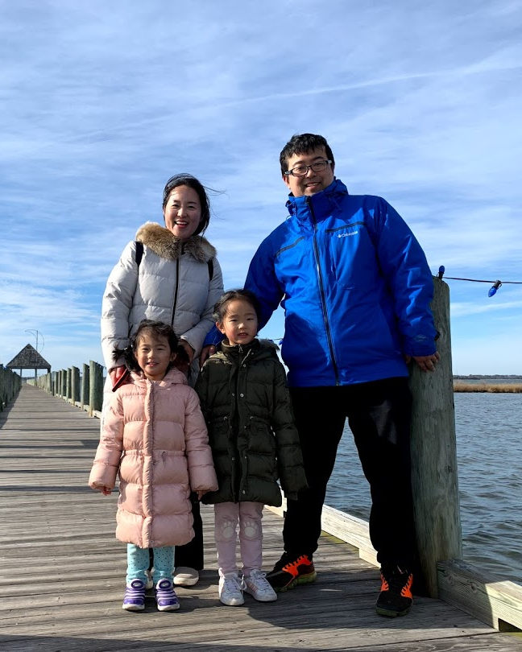
Jaein Lee (Jay)
Ph.D. Candidate, Sociology
E-mail : jlee1246@umd.edu
Taught various courses including
Research Methods
Statistics
Contemporary Social Problems
Theories of Sociology
Data analysis using SPSS, STATA
Ready to teach
Sociology of Family
Medical Sociology
Social Stratification
Sociology of Deviance
Introduction to Sociology

Slide 5
Learning goals
Central tendency
Classify appropriate level of measurement
Explore appropriate measure of central tendency
Find the representative value
Compare means
Check the differences of means in two, or more groups
Check if the groups have statistically significantly different means

Slide 6
Central tendency

Slide 7
What is central tendency?

