Slide 1
Approach & Analysis

Slide 2
Problem Statement
An education company named X wants to improve its lead conversion from the current 30% to around 80% by identifying the most potential leads.
The company wants to build a model wherein one need to assign a lead score to each of the leads such that the customers with a higher lead score have a higher conversion chance.

Slide 3
Analysis Approach
Import the data and inspect the data frame
EDA & Data Prep/Analysis
Prepare the Data (e.g. handling nulls etc.)
Dummy variable creation
Visualization
Correlation
Dummy Variables & Feature scaling
Model Building (RFE Rsquared VIF and pvalues)
Model Evaluation
Making predictions on test set

Slide 4
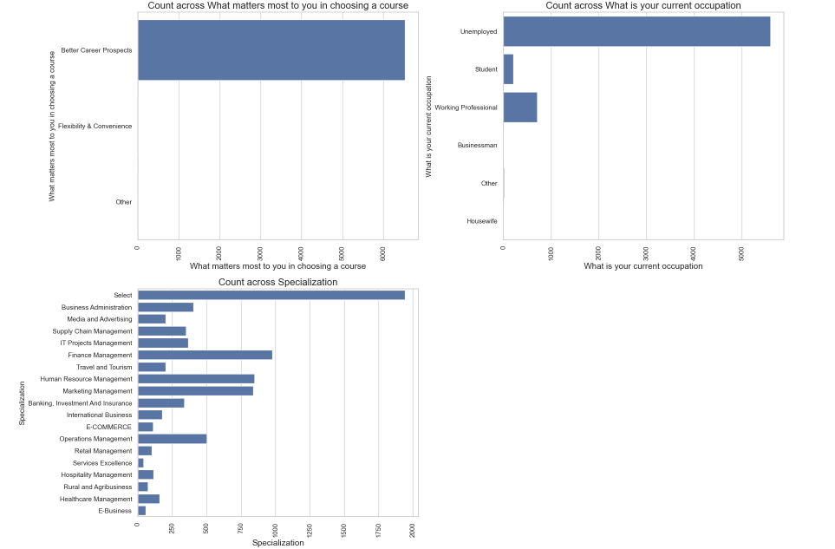
Visualization outcomes - 1
As it can be seen that the levels of "Lead Profile" and "How did you hear about X Education" have a lot of rows which have the value Select which is of no use to the analysis
So it's best that we drop them.

Slide 5
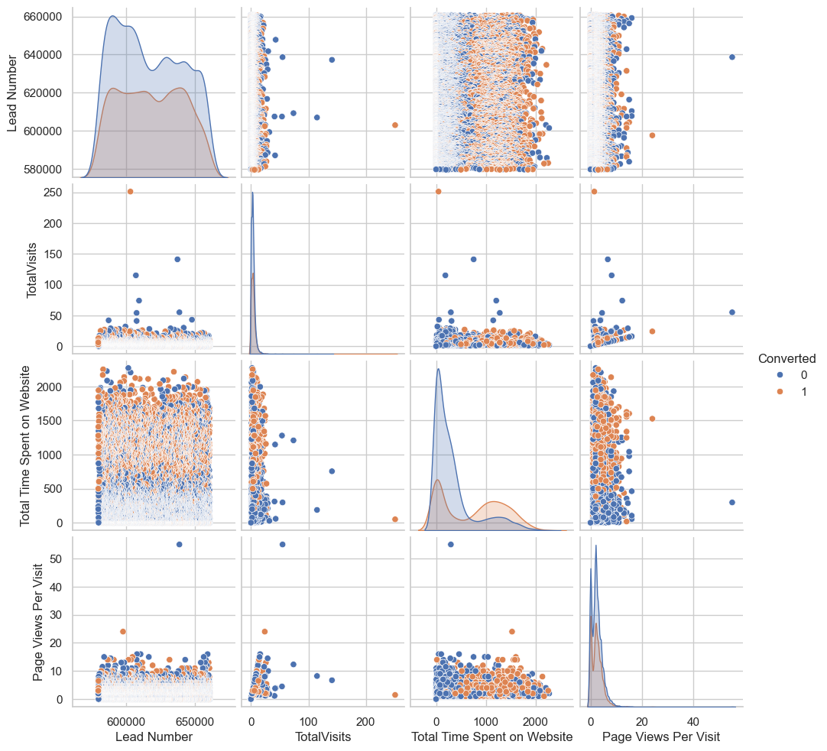
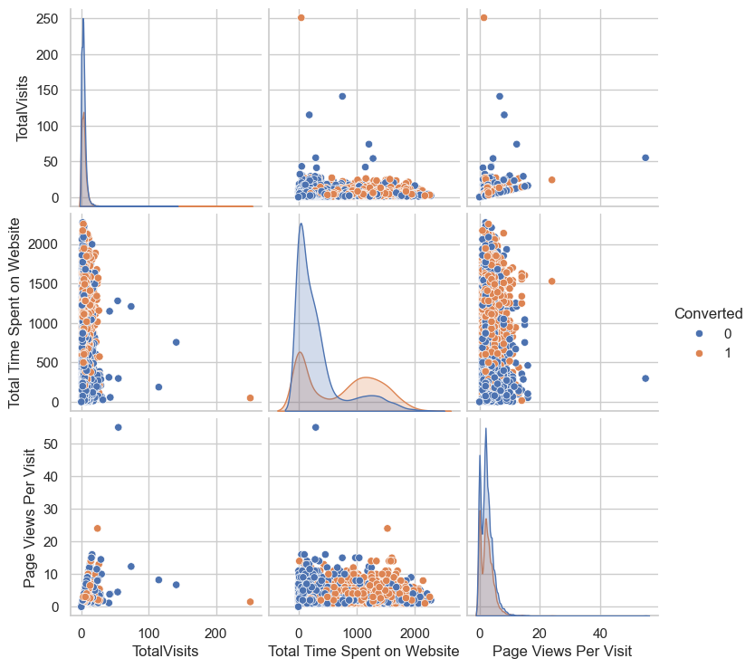
Visualization outcomes - 2
Columns that can be dropped: 'Do Not Call', 'Search', 'Magazine', 'Newspaper Article', 'X Education Forums', 'Newspaper’, 'Digital Advertisement', 'Through Recommendations', 'Receive More Updates About Our Courses', 'Update me on Supply Chain Content', 'Get updates on DM Content', 'I agree to pay the amount through cheque'

Slide 6
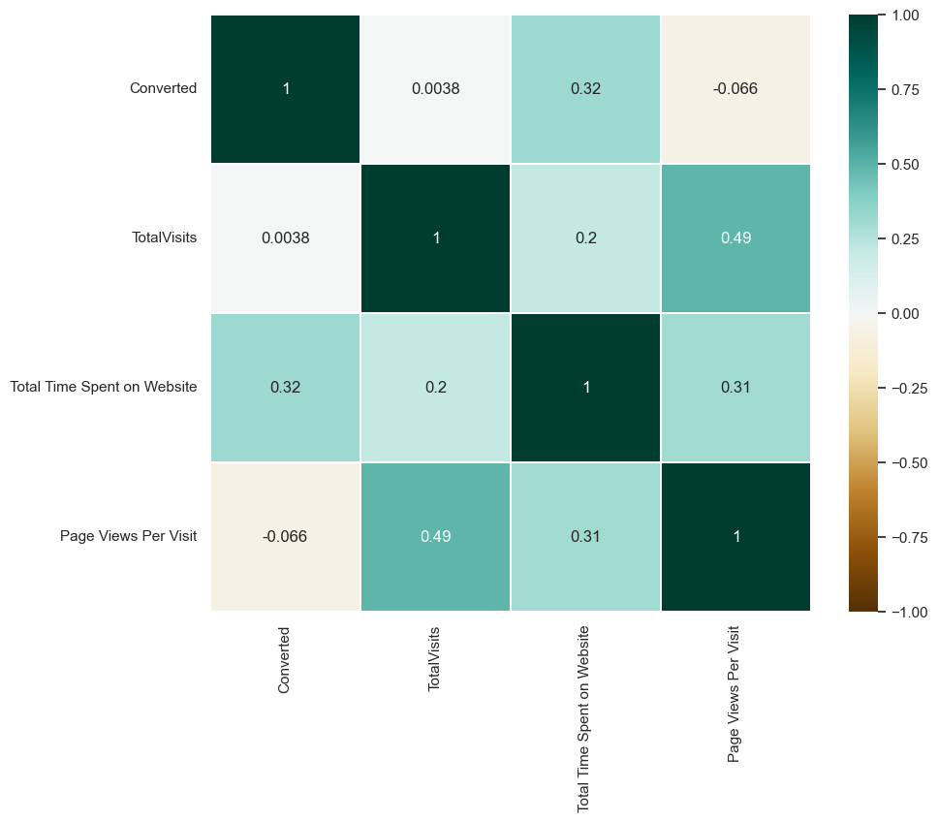
Correlation (Quants)
Eventhough the Total Visits and Page Views per visit are showing a relationship, they are not that big. Besides, each tell a different story. Hence continue to include both in the modeling.

Slide 7
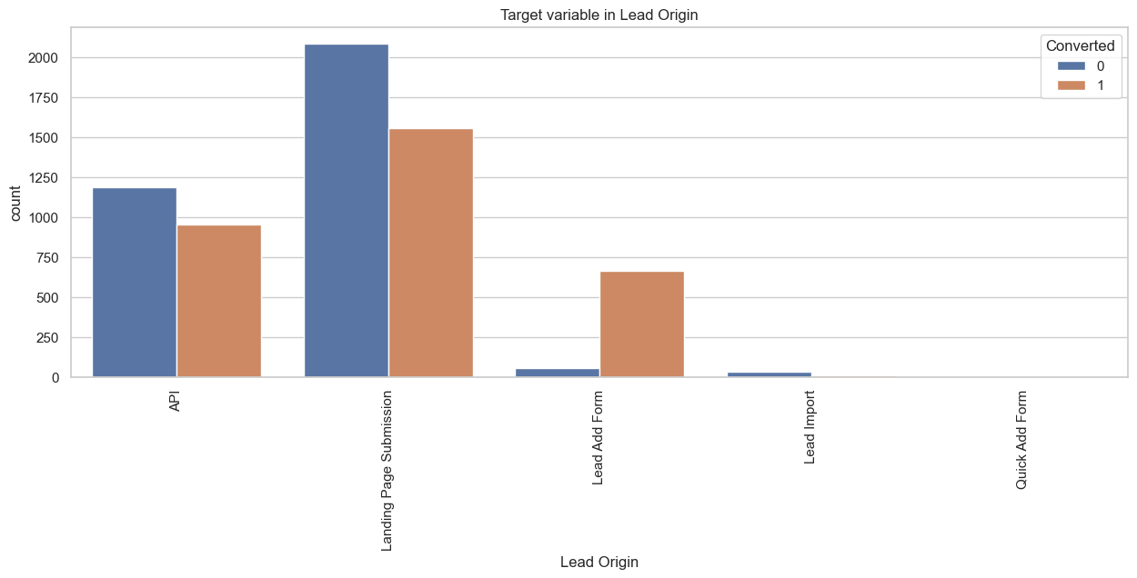
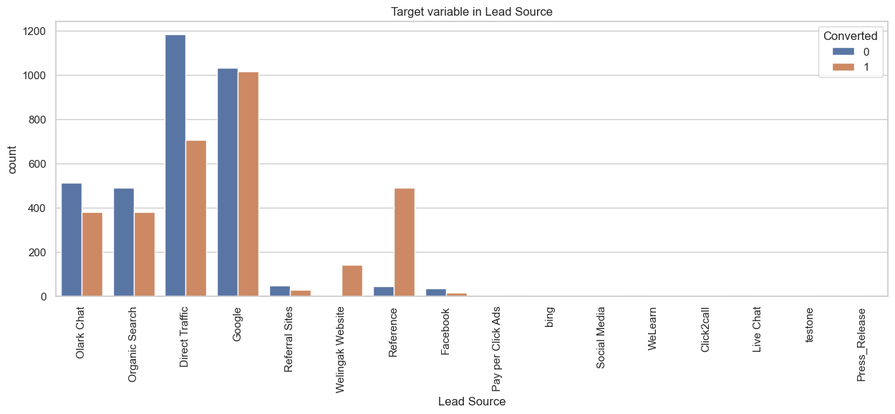
Categorical Features Visualization
High conversion leads are high on landing page submission.
Leads through google and direct traffic has higher probability to convert.
There are multiple other graphs, which can be seen in the jupyter notebook.

Slide 8
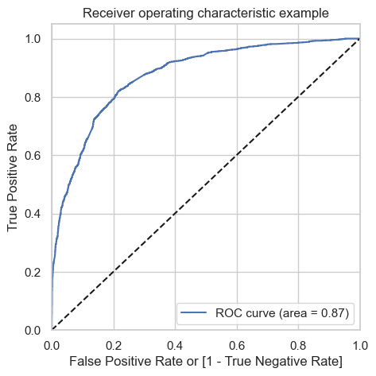
ROC Curve
ROC Curve is decent
Probability & Recall is also decent.

Slide 9
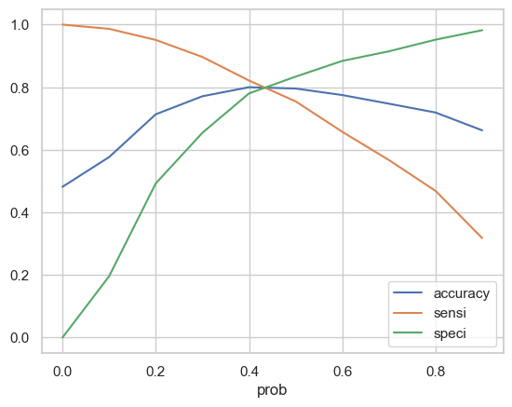
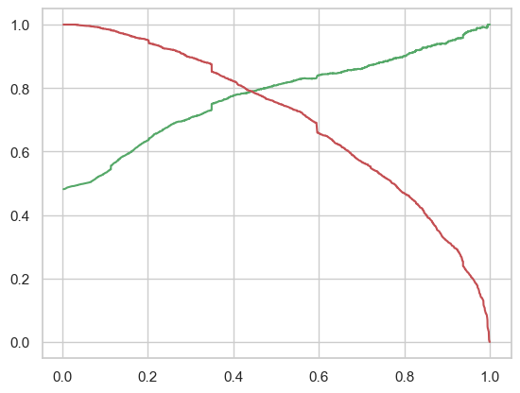
Cut Off
Around 0.42-0.44, you get the optimal values of the three metrics.

Slide 10
Results in business terms
ROC details are:
ROC = 0.86
Accuracy = 78%
Precision = 77%
Recall = 77%
Some of the top 3 variables are
Total Visits
Total Time Spent on Website
Lead Source
Some of the top 3 categorical/dummy variables
Lead Source
Lead Origin
Last Activity

