Slide 1
Python for everyone
DNDS5027
Márton Pósfai
1. Introduction

Slide 2
This course
Learn to program with Python.
How? Practice.
Outcomes
Solve simple problems with coding.
Be ready to take more advanced courses.
(Be able to use AI for coding.)

Slide 3
Useful information
How we learn
First few classes: slides + exercises on a website
Then: we code together + exercises
Practice outside of class
Grading
1/2: Home work
1/2: Test
Office hours
At request
In person: Wednesdays, Zoom: anytime

Slide 4
AI policy
No.

Slide 5
AI policy
No.
Programming is a skill that you learn by doing.
Generating code and reading it can give you the illusion that you can code.
Using AI to translate German doesn’t mean you speak German.
If you know how to code → easier to use AI.
Take responsibility of your work.
OK uses
Search information (find a new tool/library)
Debugging: help correct your own code
Do not generate code for the class.

Slide 6
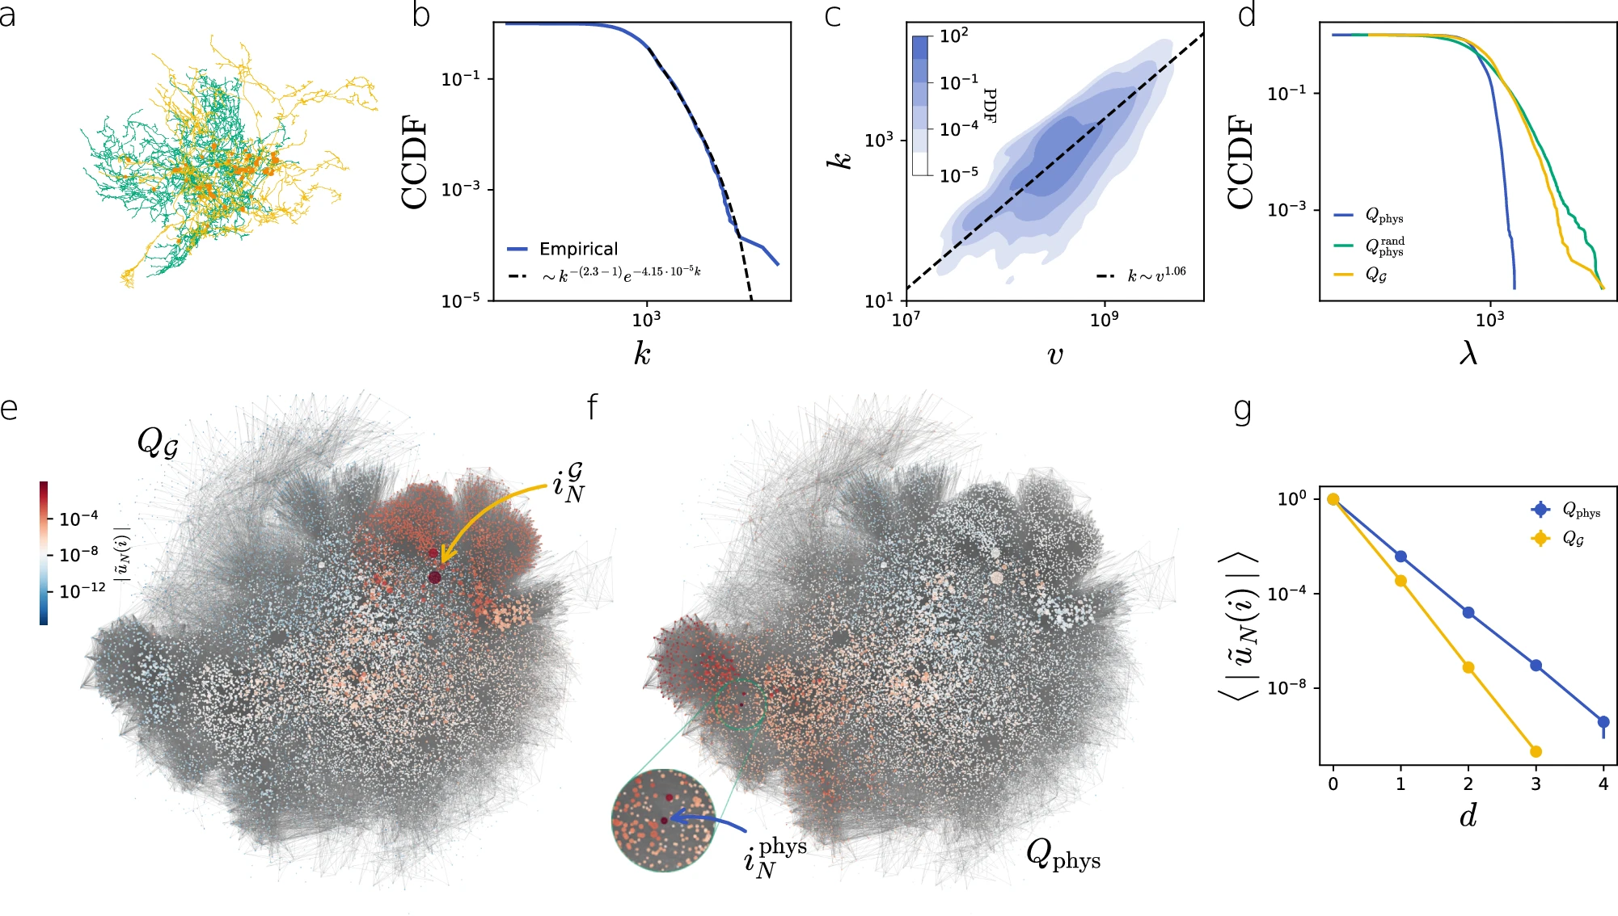
Why code?
Personal example 1: work

Slide 7


Why code?
Personal example 2: Moving photo albums
Alaska State Fair, 2011 August
Marci és egy kapitális tök.

Slide 8

Why code?
Personal example 2: Moving photo albums
Alaska State Fair, 2011 August
Marci és egy kapitális tök.

Slide 9
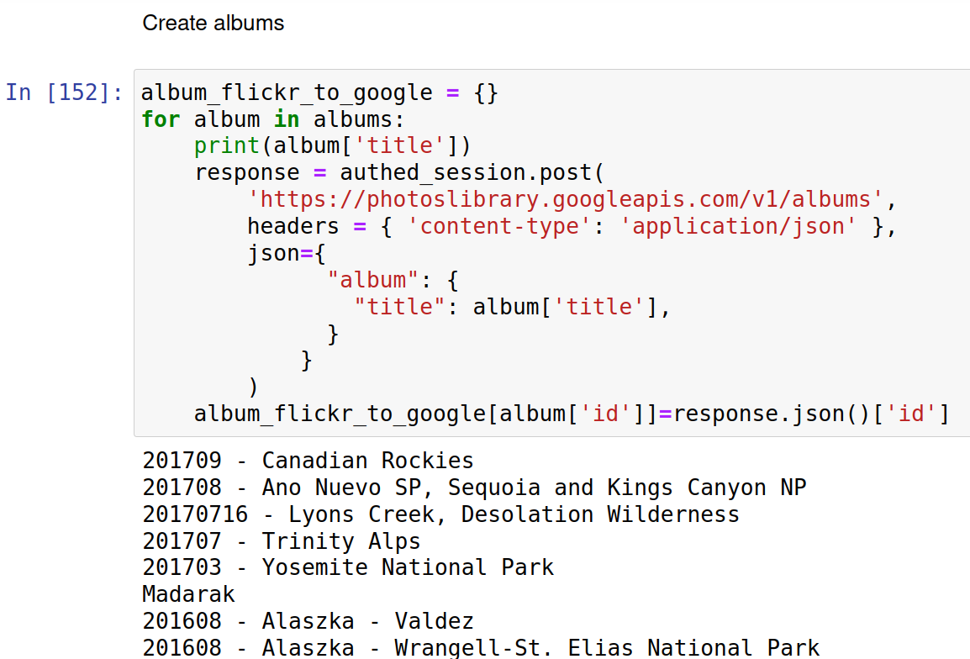
Why code?
Personal example 2: Moving photo albums
Alaska State Fair, 2011 August
Marci és egy kapitális tök.

Slide 10
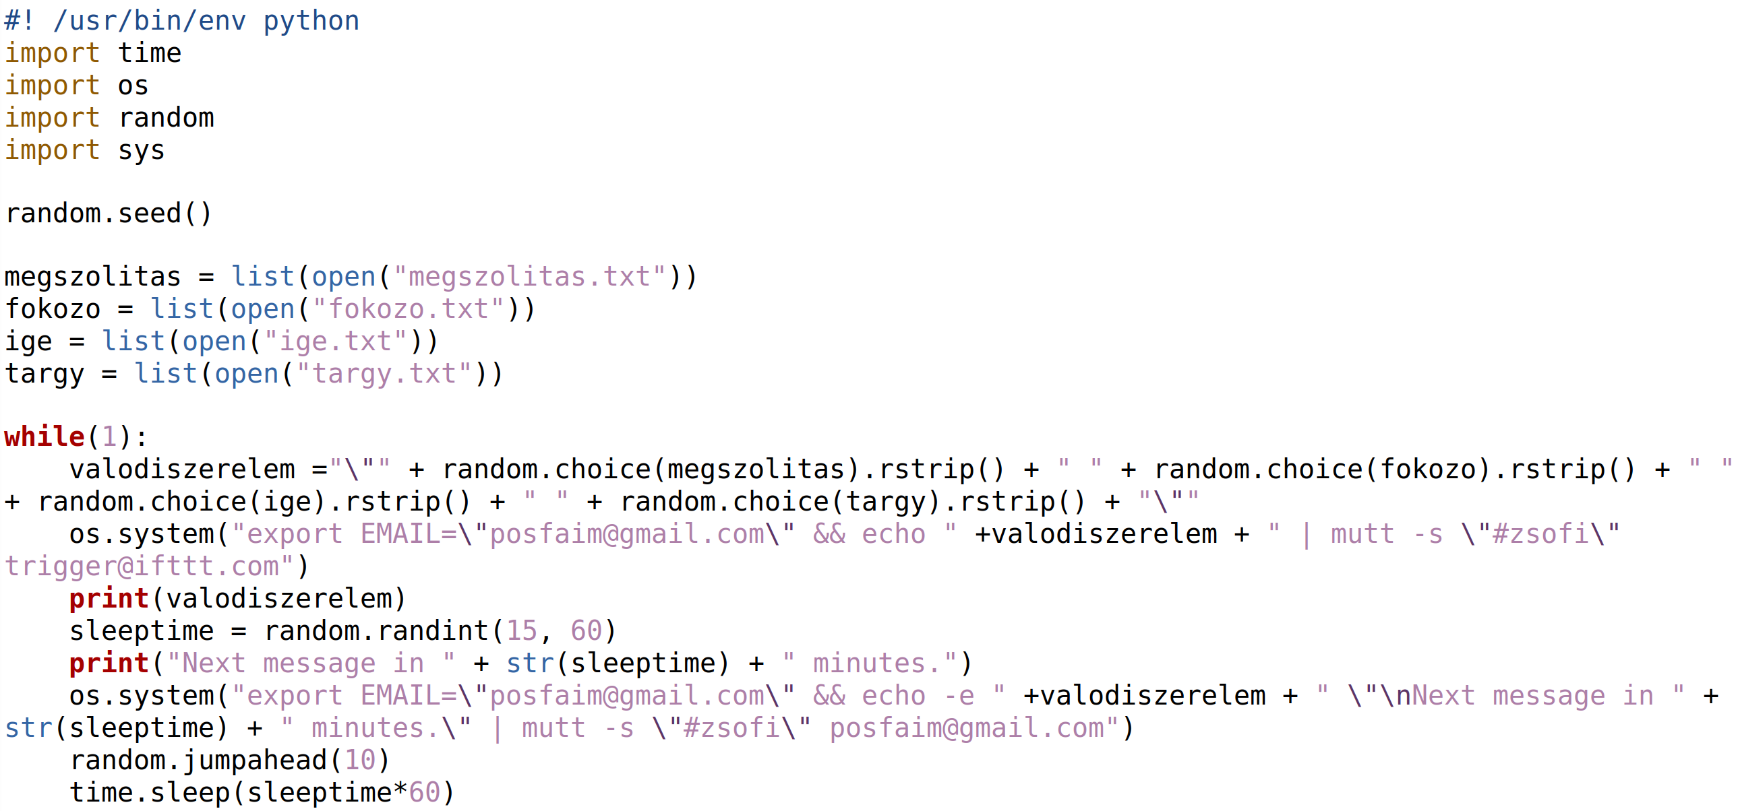
Why code?
Personal example 3

Slide 11
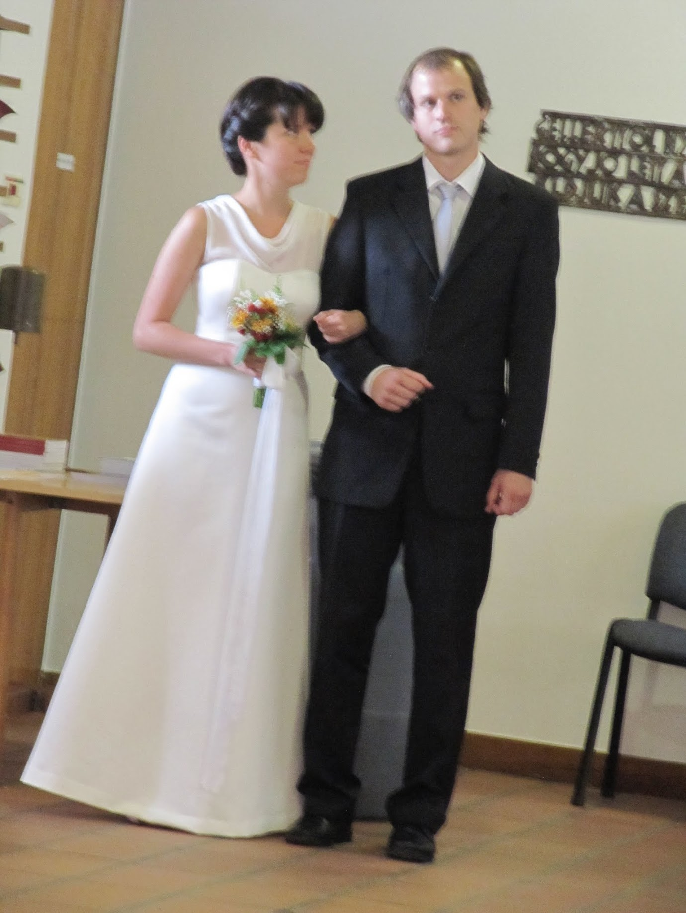
Why code?
Personal example 3

Slide 12
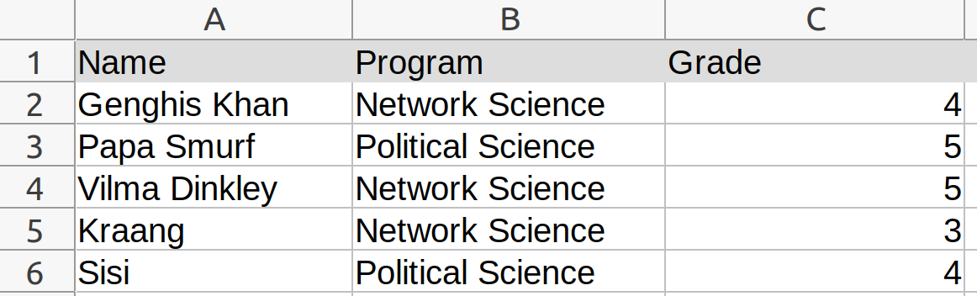
Why not Excel?
Advantages:
Familiarity.
Quick, little overhead.
Simple tasks: calculate averages, filter out data
Shortcomings:
Does not scale well.
Reproducability?
Automation

Slide 13
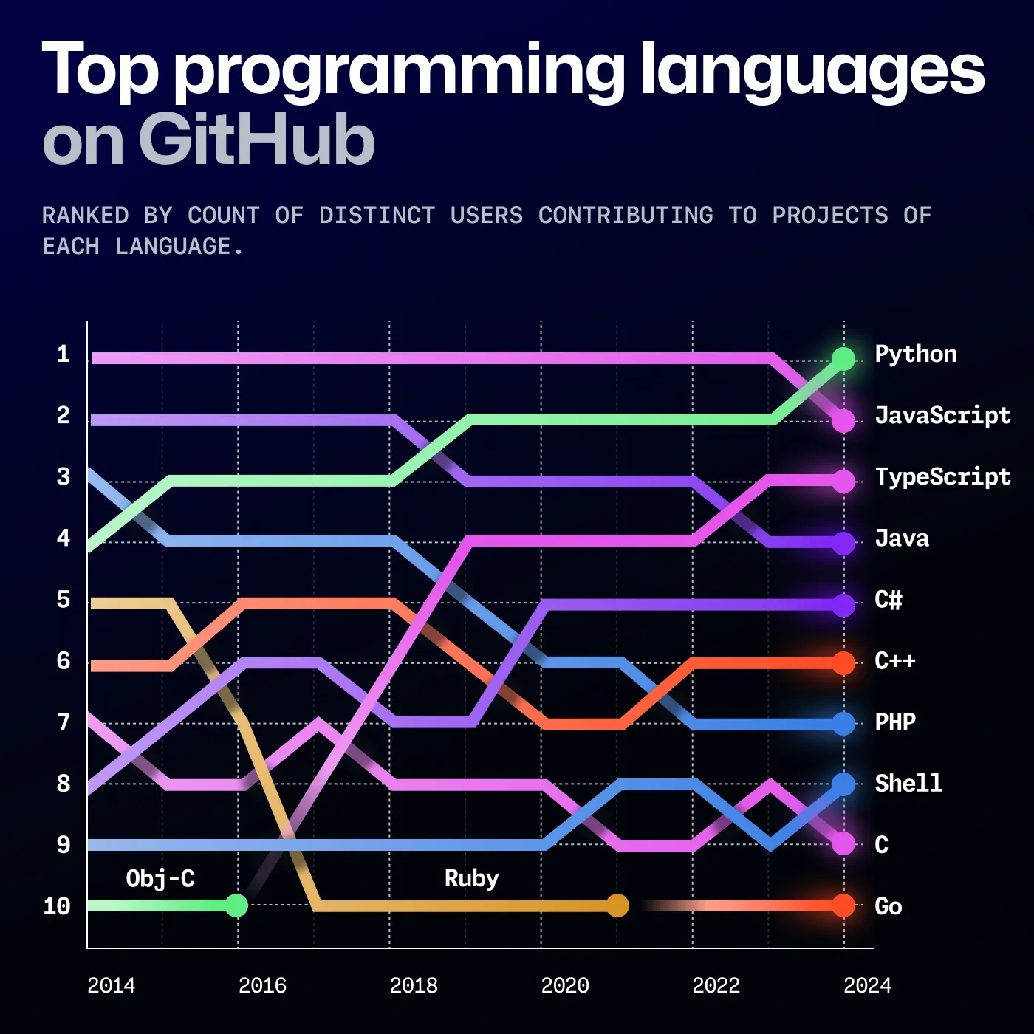
Why Python?
Easy to start.
Versatile.
Popular.
Data science courses at CEU use Python.
https://nashihamm.medium.com/top-programming-languages-on-github-in-2024-a-deep-dive-into-trends-triumphs-and-troubles-26cd6d3557f6

Slide 14
Is programming hard?
It can seem so at the beginning.
Is it math? No, but computer uses numbers.
Coding is a skill → Practice + curiosity.
Get the most out of the class:
Follow along, try out everything, experiment.
Try to solve exercises alone first.
Ask questions, help others.
No AI. (Or very last last resort.)

Slide 15
Is programming hard?
It can seem so at the beginning.
Is it math? No, but computer uses numbers.
Coding is a skill → Practice + curiosity.
Get the most out of the class:
Follow along, try out everything, experiment.
Try to solve exercises alone first.
Ask questions, help others.
No AI. (Or very last last resort.)

Slide 16
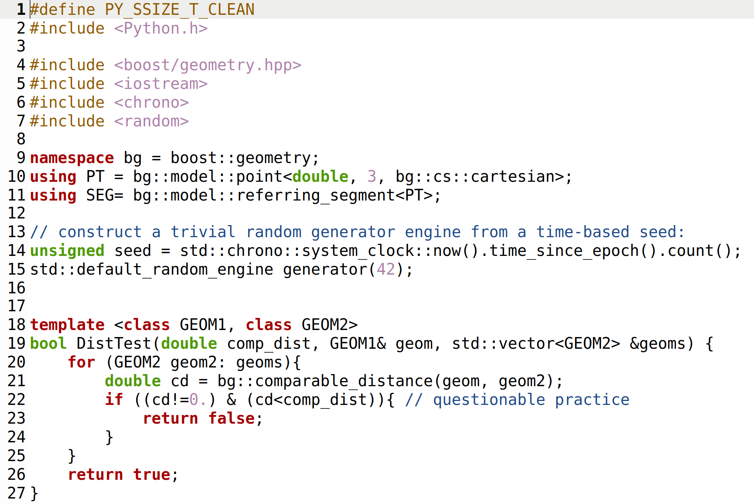
What is a computer program?
Series of instructions:
Computer
Input
Output

Slide 17
What is a computer program?
Computer
Input
Output
CPU
Mouse
Keyboard
Internet
File
Camera
...
Screen
Internet
File
...
Memory
Secondary storage
(Hard drive)

Slide 18
Let’s get started!
Follow the link on moodle to open the new material.

