Slide 1
CS434 Project Document version 2
POSTECH CSE 김근우

Slide 2
Goal Assumptions
Sorting key/value records stored on disk
The input does not fit in memory
The input does not fit in disk
Distributed sorting key/value records stored on multiple machines
each machine has several disks
Distributed/parallel sorting key/value records stored on multiple disks on multiple machines

Slide 3
Project settings
Naming convention

Slide 4
Naming convention
Variable: Camel case(each word is capitalized, except possibly the first word)
Class: Pascal case
Module:
Method: Camel case
Method parentheses: yes for side effect
* Others will follow this doc(https://docs.scala-lang.org/style/naming-conventions.html)

Slide 5
Design
Communication model
State transition rules
State diagram
Flow chart

Slide 6
Types of node
Master: Single node for coordination
Slave: Multiple nodes in which actual data is stored and sorting happens

Slide 7
4 phase of protocol
Sampling: generate information for distribution of data
Sort/Partition phase: sorting in parallel at each slave
Shuffle phase: data exchange via the master node under its coordination
Merge phase: data from other machines properly merged into a single chunk fit into a single disk

Slide 8
Communication model
Slave
File manager
RpcClient
Main
RpcClient server
RpcClient list
Master
RpcClient list
Main
RpcClient server
Slave
File manager
RpcClient
Main
RpcClient server
RpcClient list

Slide 9
Port
Master rpc server – 6602
Slave rpc server - 6603

Slide 10
RPC
All messages are implemented using gRPC

Slide 11
RPC definition
Name | PingRpc
When | Slave first makes a connection with Master
Sender | Slave
Receiver | Master
arguments | Pingreq(IP)
Return value | Pingres(ID)

Slide 12
RPC definition
Name | StartSampleRpc
When | All slaves make connection with master
Sender | Master
Receiver | Slave
arguments | Empty
Return value | Empty

Slide 13
RPC definition
Name | SendSamples
When | Slave send 10 samples to Master
Sender | Slave
Receiver | Master
arguments | Samplesreq(samples: list)
Return value | Empty

Slide 14
RPC definition
Name | metainfoRpc
When | Master spread meta information to Slaves
Sender | Master
Receiver | Slave
arguments | MetainfoReq
Return value | Empty

Slide 15
RPC definition
Name | FinishSortRpc
When | Slave finish to sort individually
Sender | Slave
Receiver | Master
arguments | Empty
Return value | Empty

Slide 16
RPC definition
Name | StartShuffle
When | All Slaves finish sorting indivudually
Sender | Master
Receiver | Slave
arguments | Empty
Return value | Empty

Slide 17
RPC definition
Name | SendFile
When | Slave send files to its peer
Sender | Slave
Receiver | Slave
arguments | FileChunk(ID, chunk)
Return value | Empty

Slide 18
RPC definition
Name | FinishSendFile
When | Slave finish to send files to its peer
Sender | Slave
Receiver | Slave
arguments | Empty
Return value | Empty

Slide 19
RPC definition
Name | success
When | Slave success to merge all files
Sender | Slave
Receiver | Master
arguments | Empty
Return value | Empty

Slide 20
Variables
name | Location | Definition | Critical reason (atomic operations are needed
connectionCount | Master | The number of slaves that make a TCP connection | Yes
metainfoCount | Master | The number of slaves sent MetainfoMessage | Yes
sortedCount | Master | The number of slaves sent FinishSortMeesage | Yes
successCount | Master | The number of slaves sent SlaveSuccessMessage | Yes
metainfoMessageSent | Slave | Whether a slave sent MetainfoMessage | No
finishSortMessageSent | Slave | Whether a slave sent FinishSortMessage | No
sortedComplete | Slave | Whether data after shuffling is sorted in a disk of slave | No
slaveId | Slave | Slave’s ID needed to be included in all messages it send | No
fileTransferFinishCount | Slave | The number of peer slaves sent FileTransferFinishMessage | Yes

Slide 21
States
Master
Init
Sample
Sortcheck
ShuffleCheck
Success
Slave
Init
Sample
Sort
Shuffle
Success
Fail

Slide 22
State transition rules (Master)
Init -> Sample
connectionCount == n
Sample -> SortCheck
metainfoCount == n
SortCheck -> ShuffleCheck
sortedCount == n
ShuffleCheck -> Success
SuccessCount == n
- State transition
- Condition
“n” is the number of slave

Slide 23
State transition rules (Slave)
Init -> Sample
Received(StartSampleMessage) == True
Init -> Fail
Connection fail to Master
Sample -> Sort
Received(MetainfoTableMessage) == True, metainfoMessageSent == True
Sample -> Fail
Fail to get MetainfoTableMessage within a time, Received(MetainfoTableMessage) == True, metainfoMessageSent == False
Sort -> Shuffle
Received(StartShuffleMessage) == True, finishSortMessageSent == True
Sort -> Fail
Received(StartShuffleMessage) == True, finishSortMessageSent == False
Shuffle -> Success
fileTransferFinishCount == n, size(fiileTransferQueue) == 0, sortedComplete == True
Shuffle -> Fail
Received out of bound data

Slide 24
State diagram
Master
Init
Sample
SortCheck
ShuffleCheck
Success

Slide 25
State diagram
Slave
Init
Sample
Sort
Shuffle
Fail
Success

Slide 26
Flow Chart
Slave
Master
Slave
Init
Init
Init
Sample
StartSampleMessage
StartSampleMessage
Sample
Sample
MetainfoMessage
MetainfoMessage
SortCheck
MetainfoTableMessage
MetainfoTableMessage
Sort
Sort
FinishSortMessage
FinishSortMessage
ShuffleCheck

Slide 27
Flow Chart (cont’d)
Slave
Master
Slave
ShuffleCheck
StartShuffleMessage
StartShuffleMessage
Shuffle
Shuffle
File
File
FileTransferFinishMessage
FileTransferFinishMessage
Me
rge
Me
rge
Success
Success
SlaveSuccessMessage
SlaveSuccessMessage
Success

Slide 28
Slave ordering

Slide 29
Ordering
We need to assign a proper id to each slaves
slaves are ordered by its sequence of connecting to master node
slave’s id can be 1 ~ n
slave’s id can be inferred from slave list of MetainfoTableMessage

Slide 30
Sampling

Slide 31
Sampling - Master
Get 10 samples from each slave
Select pivot positions which divide a range between minimum and maximum key value into N subdivision for each slave

Slide 32
Sampling - Slave
Randomly select 10 data
Send them to master

Slide 33
Test

Slide 34
logging
Master prints log message listing every slave who finish a task for a state at every state
Slave prints its state whenever it changes its state

Slide 35
System test
Settings
2 slaves (1 with localhost, 1 in local network)
1 in local network cause error. Fail to make rpc call with local address => (I manually put public IP)
10,0000 bytes for each slave (1000 lines of data for each)
Output dir should be “inputdir/output”
Slave
run -M 141.223.175.214 -O ./testData/slave1/output -I ./testData/slave1
run -M 141.223.175.214 -O ./testData/slave2/output -I ./testData/slave2
Master
- run 2

Slide 36
END

Slide 37
Final presentation

Slide 38
Types of node
Master: Single node for coordination
Slave: Multiple nodes in which actual data is stored and sorting happens

Slide 39
4 phase of protocol
Sampling: generate information for distribution of data
Sort/Partition phase: sorting in parallel at each slave
Shuffle phase: data exchange via the master node under its coordination
Merge phase: data from other machines properly merged into a single chunk fit into a single disk

Slide 40
States
Master
Init
Sample
Sortcheck
ShuffleCheck
Success
Slave
Init
Sample
Sort
Shuffle
Success
Fail

Slide 41
Variables
name | Location | Definition | Critical reason (atomic operations are needed
connectionCount | Master | The number of slaves that make a TCP connection | Yes
metainfoCount | Master | The number of slaves sent MetainfoMessage | Yes
sortedCount | Master | The number of slaves sent FinishSortMeesage | Yes
successCount | Master | The number of slaves sent SlaveSuccessMessage | Yes
metainfoMessageSent | Slave | Whether a slave sent MetainfoMessage | No
finishSortMessageSent | Slave | Whether a slave sent FinishSortMessage | No
sortedComplete | Slave | Whether data after shuffling is sorted in a disk of slave | No
slaveId | Slave | Slave’s ID needed to be included in all messages it send | No
fileTransferFinishCount | Slave | The number of peer slaves sent FileTransferFinishMessage | Yes

Slide 42
State transition rules (Master)
Init -> Sample
connectionCount == n
Sample -> SortCheck
metainfoCount == n
SortCheck -> ShuffleCheck
sortedCount == n
ShuffleCheck -> Success
SuccessCount == n
- State transition
- Condition
“n” is the number of slave

Slide 43
State transition rules (Slave)
Init -> Sample
Received(StartSampleMessage) == True
Init -> Fail
Connection fail to Master
Sample -> Sort
Received(MetainfoTableMessage) == True, metainfoMessageSent == True
Sample -> Fail
Fail to get MetainfoTableMessage within a time, Received(MetainfoTableMessage) == True, metainfoMessageSent == False
Sort -> Shuffle
Received(StartShuffleMessage) == True, finishSortMessageSent == True
Sort -> Fail
Received(StartShuffleMessage) == True, finishSortMessageSent == False
Shuffle -> Success
fileTransferFinishCount == n, size(fiileTransferQueue) == 0, sortedComplete == True
Shuffle -> Fail
Received out of bound data

Slide 44
State diagram
Master
Init
Sample
SortCheck
ShuffleCheck
Success

Slide 45
State diagram
Slave
Init
Sample
Sort
Shuffle
Fail
Success

Slide 46
Flow Chart
Slave
Master
Slave
Init
Init
Init
Sample
StartSampleMessage
StartSampleMessage
Sample
Sample
MetainfoMessage
MetainfoMessage
SortCheck
MetainfoTableMessage
MetainfoTableMessage
Sort
Sort
FinishSortMessage
FinishSortMessage
ShuffleCheck

Slide 47
Flow Chart (cont’d)
Slave
Master
Slave
ShuffleCheck
StartShuffleMessage
StartShuffleMessage
Shuffle
Shuffle
File
File
FileTransferFinishMessage
FileTransferFinishMessage
Me
rge
Me
rge
Success
Success
SlaveSuccessMessage
SlaveSuccessMessage
Success

Slide 48
Communication model
Slave
File manager
RpcClient
Main
RpcClient server
RpcClient list
Master
RpcClient list
Main
RpcClient server
Slave
File manager
RpcClient
Main
RpcClient server
RpcClient list

Slide 49
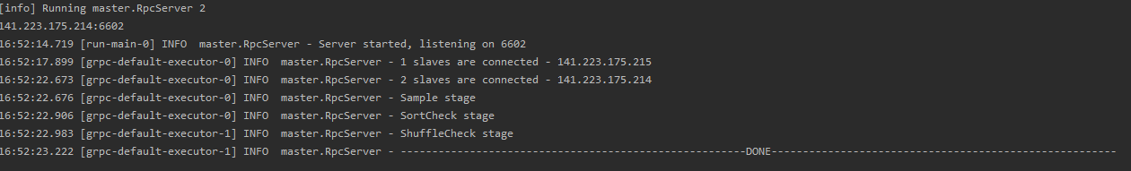
Result summary
1 master with 2 slaves
1GB per slaves

Slide 50
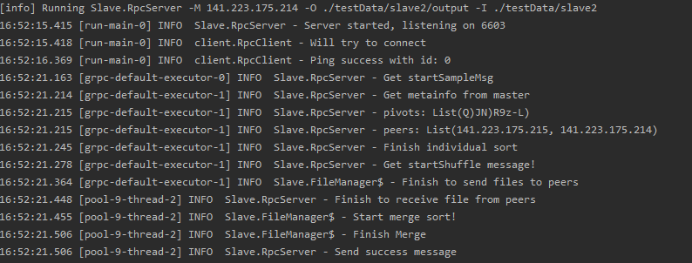
Result summary

Slide 51
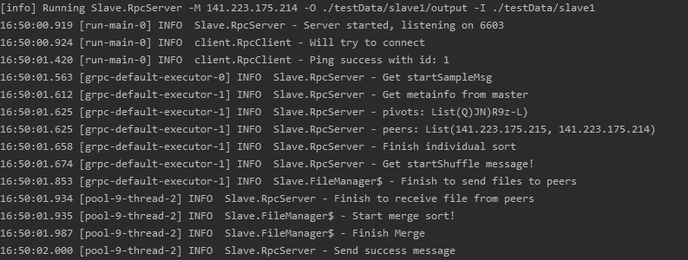
Result summary

Slide 52
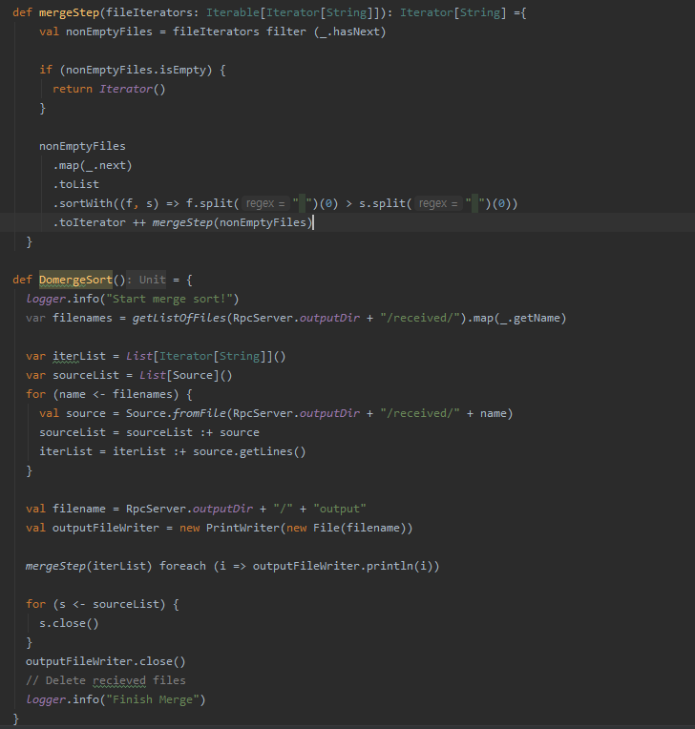
Sorting

Slide 53
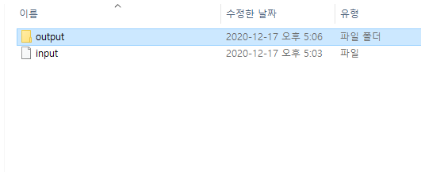
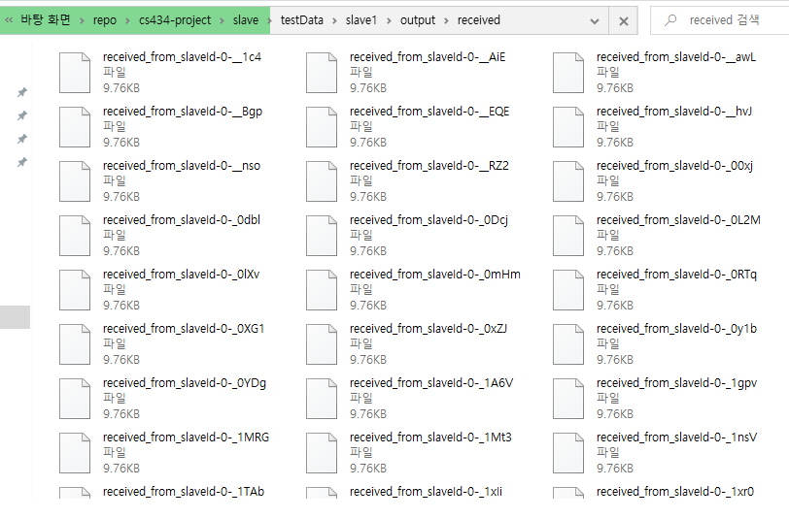

Slide 54
Comment
프로젝트 진행
마일스톤 3까지 한 일의 대부분은 설계
그 이외에 초반에 java socket 라이브러리 익히기 (=> 결국 사용안함. 마지막에 grpc로 바꿈)
본격적인 로직 구현 시작 – 12/13 (일) 23시 ~ 12/14 (월) 8시 (9시간), 12/14 (월) 14시 ~ 12/14 (월) 18시 (4시간)
모든 로직 구현 완료 (except external merge sort)
설계에서 최대한 모든 로직을 간단하고 나이브하게 하려고 노력했고 그렇게 했기 때문에 시간이 얼마 안 걸릴 것이라 생각
12/14 (월) 18시: external sortin을 제대로 설계하지 않았다는 것을 깨달음 => system test를 돌리면서 external sortin을 바로 구현하기 시작
결국 6시간 동안 완성하지 못함
결론적으로, 시간이 부족했음 => 듀를 넘어서까지 진행하게 되었음.
테스팅
Assertion과 logge로 unit test를 대신할 수 있었음
마지막에 system test를 한번 진행했음
설계에서 생각한 고급정보를 assertio으로 구현해놓으면 정말 도움이 됨 (주의! – assertion이 진짜 고급 정보여야함. 설계에서 제일 시간을 많이 쏟은 부분)
수업이 프로젝트에 도움이 된점
설계와 테스팅에 시간을 더 써야한다.
Unit test는 그 자체로 관리 대상이 된다. => 프로젝트의 또 다른 burden이 된다.
Assertion으로 고급 정보를 표현할 수 있다.
반성
설계단계에서 아무리 생각을 많이 해도 70 ~ 80 % 정도만 쓰이는 것 같다.
그러면 구현을 하다가 나머지 20~30%에 부딪혔을 때 다시 설계 단계로 돌아가야 한다.
나는 그러지 못했다가 쌓여가는 arbitrary에 tar pit에 빠졌었던 것 같다.

Slide 55
구현 상황 (Until due date)
현재까지 구현된 정도는 다음과 같습니다.
Slave가 마스터에 연결
Sampling한 결과를 Master가 slave들에게 배포
각각의 Slave에서 input data를 전송해야 할 peer slave를 기준으로 분류한다. 여기서 사용되는 기준은 앞서 sampling한 결과를 사용한다.
분류가 완료되었으면 데이터를 각각의 peer slave들에게 보낸다. (Shuffling)
Data를 전부 받았으면 merge sort를 실행한다. (구현중)

