Slide 1
Data Security through Steganography
Using LSB substitution algorithm
Department of Software Engineering
Nepal College of Information Technology
Balkumari, Lalitpur, Nepal
Submitted by:
Sanjaya Adhikari,14731
Mithun Adhikari, 14748

Slide 2
Agenda

Slide 3
Overview
Cross platform React Native (iOS/Android).
Platform for those who needs securely transfer the confidential data through network.
By using our application , the user should be able to conceal a text message in an image file without any visible alterations to the image

Slide 4
Problem Statement
Adjusting the quality of image from Human Visual System
Successfully encrypting the data with symmetric key
The size of data hidden
Level of data protection
The level of suspicion

Slide 5
Project Objectives
To create a tool that can be used to hide data inside a 24-bit color image.
The tool should be able to encrypt the message with symmetric key and produce cipher text before embedding it.
To display the hidden message successfully from the cover image if and only if private key is matched.
The tool should be easy to use, and should use a graphical user interface.
The tool should work cross-platform.

Slide 6
Scope and Limitation
The scope of the study encompasses:
This research will focus on hiding data in image
This research will focus on extracting the secret message from stego-image.
The limitations of the project are listed below:
Only bitmap file format is allow as input/output image.
Only 24-bit color depth is allow as input image

Slide 7
Steganography vs. Cryptography
Steganography:
Steganography is the art and science of writing hidden messages in such a way that no one, apart from the sender and intended recipient, suspects the existence of the message, a form of security through obscurity.
Cryptography:
the structure of a message is scrambled to make it meaningless and unintelligible unless the decryption key is available

Slide 8
Least Significant Bit Algorithms
The process of adjusting the least significant bit pixels of the carrier image
For 24-bit image, the colors of each component like RGB (red, green and blue) are changed.
We have used BMP Image for our proposed work.
Modulating the LSB does not result in a human-perceptible difference because the amplitude of the change is small. Therefore, to the human eye, the resulting stego-image will look identical to the cover-image.

Slide 9
Task Status Overview
S.N. | TASKS | TASK STATUS
1. | Image Picker | Completed
2. | Graphical User Interface for Encode and Decode Screen | Completed
3. | Image Picker | Completed
4. | Encrypt | Completed
5. | Decrypt | Remaining
6. | Pixel Extraction from bitmap Image | Completed
7. | Hiding Data into LSB of Image | Currently working
8. | Extracting Text from Stego-Image | Remaining

Slide 10
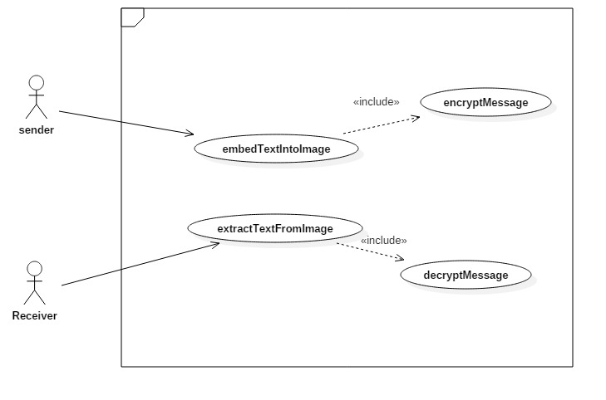
Use case Diagram

Slide 11
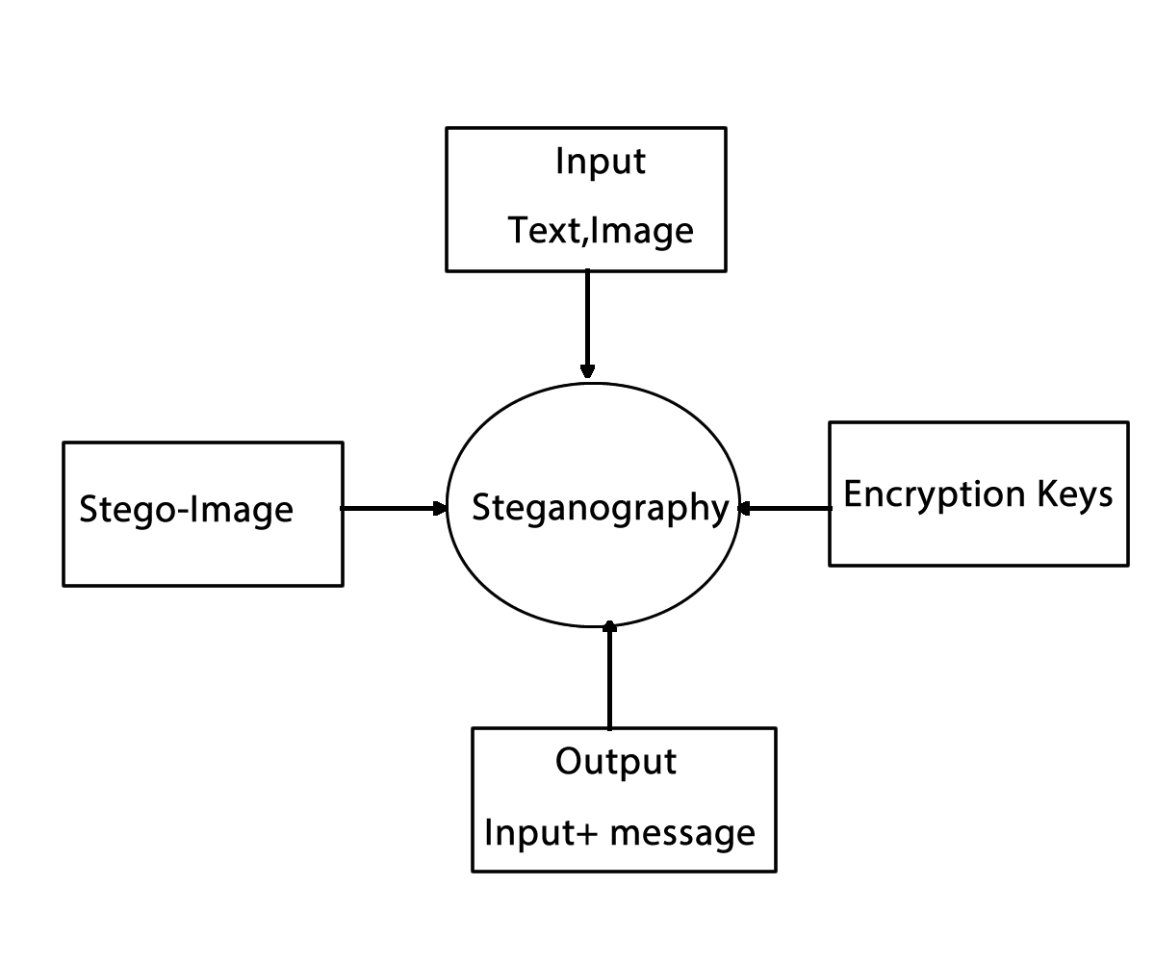
Context Diagram

Slide 12
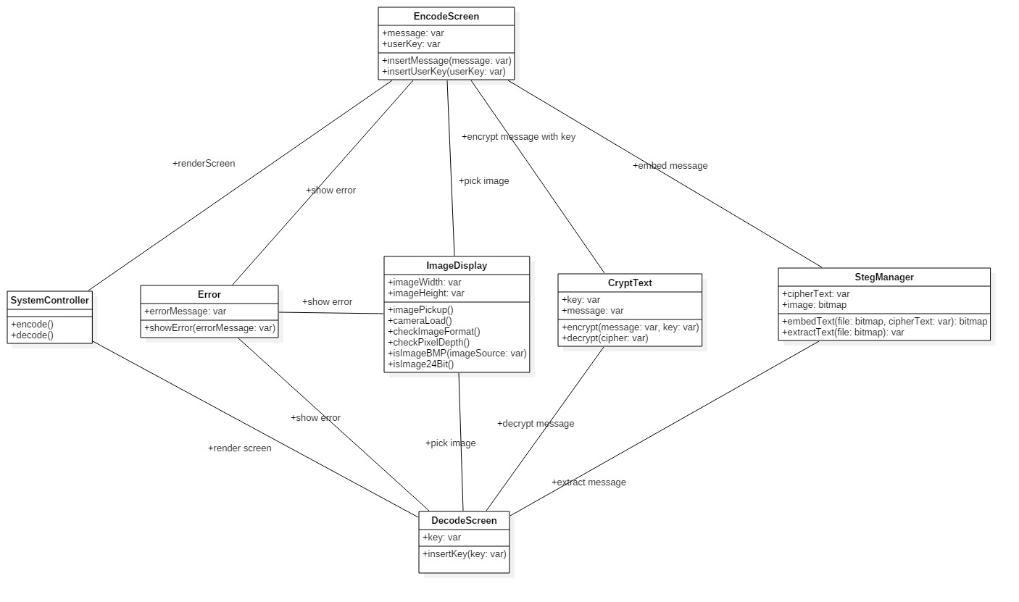
Design Class Diagram

Slide 13
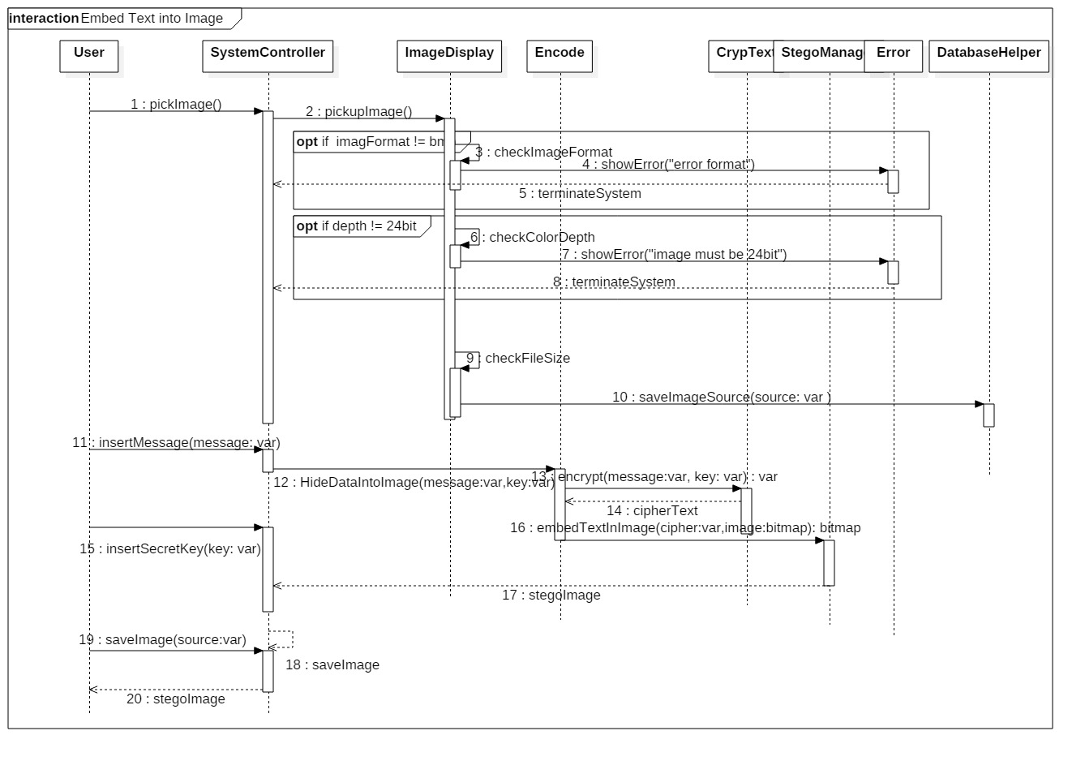
Sequence Diagram for Steganography

Slide 14
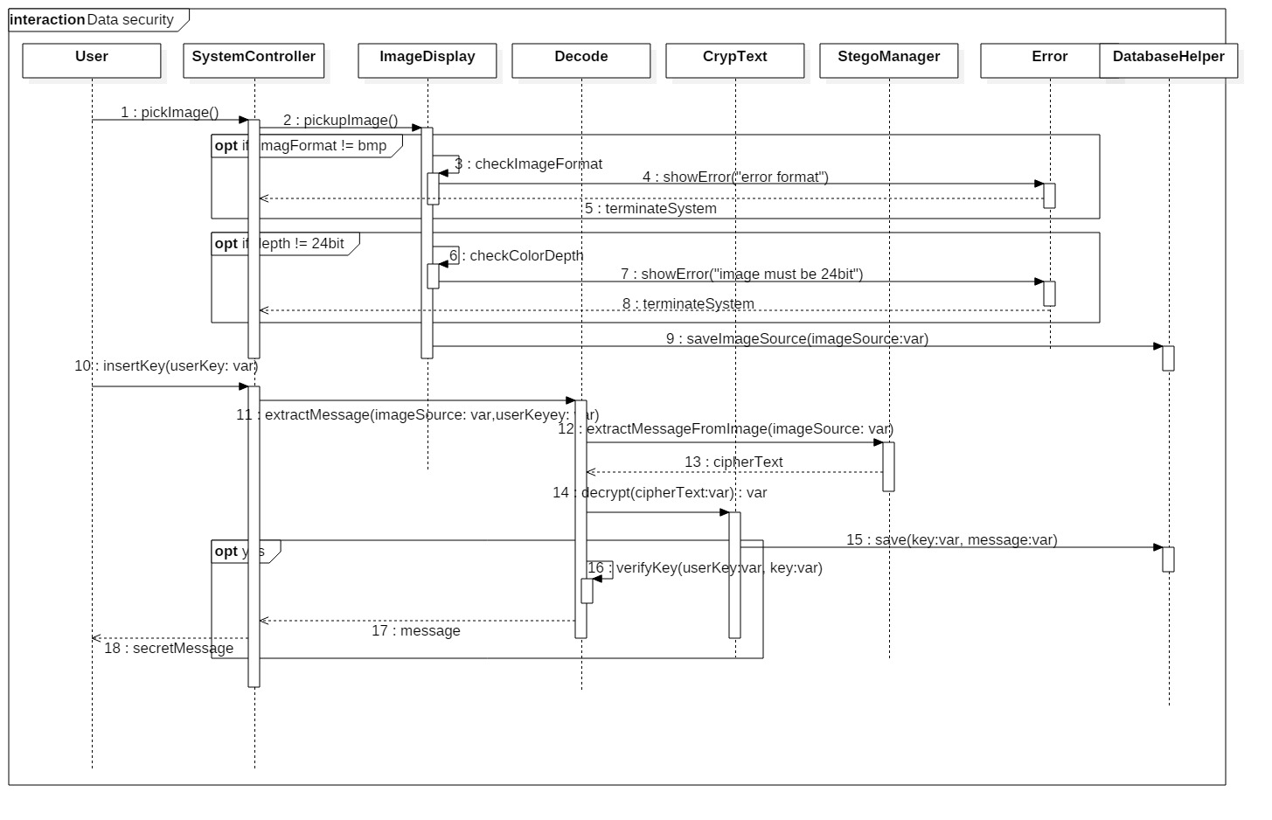
Sequence Diagram for Steganalysis

Slide 15
Works to be done
More data collection
Layout completion
Analysis of layout
Connecting to database
Json parsing
Testing
Upload into google play store

Slide 16
Works to be done
More data collection
Layout completion
Analysis of layout
Connecting to database
Json parsing
Testing
Upload into google play store

Slide 17
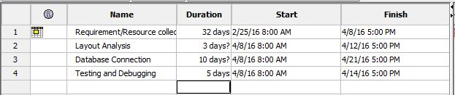
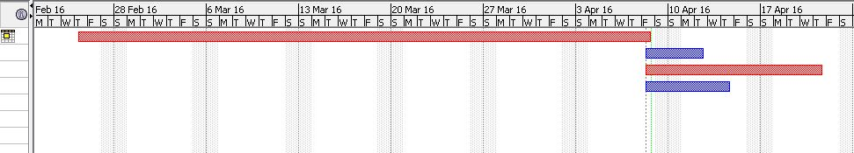
Scheduling

Slide 18
Questions??

Slide 19
Thank you!

