Slide 1
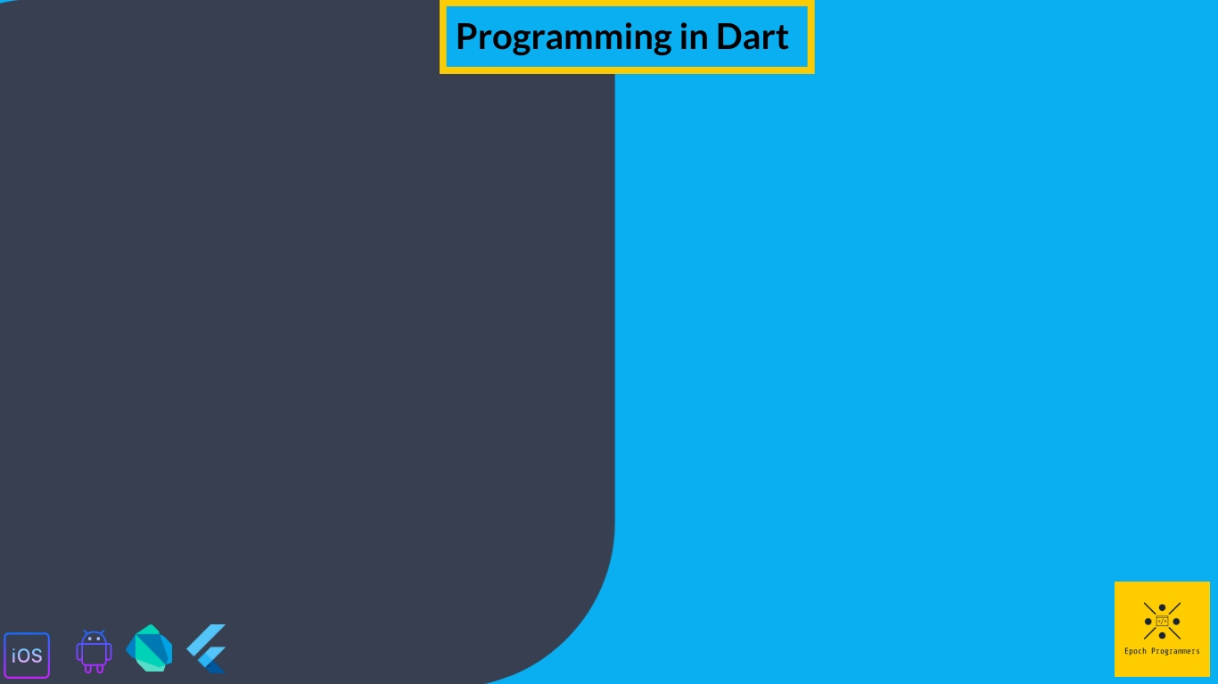
Loop control Statements

Slide 2
What are we going to learn in this video?
For Loop
While Loop
Do While Loop
Difference Between Loop Statements
Using Break and Continue Statements
Using Labels in Control Flow Statements

Slide 3
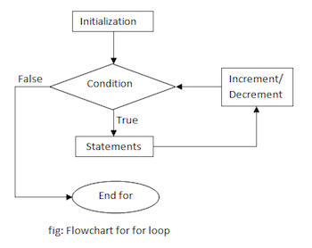
For Loop
The for loop is an statement which executes the code block for a specified number of times. It can be used when we have to iterate certain block of codes over a fixed set of values.
Syntax:
for(initial_count_value; termination_condition; value_increment){
//statements
}

Slide 4
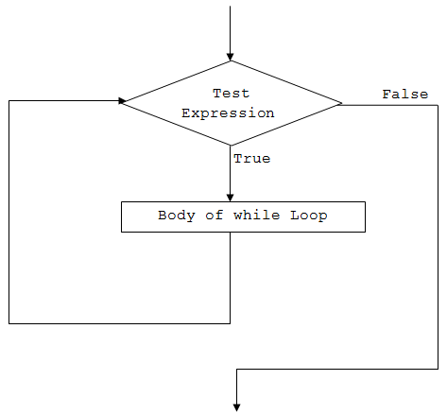
While Loop
The while loop is an statement which executes certain block of codes only if the condition is satisfied. It first evaluates the condition and executes only if the condition is true.
Syntax:
while(condition){
//statements
Increment;
}

Slide 5
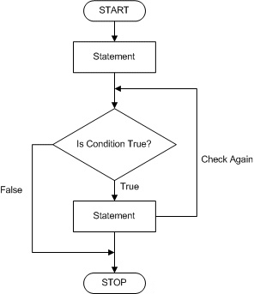
Do While Loop
The do while loop is almost similar to while loop except that it at first do not evaluate the condition. That is code block will always be executed at least once.
Syntax:
do{
//statements
Increment;
} while(condition)

Slide 6
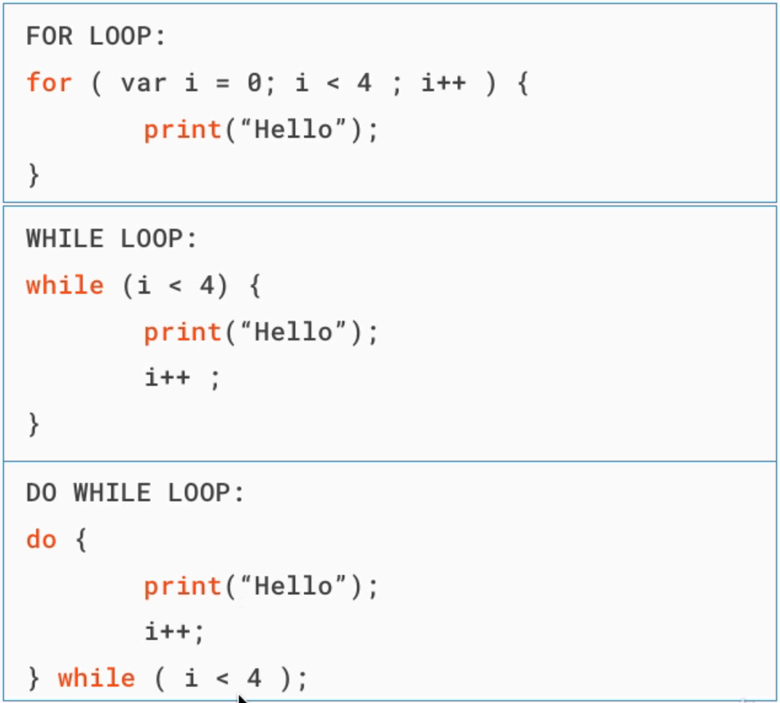
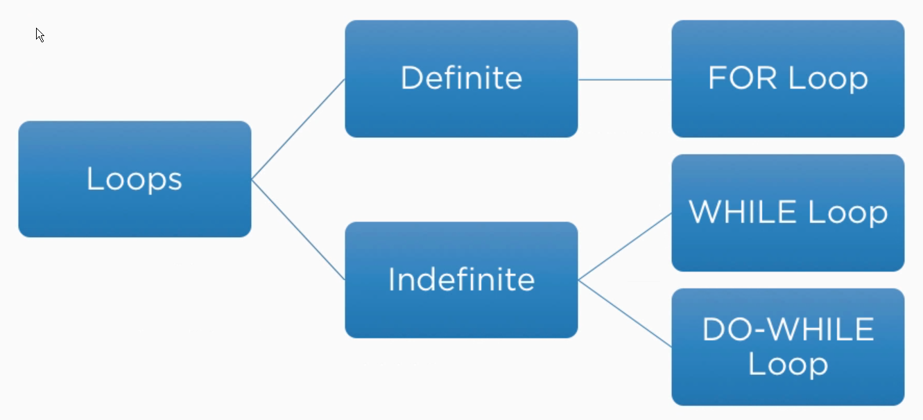
Difference Between Loop Statements

Slide 7
Using Break and Continue Keywords
Break
Break statement is used to terminate the construct, i.e. If we use break statement inside a for loop it will terminate that for loop.
Continue
Continue is used to skip the subsequent statements in the current iteration and takes control back to the beginning. That is unlike break it only terminates the current iteration.

Slide 8
Using Labels in Control Flow Statements
A label in a simple word is an identifier followed by a colon. It is applied to a statement or a block of code. Labels are mostly used when continue and break statements need to jump to certain block of code or to certain iterations.

Slide 9


