Slide 1

SentiMeter An Android Application for Sentiment Analysis of Twitter Data Using KNN and NBayes Classifiers
Under the supervision of
Asst . Prof. Himal Acharya
Submitted by:
Kanchan Singh, 161716
Poshan Pandey, 161724
Priska Budhathoki, 161726

Slide 2
Overview
Introduction
Problem Statement
Why Twitter?
Project Objective
Similar Projects
Scope and Limitation
Methodology
Classifiers Used
Tools Used
Technologies Used
System Implementation
Calculation Process
Result and Discussion
Conclusion and Future Work

Slide 3
Introduction
Sentiment analysis is also known as “opinion mining” or “emotion Artificial Intelligence”.
It alludes to the utilization of natural language processing (NLP), text mining, computational linguistics, and bio measurements to methodically recognize, extricate, evaluate, and examine emotional states and subjective information.

Slide 4
Problem Statement
Decent amount of related prior work has been done in this field.
Most of the work are based on the manual labelling which is expensive.
There is need of proper comparison between these results in order to select best features.

Slide 5
Why Twitter?
Limited tweet size
Use of hashtags, user reference and URLs.
Mass users expressing their opinions.
134 million user [1]
3.39 minutes per session [1].
Use of repeated words or symbols to convey an emotion.

Slide 6
Similar Projects
SocialMention | Web application
NCSU Tweets Visualizer | Sentiment Viz

Slide 7
Project Objective
Extract tweets and preprocess them.
Estimate the sentiment of those tweets.

Slide 8
Scope and Limitation
Scope
Limitation
Classifies the sentiment’s positiveness
Can be applied during
Movie Premier
Election
Social Campaign, etc.
Cannot identify humor and sarcasm
Does not consider the neutral sentiments.
Does not consider the context of tweets.
8

Slide 9
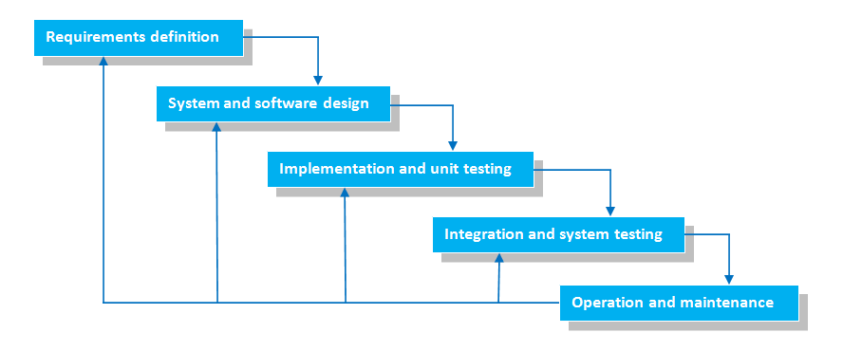
Methodology
Waterfall Model

Slide 10
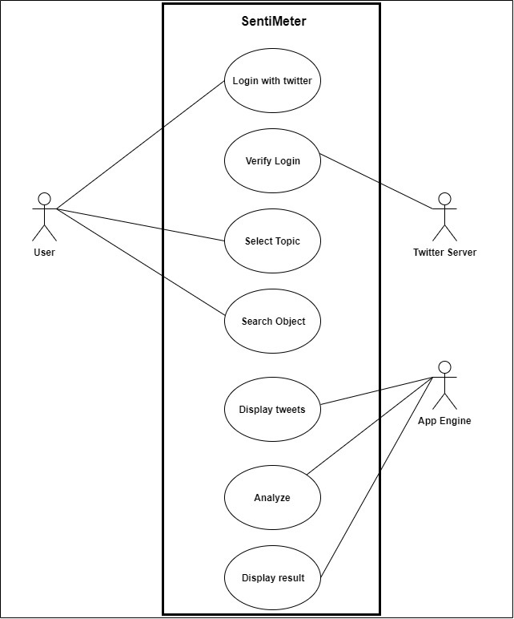
Use Case Diagram

Slide 11
Classifiers Used
Naïve Bayes
KNN

Slide 12
Tools Used
Android Emulator
Android Studio
Draw.io
Figma
GitHub
Microsoft Visio

Slide 13
Technologies Used
Java
Twitter Developer API
XML

Slide 14
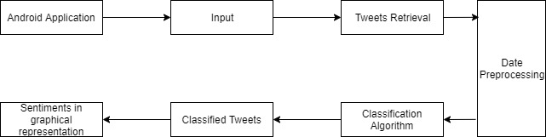
System Implementation

Slide 15
Calculation Process
Tweets are converted to lowercase
Punctuations and additional white spaces are removed
Removal of text that are not responsible
Tokenization of sentiment texts
Removal of text that are not responsible
Testing with KNN and NBayes Classifiers

Slide 16
Result and Discussion
The proposed android application is developed.
Using the datasets of movie reviews from Kaggle the accuracy is calculated to be 61.8335%

Slide 17
Conclusion and Future Work
Furnished mobile application obtained
Bigrams can be analyzed in future.
Multiple languages can be analyzed.
Neutral Sentiments can be calculated.

Slide 18
References
https://www.oberlo.com/blog/twitter-statistics [Accessed on 01/08/2020]

Slide 19
Demo

Slide 20
Thank you for your attention!
Any Questions?

