Slide 1

Sentiment Analysis on Twitter Data
Authors:
Apoorv Agarwal
Boyi Xie
Ilia Vovsha
Owen Rambow
Rebecca Passonneau
Presented by Kripa K S

Slide 2
Overview:
twitter.com is a popular microblogging website.
Each tweet is 140 characters in length
Tweets are frequently used to express a tweeter's emotion on a particular subject.
There are firms which poll twitter for analysing sentiment on a particular topic.
The challenge is to gather all such relevant data, detect and summarize the overall sentiment on a topic.

Slide 3
Classification Tasks and Tools:
Polarity classification – positive or negative sentiment
3-way classification – positive/negative/neutral
10,000 unigram features – baseline
100 twitter specific features
A tree kernel based model
A combination of models.
A hand annotated dictionary for emoticons and acronyms

Slide 4
About twitter and structure of tweets:
140 charactes – spelling errors, acronyms, emoticons, etc.
@ symbol refers to a target twitter user
# hashtags can refer to topics
11,875 such manually annotated tweets
1709 positive/negative/neutral tweets – to balance the training data

Slide 5
Preprocessing of data
Emoticons are replaced with their labels
:) = positive :( = negative
170 such emoticons.
Acronyms are translated. 'lol' to laughing out loud.
5184 such acronyms
URLs are replaced with ||U|| tag and targets with ||T|| tag
All types of negations like no, n't, never are replaced by NOT
Replace repeated characters by 3 characters.

Slide 6
Prior Polarity Scoring
Features based on prior polarity of words.
Using DAL assign scores between 1(neg) - 3(pos)
Normalize the scores
< 0.5 = negative
> 0.8 = positive
If word is not in dictionary, retrieve synonyms.
Prior polarity for about 88.9% of English words

Slide 7
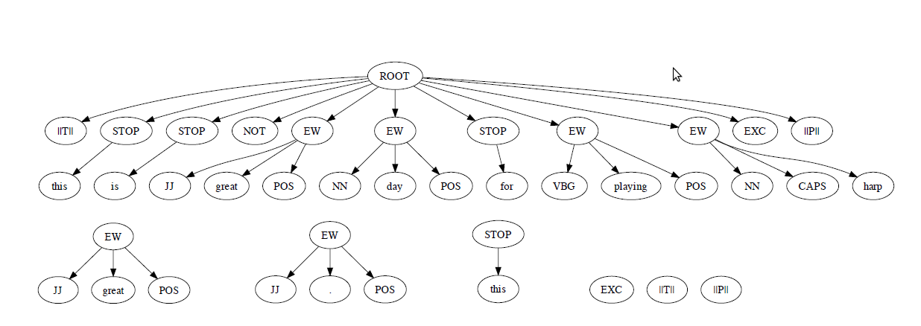
Tree Kernel
“@Fernando this isn’t a great day for playing the HARP! :)”

Slide 8
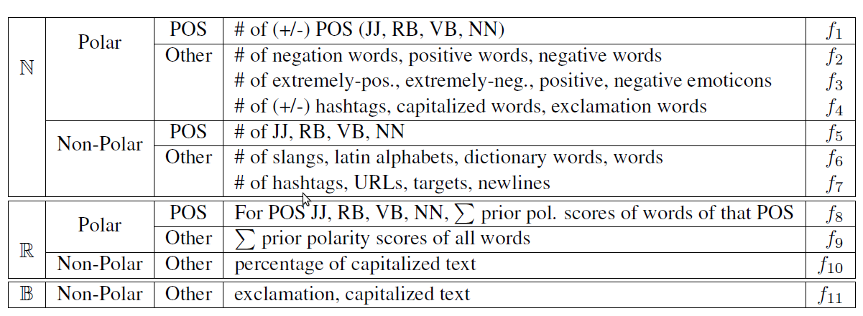
Features
It is shown that f2+f3+f4+f9 (senti-features) achieves better accuracy than other features.

Slide 9
3-way classification
Chance baseline is 33.33%
Senti-features and unigram model perform on par and achieve 23.25% gain over the baseline.
The tree kernel model outperforms both by 4.02%
Accuracy for the 3-way classification task is found to be greatest with the combination of f2+f3+f4+f9
Both classification tasks used SVM with 5-fold cross-validation.

