Slide 1
Namaste!

Slide 2

Twitter has 330 million monthly active users(as of 2019 Q1). Of these, more than 40 percent that is about 134 million people use the service on a daily basis (Twitter, 2019).
The average time spent on Twitter clocks in at 3.39 minutes per session (Statista, 2019)
Users tweets about various aspects of day to day life.
That is a whole lots of data.
What if we say those data can be utilized for better purpose:

Slide 3

SentiMeter
An Android Application for Sentiment Analysis of Twitter Data Using KNN and NBayes Classifiers

Slide 4
What is Sentiment Analysis?
The process of computationally identifying and categorizing opinions expressed in a piece of text, especially in order to determine whether the writer's attitude towards a particular topic, product, etc. is positive, negative, or neutral.
Also referred to as opinion mining , it helps to determine whether someone’s opinion is positive negative or neutral.

Slide 5
Why Sentiment Analysis is important?
Movie: is this review positive or negative?
Products: what do people think about the new iPhone?
Public sentiment: how is consumer confidence? Is despair increasing?
Politics: what do people think about this candidate or issue?
Prediction: predict election outcomes or market trends from sentiment

Slide 6
Why Twitter?
Limited tweet size
Use of hashtags, user reference and URLs.
Mass users expressing their opinions.
Use of repeated words or symbols to convey an emotion.

Slide 7
Problem Statement
This project aims to extract the features of tweets and analyze the opinion of tweets as positive or negative.
It aims to classify the tweets on certain people or objects as positive or negative for a set of latest tweets by people around the globe.
Using such data we are performing sentiment analysis to calculate if the majority of tweets are of positive sentiments or a negative one.

Slide 8
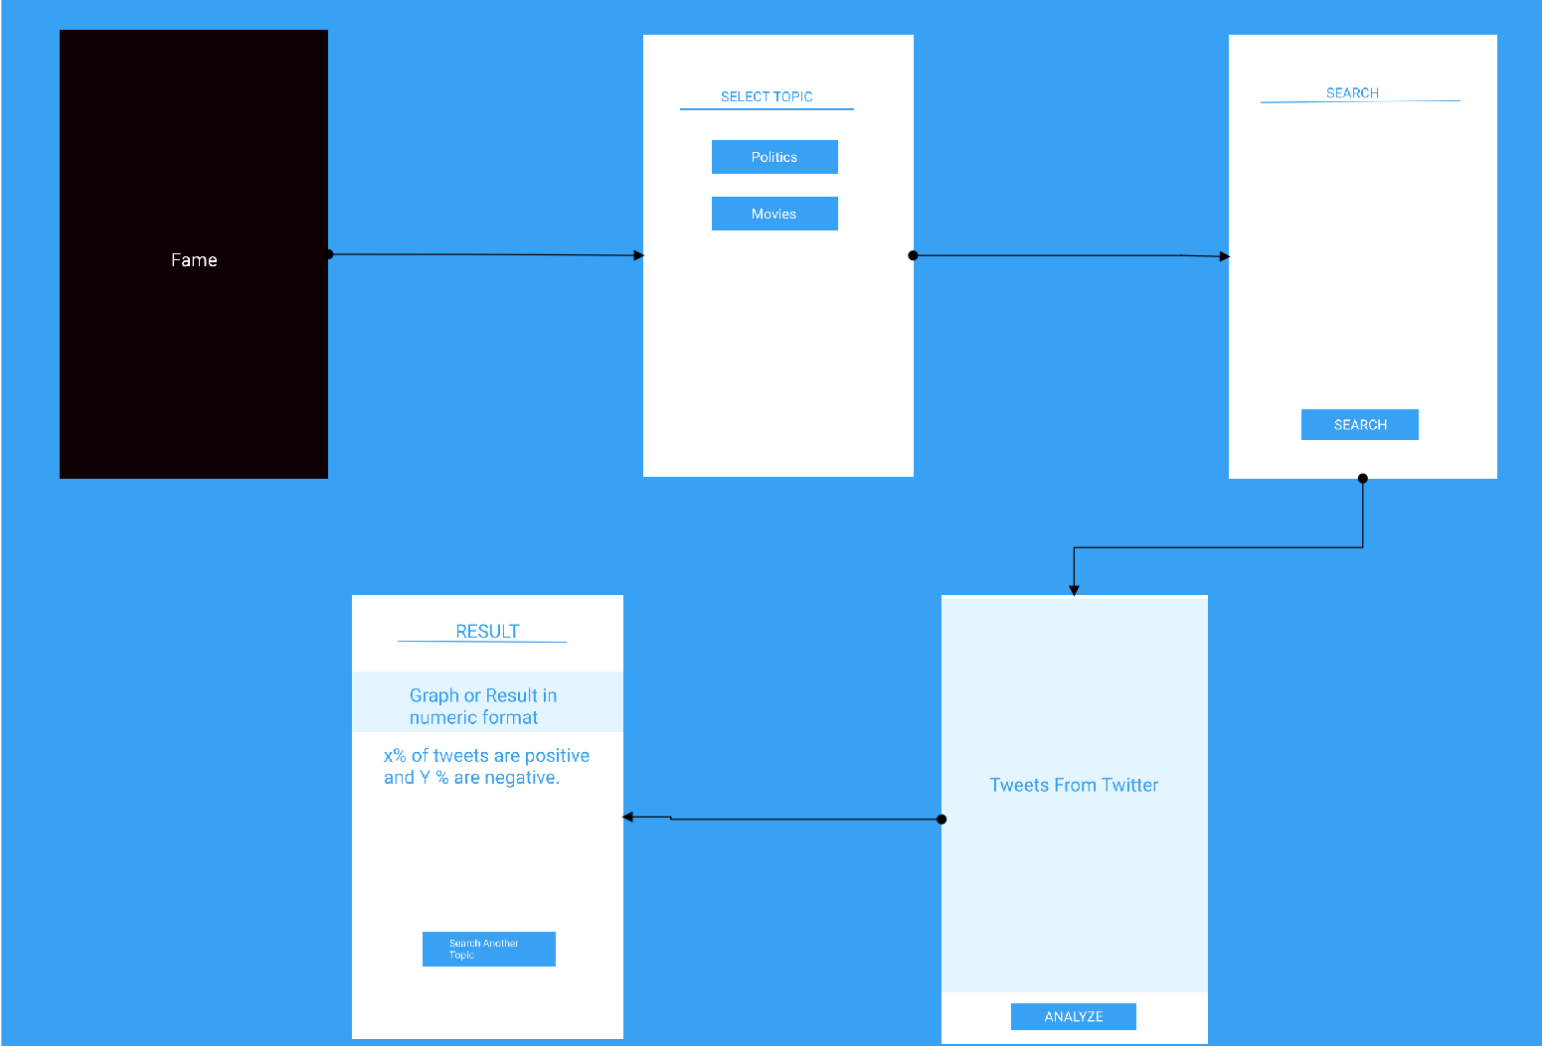
Flow of UI process
SentiMeter

Slide 9
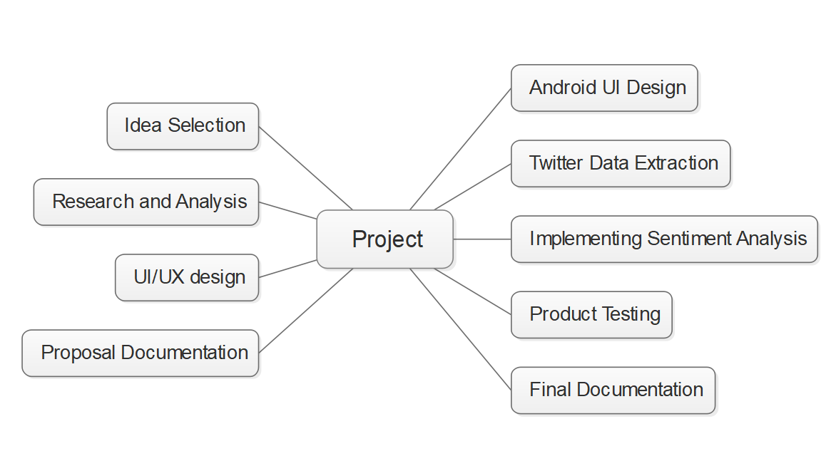
Project Tasks

Slide 10
Calculation Process
All tweets were converted to lower case
All links and urls were replaced by generic word URL  All usernames were replaced by generic word USER  Words with hashtags were replaced with the same words without the hashtag
 Punctuations and additional white spaces were removed from the tweets.
Tokenization of the sentiment texts
Removal of Texts that are not responsible for sentiment determination but used largely such as pronouns, prepositions, etc.
Construction of Histograms for every element
Construction of averaged histogram for both positive and negative class
Testing with KNN and nBayes classifiers

Slide 11
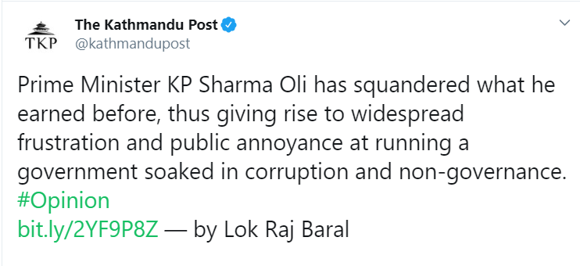
KNN
Positive | Negative
earned | Squandered Frustration Annoyance Soaked Corruption Non-governance
NBayes
Output
P(Positive)
P(Negative)

Slide 12
Technologies to be used
Java for Android development
Twitter Developer API to extract twitter data
Java for KNN and Nbayes
XML for Android UI

Slide 13
Tools Used
Figma
Edraw
Github
Android Emulator
Android Studio
Microsoft Word
MS Powerpoint
Google Chrome

Slide 14
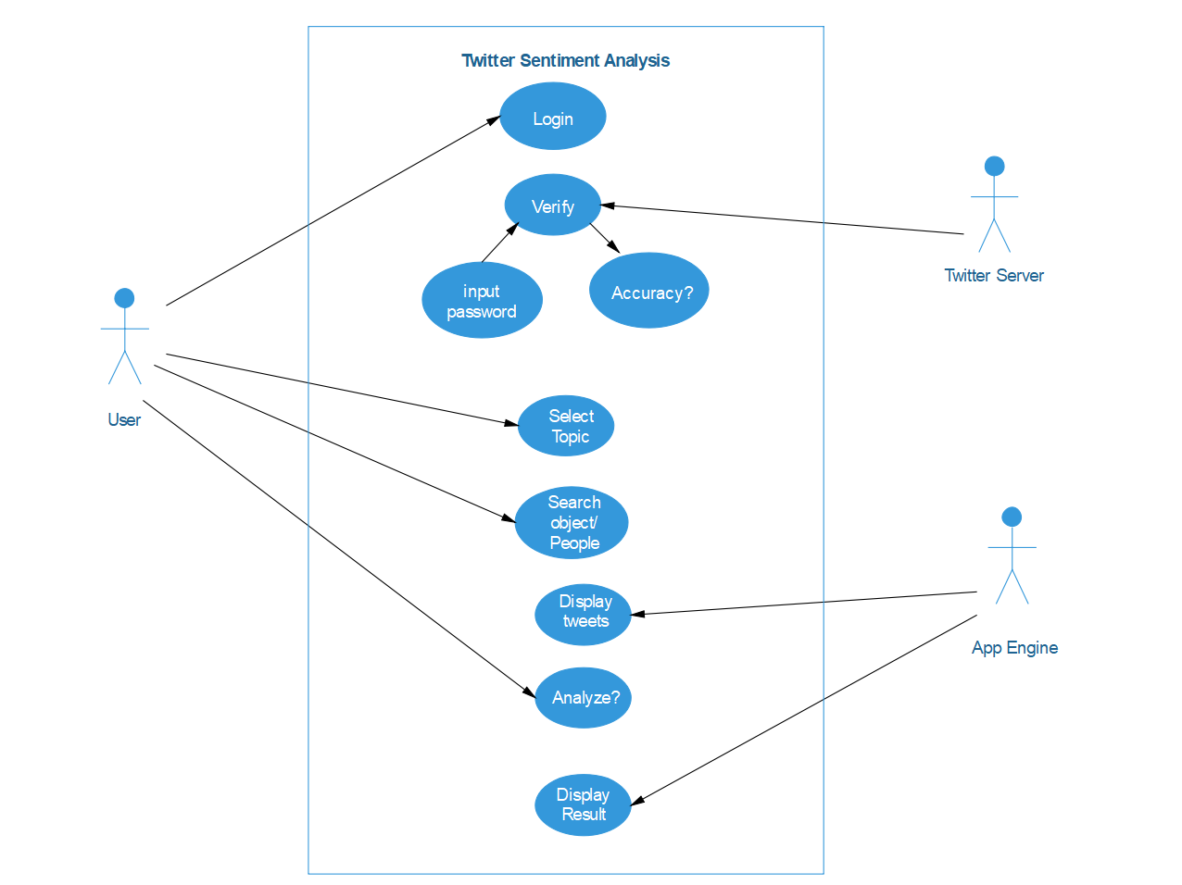
Use Case

Slide 15
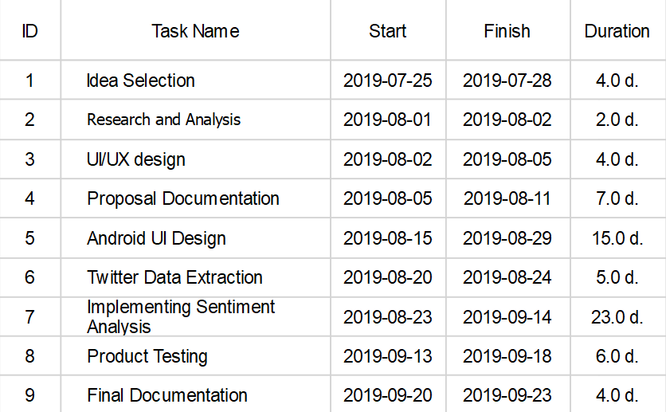
Time Schedule

Slide 16
Scope
The information is becoming vast and can be extracted to turn into business objectives, social campaigns, marketing, and other promotional strategies.
It can be used during :
Elections
Movie Premier
Promotions
Product Analysis

Slide 17
Challenges and Limitation
Challenges
Limitation
Tokenizations of sentimental words
Importing Twitter data
Cannot identify humor and sarcasm, So sometime might be wrong.
We cannot assure 100% accuracy but the result is closest to human thoughts.
For now, this project is limited to the English language.

Slide 18
Neutral tweets: The current classifier does not consider neutral sentiments, even though many tweets do not exhibit a clear cut positive or negative emotion, especially the ones stating a fact or news.  Bi-grams in combination with unigrams to handle negations like “not happy”  Semantics may be employed when sentiment of a tweet depends on the perspective of the reader. For example: “India lost to Australia in the semis ☹” indicates negative sentiment for India, but positive for Australia.

Slide 19
References
https://www.kaggle.com/vishaldwivedi/python-nltk-sentiment-analysis (Accessed on 10th August 10:24 PM )
https://www.geeksforgeeks.org/twitter-sentiment-analysis-using-python/ (Accessed on 10th August 10:30 PM)

Slide 20
Thank you Kanchan Singh Poshan Pandey Priska Budhathoki

