Slide 1
Namaste! We are
Kanchan Singh(161716)
Poshan Pandey(161724)
Priska Budhathoki(161726)
We have come up with…..

Slide 2
SentiMeter
An Android Application for Sentiment Analysis of Twitter Data Using KNN and NBayes Classifiers

Slide 3
What is Sentiment Analysis?
process of computationally identifying and categorizing opinions expressed in a piece of text, especially in order to determine whether the writer's attitude towards a particular topic, product, etc. is positive, negative, or neutral.
Also referred to as opinion mining , it helps to determine whether someone’s opinion is positive negative or neutral

Slide 4
Why Sentiment Analysis is important?
Business: In marketing field companies use it to develop their strategies, to understand customers’ feelings towards products or brand, how people respond to their campaigns or product launches and why consumers don’t buy some products.
Politics: In political field, it is used to keep track of political view, to detect consistency and inconsistency between statements and actions at the government level. It can be used to predict election results as well!
Public Actions: Sentiment analysis also is used to monitor and analyse social phenomena, for the spotting of potentially dangerous situations and determining the general mood of the blogosphere.

Slide 5
Why Twitter?
Limited tweet size
Use of hashtags, user reference and URLs.
Mass users expressing their opinions.
Use of repeated words or symbols to convey an emotion.

Slide 6
Problem Statement
This project aims to extract the features of tweets and analyze the opinion of tweets as positive or negative.
It aims to classify the tweets on certain people or objects as positive or negative for a set of latest tweets by people around the globe.
Using such data we are performing sentiment analysis to calculate if the majority of tweets are of positive sentiments or a negative one.

Slide 7
Scope
The information is becoming vast and can be extracted to turn into business objectives, social campaigns, marketing, and other promotional strategies.
It can be used during :
Elections
Movie Premier
Promotions
Product Analysis

Slide 8
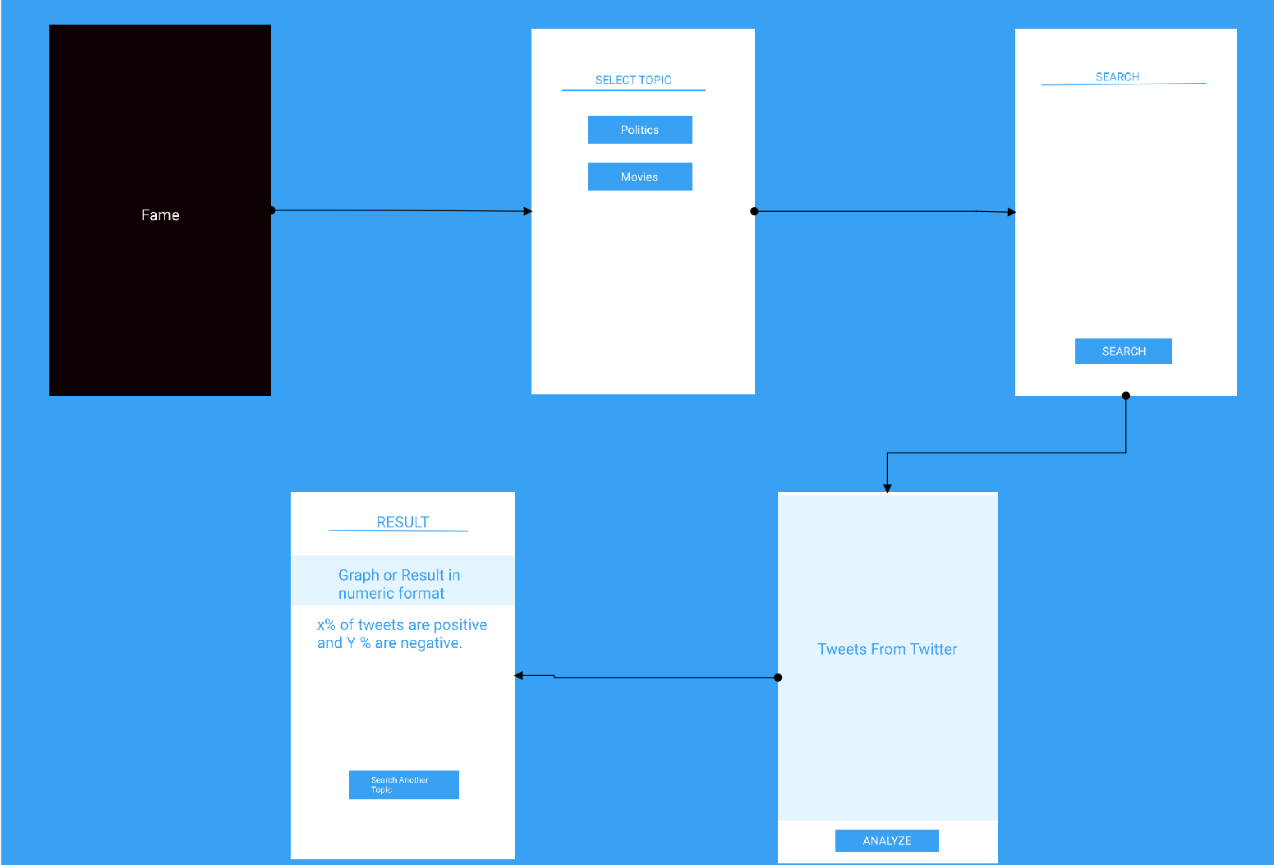
Flow of UI process
SentiMeter

Slide 9
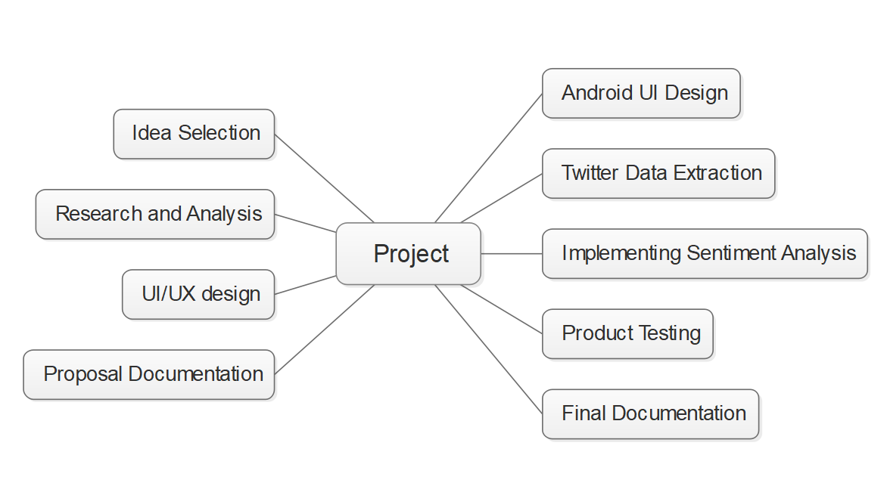
Project Tasks

Slide 10
Calculation Process
Tokenization of the sentiment texts
Removal of Texts that are not responsible for sentiment determination but used largely such as pronouns, prepositions, etc.
Construction of Histograms for every element
Construction of averaged histogram for both positive and negative class
Testing with KNN and nBayes classifiers

Slide 11
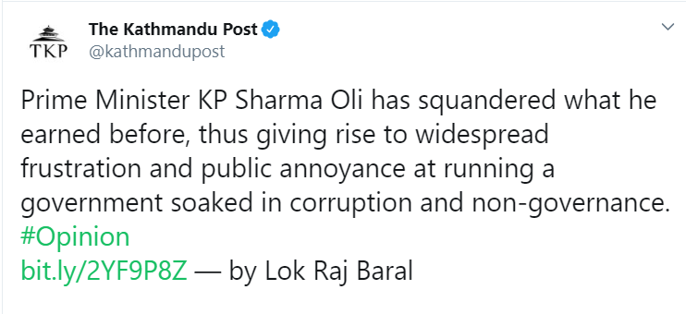
KNN
Positive | Negative
earned | Squandered Frustration Annoyance Soaked Corruption Non-governance
NBayes
Output
P(Positive)
P(Negative)

Slide 12
Technologies to be used
Java for Android development
Twitter Developer API to extract twitter data
Java for KNN and Nbayes
XML for Android UI

Slide 13
Tools to be Used
Figma
Edraw
Github
Android Emulator
Intelij
Microsoft Word
MS Powerpoint
Google Chrome

Slide 14
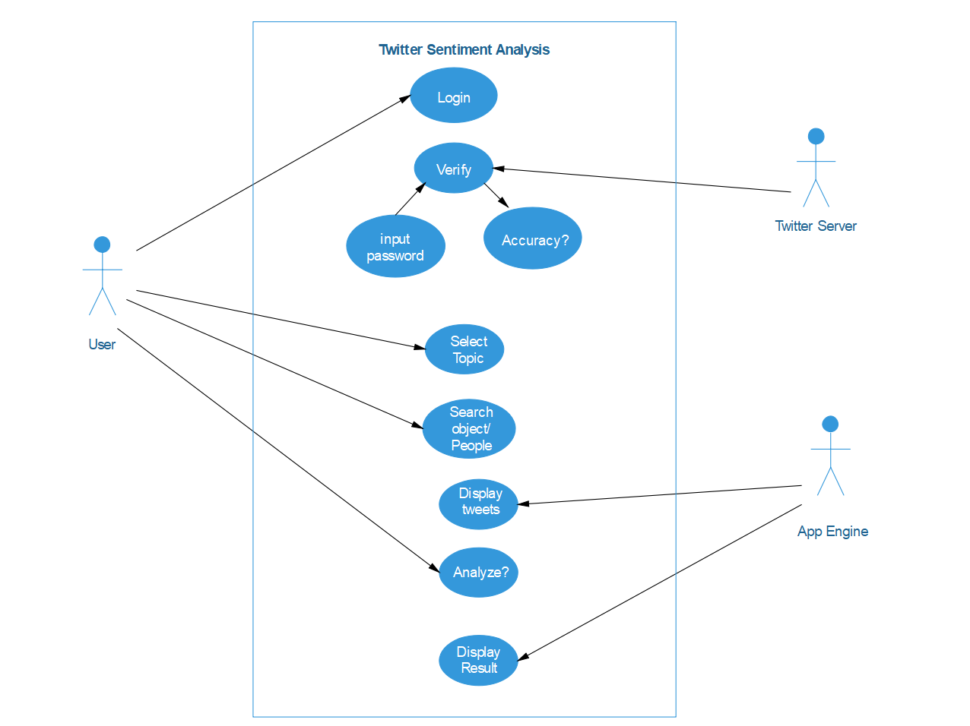
Use Case

Slide 15
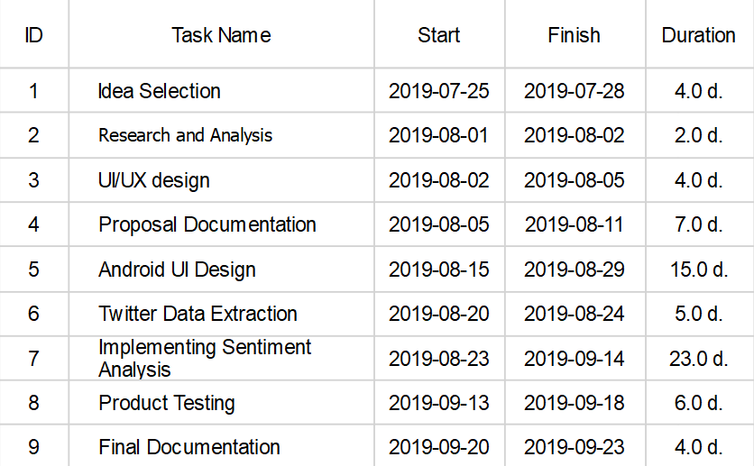
Time Schedule

Slide 16
Challenges and Limitation
Challenges
Limitation
Tokenizations of sentimental words
Importing Twitter data
Cannot identify humor and sarcasm, So sometime might be wrong.
We cannot assure 100% accuracy but the result is closest to human thoughts.
For now, this project is limited to the English language.

Slide 17
References
https://www.kaggle.com/vishaldwivedi/python-nltk-sentiment-analysis (Accessed on 10th August 10:24 PM )
https://www.geeksforgeeks.org/twitter-sentiment-analysis-using-python/ (Accessed onn 10th August 10:30 PM)

Slide 18
Thank you

