Slide 1


Reach · Engage · Innovate
CONNECTED IoT PLATFORM
A Predictive and Prescriptive Analytics Solution

Slide 2
Objective
To analyse the Honda car data for Delhi city.

Slide 3
Findings
4 vehicles were observed in Delhi 2 Amaze and 2 City.
The data is from 21 September to 6 October, 2015.
It was observed that all the cars were Diesel.
No Hard Acceleration or Hard Breaking was observed in any of the trips.
The trips were divided in 3 categories according to Distance:
Cat 1: Distance less than 5 km.
Cat 2: Distance from 5 – 20 km.
Cat 3: Distance Above 20 km.
Cars\No. of Trips | Distance less than 5 km | Distance 5 – 20 km | Distance greater than 20 km
Amaze 1 | 1 | 2 | 3
Amaze 2 | 7 | 33 | 6
City 1 | 0 | 4 | 3
City 2 | 3 | 2 | 3

Slide 4
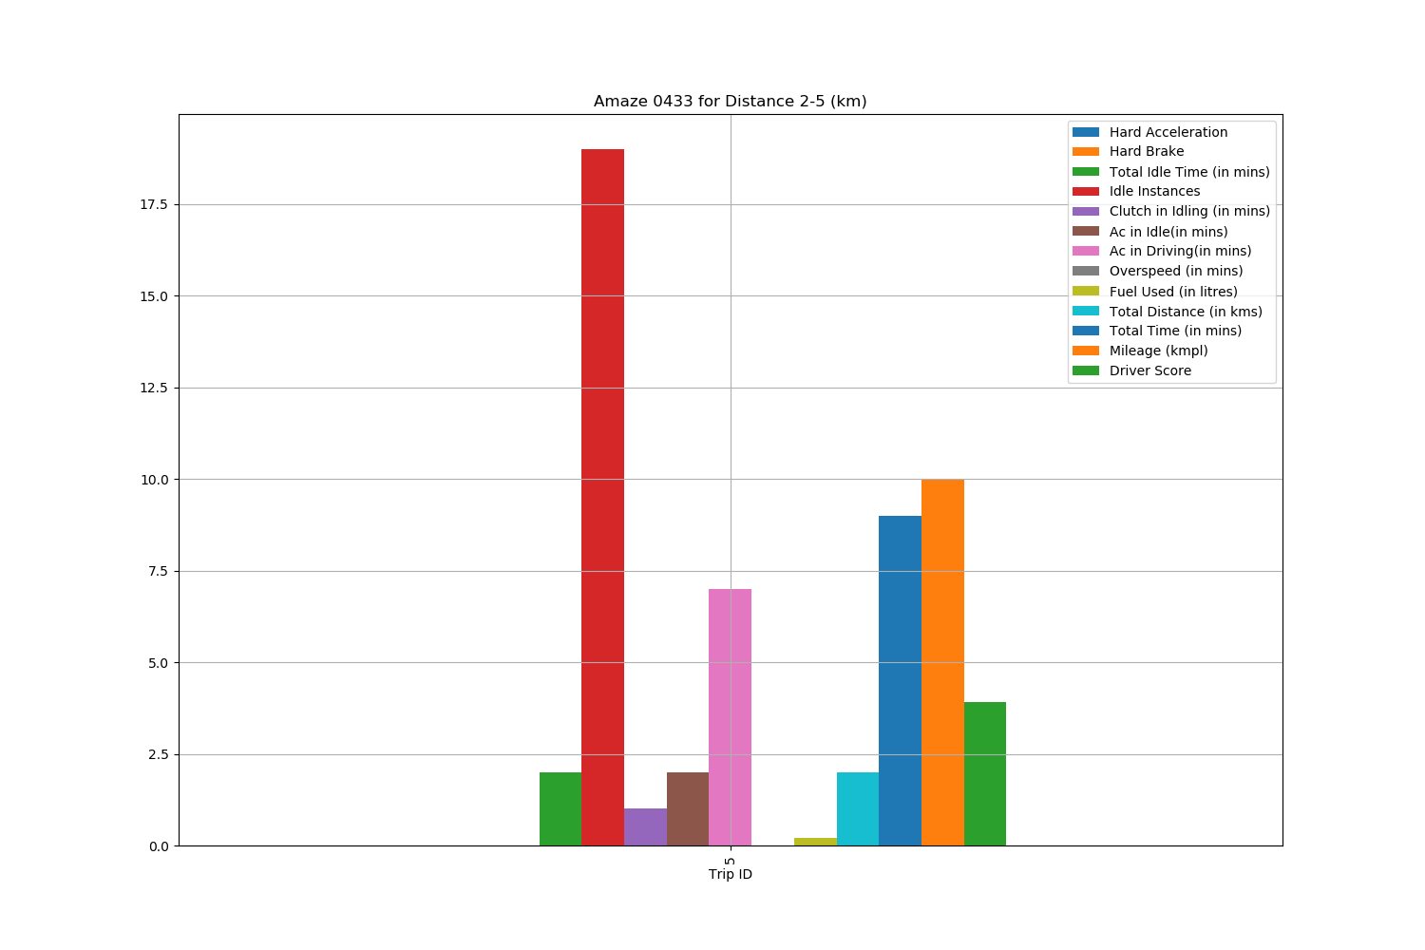
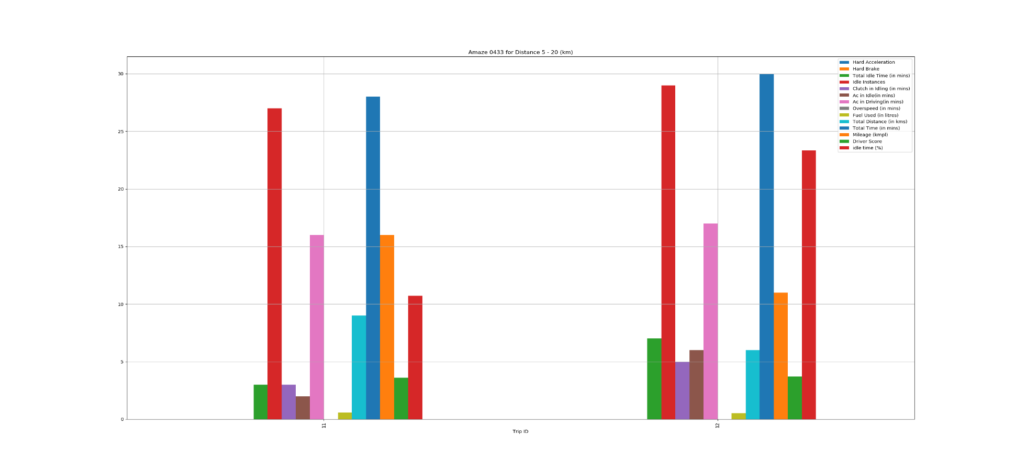
Amaze 1
Findings:
Idle Instances are high for distance less than 20 km signifying traffic in the city.
No overspeeding was observed.
Mileage for shorter distances was observed to be 10-16 kmpl which is very low.
Driver Score is around 4 for these trips.

Slide 5
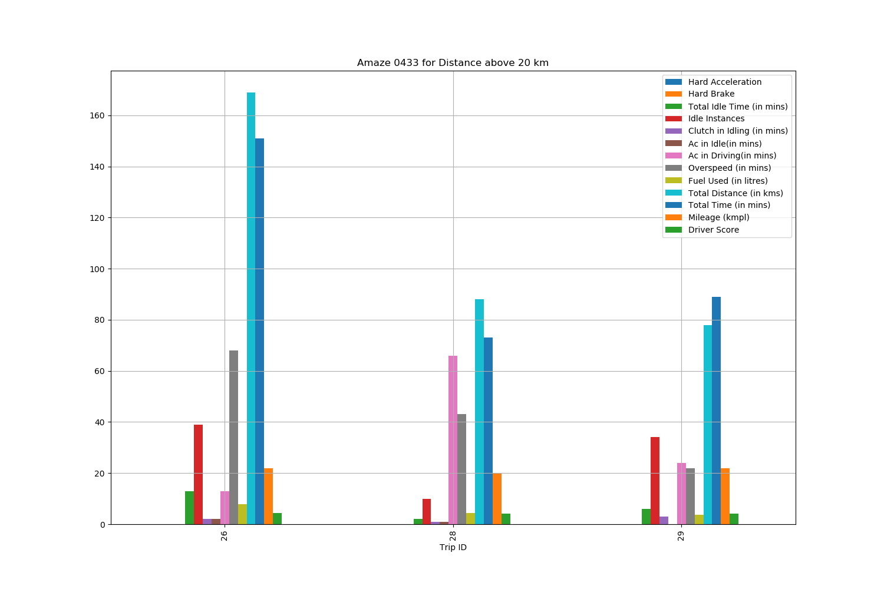
Findings:
Idle Instances are low for distances more than 20 km.
20 % – 60 % overspeeding was observed in longer trips.
Mileage for longer distances was observed to be above 20 kmpl which is good.
Driver Score is around 4 for these trips.
It was observed that Fuel Consumption was more in case of overspeeding.

Slide 6
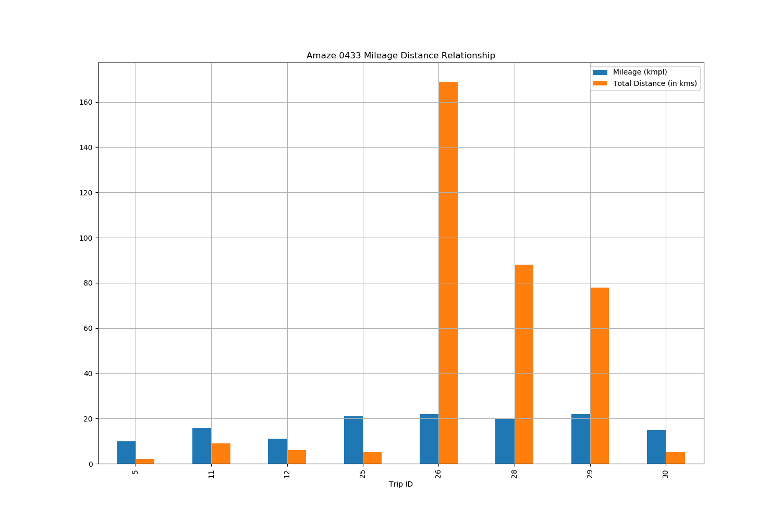
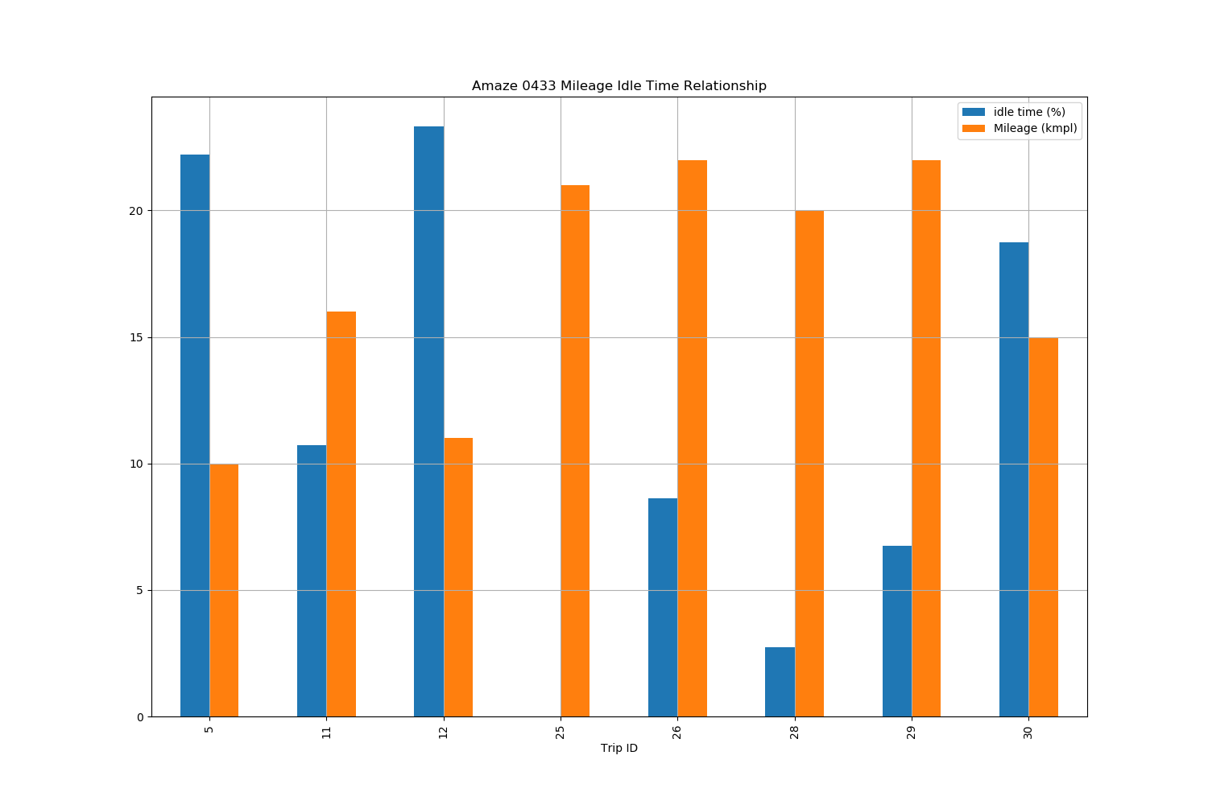
Findings:
Graph 1 is showing a positive correlation between Mileage and Total Distance.
Graph 2 is showing a negative correlation between Mileage and Total Idle time, i.e. Mileage will reduce as the Idle Time increases.

Slide 7
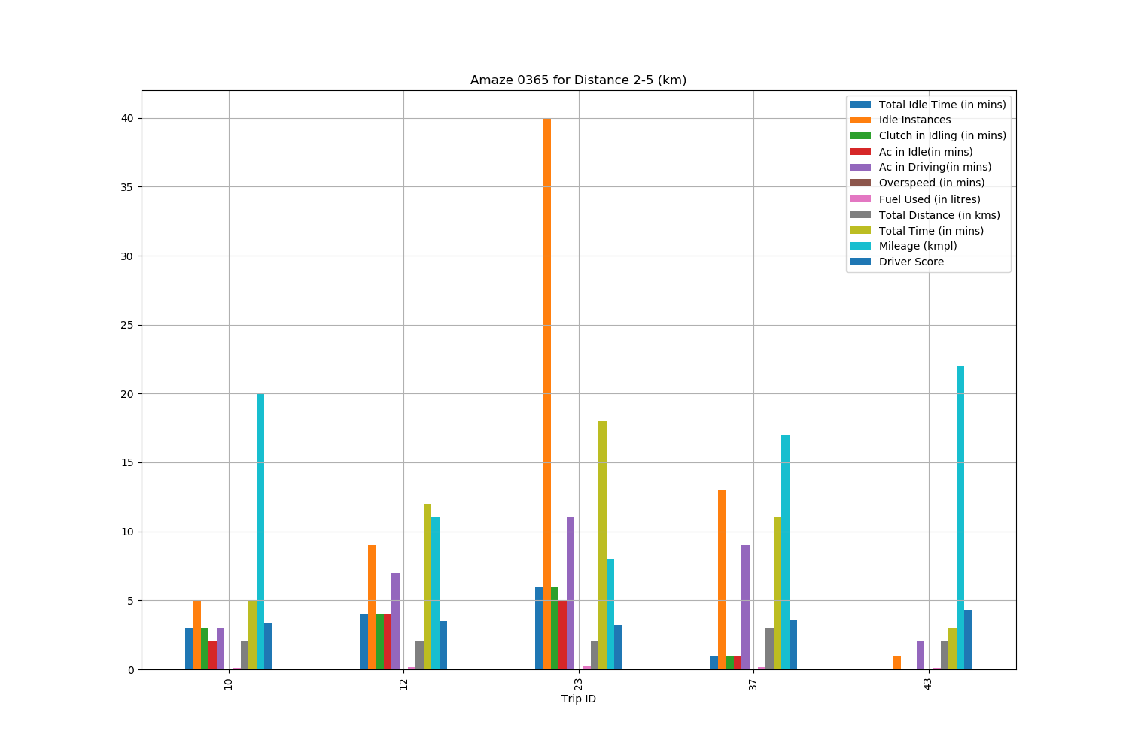
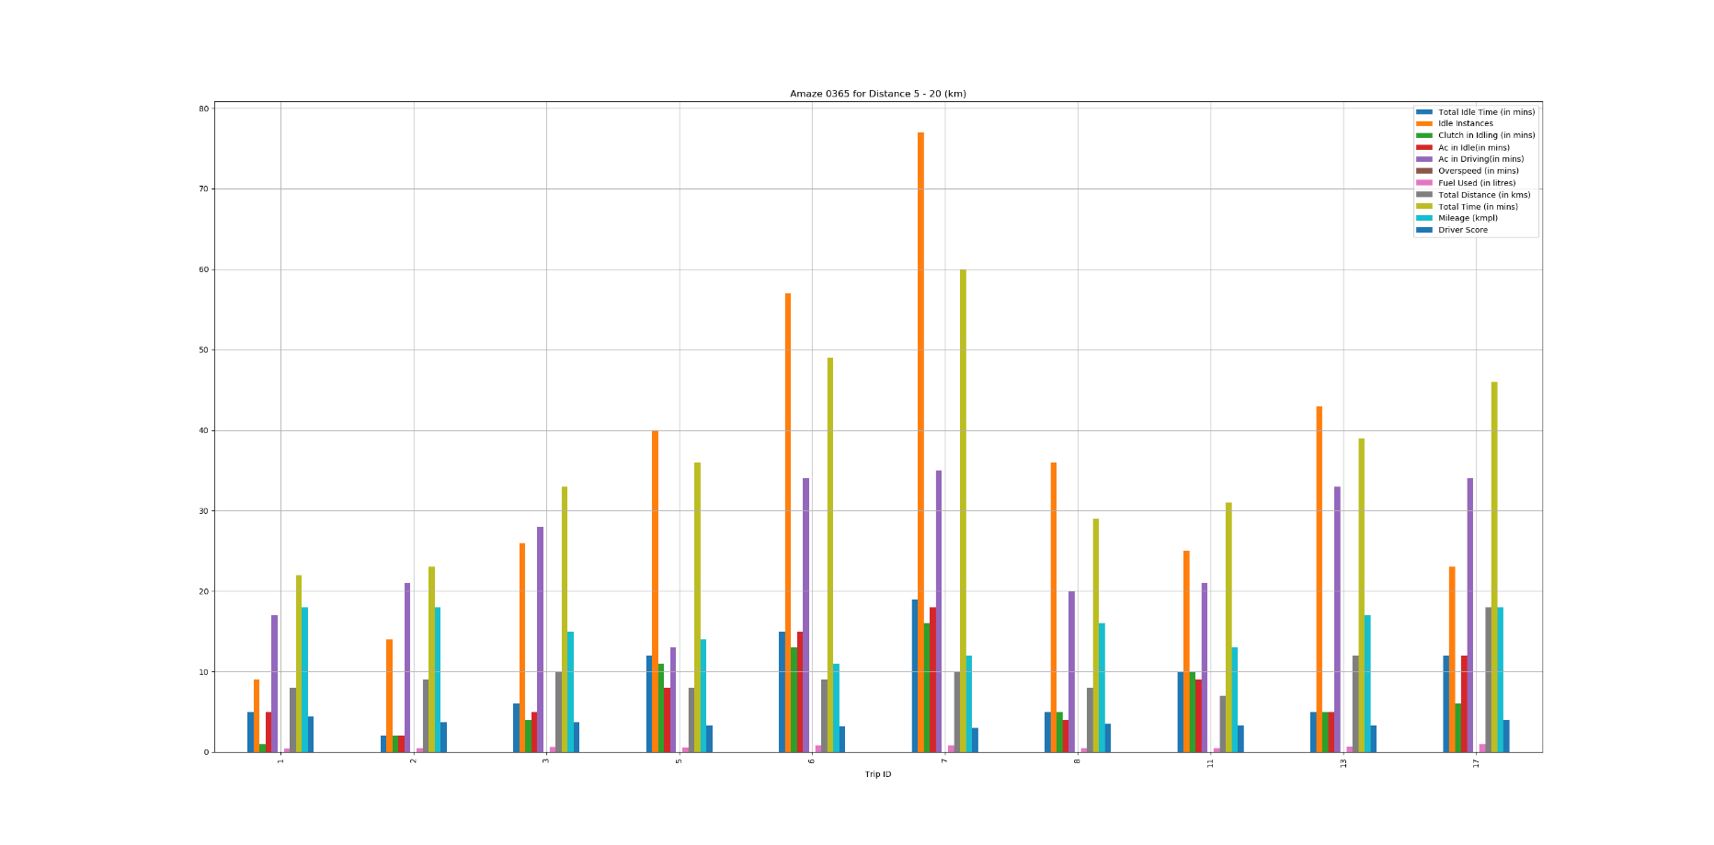
Amaze 2
Findings:
Idle Instances are high for distances less than 20 km signifying traffic in the city.
No overspeeding was observed.
Mileage for shorter distances was observed to be 8-22 kmpl which is very low.

Slide 8
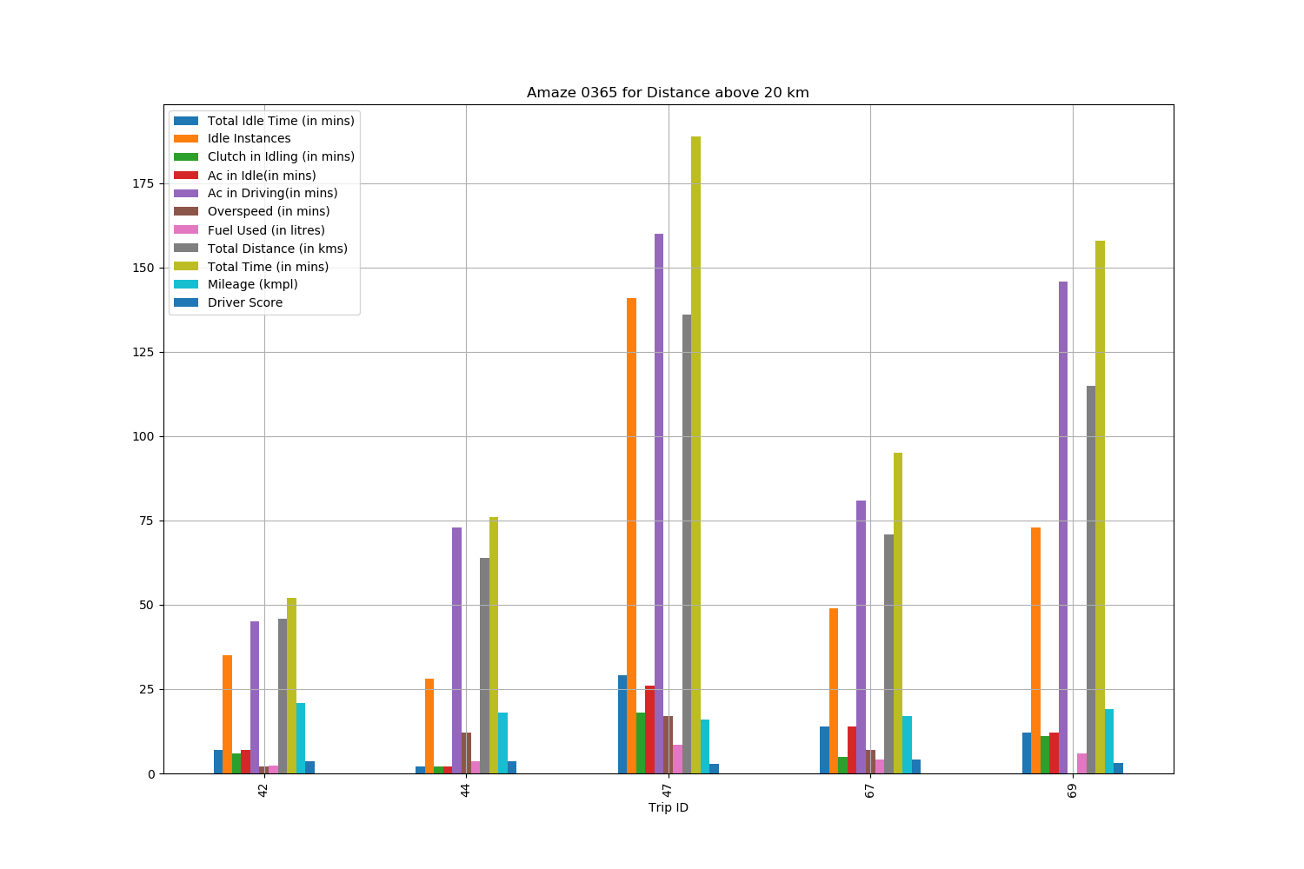
Findings:
Idle Instances are low for distances more than 20 km.
8% - 20 % overspeeding was observed in longer trips.
Mileage for longer distances was observed to be above 20 kmpl which is good.
It was observed that Fuel Consumption was more in case of overspeeding.

Slide 9
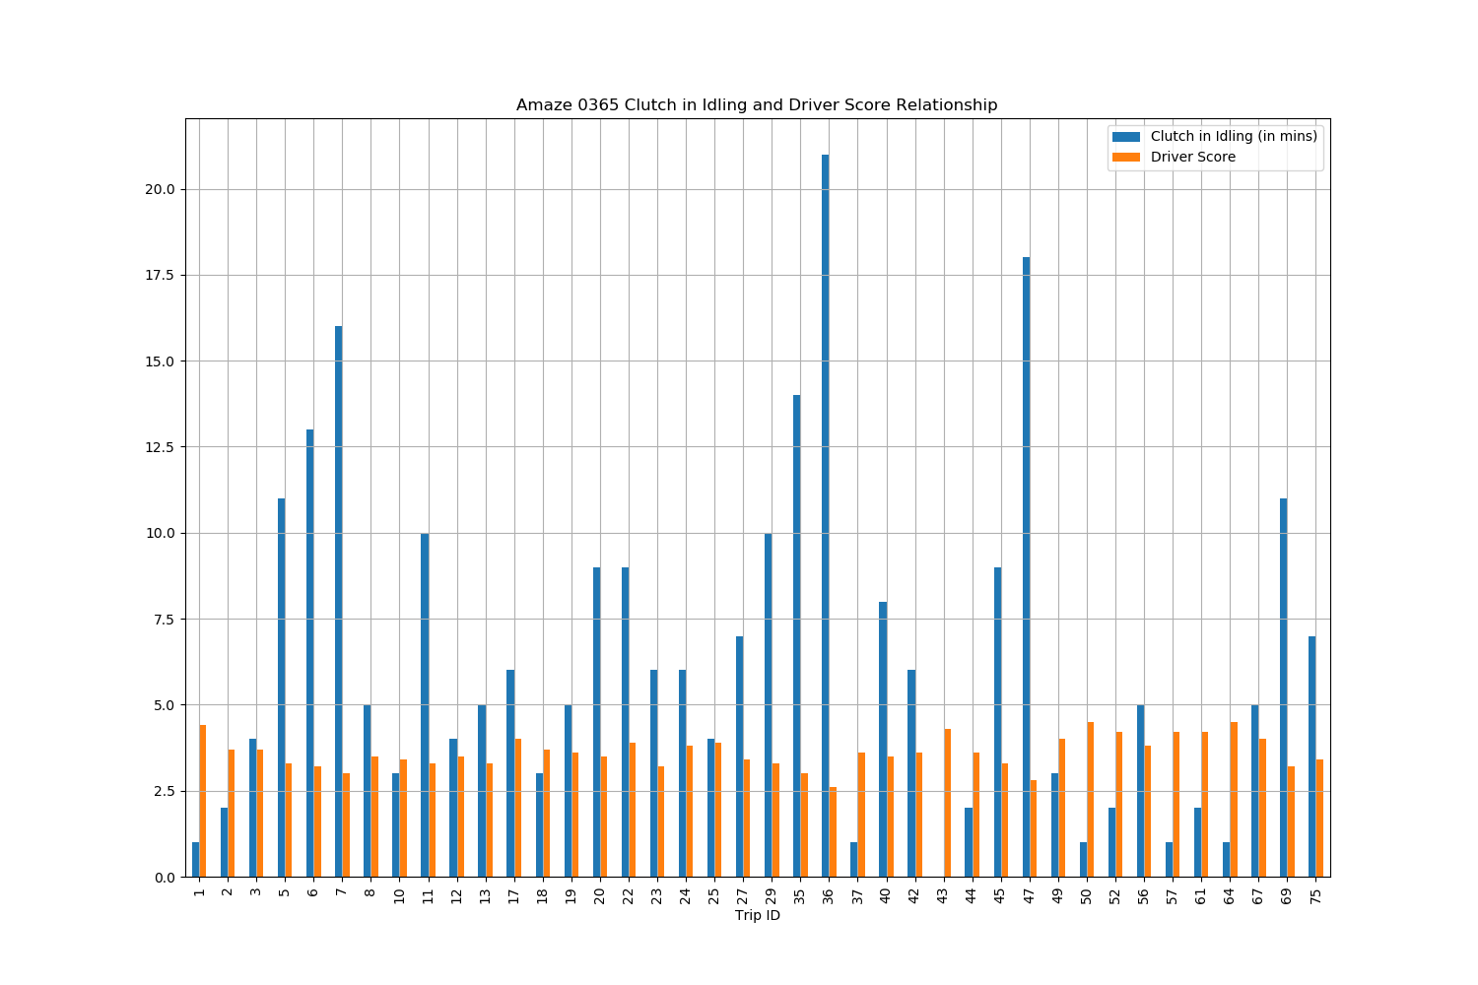
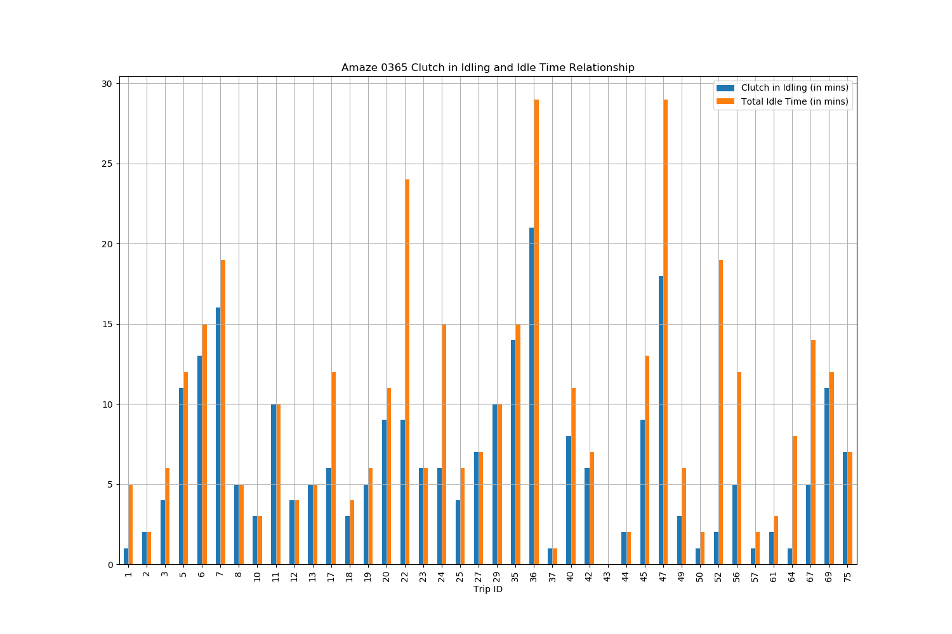
Findings:
Graph 1 is showing a negative correlation between ‘Clutch pressed in Idling’ and ‘Driver Score’.
It was observed in graph 2 that 50% - 80 % of the times the clutch was pressed in Total Idle Time of all trips.

Slide 10
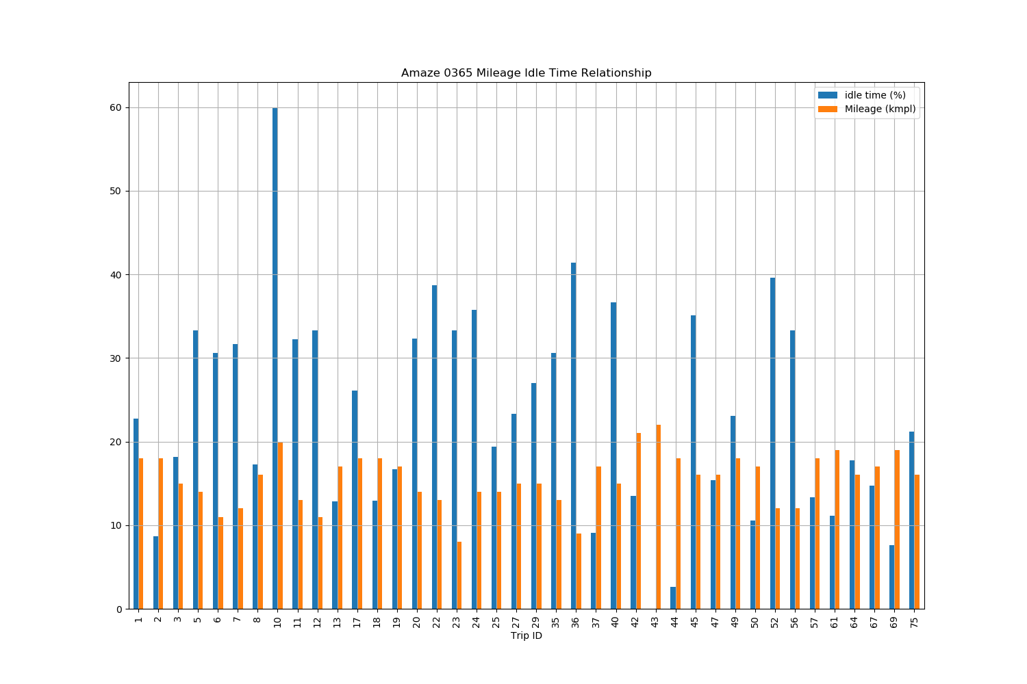
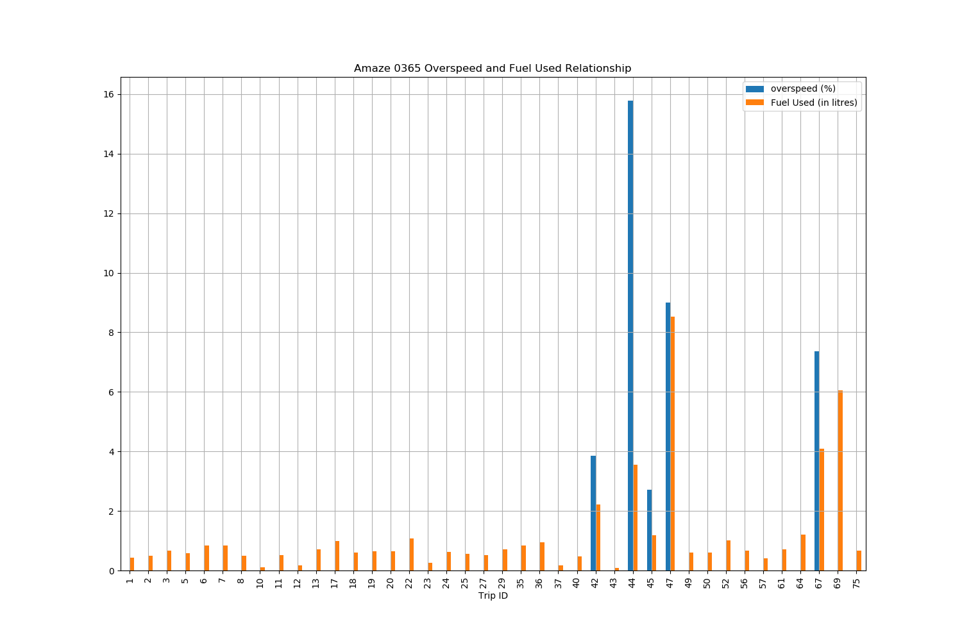
Findings:
Graph 1 is showing a negative correlation between Mileage and Total Idle time, i.e. Mileage will reduce as the Idle Time increases.
It was observed in Graph 2 that Fuel Consumption was more in case of overspeeding.

Slide 11
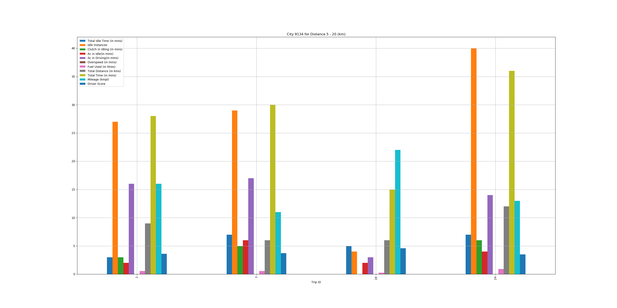
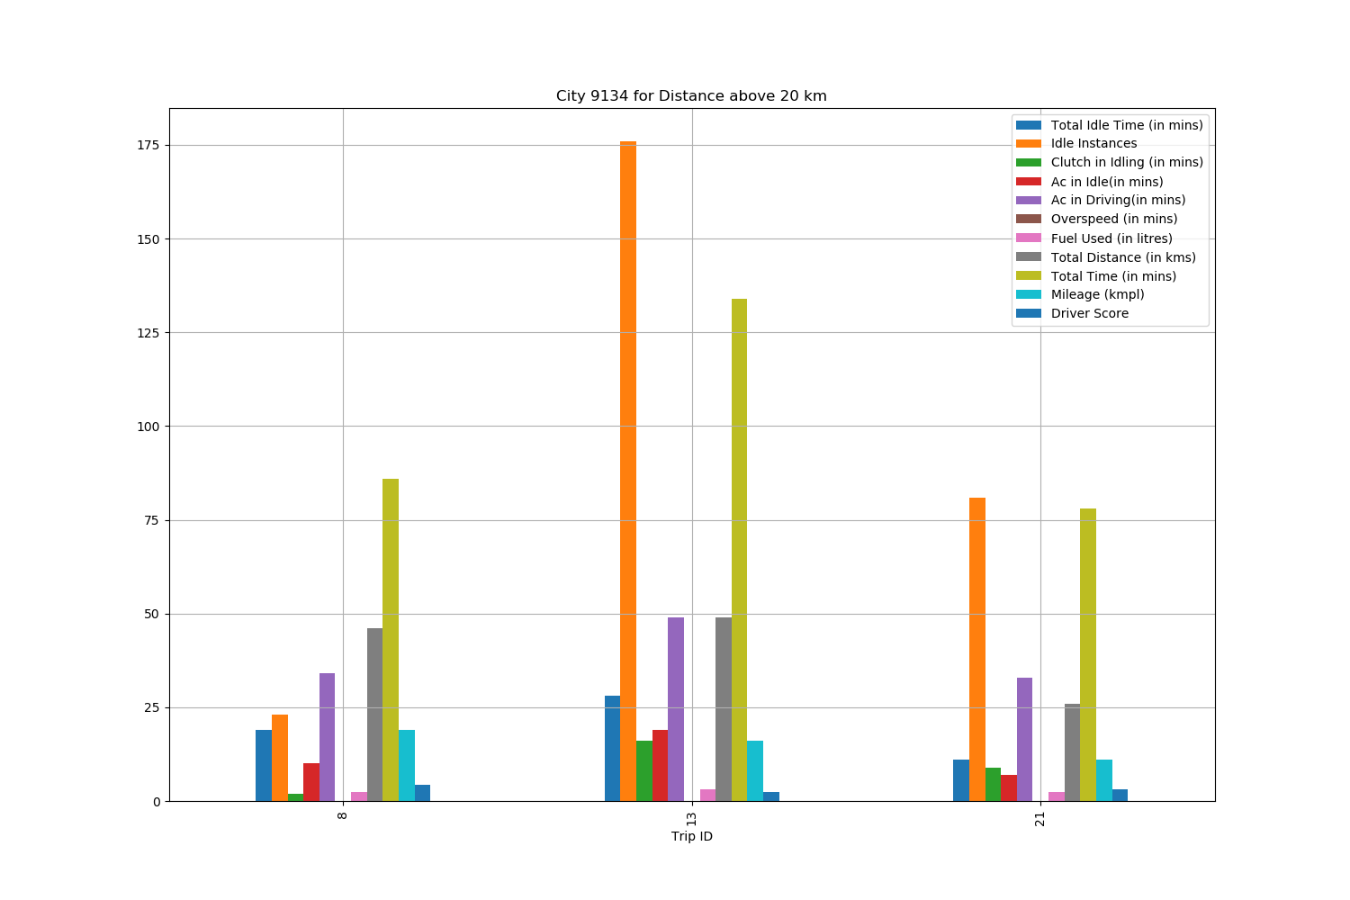
City 1
Findings:
Idle Instances are high for distance less than 20 km but less for distance greater than 20 km.
No overspeeding was observed across all trips.

Slide 12
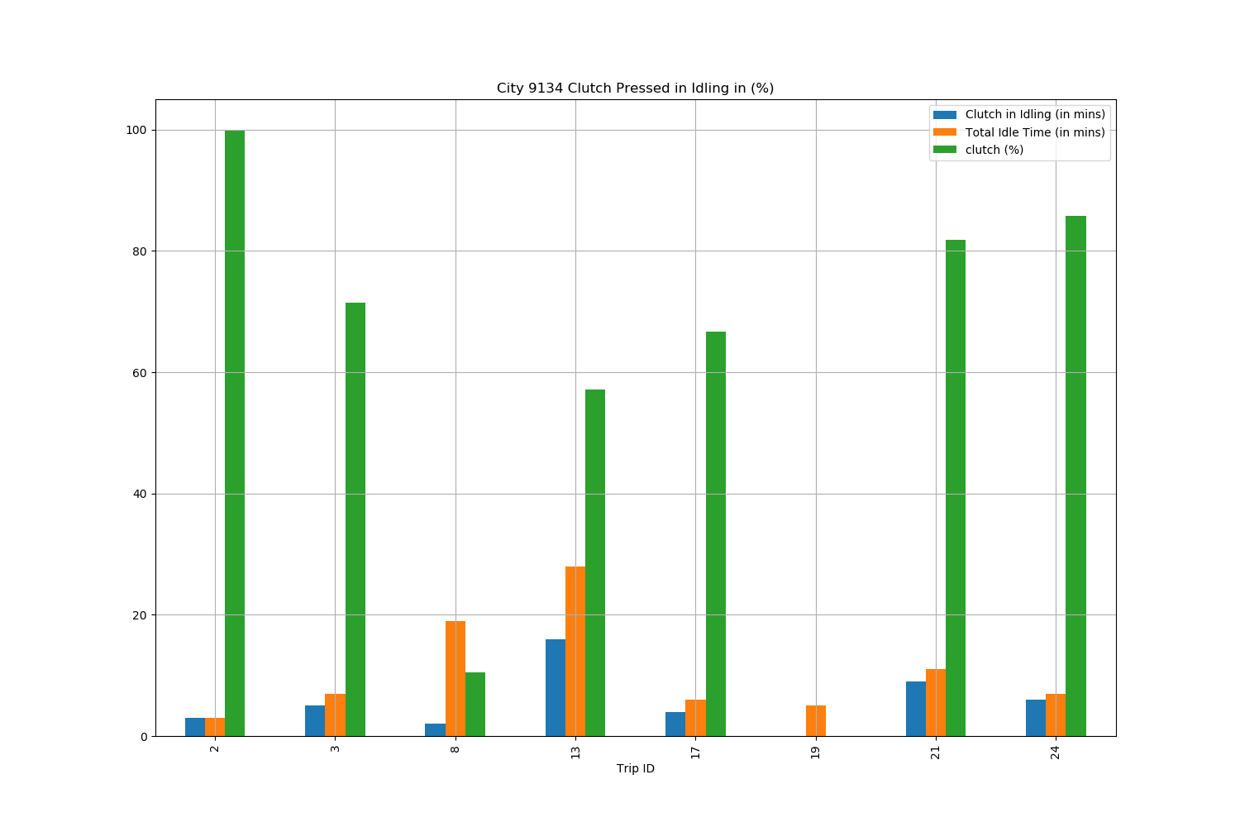
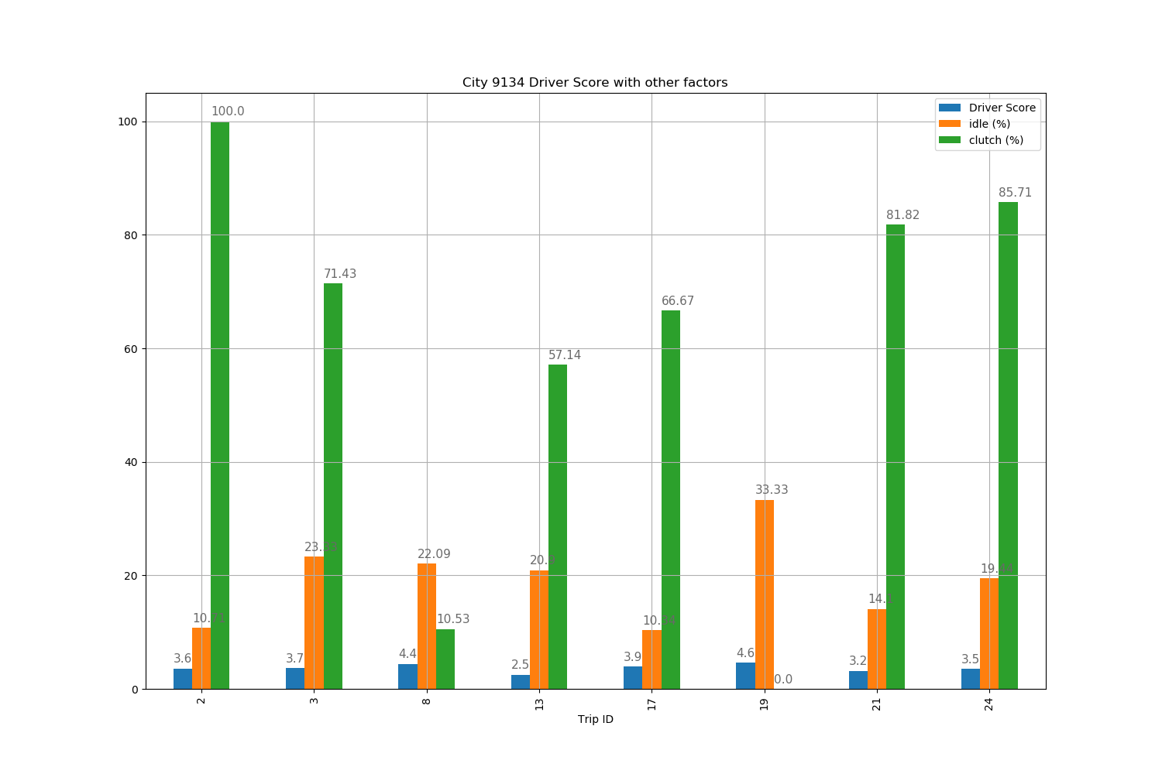
Findings:
In Graph 1 the Clutch was pressed for more than 60% of the Total Idle Time.
Graph 2 is showing the effect of Clutch pressed in Idle Time and Total Idle Time on Driver Score across all trips. The more these 2 parameters are the less the Driver Score will be.

Slide 13
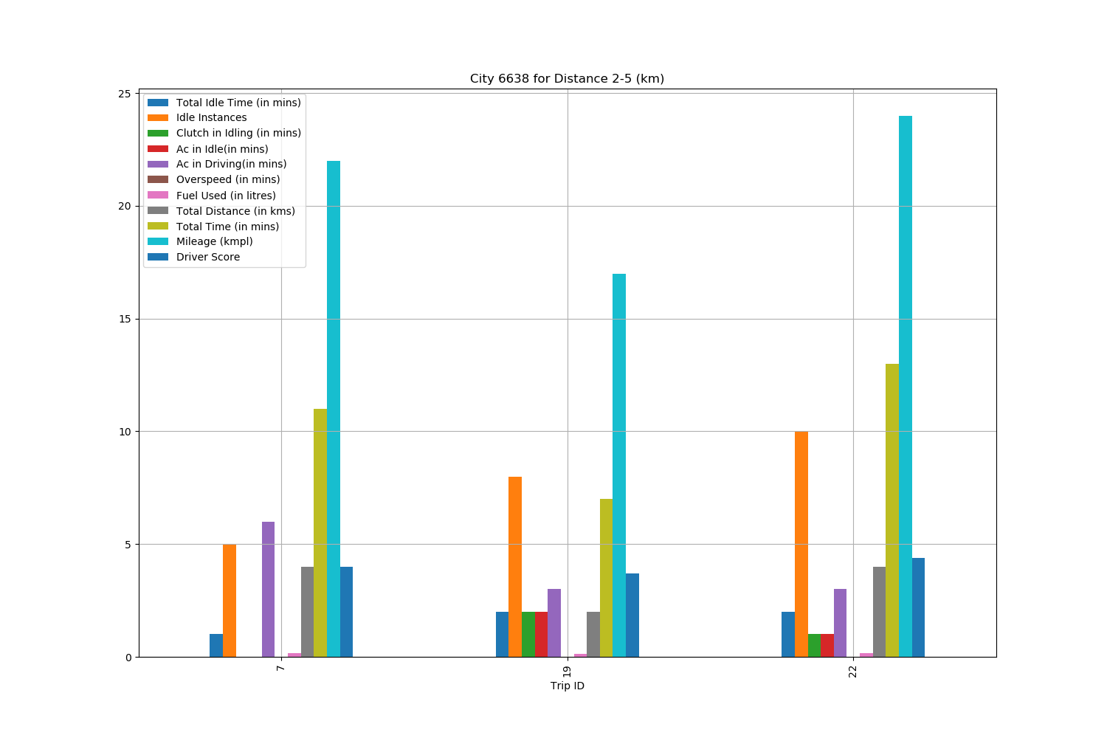
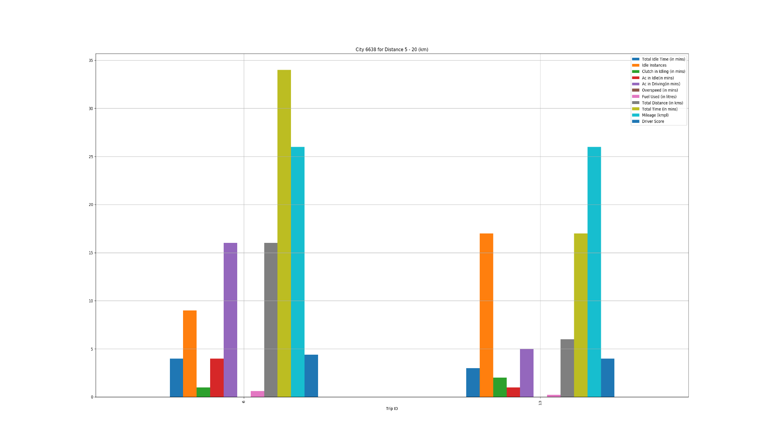
City 2
Findings:
Idle Instances are high for distances less than 20 km.
No overspeeding was observed.
Mileage for shorter distances was observed to be 17 - 24 kmpl.
Driver Score was around 4

Slide 14
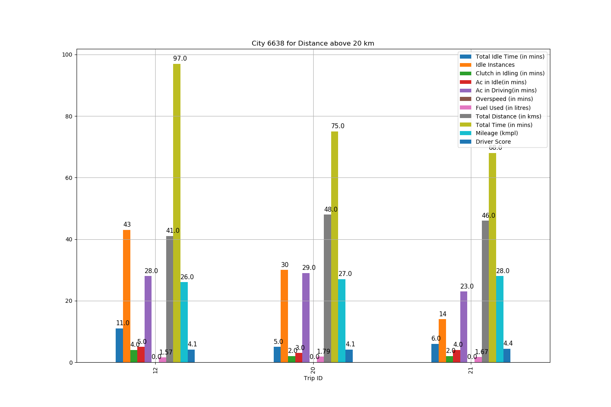
Findings:
Idle Instances are low for distances more than 20 km.
No overspeeding was observed.
Mileage for longer distances was observed to be above 26 kmpl which is good.
Driver Score is around 4 for these trips.

Slide 15
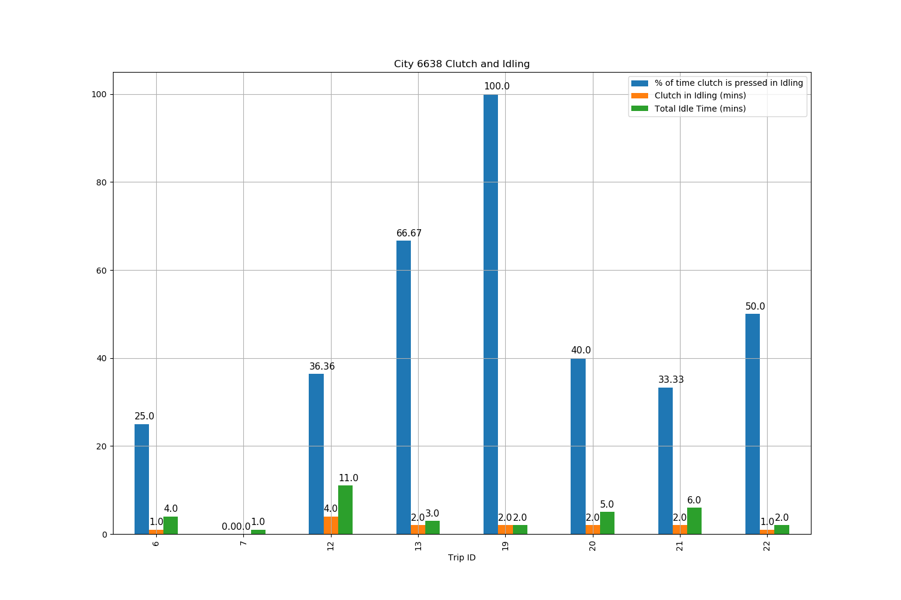
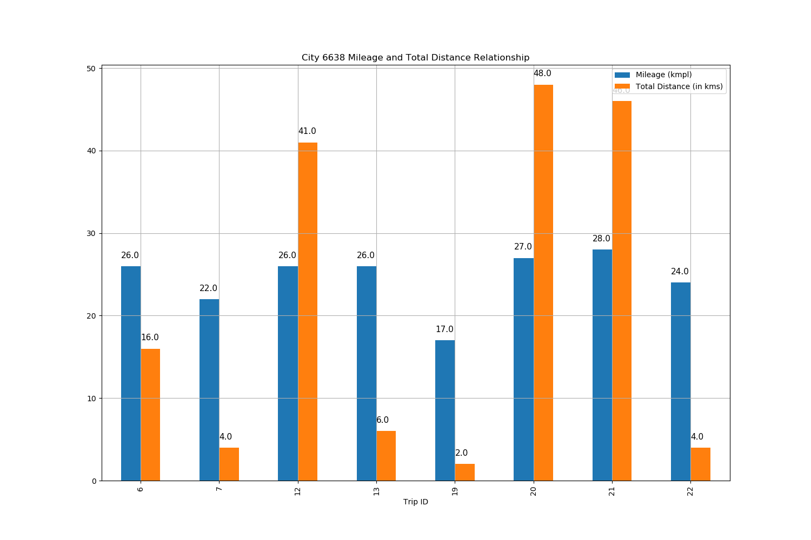
Findings:
In graph 1 it was observed that for more than 30% of the Idle Time, Clutch was pressed.
Graph 2 is showing Mileage is more for long distances as compared to short distances.

Slide 16
Summary
Idle Instances are high for short distance and less for long distance.
Fuel Consumption is affected by:
Overspeeding
AC on/off
Idling Instances and Idling Time
Clutch pressed in Idling.
Mileage is majorly affected by Idling Time
Driver Score is majorly affected by Clutch pressed during Idling.
AC was on in all the trips.
No Overspeeding was recorded in any of the trips of Honda City cars as compared to Honda Amaze.
Mileage of City cars are better than Amaze cars.

Slide 17
Thank you!
Dr. Amit Shekhar
amit@igloble.com
Mob: +91 9650077258
www.iotasmart.com

