Slide 1
{admiral}
ADaM in R Asset Library

Slide 2

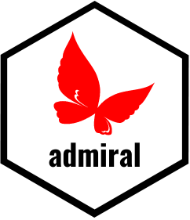

How It All Started
The ADaM in R Asset Library
Open-source modular toolkit for generating ADaM in R
Notes:
It all started in early 2021 when Roche and GSK joined source to develop an open-source modular toolkit for programming ADaM datasets in R—{admiral}.
LinkedIn post -> kick off meeting -> joint development
Across the pharmaceutical industry we all face the same challenge when it comes to analysis and creating ADaM datasets!
We all work on our own “standard solutions” for ADaMs
We all face the challenge of a changing and novel data landscape
New therapeutic areas and analysis concepts
Individual “blackbox” solutions instead of re-use, co-creation and sharing
We tend to see siloed and hierarchical approaches as more efficient than a collaborative approach

Slide 3
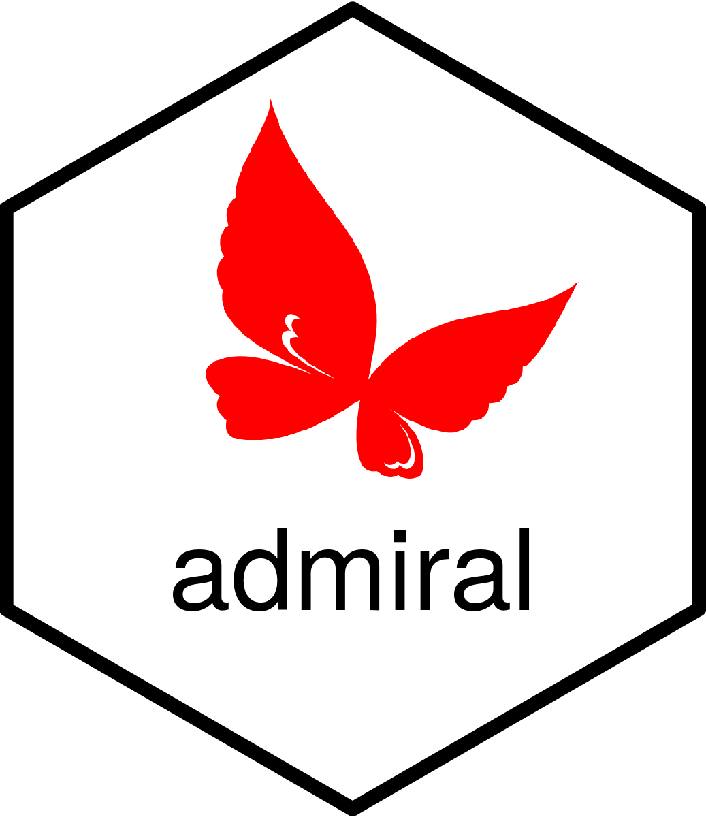
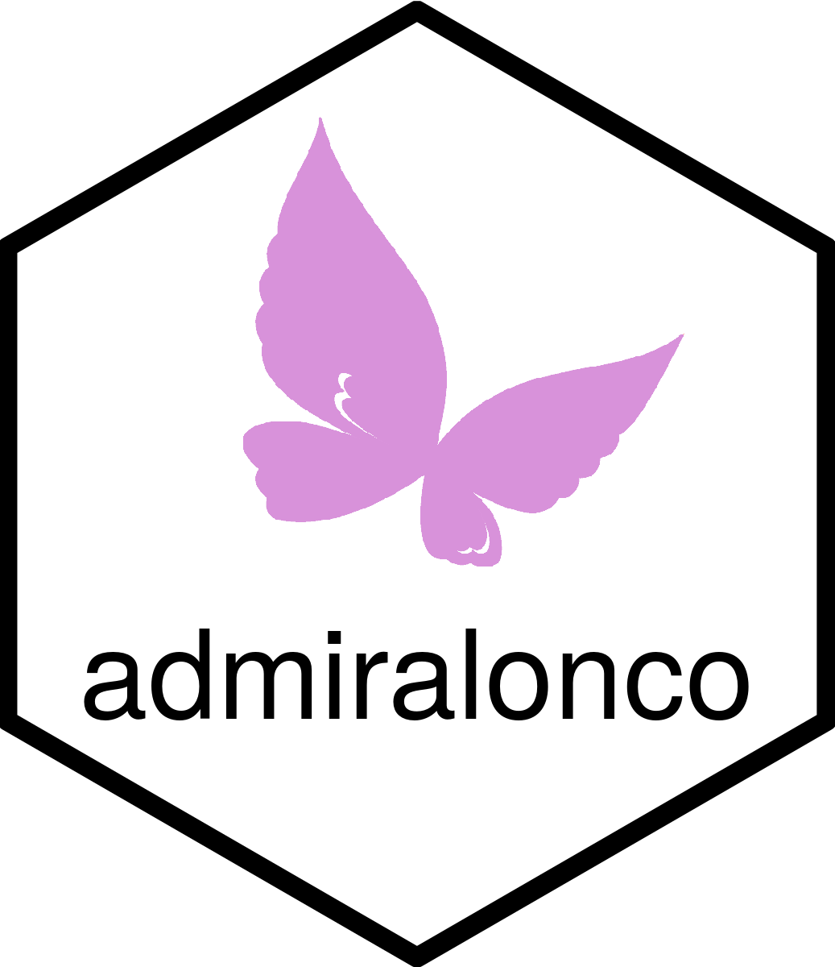
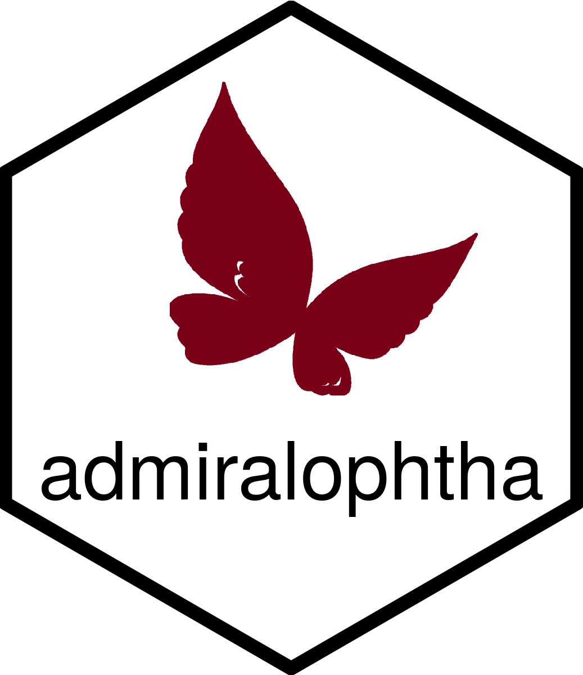
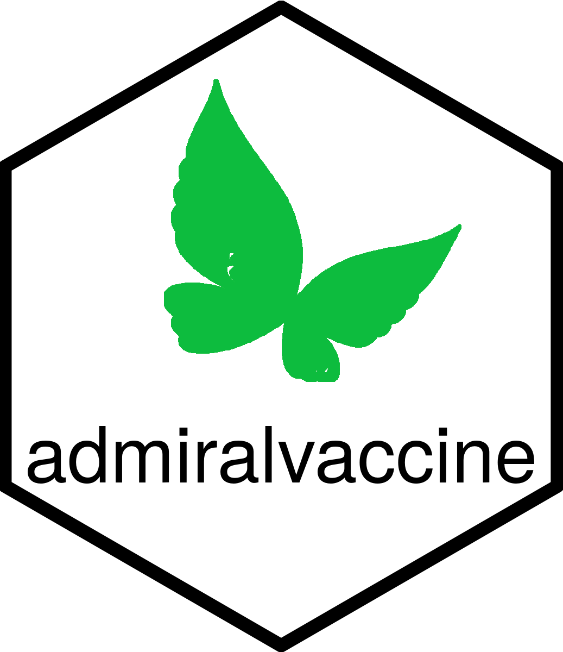





Ecosystem

Slide 4
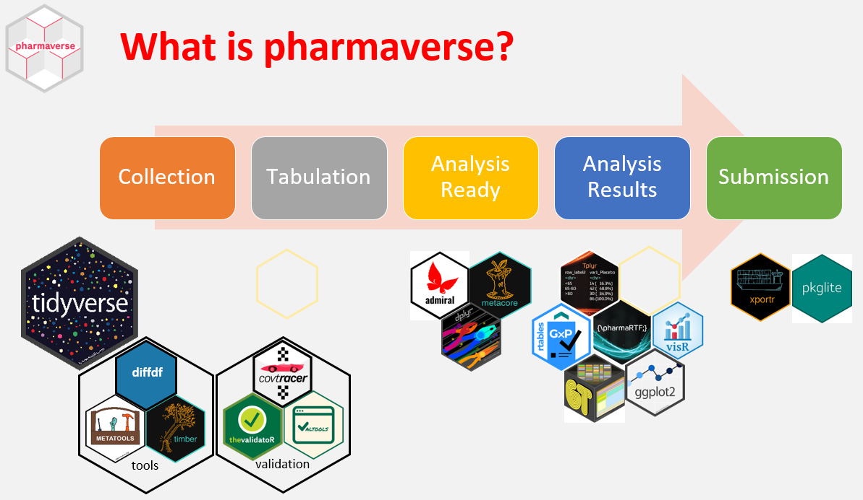

Slide 5

Modular Approach
pre_processing()
create_advs(
dataset_name = vs,
param_01 = ,
param_02 = ,
...,
param_99 =
)
post_processing()
vs %>%
derive_vars_a() %>%
derive_vars_b() %>%
study_vars_x() %>%
derive_param_c() %>%
project_param_y() %>%
...
Notes:
Think of admiral as a toolbox of modular blocks (toolbox of R functions) →
each block has a stand alone purpose (each function provides a specific functionality)
Data Scientists can create their own blocks (create own R functions)
Constructing an ADaM dataset should become like building out of blocks that are based on admiral modular functions and user-created modular functions.

