Slide 1
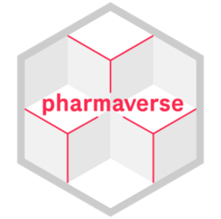
Contributing To The Pharmaverse!

Slide 2
You’ve now learned at a high level how to go from STDM to an actual display
Packages we’ve used are all part of the pharmaverse!

Slide 3
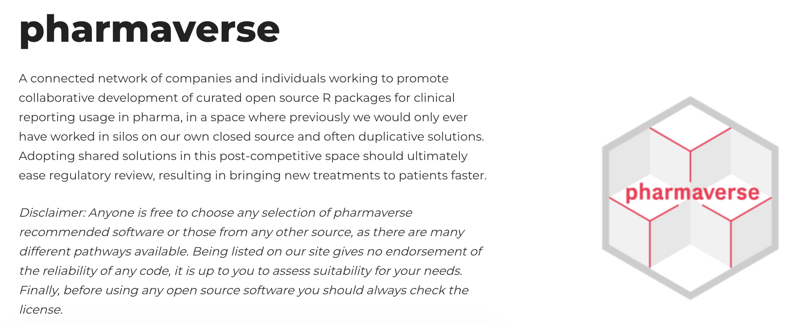
What is the pharmaverse?
pharmaverse.org

Slide 4
Why use the pharmaverse?
Leverage what others have build
Avoid mistakes when coding from scratch
Support the open-source revolution in pharma

Slide 5
Why contribute to the pharmaverse?
…or open-source in general
So many reasons… (Pick your favorite!)
Collaboration
Rapid Innovation
Cost Savings
Transparency
Reproducibility
Access to Talent
Standardization

Slide 6

I. Collaboration
Open-source software enables collaboration with other organizations, which can lead to faster development and more comprehensive testing and validation of the software.

Slide 7
II. Rapid Innovation
Because open-source software is often developed collaboratively, it can benefit from a faster pace of innovation than proprietary software. New features and capabilities can be added more quickly, and bugs and issues can be addressed more efficiently.

Slide 8
III. Cost Savings
Open-source software can be developed and maintained at a lower cost compared to proprietary software, as the development and maintenance costs are distributed across a larger user and developer base.

Slide 9
IV. Transparency
Open-source software is transparent, meaning that all users have access to the source code and can review it, test it, and provide feedback. This can increase confidence in the software and make it easier to identify and address issues.

Slide 10
V. Reproducibility
Open-source is hard requirement for reproducibility. Only open-source code can guarantee that someone other than the original author can reproduce a particular analysis.

Slide 11
VI. Access to Talent
Open-source software development can attract a wider pool of talent, including volunteers and independent developers who are passionate about the project. This can bring new perspectives and ideas, and can help the project to grow and evolve over time.

Slide 12
VII. Standardization
Open-source software can help to standardize the submission and review of regulatory data, which can improve consistency and accuracy across different submissions.

Slide 13
Contribution levels
Use the packages

Slide 14
Contribution levels
Use the packages
Submit Issues
Documentation Enhancements
Feature Requests
Bug Reports

Slide 15
Opening an Issue
If you saw a discrepancy or typo in the documentation of a package used today, open an issue pointing to the documentation and what you think should be fixed
Find the GitHub page for the package
Click on “Issues” then “New issue”
Write the location of the discrepancy and what you think might be a better solution
Demo Time on admiral!

Slide 16
Opening an Issue (Innovator mode)
If you have a feature you would like to see in the package!
Find the GitHub page for the package
Click on “Issues” then “New issue”
Write out an explanation of the feature you would like to see and why
(optional) write pseudocode code content, detailing what you would expect and how you would like to interact with it

Slide 17
Opening an Issue (Advanced mode)
If you saw a bug today, open an issue with an MVP!
Find the GitHub page for the package
Click on “Issues” then “New issue”
Construct an MVP
Make issue you see reproducible (you can repeat the error)
See if you can simplify the code down to only the required parts
Run in a fresh R session to confirm
Use {reprex} to generate code content and write in a) the issue the error you see and b) what you would expect

Slide 18
Contribution Levels
Use the packages
Submit Issues
documentation
feature requests
bug
Submit Issues and (co)develop the PR
Join as a contributor – get in touch with the maintainer
All types of contributions are welcome!

Slide 19
Exercise Time! (50 minutes)
Form a group of group of 5
Find an issue across on of the pharmaverse packages
Hint: look for “good first issue”
Hint: Aim for documentation based issues
Once you find one, flag down an instructor
Lets work on fixing that bug!
One of the workshop leaders will walk around and help you.
Packages we worked on today:
https://github.com/pharmaverse/admiral
https://github.com/insightsengineering/teal
https://github.com/GSK-Biostatistics/tfrmt
https://github.com/GSK-Biostatistics/tfrmtbuilder

Slide 20
Close Out
Welcome to the Pharmaverse!
We hope you enjoyed your stay and want to come back to visit, maybe stay for a while

Slide 21
Post-Workshop Survey
Your feedback is crucial!
Data from the survey informs curriculum and format decisions for future conf workshops, and we really appreciate you taking the time to provide it
pos.it/conf-workshop-survey

