Slide 1
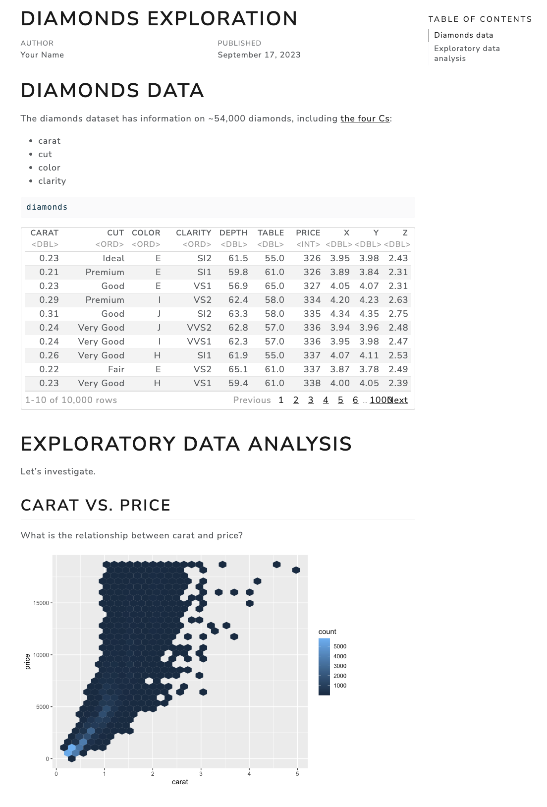
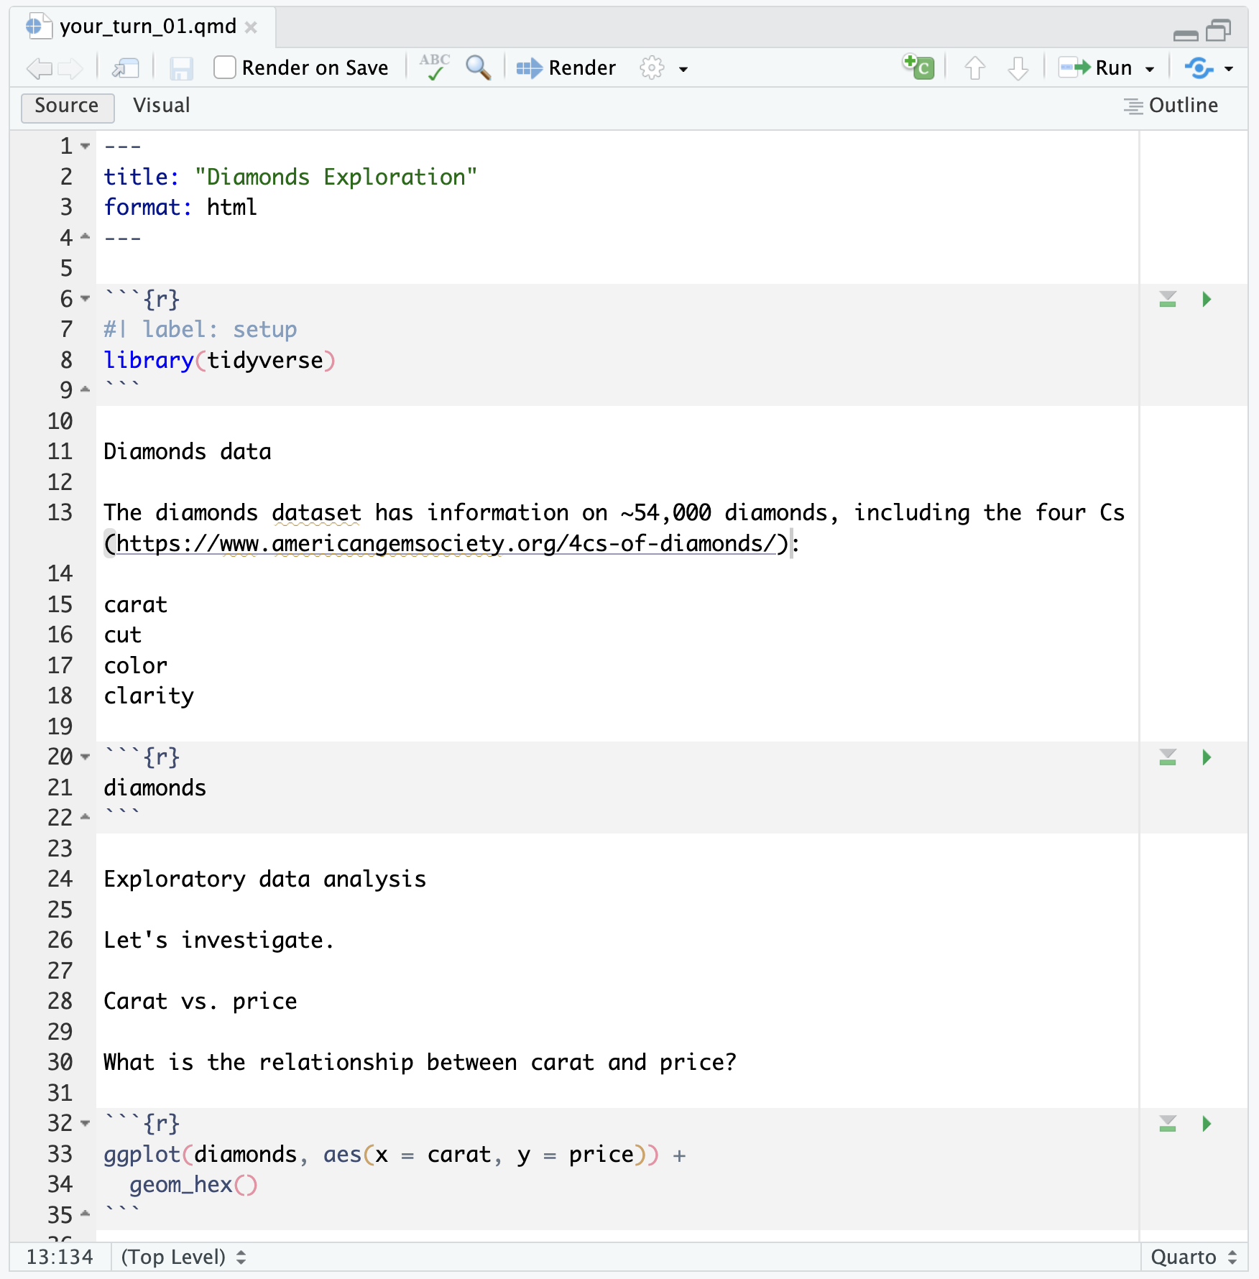
Markdown formatting
Chunk options
YAML metadata
1
2
3

