Slide 1

Recap, Contributing,& Discussion

Slide 2
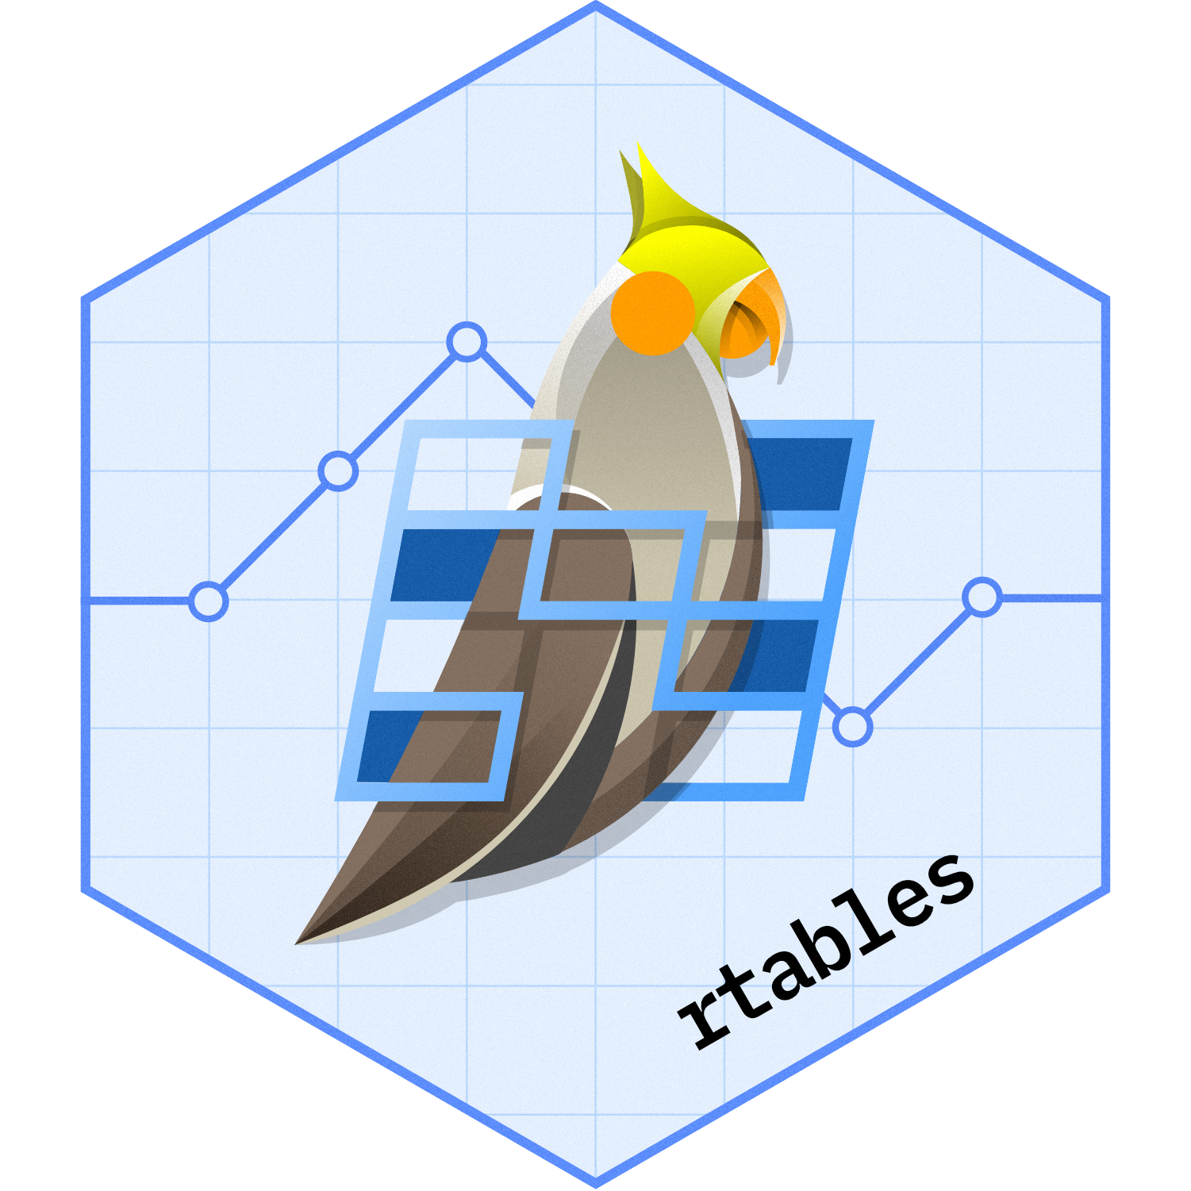

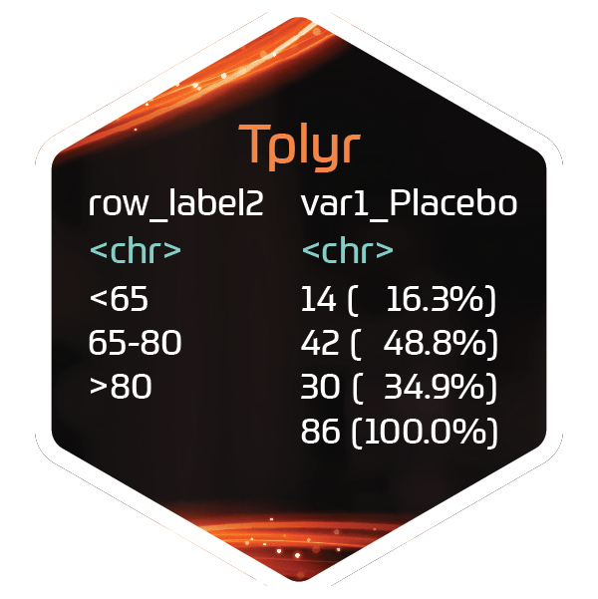






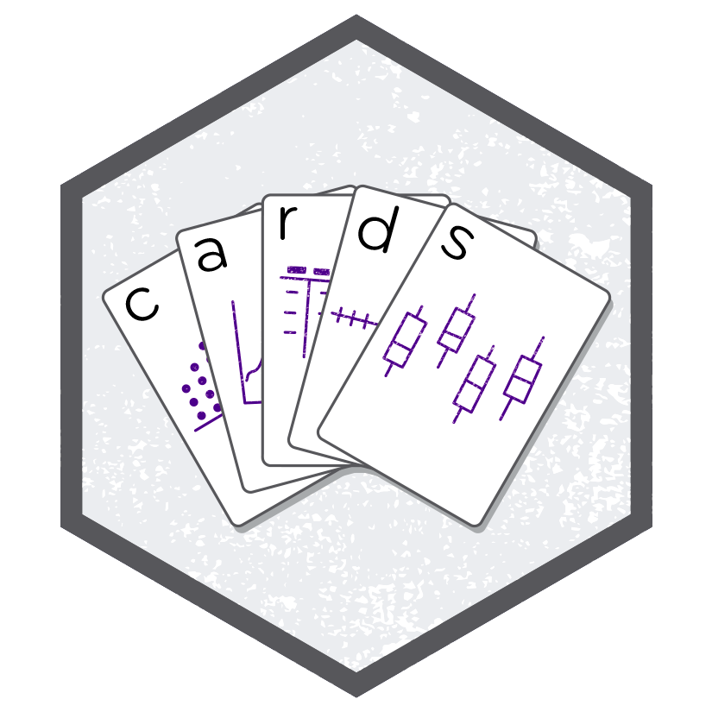
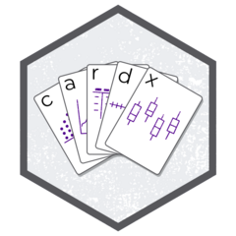


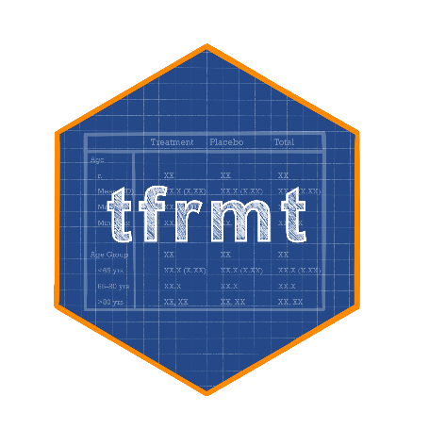


ADaMs
Outputs

Slide 3
ADaMs
Outputs

Slide 4
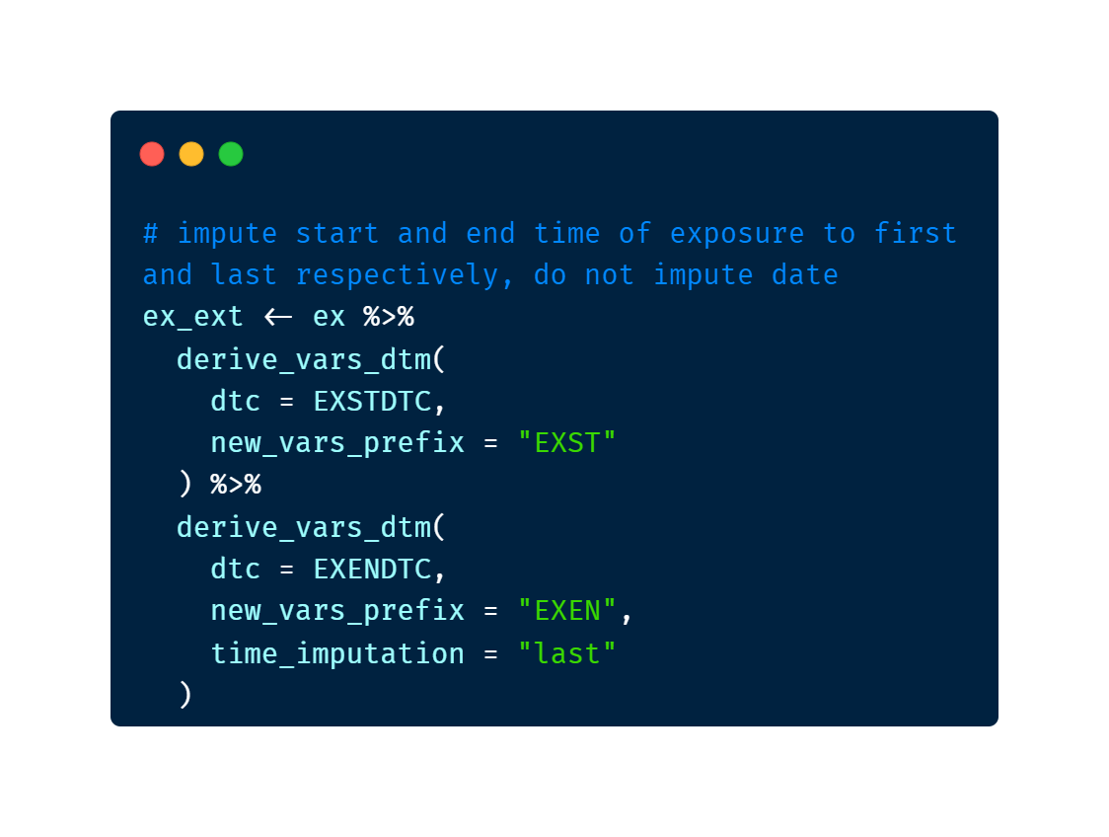

Slide 5
ADaMs
Outputs

Slide 6
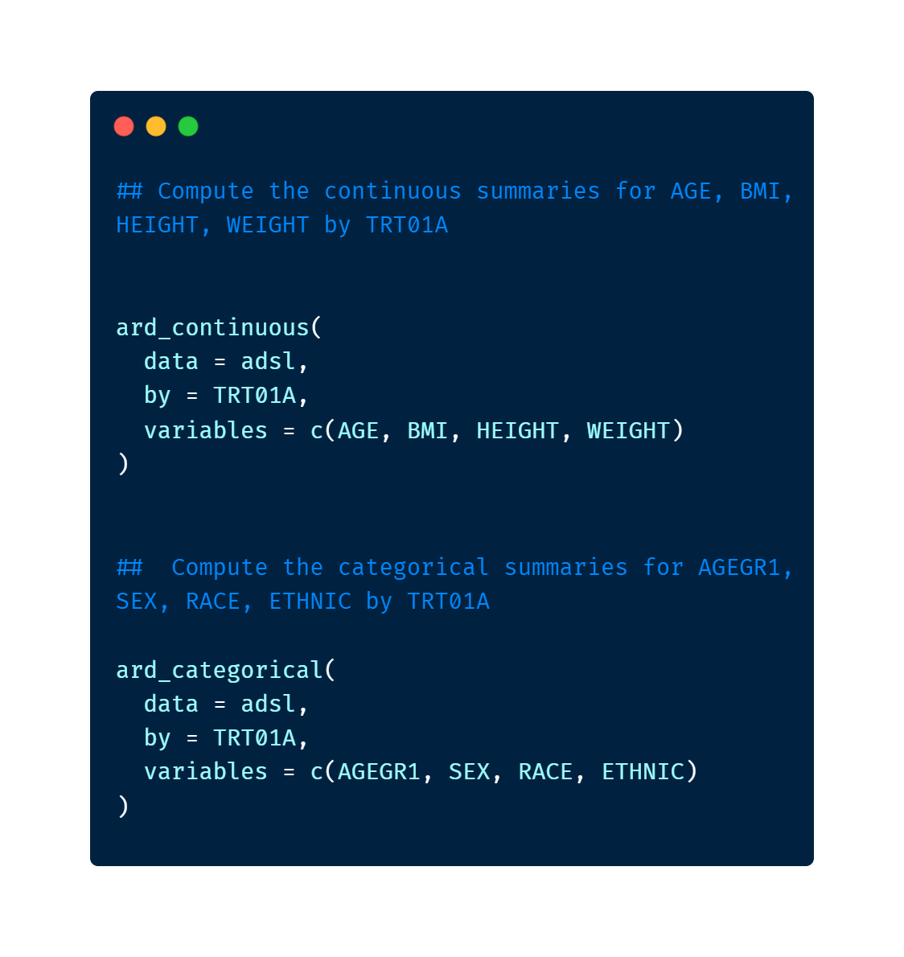

Slide 7
ADaMs
Outputs

Slide 9
ADaMs
Outputs

Slide 10
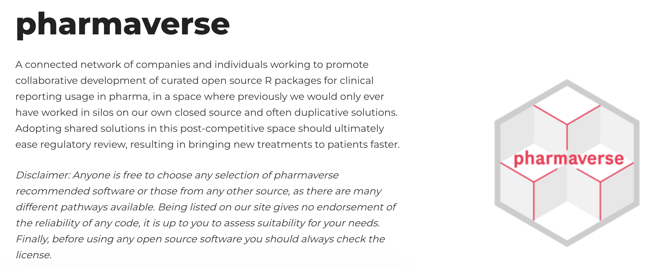
What is the pharmaverse?
pharmaverse.org

Slide 11
Why use the pharmaverse?
Leverage what others have build
Avoid mistakes when coding from scratch
Support the open-source revolution in pharma

Slide 12
Why contribute to the pharmaverse?
…or open-source in general
So many reasons…

Slide 13

I. Collaboration
Open-source software enables collaboration with other organizations, which can lead to faster development and more comprehensive testing and validation of the software.

Slide 14
II. Rapid Innovation
Because open-source software is often developed collaboratively, it can benefit from a faster pace of innovation than proprietary software. New features and capabilities can be added more quickly, and bugs and issues can be addressed more efficiently.

Slide 15
III. Cost Savings
Open-source software can be developed and maintained at a lower cost compared to proprietary software, as the development and maintenance costs are distributed across a larger user and developer base.

Slide 16
IV. Transparency
Open-source software is transparent, meaning that all users have access to the source code and can review it, test it, and provide feedback. This can increase confidence in the software and make it easier to identify and address issues.

Slide 17
V. Reproducibility
Open-source is hard requirement for reproducibility. Only open-source code can guarantee that someone other than the original author can reproduce a particular analysis.

Slide 18
VI. Access to Talent
Open-source software development can attract a wider pool of talent, including volunteers and independent developers who are passionate about the project. This can bring new perspectives and ideas, and can help the project to grow and evolve over time.

Slide 19
VII. Standardization
Open-source software can help to standardize the submission and review of regulatory data, which can improve consistency and accuracy across different submissions.

Slide 20
Why contribute to the pharmaverse?
…or open-source in general
So many reasons… (Pick your favorite!)
Collaboration
Rapid Innovation
Cost Savings
Transparency
Reproducibility
Access to Talent
Standardization

Slide 21
Contributing to the Ecosystem
Use the packages
Write blogs, create templates
Submit Issues and/or Code
documentation
feature requests
Bug
Join as a contributor – get in touch with the maintainer
All types of contributions are welcome!

Slide 22

Success of Pharmaverse/OS relies on the Community
🎵 we're all in this together
Its up to us to make the community we want to see
Leaders need to select and be conscious of their impacts
This Photo by Unknown Author is licensed under CC BY-NC-ND

Slide 23
Opening an Issue
If you saw a discrepancy or typo in the documentation of a package used today, open an issue pointing to the documentation and what you think should be fixed
Find the GitHub page for the package
Click on “Issues” then “New issue”
Write the location of the discrepancy and what you think might be a better solution

Slide 24
Discussion Time!
Packages we worked with today:
Admiral
Xportr
gtsummary
Cards
Tfrmt
tfrmtbuilder
Form a group of group of 4-6
Discuss the following questions (25 minutes)
What had you expected to learn today
What was learned at today
What will you be bringing back to your teams
What do we think is the skillset that will be required in the future
What do we see as benefits of ARDs
If you could tell yourself something 5 years ago, what would it be?
Report Out & Discussion (25 Minutes)

Slide 25
Q&A/Panel Time

Slide 26
Close Out
Welcome to the Pharmaverse!
We hope you enjoyed your stay and want to come back to visit, maybe stay for a while

Slide 27
Post-Workshop Survey
Your feedback is crucial!
Data from the survey informs curriculum and format decisions for future conf workshops, and we really appreciate you taking the time to provide it
pos.it/conf-workshop-survey

