Slide 1
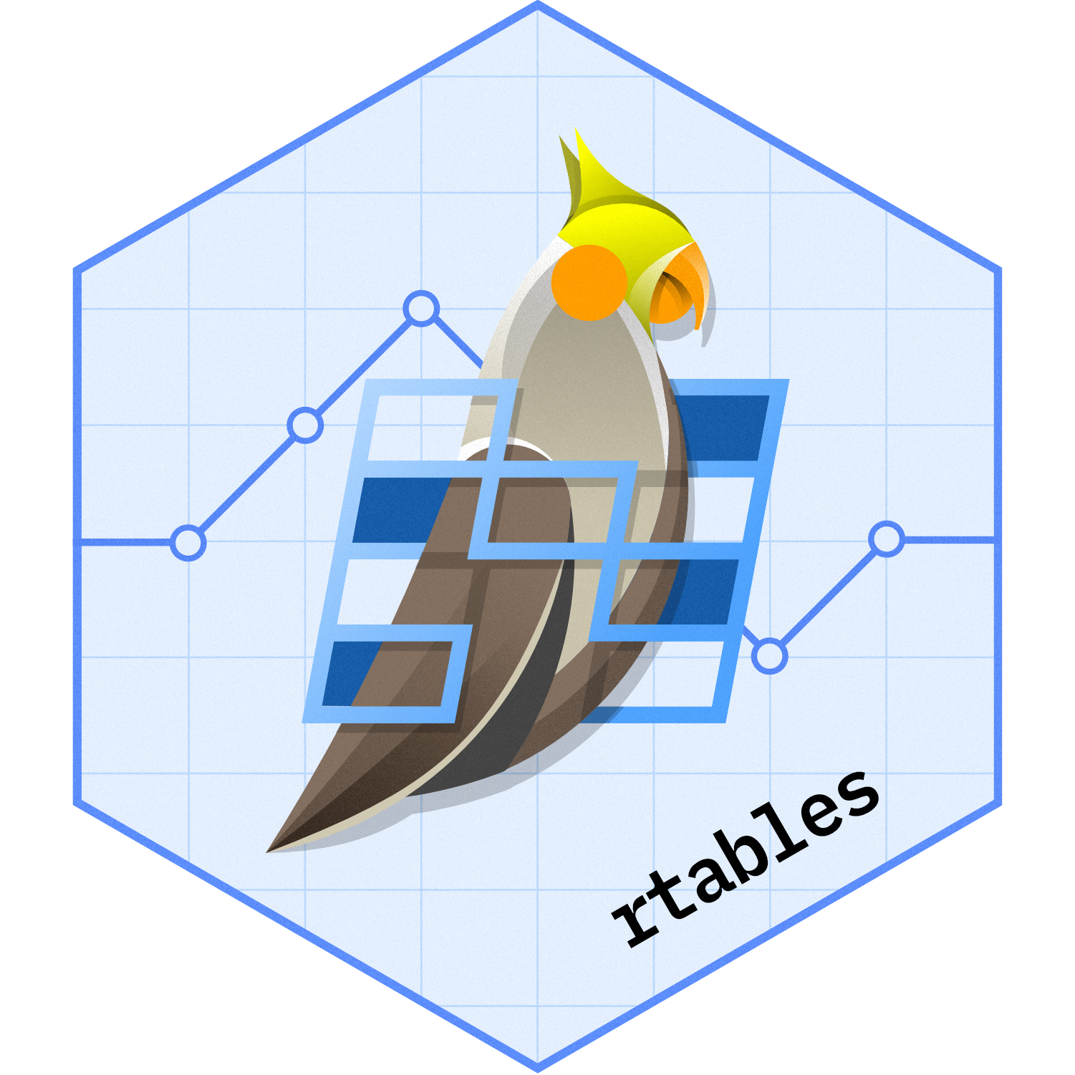

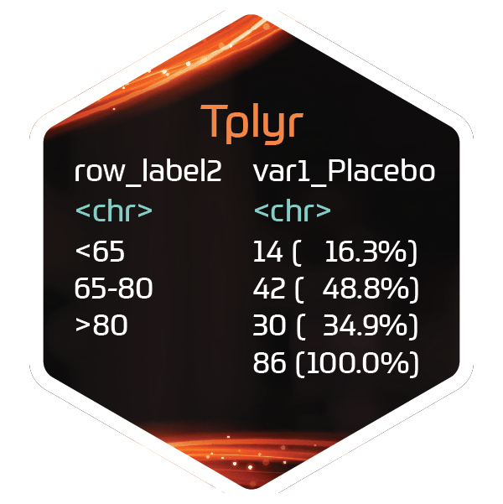





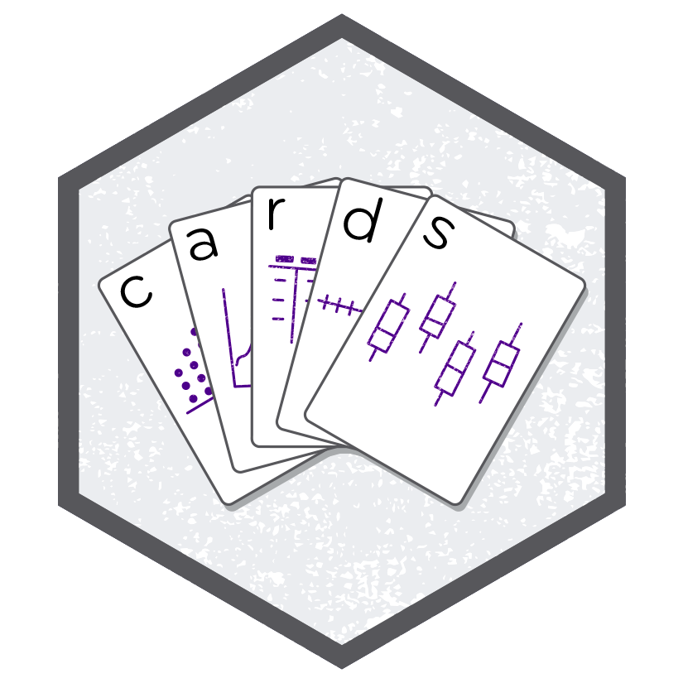
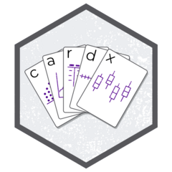





ADaMs
Outputs

Slide 2


Agenda
What is Admiral?
Admiral Manifesto
Package Overview
Demo/Example
What is xportr?
Workflow
Dataset Checks
Demo/Example

Slide 3
What is admiral?

Slide 4
What is admiral?
A toolbox for programming Clinical Data Interchange Standards Consortium (CDISC) compliant Analysis Data Model (ADaM) datasets in R.
{admiral} code is comprised of interchangeable blocks, ie. function calls, that sequentially derive new variables or parameters to help construct an ADaM dataset.
Notes:
In a nutshell, Admiral is an R package to help you make ADaM data sets.
It provides a suite of tools to enable clinical programmers to develop ADaM data sets in R.

Slide 5
The Admiral Manifesto
Usability
Simplicity
Findability
Readability
Easy to use
Clear purpose
Easily findable
Follow a Programming Strategy
Notes:
Admiral is designed around these key principles.
The aim is to provide a set of functions that are well-named, easy to use, and fulfill a particular purpose.
Admiral is one of the most, if not the most, documented R packages out there.
Along with examples for each function, there are many vignettes showing how to combine the individual functions to generate ADaM data sets.
Additionally, there are a number of template R files to use as a starting point for building your data sets.

Slide 6
Admiral Functions
Adding variables (`derive_var_*`)
`derive_vars_age_years`
Adding parameters (`derive_param_*`)
`derive_param_bmi`
Adding records (`derive_*_records`)
`derive_extreme_records`
Computing/converting (`compute/convert_*`)
`compute_age_years`
Filtering (`filter_*`)
`filter_extreme`
Notes:
In keeping with the principles of the Admirial Manifesto, most of the functions follow a set of naming conventions to indicate their purpose and identify groups of similar functions.
This helps you as a programmer because you have to think less about what a functions name is.
You can focus more on the context, making ADaM data sets, rather than the fact you're using R.
For example, even if you're new to R, if you're familiar with ADaM, you understand what `derive_param_bmi` means.

Slide 7
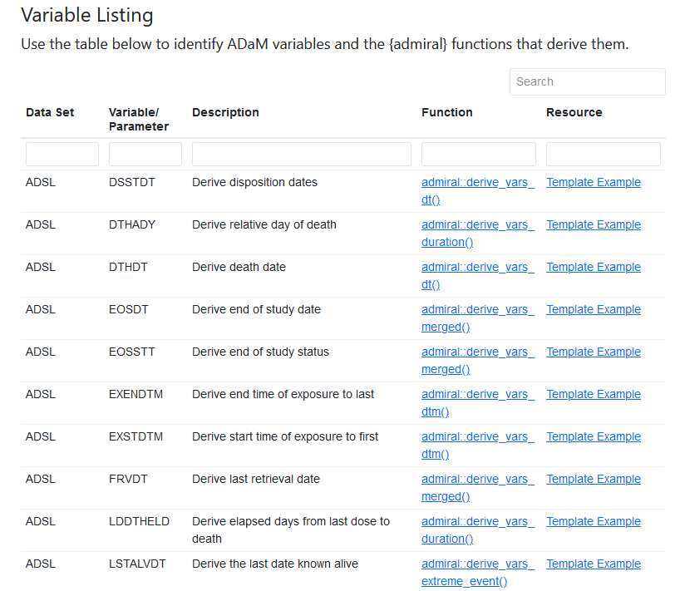
Admiral Functions: CDISC Variables
Notes:
Admiral gives you a great way to use your CDISC knowledge to navigate the package.
Instead of searching the package documentation based on function names, you can use your CDSIC knowledge.
You may know that you want to make the variable SAFFL.
With this table, you can search for that in the varaibles column, and you'll get a link to the function you can use to do that.

Slide 8





Admiral Extensions
admiralonco
admiralmetabolic
admiraloptha
admiralvaccine
admiralpeds​
Notes:
In addition to {admiral}, there are a number of extension packages for specific therapeutic areas.
An oncology study is different than an ophthalmology study for example, so there are separate packages for each.
{admiral} is the foundation, supporting variables and conventions that are common across studies.
The extension packages provide another layer of abstraction on top of {admiral}.
This allows functions to be grouped by the therapeutic area they apply to while keeping {admiral} itself from getting overloaded.

Slide 9
Demo

Slide 10
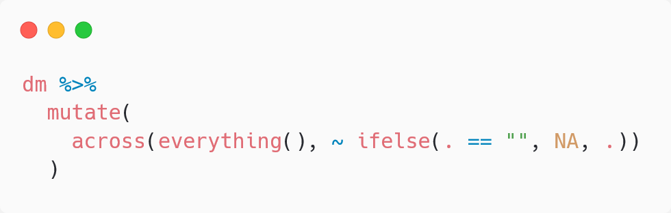
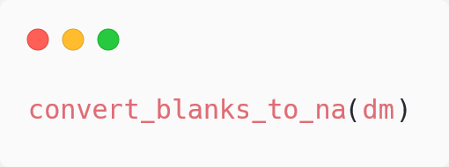
tidyverse – admiral comparison
tidyverse
admiral

Slide 11
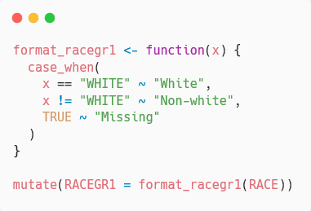
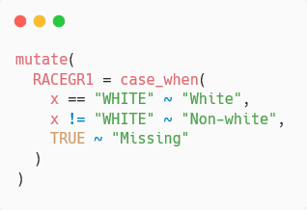
tidyverse – admiral comparison
tidyverse
admiral

Slide 12
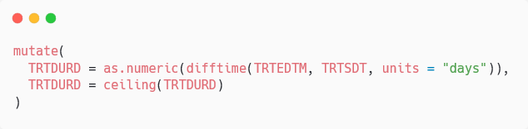
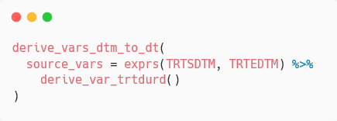
derive_var_trtdurd
tidyverse
admiral

Slide 13
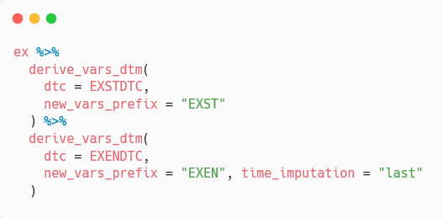
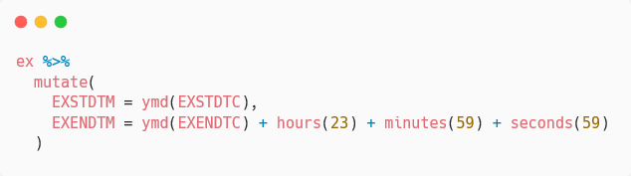
derive_vars_dtm
tidyverse
admiral

Slide 14
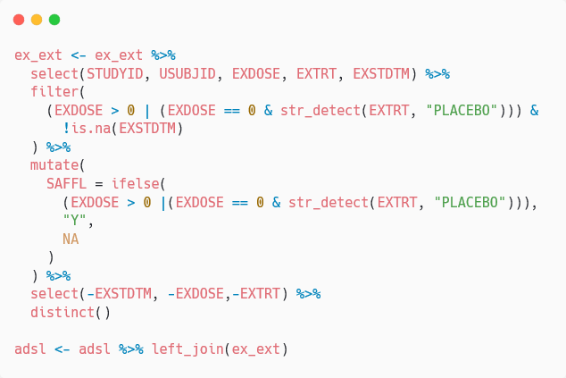
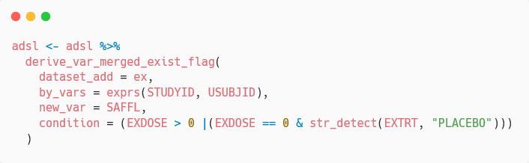
derive_var_merged_exist_flag
tidyverse
admiral

Slide 15
DIY

Slide 16
What is xportr?

Slide 17
What is xportr?
{xportr} is designed for clinical programmers to create CDISC compliant xpt files- ADaM or SDTM
Notes:
{xportr} helps you write xpt files suitable for sharing.
It provides support for including metadata with a data set, and it includes tools for verifying the format of your data set.

Slide 18
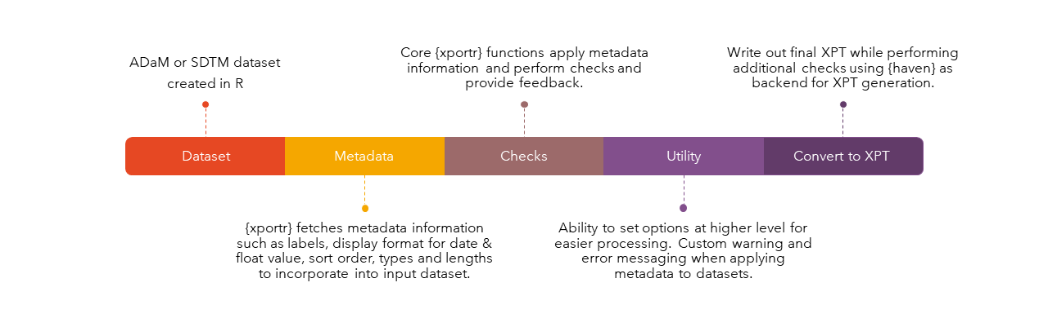
Workflow
Notes:
When using {xportr}, your workflow will look something like this.
Once you have a data set ready
You define metadata for that data set
You run your data and metadata through some checks
And when everything is good, you write the output file
The last step here done by the {haven} package.
{haven} actually writes the file.
{xportr} adds the metadata and runs the checks needed for submission and sharing.
(Mike has anecdote about a GitHub issue in {haven})

Slide 19
Dataset Checks
Variable names
Start with a letter
Contain only uppercase letters (A-Z) and numbers (0-9), and ASCII characters, symbols, underscores
<= 8 characters
Variable labels are <= 40 characters
Data set labels are <= 40 characters.
Notes:
These are some of the things {xportr} looks for when it runs through it's checks. For the full list of checks see the package documentation.
{xportr} doesn't check if you created the data set correctly of course. What it looks for is things like the format of your variable names meet the specification.

Slide 20
Dataset-JSON
https://www.cdisc.org/dataset-json
https://github.com/atorus-research/datasetjson
Notes:
It's worth mentioning that there is a new data transport format in the works.
The project is a collaboration between CDSIC and PHUSE and uses a JSON specification called Dataset-JSON as a replacement for xpt.
For more details on the specification and an R implementation see these links.
(Mike can explain more)

Slide 21
Demo

