Slide 1
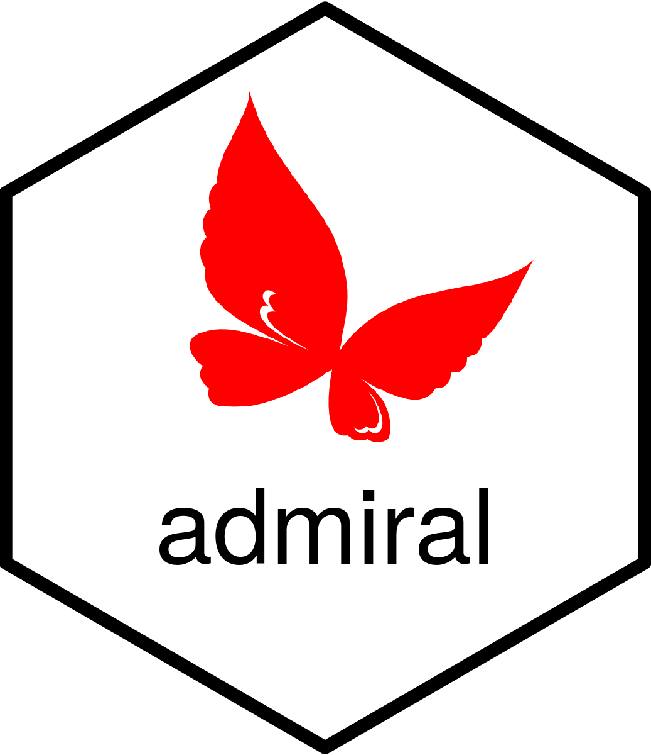
Admiral
With a subhead

Slide 2
Outline from GH discussion
Pre intro chunk on what is pharmaverse? (2-3 minutes)
We want to do something unique, rather than repeating past presentations. So maybe we can find something other than ADSL/ADAE that is still common enough to be familiar.
Introduction (x min)
What is Admiral? What is the purpose? What are it's use cases?
Who uses it?
Admiral Manifest review
Package overview (x min)
What are the main functions/groups of functions? (show examples of each group)
How do we use them?
How do we combine them?
What else is in the Admiral ecosystem? (therapeutic areas)
(optional) Tidyverse vs admiral solution for 1 or 2 vars?
Demonstration (participants can follow along in RStudio cloud) (x min)
Make (partial) ADSL
Make (partial) ADAE
Practice (participants finish making ADSL/ADAE/something to practice what they learned) (x min)
do more on their own, in previous sections there may have a little exercise before where its fill in x,y,z
link out to: https://pharmaverse.github.io/admiraldiscovery/articles/reactable.html
Transition to xportr (now that we have the data set, how do we save it)
https://github.com/thebioengineer/posit_pharamverse_2024/discussions/6

Slide 3
Outline
Introduction (2 min)
Package overview (5 min)
Demo (10 min)
Practice (15 min)
Notes:
We’ll have 40 minutes total

Slide 4
Introduction

Slide 5
What is Admiral?
A toolbox for programming Clinical Data Interchange Standards Consortium (CDISC) compliant Analysis Data Model (ADaM) datasets in R.
{admiral} code is comprised of interchangeable blocks, ie. function calls, that sequentially derive new variables or parameters to help construct an ADaM dataset.
Notes:
(this is from the DESCRIPTION)
In a nutshell, Admiral is an R package to help you make ADaM data sets.
It provides a suite of tools to enable clinical programmers to develop ADaM data sets in R.

Slide 6
The Admiral Manifesto
Usability
Simplicity
Findability
Readability
Notes:
Admiral is designed around these key principles.
The aim is to provide a set of functions that are well-named, easy to use, and fulfill a particular purpose.
Admiral is one of the most, if not the most, documented R packages out there.
Along with examples for each function, there are many vignettes showing how to combine the individual functions to generate ADaM data sets.
Additionally, there are a number of template R files to use as a starting point for building your data sets.

Slide 7
Package Overview

Slide 8
Admiral Functions
Adding variables (`derive_var_*`)
`derive_vars_age_years`
Adding parameters (`derive_param_*`)
`derive_param_bmi`
Adding records (`derive_*_records`)
`derive_extreme_records`
Computing/converting (`compute/convert_*`)
`compute_age_years`
Filtering (`filter_*`)
`filter_extreme`
Notes:
In keeping with the principles of the Admirial Manifesto, most of the functions follow a set of naming conventions to indicate their purpose and identify groups of similar functions.
the point I'm trying to make here is most of the functions follow patterns that make your life as a programmer easier. We could probably remove some of these, I just went through the function reference page and pulled these out. Maybe just stick to derive_var and derive_param, with a few examples of each.
We can probably reference the cheatsheet and take some of the higher level functions that are featured within that as well - or do we want to cover important functions that relate to our demo/DIY section to keep it simple?

Slide 9
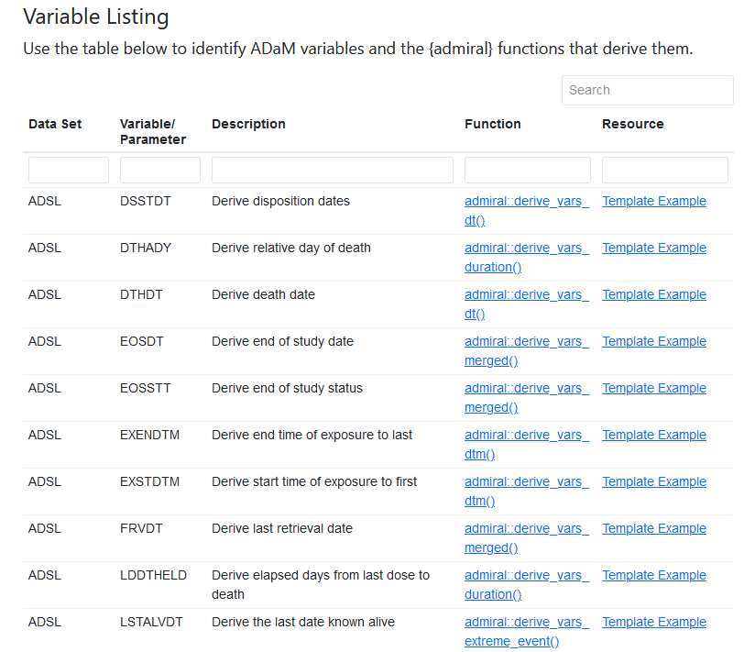
Admiral funs - CDISC vars
Notes:
I want the image to link to https://pharmaverse.github.io/admiraldiscovery/articles/reactable.html
The point I want to make here is that this is a great tool. Even if you are still new to R, you already know the CDISC variables so you can search based on that. So when you're first learning admiral, you search up each CDISC variable as you go along

Slide 10





Admiral Extensions
admiralonco
admiralmetabolic
admiraloptha
admiralvaccine
admiralpeds​
Notes:
We probably won't go into these during the demo but it may be worth mentioning that there are a number of extension package for different therapeutic areas.
Also use stickers instead of bullets. - on it
Also also mention company-specific pacakges like mentioned here https://pharmaverse.github.io/admiral/index.html#the-admiral-family-of-packages

Slide 11
Demo
Notes:
From here we'll jump to RStudio Cloud. I think we should walk through making a data set, say ADSL. Or at least enough through it to give them the idea. We can incorporate blank function arguments, function names, etc as sort of a quiz as they follow along.

Slide 12
DIY
Notes:
This will be where they can do a practice on their own. We should probably be very specific like 'I want you to create variables x, y, z.'

Slide 13

xportr
Notes:
10 minutes for this

Slide 14
What is xportr?
{xportr} is designed for clinical programmers to create CDISC compliant xpt files- ADaM or SDTM
Notes:
{xportr} is an R package that let's you write xpt files.
It's functionality can be broken down into 2 categories
Build CDISC compliant xpt files in R
Perform checks on the data before sending to validators or data reviewers.

Slide 15
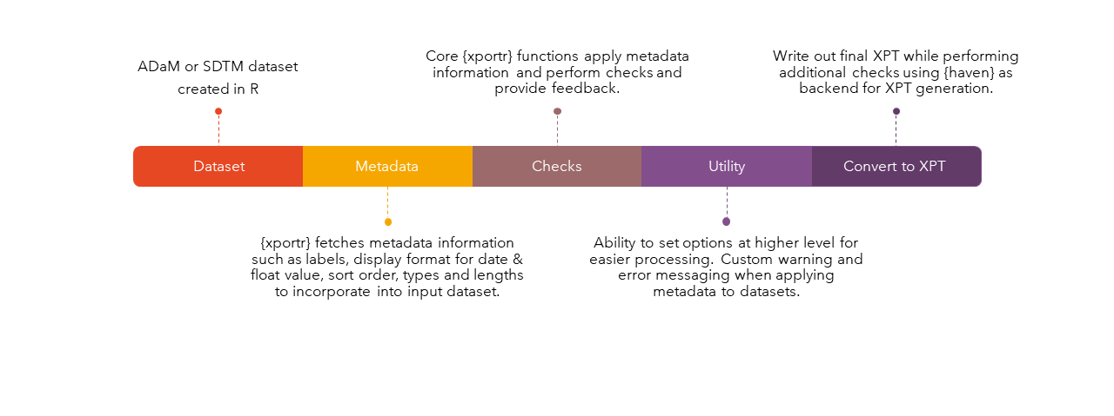
Workflow
Notes:
Brief review of workflow
Then the next few slides, explain some of the steps a little more. At minimum
Metadata. What metadata is needed? I think this is the excel files? Show some of the content of those. And/or brief explanation then show it as part of the demo
Checks. What quality checks are implemented.
just don't go into too much detail about the file format specification
Next, walk through an example. Similar to admiral, have a file they can follow along with and ideally have one they can work on their own (on their own time. Not enough time in the workshop)

