Slide 1

TagBase and FishTracker – informatics tools for tag data management, analysis and visualization
Chi Lam (Tim), Vardis Tsontos and Dale Kiefer
University of Southern California
Second International Symposium on Tagging and Tracking Marine Fish with Electronic Devices
October 8, 2007

Slide 2
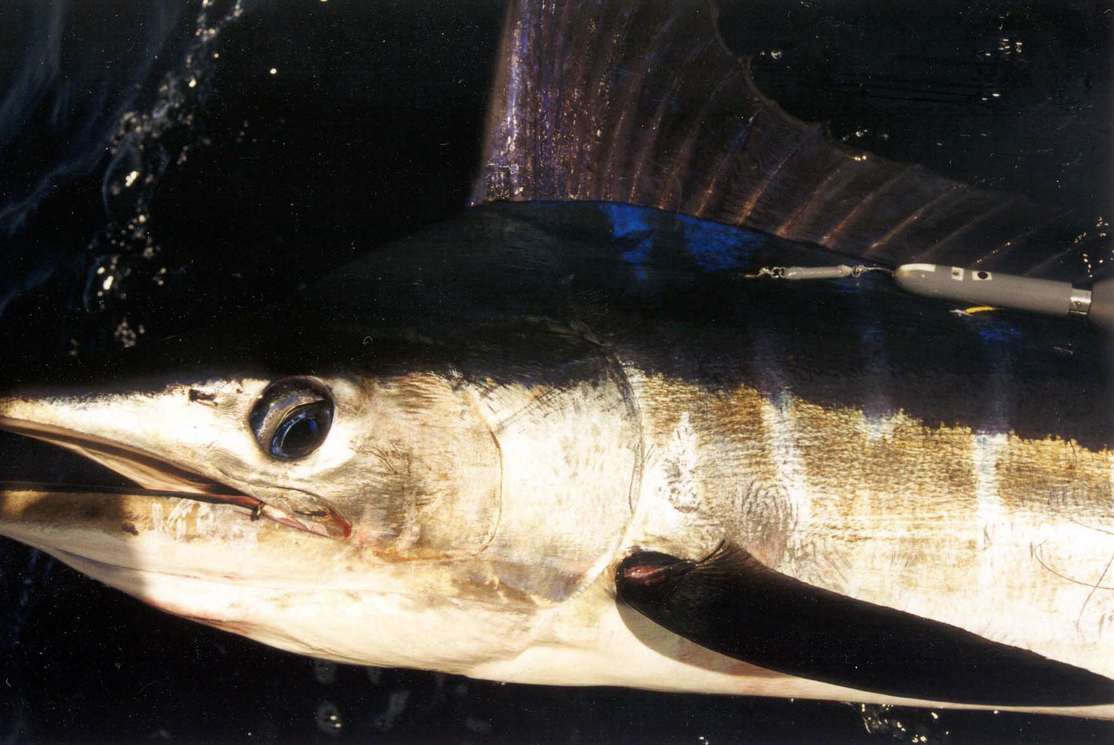

Statement of the problem
Data storage tags (pop-up archival and archival) allow us to collect large volumes of environmental and physiological data of marine species, but these rich datasets present us with challenges in efficiently managing and visualizing our data
Photo: PIER/ MCSI/ M. Domeier
Photo © Andy Murch
Notes:
As we all know, data storage tags allow us to collect large volumes of data of our studied species.
This vast volume of data presents us with challenges in efficiently managing and visualizing them.

Slide 3



Tag data origami
What a mess!
As a tagging researcher, you may start out…
Tag#, Date, Depth, Temp …
777, 10/8/2007, 10, 25.4 …
777, 10/9/2007, 85, 22.6 ...
…
Record # 23467987
Open your file
  As you before more and more successful (yeah!!) …
  - Different manufacturer formats
  - Different tag types
  Multiple tags, with lots of recovered data
Notes:
Let me use a cartoon to illustrate what our colleagues may come across.
First you may start with a small tagging project, you process your raw data with manufacturer software and end up with a data file.
Let’s use this origami sea lion to represent a data file. You open your file and find many data records, the fruit of your hard work out there tagging the animals.
As you become more successful in your project, you probably will have more tags from one or many species – and it’s easy to imagine handling all these files – can be … a frustrating process.

Slide 4
Information pathway
Integrated Systems
Hartog et al.
(CISRO, U Canterbury
next talk)
Electronic Tagging
Data Repository
Sibert and Ancheta (PFRP)
Protocol & specifications
e.g. Ecological Metadata Language (EML) or
XML (Royer and Lutcavage, this conference)
TagBase, our database
(this talk)
Flexibility to perform your own quality control
Freedom to explore, manipulate, analysis data
Customized output formats for export to higher systems
Manage analysis parameters & results
Raw data files
Manufacturer processed files
Your own analysis
Model parameters
Results
Individual Tags
Notes:
A way to handle data is by utilizing databases and other informatics tools, which a number of them are available or becoming available.
Our tag database, TagBase is one of them – and I want to show you TagBase is relevant to all the other exciting tools out there.
You always start out with individual tags, either as raw data files you download off the tag or from Service Argos, or as output files from manufacturer processing software.
Both types of file can be catalogued and archived or shared with the community via the Electronic Tagging Data Repository that John has developed.
These file types can also be assimilated into powerful integrated systems that we will learn from Dr. Hartog in the next talk.
Compared to these great tools, TagBase is like your home-cooking.
It is primarily a local database, although it is very capable of being extended for web-based access.
While keeping TagBase local may narrow its scope, this does offer us a few striking advantages:
First, it gives you flexibility in performing your own data quality control.
Second, I know all researcher want to get their hands on their data, keeping TagBase local is like exploring data in your Excel or your spreadsheet program,
the difference is – you get to see multiple tags, not just one file.
Third, you can customized your data for export, add relevant metadata that follows some transfer protocols like EML which Electronic Tagging Data Repository is using, and export them.
Using transfer protocols also allows data from integrated systems or data repository to be added to TagBase.
Last but not least, when you can keep track the parameters you use to run an analysis
and the sets of result by putting them back to TagBase.

Slide 5
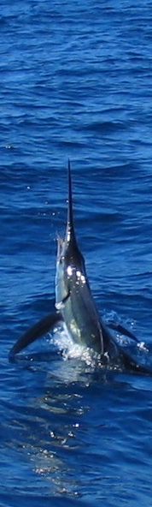
TagBase as a local tag database
A starter kit to manage different manufacturer output files
Centralize data within a unified relational model
Integrate metadata and auxiliary data
Query data efficiently (subset, regroup, summarize)
Visualize data rapidly (e.g. forms with MS-Graph)
Integrate with other tools as a backend database and manage result outputs
  e.g. Matlab,
  R with ODBC package
  EASy-FishTracker
Notes:
Very quickly – TagBase provides a starter kit to manage multiple tag files.
You can centralize your tag in one place, with metadata.
You can efficiently query your data, visualize it with built-in forms, and
hook TagBase your with other analysis such as Matlab, R, or Easy-FishTracker which I will show you a bit later.

Slide 6
Objectives of this talk
Show how TagBase is implemented in Microsoft Access & what you can get out of it
Demonstrate its integration with Easy-FishTracker, a visualization and analysis tool
Notes:
Now, I will show you how TagBase is implemented in Microsoft Access, a database management system, and what sort of things you can expect to come out of it.
Then, I will demonstrate an integration of TagBase with a custom application, Easy-FishTracker and use this integrated tool for visualization and analysis.

Slide 7
Objective # 1:
TagBase implementation in MS-Access
How to get things in?
And out?

Slide 8
Data assimilation into Tag Database
“TagBase” Tag Database
Final Tag Data Tables & Relational Model
ISSUES:
Data Quality Control
Complete Lat/Lon metadata (TagInfo table)
Metadata Input & Tag Data Processing/Import Forms
Query sequence
Macros
Temporary Data Import Tables
Automated Import in Batch or Individually
Source Tag Data Files (Manufacturer Formats)
Wildlife Computers PAT
Microwave Telemetry PAT
ARCHIVAL
Lotek and Wildlife Computers
SPOT
Wildlife Computers
Bin Depth-Freq
Bin Temp-Freq
PDT
Estimated Locations
Light data points
ARGOS positions
Press Data
Temperature Data
Estimated Locations
ARGOS positions
File 1
Depth, Light, Temp
File2
Estimated Locations
ARGOS Lat/ Lon
Reception Codes
Notes:
This shows the flow of data into TagBase, which is implemented in Microsoft Access.
First, you have your manufacturer processed data files.
Currently, TagBase is mainly set up to handle archival and popup tags.
These data files can be imported via an import interface.
Then through a number of macros and queries, data are assimilated into TagBase’s data relational model.
This step allows us to explicit define how different data are related to each other, such as what metadata should go along with your tag data.
Storing data in this data relational model also means that you can look at data from multiple tags, and relate new sets of data to these tags.

Slide 9
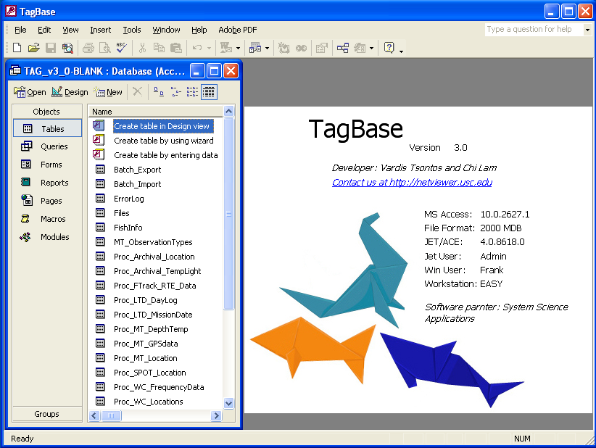
Just to give you an idea…
Notes:
This is just to show you what

Slide 10
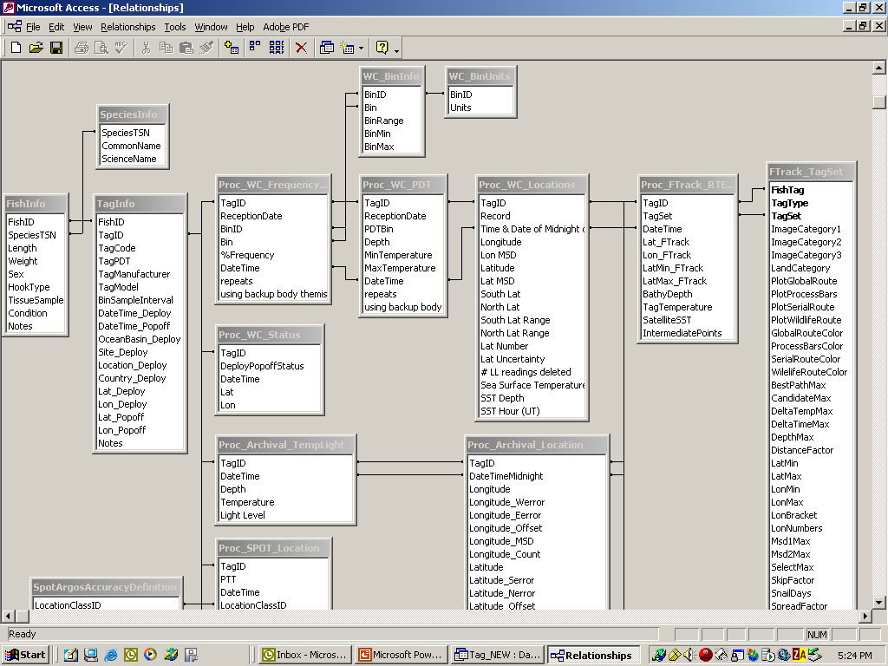
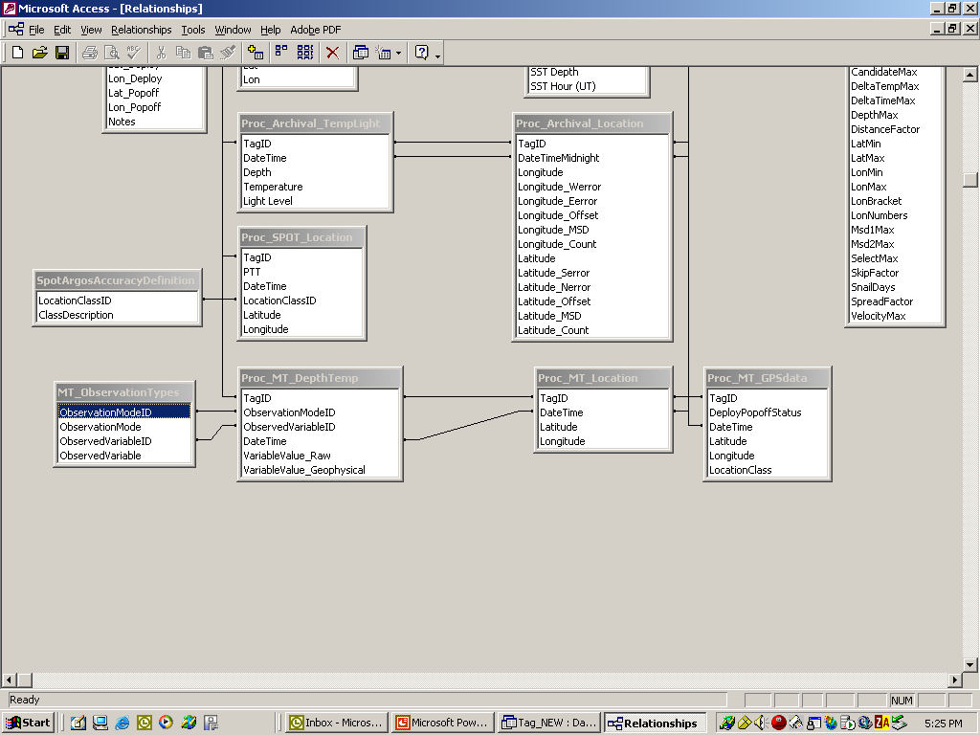
TagBase Relational Model
* Metadata * WC * MT * Spot * Archival * EASy-FishTracker Output
Notes:
This is the TagBase Relational Model.
There are quite a number of tables, but we can break them down by their function.
Each color bounding box denotes the tables needed to support a data type.
Starting from the left, metadata is stored in the green tables,
Tables in yellow, orange, blue and red handle different tag types
On the very right, tables in cyan show how outputs from an geo-location algorithm can be incorporated back in the database together with the results

Slide 11
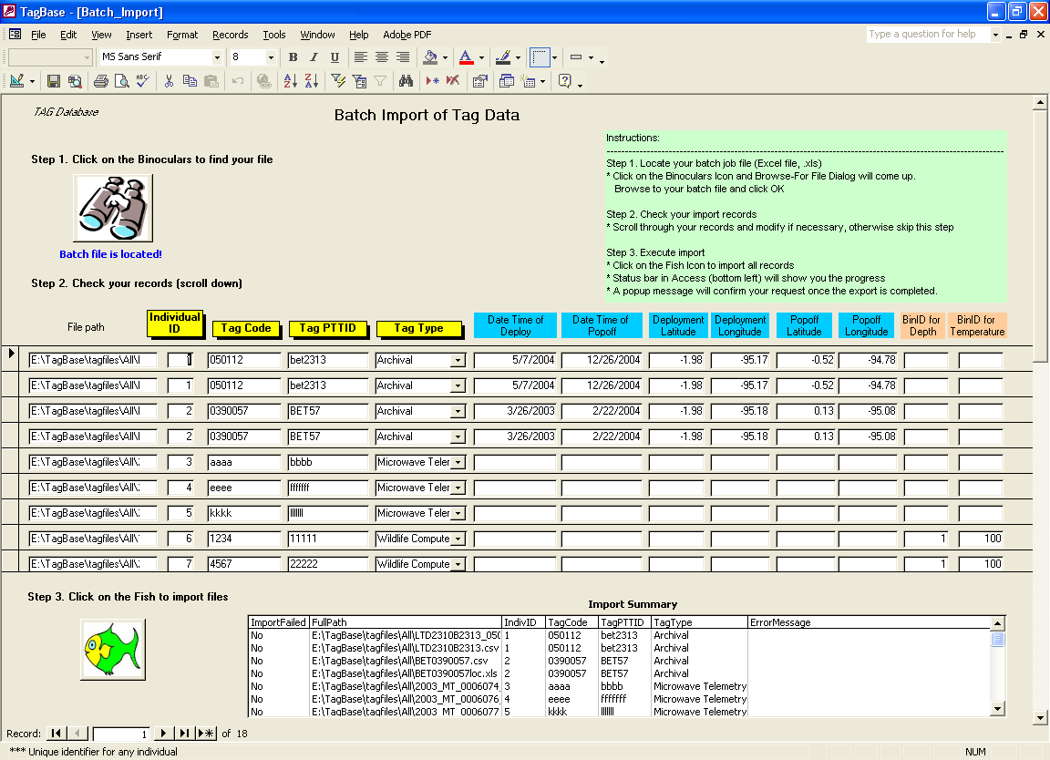
What to get data in
Notes:
This is an example of the import interface that allows you get the data into a system as a batch.
You start by constructing a batch file from an Excel template, specific the file name, and 4 or so key fields for a tag.
Then you bring in the batch file, and click import.

Slide 12
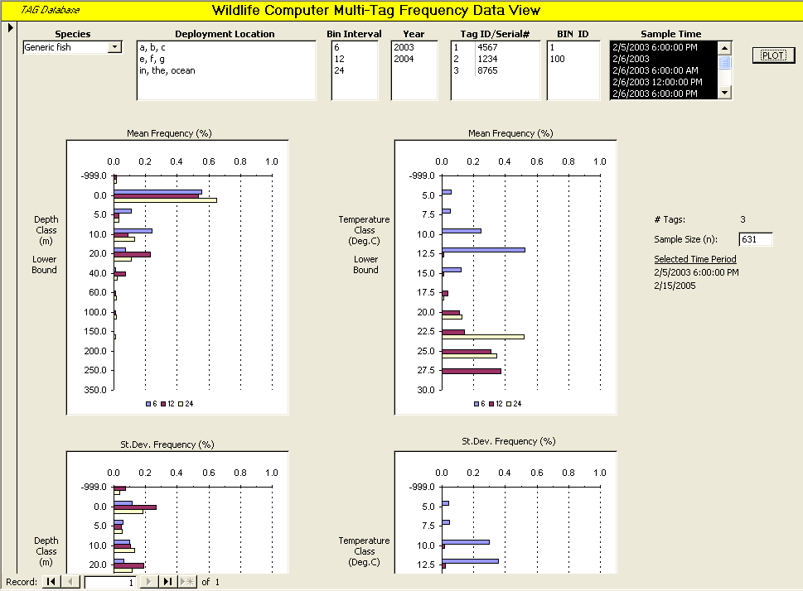
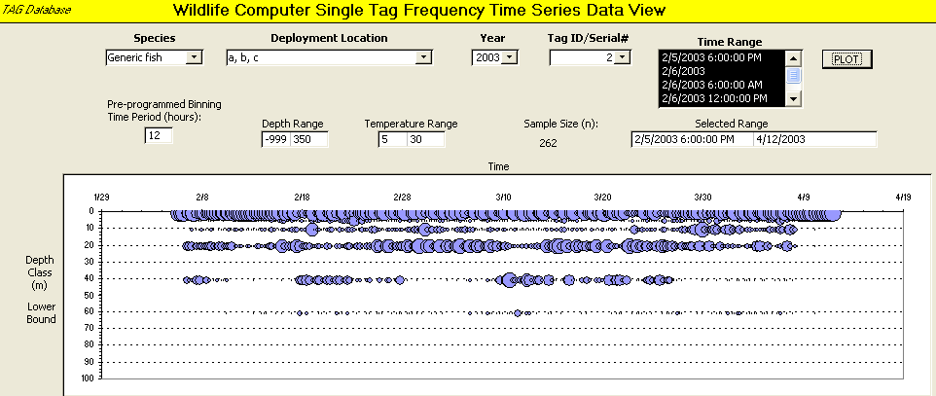
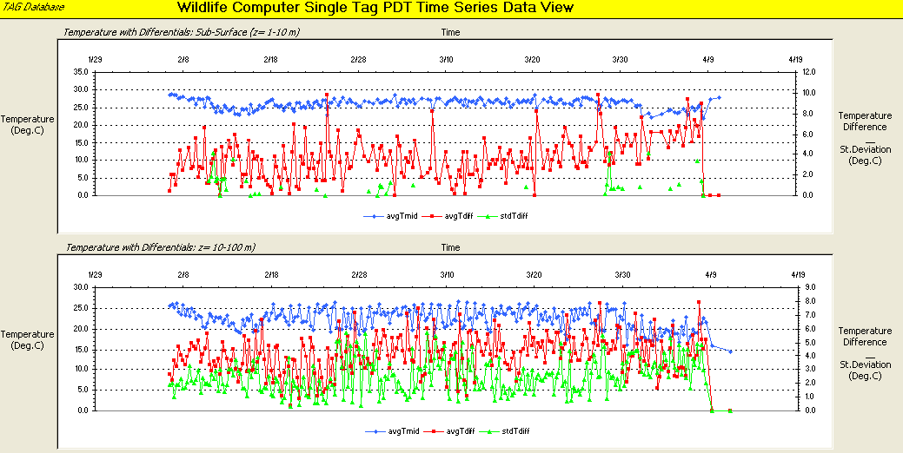
Integrated Plot Forms
Plot forms for all tag & data types
XY/Time Series,
Histogram,
Bubble Plots
Single/aggregate datasets
Raw Data / Aggregate statistics
Notes:
Once your data are in, you can do a lot of things.
For example, we have built some forms that utilize Microsoft Graph in Access
And generate different types of plots, including XY-Time Series plots,
Histograms, Bubble plots for 1 tag or multiple tags for some plots.
Through queries, you can also summarize data with simple statistics.

Slide 13
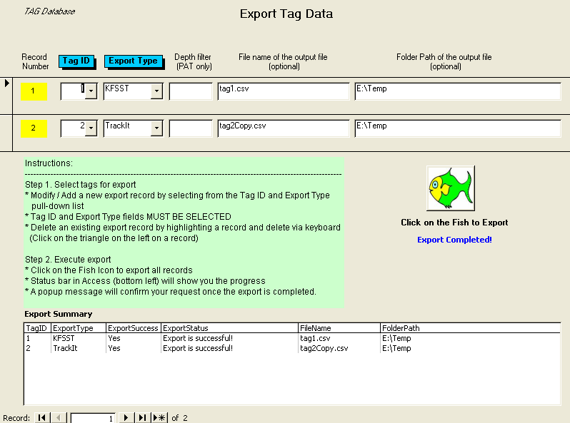
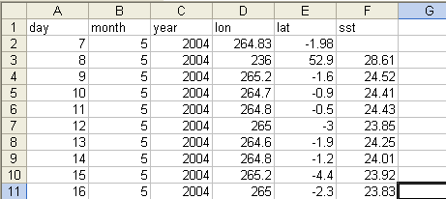
What you can get data out from TagBase
Export data formatted for KFSST (or UKFSST) and TrackIt
Endless possibilities with your own queries
Goodies queries & code
  Moving average (in days) for archival data
  Day/ Night data subset for Wildlife Computers tags
  Daily summary of sea surface temperature (SST)
Notes:
You can also export data from TagBase, format them for a specific purpose,
For example, improve geolocation estimates with KFSST or TrackIt,
the awesome models that Anders has just told us about.
You really have endless possibilities in terms of what you can get out using queries,
For example, preparing your data with metadata in XML format for archiving purposes.
To further illustrate this functionality, I had set up queries to
Generate a moving average of a data value, such as moving 3-day average of daily temperature
Data subset by day / night

Slide 14
Objective # 2:
Integration with EASy-FishTracker
What about analysis?

Slide 15
TagBase EASy-FishTracker Integration
End-User
TagBase as backend data repository
EASy-FishTracker as front-end visualization/ analysis tool
EASy (Environmental Analysis System):
  custom oceanographic GIS software in Windows OS
  extensive imagery handling & data connectivity capabilities
  extensible: model/module integration via COM-based API
EASy GUI
EASy GIS
FishTracker Module
FishTracker Geolocation Algorithm
Bulk processing
Imagery assimilation tool
Track and Tag data visualization
Kernel Home Range Analysis
Internet FTP & Local
ODBC
Satellite SST Imagery Archives
TagBase as backend tag database
- NASA PoDAAC, Coastwatch
Thermal Imagery
(AVHRR or MODIS)
- Universal tag relational model
- Forms with standard plots
ODBC
Source Tag Data Files
(Manufacturer Formats/XLS)
WC • MT • LT • Arc • SPOT
(WC: Wildlife Computers; MT: Microwave Telemetry
LT: Lotek; Arc: Archival; SPOT:ARGOS/GPS)
Notes:
TagBase is integrated with a custom GIS system called EASy as its data backend.
Data are passed around through ODBC, a standard application program interface for communicating with databases.
EASy serves a front-end GIS system, provides a user interface to interact with end users.
EASy also has a plug-in called FishTracker which allows a handful of useful functionalities.

Slide 16
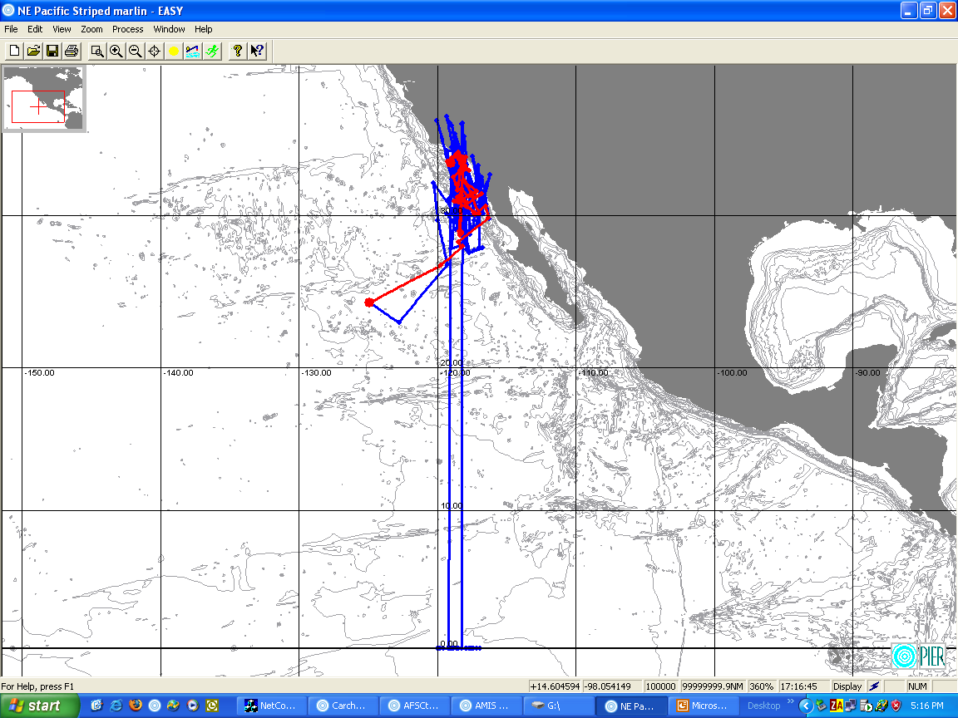
Geolocation improvement
Just one implementation of the many good models and algorithms available in the research community
Domeier et al., 2005. Fishery Bulletin 103(2): 292-306.
Future Goal: allow flexibility and connectivity to use other models/ algorithms (e.g. KFSST)
Comparison of FishTracker track solution (red) to manufacturer light-based positional estimates (blue)
Notes:
Right now, EASy-FishTracker has implemented the Domeier et al. geolocation improvement algorithm. So position data are fetched from TagBase, processed in EASy-FishTracker, and visualized on the screen, like what you see on the right.
The blue track is the light-based positions from manufacturer while the red is the improved position estimates.
As we know there are a number of very good improvement models out there, our future goal is to establish connectivity to utilize new models out there.

Slide 17
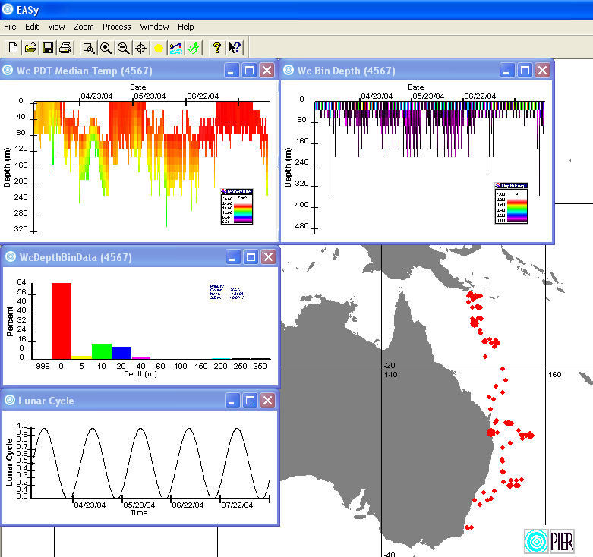
Visualization of data
Exposes the full range of tag data in backend database
Switching views between multiple tags
Interactive Filtering of data
Multiple XY-diagnostic plots
Time Series, XY, Vertical False Color
New plots through underlying query configuration in TagBase
WC PDT false-color profile plots and Depth/Temperature frequency histograms for tag data
Notes:
Stepping beyond the basic plots in Microsoft Access, you can do more elaborate exploration plots in EASy-FishTracker.
You can pull different data about a tag out from TagBase, and
visualize them as time series, histograms, and false color plots, all in relation to a refined track.
Data can also be filtering through the user interface.
New plots can be generated by configuring new queries in TagBase

Slide 18
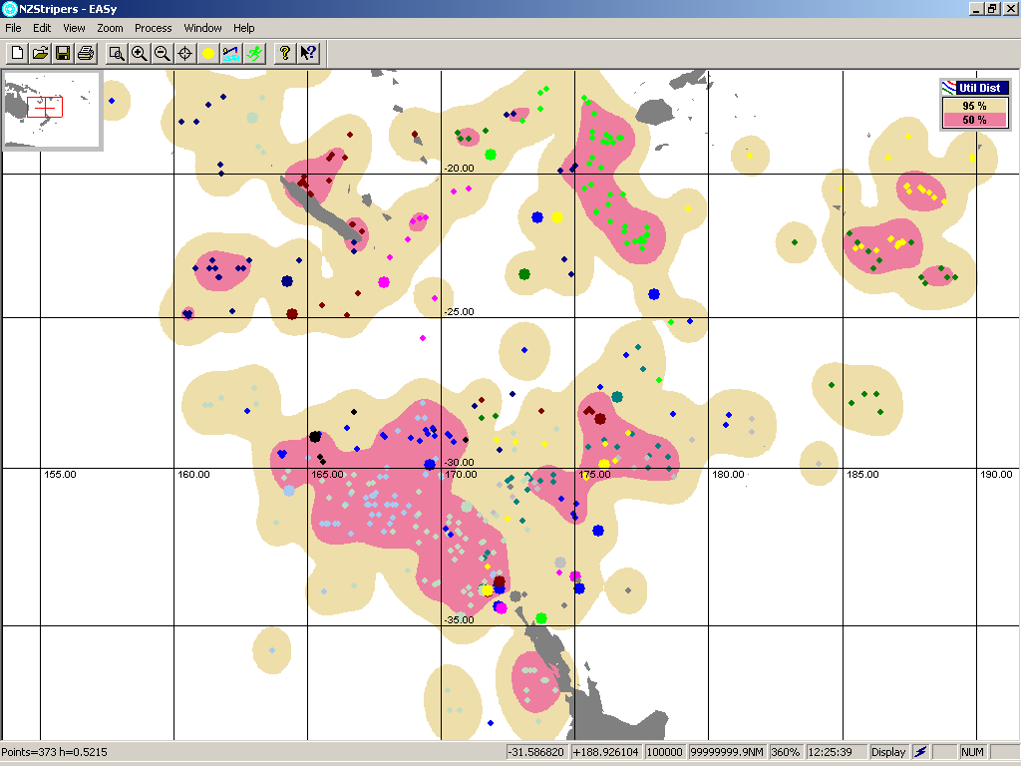
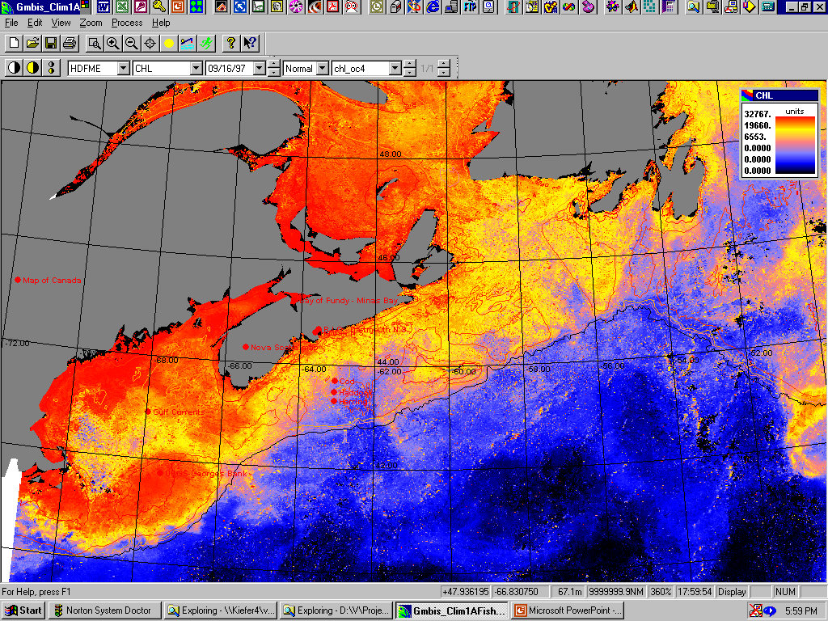
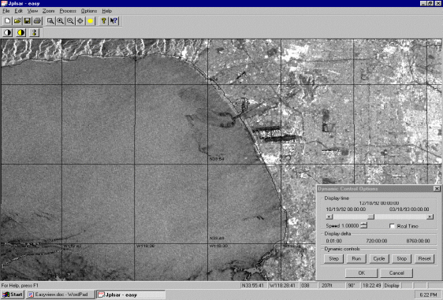
Analysis tool and GIS integration
Home Range analysis tool
  Kernel method (Worton, 1989)
  fixed H /single H / adaptive H estimation (least square cross-validation)
  returns smoothed Utilization Distribution surface
GIS integration
  supports multiple imagery formats
  bathymetry
Habitat utilization distribution for striped marlin based on 20 individuals tagged between 2004-2005 off of New Zealand (n = 373, Kernel H = 0.5215)
SEAWIFS Ocean Color
SAR imagery
Notes:
EASy-FishTracker also has a home range analysis tool that utilizes the Kernel method.
Moreover as a geographical information system, EASy can assimilate various data layers, such as satellite ocean thermal and ocean color imagery or bathymetry.

Slide 19
Limitations of TagBase
Dependent on consistent manufacturer formats
  Import code is a reactive development, rather than proactive
  Nevertheless, TagBase’s relational model should hold unless major changes occur
May not fit perfectly your data needs
  Require some expertise in adding new tables, or setting up queries
  Need high-end database management systems if you have many tags
Notes:
After showing you TagBase and its integration with EASy-FishTracker, I must point out its limitations. The most obvious one is all these work is a reactive development process, we have to react to changes in manufacturer formats.
That’s why we are really looking forward to collaborating with manufacturers, and try to develop data management system from the source.
Our second limitation is that we possibly can’t use one model to fulfill all your data needs – since you know your data best.
That translates to adapting TagBase to your needs with new tables or queries.
Microsoft Access does provide a fairly friendly interface for you to sketch things up on your own easily, and you can use TagBase as your starter kit
Lastly, when you need to a large number of tags (more than 1 Gb),
it will be more efficient to implement TagBase in a high-end database management system, rather than what it is now in Microsoft Access.

Slide 20
Conclusions
TagBase provides a relational model to handle multiple data types from tags
Integrated plots and flexible queries allow efficient data mining and export for other analysis
We are enthusiastic about collaborating with manufacturers, Hartog et al. and tag users
If you want to know more/ try to use with the TagBase
  Look for me during the next few days, so that I can give you a quick jump-start tutorial session
  Or invite me for a talk at your institute and I can tell you whatever I know!
Notes:
So to conclude, TagBase provides a relational model to handle multiple tag types.
Queries and plots enhance data mining capacity and allow export of data for other analysis.
I can’t emphasize this further, or I am almost at a point of over-emphasizing it – I am enthusiastic about getting collaborations with tag manufacturers, Hartog and colleagues, and all tag users.
I would even make the suggestion of forming a pilot team of researchers who are interested in developing informatics tools together, and concentrate our efforts to minimize redundancy and confusion.
Lastly, if you want to know more about TagBase, let’s find a time to get together in the next couple of days and I can show you the details and get you started using it.

Slide 21
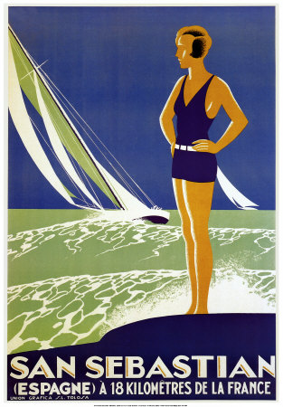
Questions?
“Vacaciones!!”

