Slide 1

Predicting voting score using 2018 IMDB
Huilin tang
Ucla statisitcs 418 – tOOLS IN DATA SCIENCE
SPRING 2019

Slide 2
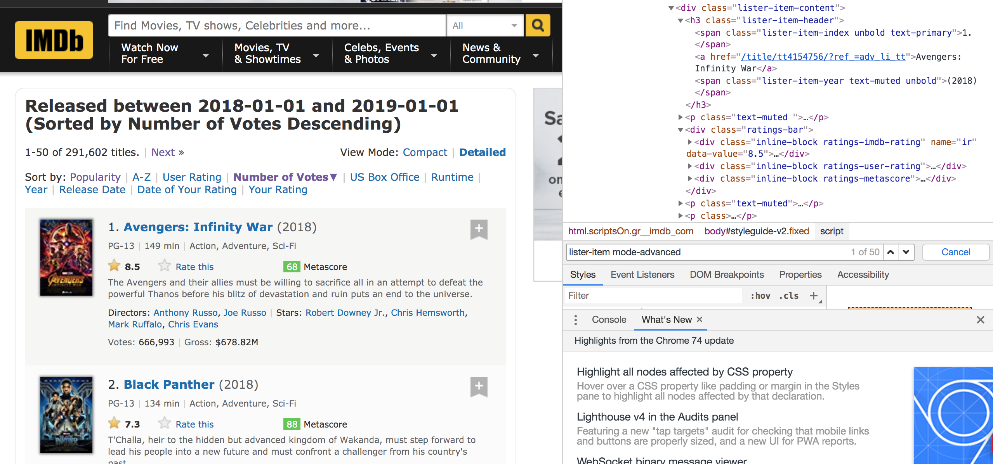
Attaining data – web scraper
IMDb score

Slide 3
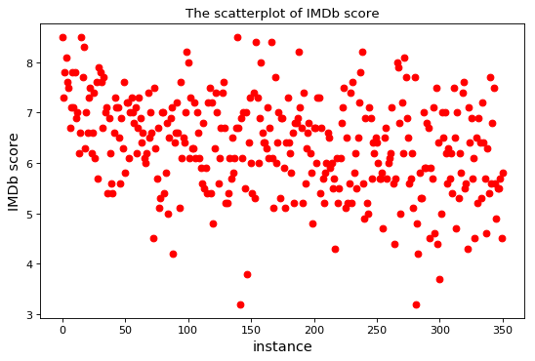
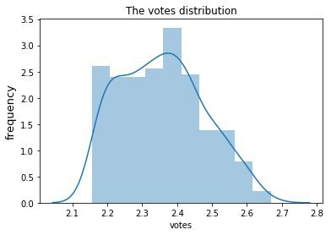
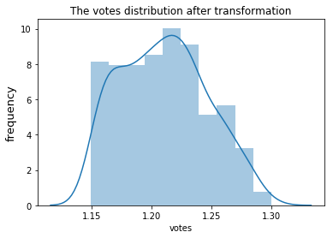
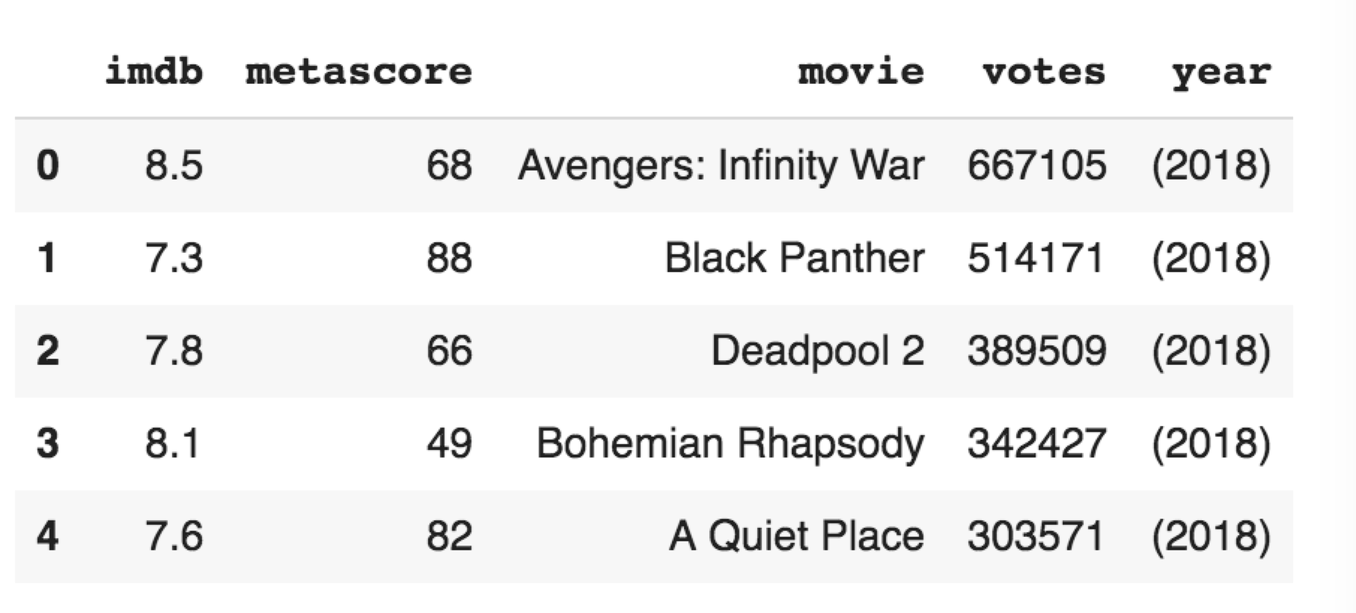
Data exploration analysis

Slide 4
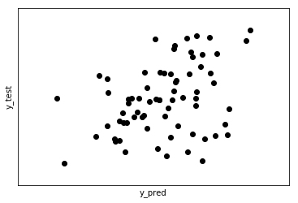
Model analysis
Mean squared error: 0.0010889836135416554

Slide 5



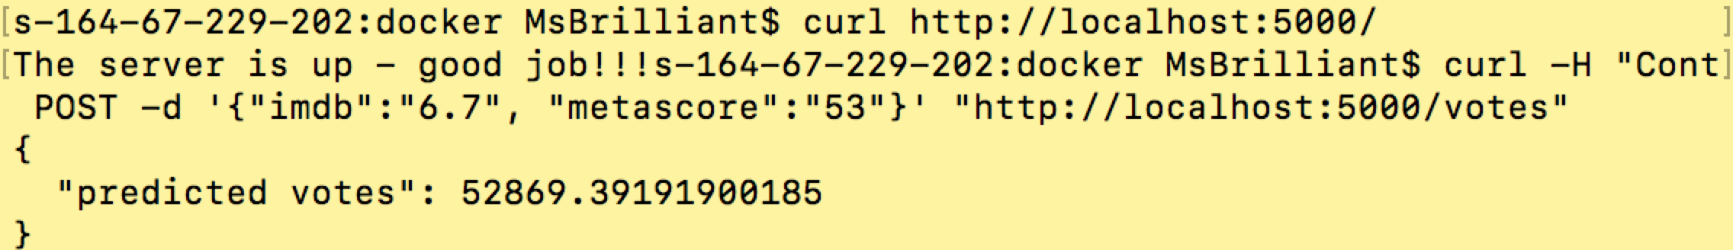
DEPLOYMENT
Docker & Flask & AWS
Input: Imdb score, Metascore
Output: Predicted Votes
curl -H "Content-Type: application/json" -X POST -d '{"imdb":"6.7", "metascore":"53"}' "http://localhost:5000/votes"
Predicted result

