Slide 1
Time Series Analysis for India Air Quality

Slide 2
Introduction to Time Series Analysis
What is Time Series Analysis?
Time series analysis is a statistical technique used to analyze data patterns over time. It involves studying and modeling data points collected at regular intervals to identify trends, seasonality, and other patterns.
Applications of Time Series Analysis
Time series analysis has a wide range of applications, including:
Forecasting future values based on historical data
Detecting and analyzing seasonal patterns
Identifying trends and changes over time
Modeling and predicting future behavior
Evaluating the impact of interventions or events
Understanding the underlying processes and dynamics of a system

Slide 3
Understanding Air Quality Data
What is Air Quality Data?
Importance of Air Quality Data
Air quality data refers to the measurement and analysis of pollutants in the air, such as particulate matter, ozone, carbon monoxide, and nitrogen dioxide. It provides insights into the level of pollution in a specific area and helps assess the environmental conditions.
Understanding air quality data is crucial for several reasons:
Health Impacts: Poor air quality can have severe health effects, including respiratory problems, allergies, and even cardiovascular diseases. Analyzing air quality data helps identify potential health risks and take appropriate measures to protect public health.
Environmental Assessment: Air quality data helps assess the impact of human activities, such as industrial emissions and vehicular pollution, on the environment. It provides valuable information for policymakers and researchers to develop strategies for environmental protection.
Regulatory Compliance: Air quality data is used to monitor compliance with air quality standards and regulations. It helps identify areas that require intervention and implement measures to reduce pollution levels.
Public Awareness: Sharing air quality data with the public raises awareness about the importance of clean air and encourages individuals to take actions to reduce pollution.
Factors Contributing to Air Quality
Several factors contribute to air pollution and affect air quality:
Industrial Emissions: Industrial activities, such as manufacturing and power generation, release pollutants into the air. These emissions include particulate matter, sulfur dioxide, nitrogen oxides, and volatile organic compounds.
Vehicle Emissions: Exhaust emissions from vehicles, especially those running on fossil fuels, contribute significantly to air pollution. These emissions contain pollutants like carbon monoxide, nitrogen dioxide, and particulate matter.
Biomass Burning: The burning of biomass, such as wood and crop residues, for cooking and heating purposes releases pollutants into the air.
Urbanization: Rapid urbanization leads to increased construction activities, traffic congestion, and industrial growth, all of which contribute to air pollution.
Natural Sources: Natural sources, such as dust storms, wildfires, and volcanic eruptions, can also impact air quality.

Slide 4
Time Series Models
Time series models are statistical models used to analyze and forecast data that varies over time. These models are particularly useful for analyzing trends, patterns, and seasonality in time-dependent data. Here are some commonly used time series models and their applications:
Moving Average (MA) Model
Autoregressive (AR) Model
Autoregressive Moving Average (ARMA) Model
Autoregressive Integrated Moving Average (ARIMA) Model
Seasonal Autoregressive Integrated Moving Average (SARIMA) Model
The Moving Average model is used to capture the short-term fluctuations in a time series. It calculates the average of the previous observations to predict the future values. This model is useful for smoothing out noise and identifying trends in the data.
The Autoregressive model is used to capture the linear relationship between the current observation and the previous observations in a time series. It predicts future values based on past values and is useful for identifying patterns and trends in the data.
The Autoregressive Moving Average model combines the AR and MA models to capture both the linear relationship and short-term fluctuations in a time series. It is useful for analyzing data with both trend and seasonality.
The Autoregressive Integrated Moving Average model extends the ARMA model by incorporating differencing to remove trends and seasonality from the data. It is useful for analyzing non- stationary time series data.
The Seasonal Autoregressive Integrated Moving Average model is an extension of the ARIMA model that incorporates seasonal components. It is useful for analyzing and forecasting data with seasonal patterns.

Slide 5
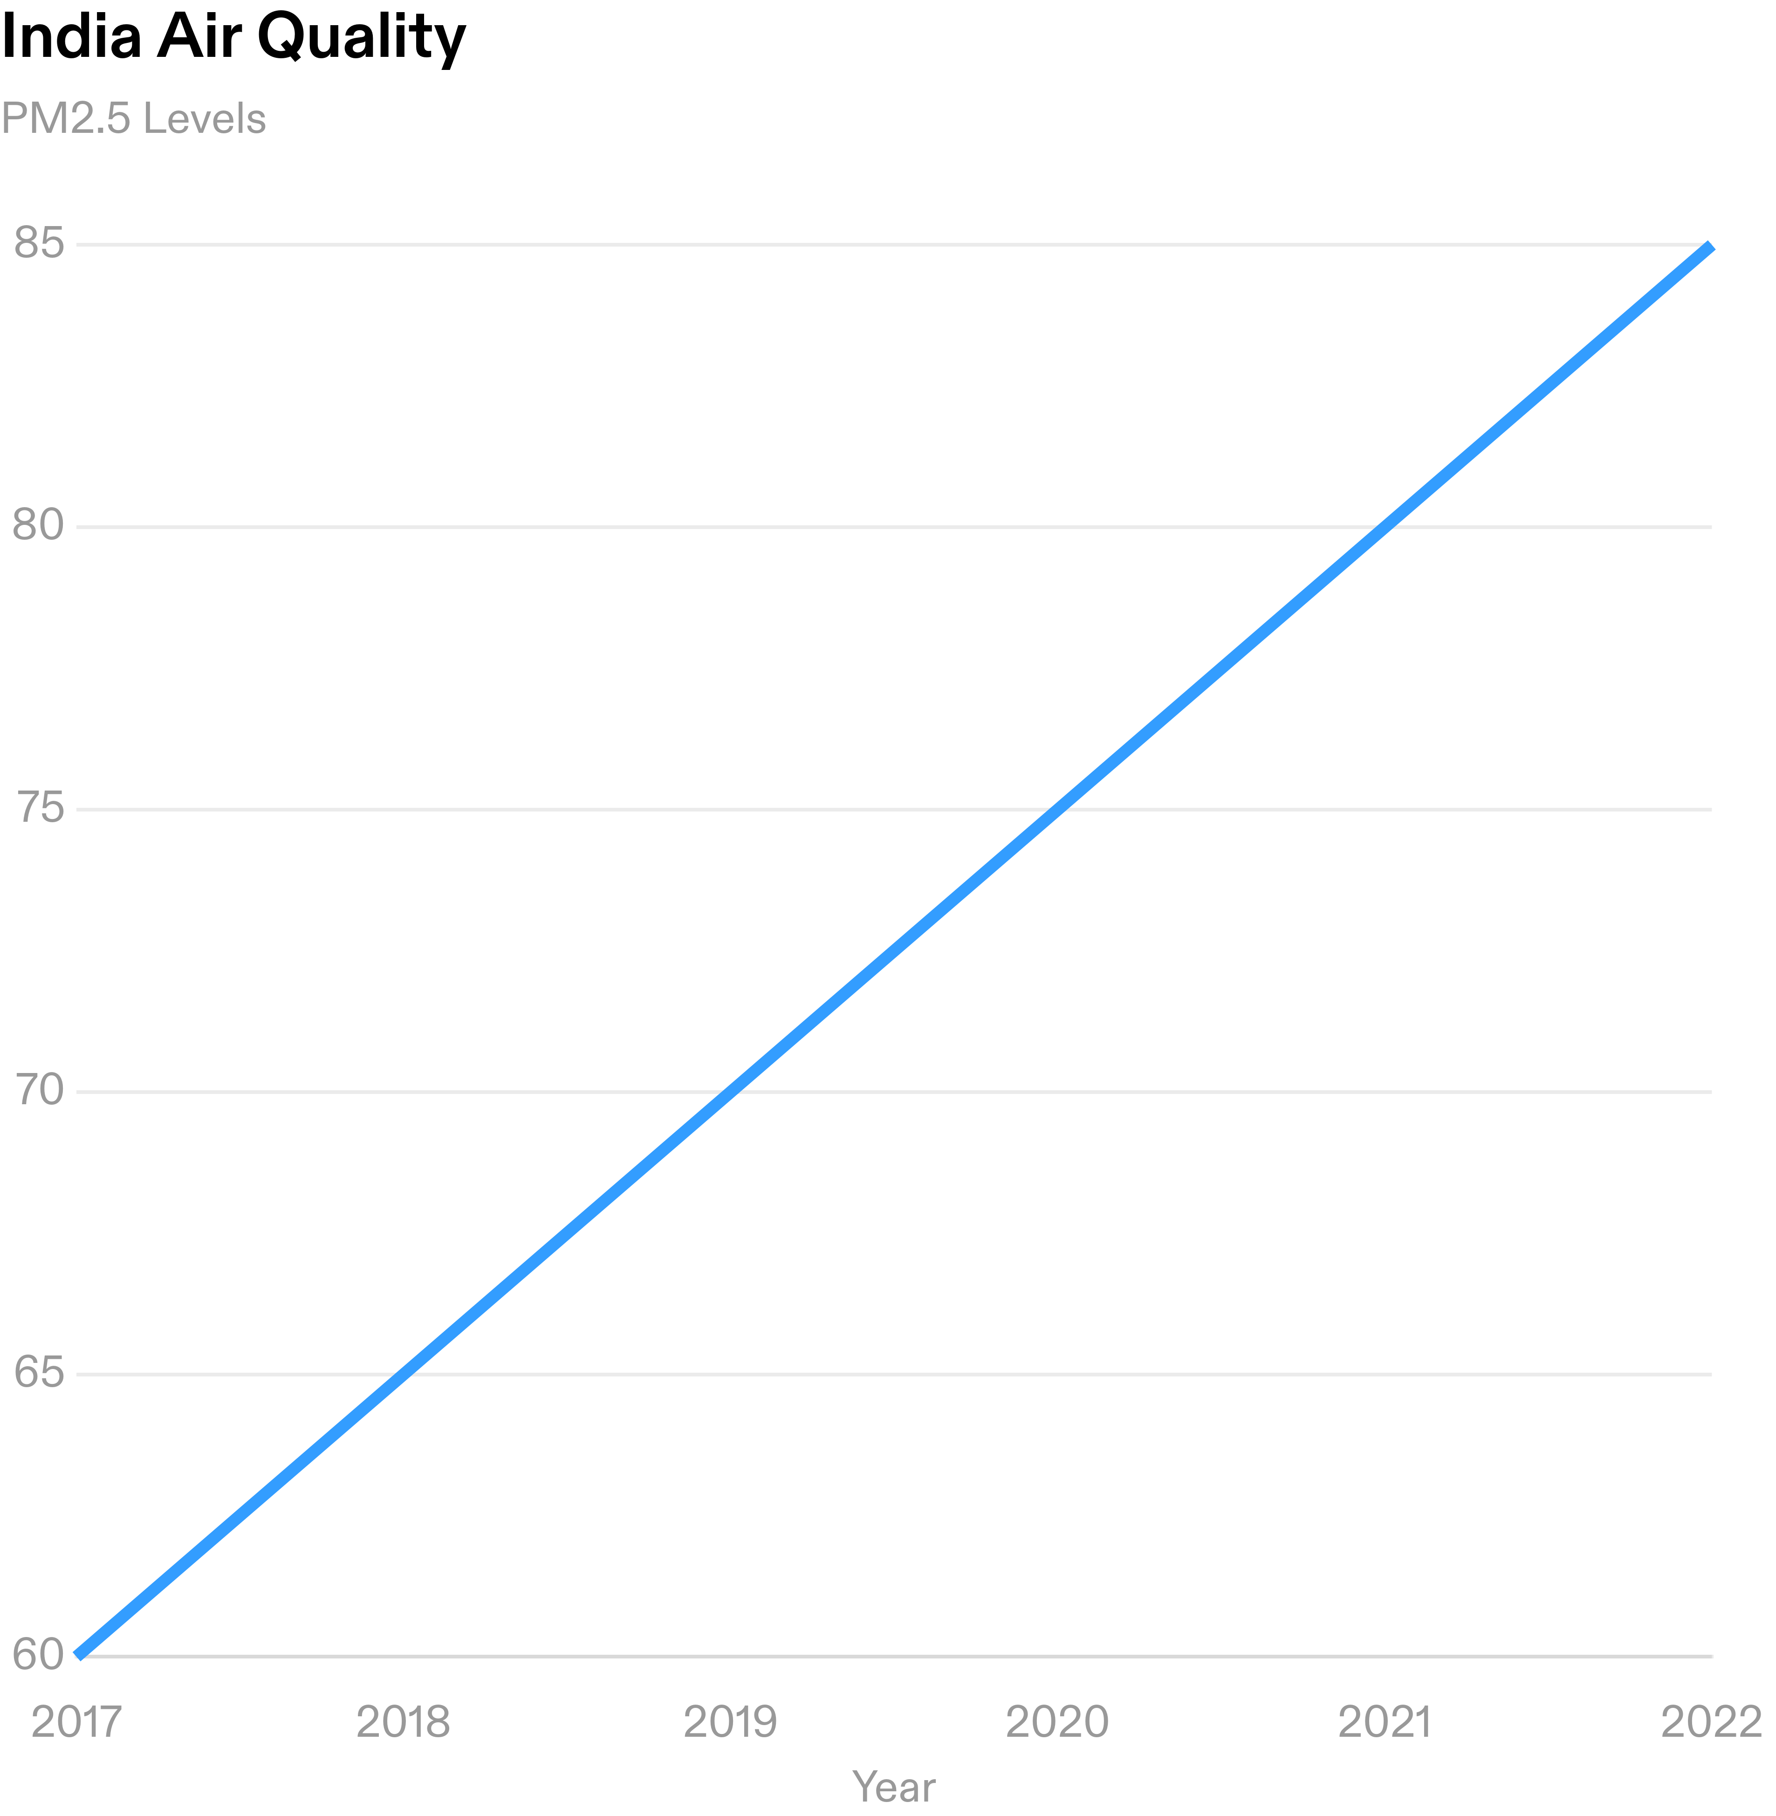
Analysis of India Air Quality
Key Findings
Increasing Pollution Levels: The air quality in India has been deteriorating over the years, with a significant increase in pollution levels.
Seasonal Variations: Air pollution tends to be higher during certain seasons, such as winter when the burning of crop residues and the use of biomass for heating contribute to the pollution.
Urban vs Rural Areas: Urban areas experience higher pollution levels compared to rural areas due to industrial activities, vehicular emissions, and construction.
Health Impacts: The high levels of air pollution have severe health impacts, including respiratory problems, cardiovascular diseases, and premature deaths.

Slide 6
Conclusion and Recommendations
Conclusion
The analysis of India air quality reveals significant pollution levels in several cities.
The air quality index (AQI) consistently exceeds the safe limit, posing health risks to the population.
The major contributors to air pollution in India are industrial emissions, vehicular pollution, and agricultural practices.
Recommendations
Implement stricter regulations and policies to control industrial emissions and enforce compliance.
Promote the use of cleaner and more sustainable modes of transportation, such as electric vehicles and public transport.
Encourage the adoption of cleaner and more efficient agricultural practices to reduce crop burning and chemical usage.
Increase public awareness and education about the importance of air quality and individual actions to reduce pollution.

