Slide 1
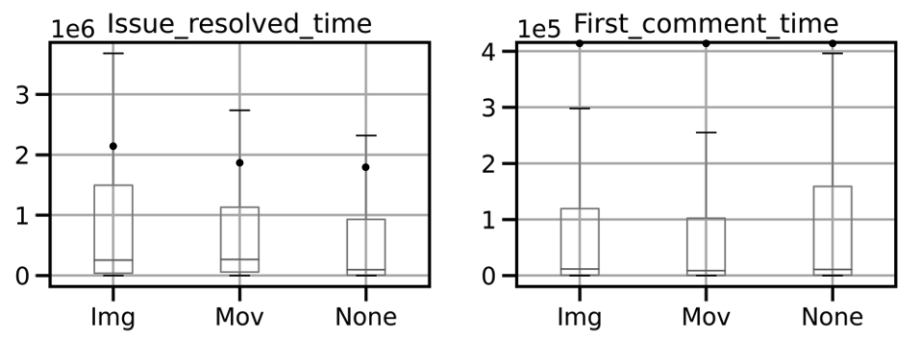
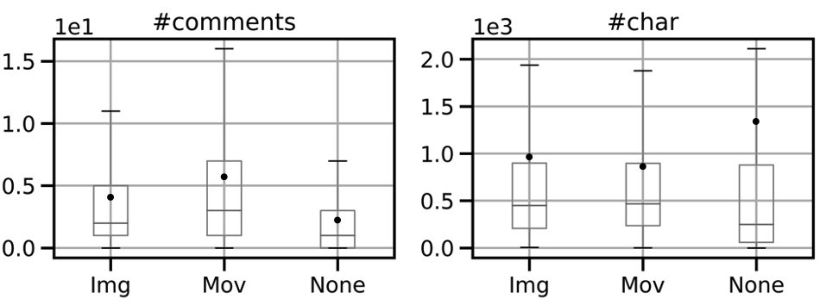

Slide 2

Downloading and collecting data
Selecting, converting, and classifying data
4,173
repositories
Attributes of 770,656 issues
Our dataset
Get time
information
Download issues of selected repositories from GitHub
Focus target issues
Count words and
# of characters
in the text
Classify into categories by presence or absence of images and movies
Count # of
images and movies
in the text
Convert words to TFIDF values
Downloaded
issues

