Slide 1
Review of Previous Meeting
To-Do Items
Single-frame & Sequence VLM Test: Conduct detection tests using GPT/Gemini on both cherry-picked single frames and 41-frame temporal sequences．The sequence-based approach provides 1.34 seconds of movement data to verify if the models can identify glitches that require temporal context，such as speed-based anomalies or state-change defects that are unidentifiable in static images．
Expand Annotation Data: Manually annotate at least 10 more WR videos to check if the glitch types and their durations are consistent across different runs.
Notes:
First，I'd like to review our previous meeting and the current to-do items ．We conducted detection tests using GPT and Gemini on both cherry-picked single frames and 41-frame temporal sequences ．The sequence-based approach provides 1.34 seconds of movement data，allowing us to verify if the models can identify glitches that require temporal context，such as speed-based anomalies or state-change defects that are unidentifiable in static images ．Additionally，we expanded our annotation data by manually annotating at least 10 world record videos to check for consistency in glitch types and durations across different runs ．

Slide 2
Single-frame VLM Test
Results: Correct labels obtained in only 2 out of 8 cases．
Observations: Detection appears feasible when spatial or locational cues are prominent and distinct．
Limitation: Static images fail to capture the temporal context essential for identifying speedrun-specific glitches．
Notes:
Regarding the single-frame VLM test，the results showed that correct labels were obtained in only 2 out of 8 cases ．From our observations，detection appears feasible when spatial or locational cues are prominent and distinct ．However，a significant limitation is that static images fail to capture the temporal context that is essential for identifying speedrun-specific glitches ．

Slide 3
Frame Sequence VLM Test
Results: While only 3 out of 8 were labeled correctly，the reasoning for 6 out of 8 cases accurately captured the actual events．
Analysis of Failures: The two cases that failed to be identified involved glitches characterized by extremely high-speed movement．
Hypothesis Testing: I explicitly stated the 1.34-second duration in the prompt to improve detection；however，this backfired as the model became biased by the numerical data，leading to a decrease in accuracy．
Notes:
Moving on to the frame sequence VLM test，while only 3 out of 8 cases were labeled correctly，the reasoning in 6 out of 8 cases accurately captured the actual events．We believe this is because the current glitch list was not entirely appropriate，so I will propose a new approach at the end of this presentation．Our analysis of the failures revealed that the two cases that were not identified involved glitches characterized by extremely high-speed movement．We also performed hypothesis testing by explicitly stating the 1.34-second duration in the prompt to improve detection．Unfortunately，this backfired as the model became biased by the numerical data，leading to a decrease in accuracy．

Slide 4
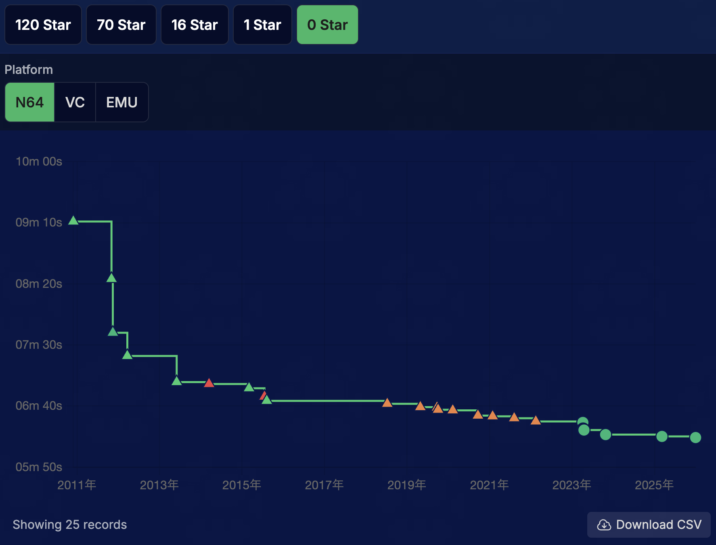
Expand Annotation Data
Sampling Methodology: I sampled and annotated 10 representative runs that marked major record improvements and were available on YouTube，ensuring a balanced historical coverage．
Notes:
Next，I'll discuss the expansion of the annotation data ．Regarding our sampling methodology，I sampled and annotated 10 representative runs that marked major record improvements and were available on YouTube，ensuring balanced historical coverage ．

Slide 5
Annotation Results
Consistency in Glitch Types: The types of glitches utilized have remained largely consistent over time (with minor shifts such as the adoption of the Pole Glitch and recent BLJ usage)．
Duration Patterns: Two primary patterns were observed regarding glitch durations: those that remain stable and those that are steadily decreasing．
Interpretations: Reductions in frame counts are attributed to improved player proficiency，while occasional increases reflect the extreme execution difficulty that remains unstable even for elite players．
Notes:
Next，I will summarize our annotation results．Although the raw data is omitted from this slide due to space constraints，our analysis reveals that the types of glitches utilized have remained largely consistent over the years，with only minor shifts such as the adoption of the Pole Glitch and recent BLJ usage．Regarding the duration of these glitches，we identified two primary patterns: those that remain stable and those that are steadily decreasing．We interpret the reductions in frame counts as a direct result of improved player proficiency，whereas occasional increases in duration reflect the extreme execution difficulty of certain tricks that remain unstable even for elite players．

Slide 6
Is the current glitch list appropriate?
Some glitches are very similar and potentially confusing:
BLJ: High-speed movement utilizing repeated long jumps．
LBLJ: A specific variant of BLJ performed in the castle lobby．
Miscellaneous Wall Clipping (MWC): Wall clipping achieved without using SM64-specific mechanics like BLJ．
Ledge Clipping: A sub-type of MWC that exploits momentary gaps in collision hitboxes during ledge-grab or pull-up animations．
Notes:
Now，I'd like to discuss whether the current glitch list is appropriate ．Some glitches are very similar and potentially confusing ．For instance，a BLJ involves high-speed movement utilizing repeated long jumps，whereas an LBLJ is a specific variant of a BLJ performed in the castle lobby ．Similarly，Miscellaneous Wall Clipping (MWC) is achieved without using SM64-specific mechanics like a BLJ，while Ledge Clipping is a sub-type of MWC that exploits momentary gaps in collision hitboxes during ledge-grab or pull-up animations ．

Slide 7
Our Proposal: Hierarchical Glitch List
Glitch
〜
BLJ
Miscellaneous Wall Clipping
〜
LBLJ
SBLJ
Ledge Clipping
DDD Skip
If the model identifies an LBLJ as a general BLJ, we would consider it a successful detection (OK) because the core event was accurately captured．
Notes:
Our proposal is to implement a hierarchical glitch list．For example，since LBLJ is a type of BLJ，we define them in a parent-child relationship．Under this model，if the model identifies an LBLJ as a general BLJ，we would consider it a successful detection because the core event was accurately captured．

Slide 8
Alternative Approaches
Simplification: Removing redundant labels to ensure a streamlined and minimal list．
Generalized Classification: Adopting high-level categories like OoB (Out of Bounds) and SG (Speed Glitch), consistent with our previous research．
Taxonomy Alignment: Following the taxonomy of prior work to maintain consistency with established research．
Notes:
We are also considering several alternative approaches ．The first is simplification，which involves removing redundant labels to ensure a streamlined and minimal list ．Another is generalized classification，where we adopt high-level categories like Out of Bounds (OoB) and Speed Glitch (SG) to maintain consistency with our previous research ．Finally，we could align our taxonomy with prior work to maintain consistency with established research ．

Slide 9
Key Question
Given our goal of supporting the speedrun community，which of these approaches is the most appropriate?
Notes:
This leads to our key question ．Given our goal of supporting the speedrun community，which of these approaches do you think is the most appropriate ？

