Slide 1
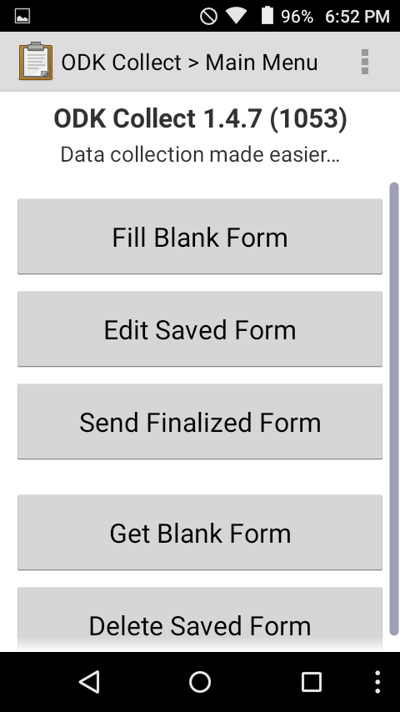
First, make sure your phone is connected to the POSM wifi. Launch OpenDataKit (you always use OMK through ODK; you will never launch it from the OMK app). You’ll see this menu.
Tap the three dots at the top-right of the screen and select “General settings”

Slide 2
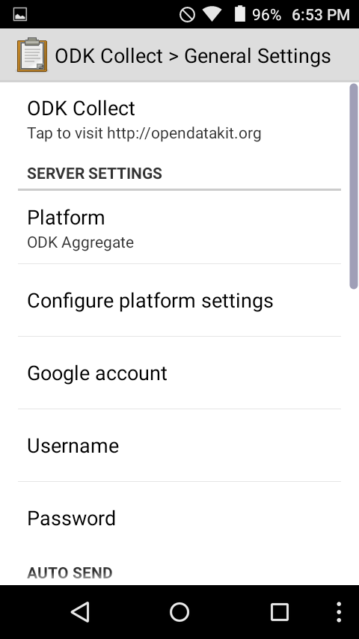
We have to tell the ODK app to connect to the OMK server, where it will find all the forms and will upload its responses. To do this, tap “Configure platform settings”

Slide 3
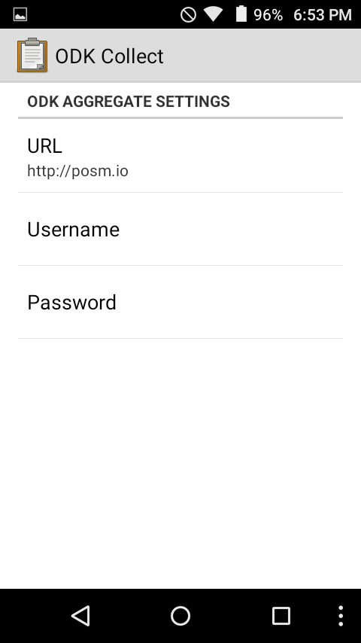
Set the URL to http://posm.io You have to do this the first time you set up the phone; after that, it will know where to point.
Be careful to write “http” and not “https”. You will get an error at the next step if you add the ‘s’.

Slide 4
Go back to the “General settings” screen.
Scroll down to the options for “Auto send” and make sure that there is a check next to “Auto send with wifi” and not next to “Auto send with network”. Since we’re doing this offline, we only want the forms sent over the POSM wifi.

Slide 5
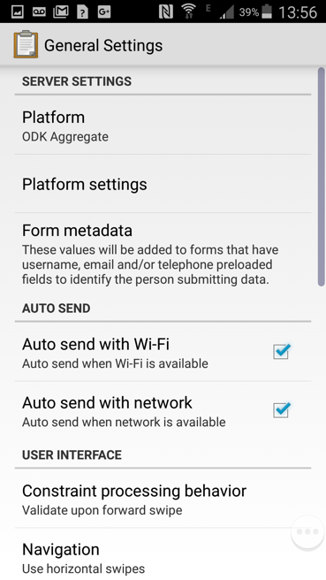
Go back to the “General settings” screen.
Scroll down to the options for “Auto send” and make sure that there is a check next to “Auto send with wifi” and not next to “Auto send with network”. Since we’re doing this offline, we only want the forms sent over the POSM wifi.

Slide 6
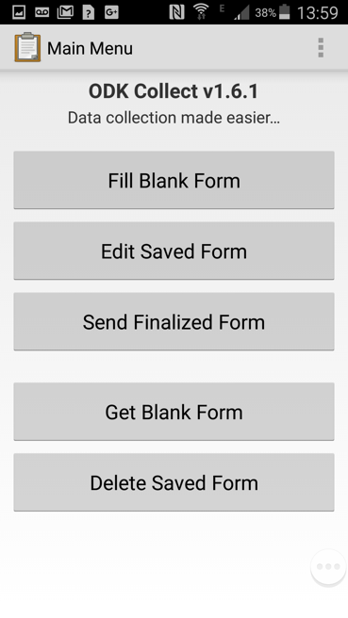
Now that the server settings are right, go back to the ODK home screen and select “Get blank form”.

Slide 7
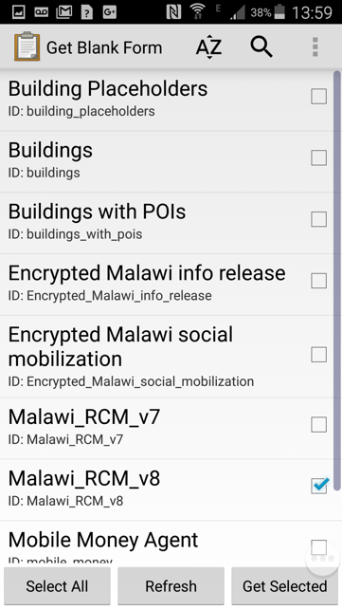
The app will connect to the OMK server on POSM and show you all the forms that have been uploaded.
Only get the ones you need - otherwise your enumerators may get confused later.

Slide 8
To use ODK, go to the ODK home screen and tap “Fill blank form”, then select the form you want to complete.
This launches the ODK survey and, in turn, prompts you to launch OpenMapKit.

Slide 9
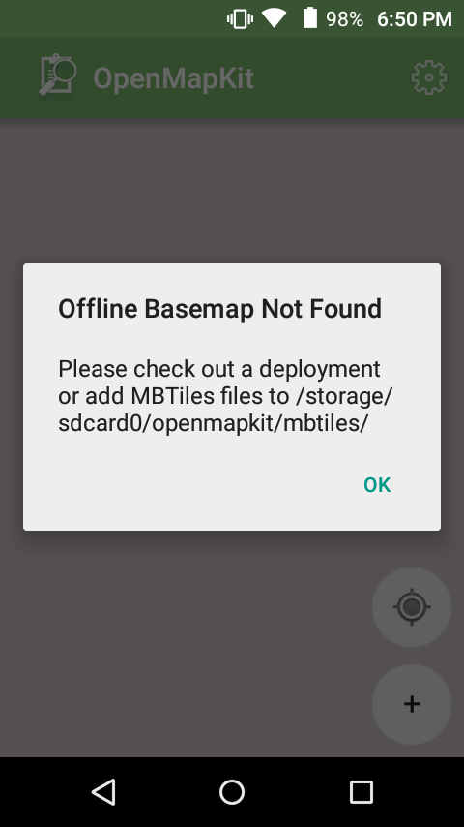
You may see this screen when you launch OMK for the first time. This is because you need to load the deployment.
Tap the gear icon at the top-right of the screen and select “Deployments”. You should see a list of any deployments that are on your POSM (items get added to the list when you load an OSM export onto the POSM).

Slide 10
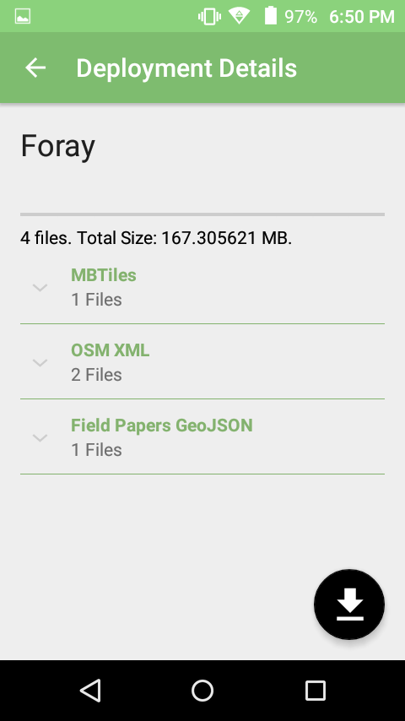
Tap on the deployment you want to load, and you’ll see a list of what files are available.
Tap the download button on the bottom-right to download all of these files.

Slide 11
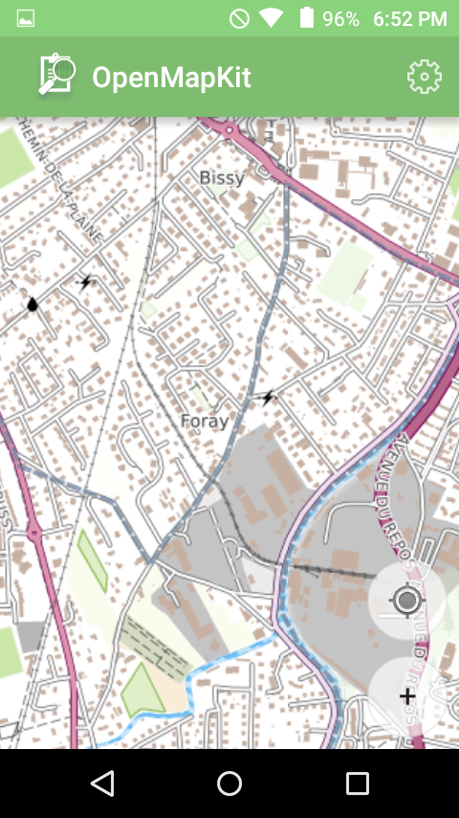
When the download has finished, tap on the map button on the bottom-right - you’ll see a map of the deployment.

Slide 12
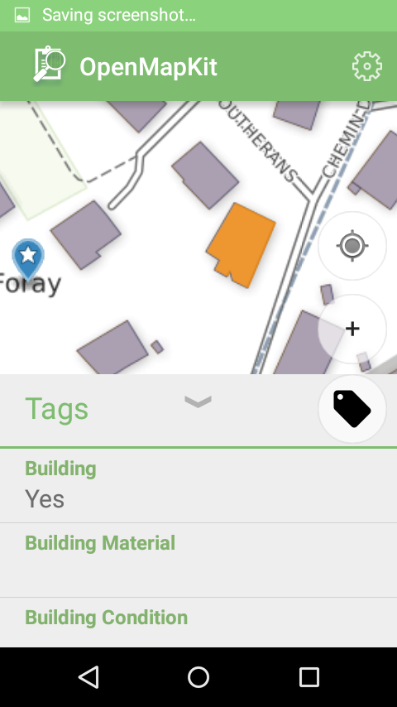
You can zoom into the deployment to select a building and complete the OMK survey for it. (If you have any problems, tap the gear icon again and select “OSM XML Layers”, and make sure your layers are turned on.)
Tapping on a building will show the existing OSM data for that feature.

Slide 13
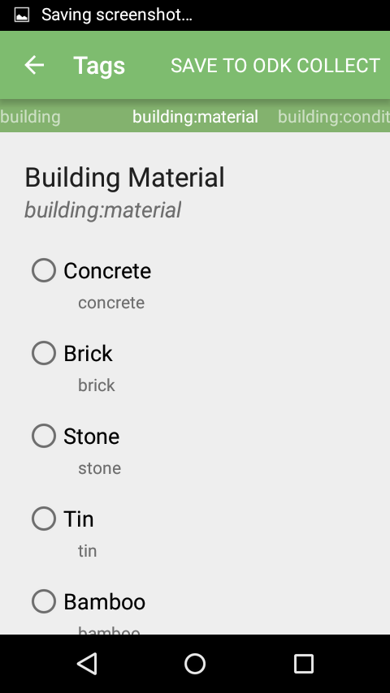
Press the tag button to complete the OMK survey, swiping through the different fields from the OMK form you prepared.

Slide 14
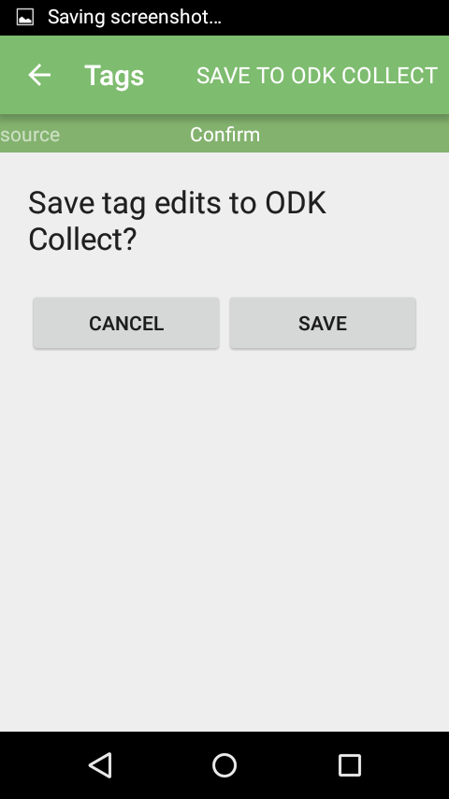
When you’ve finished, you’ll be prompted to save the OMK data.

Slide 15
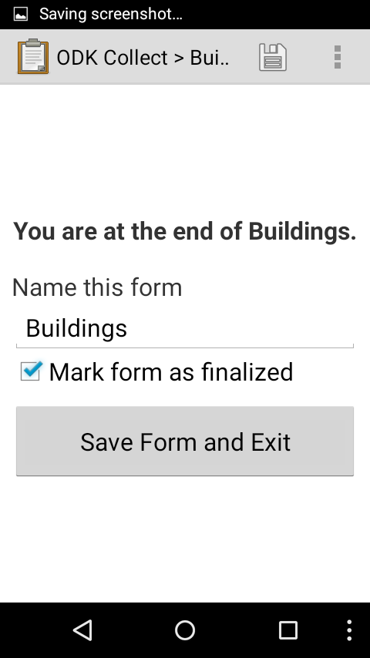
You will need to enter your OSM username for this.
Then, back in ODK, you need to save the form and exit the survey.
Enumerators sometimes forget to press “Save form and exit”. Please stress this in your trainings.

Slide 16
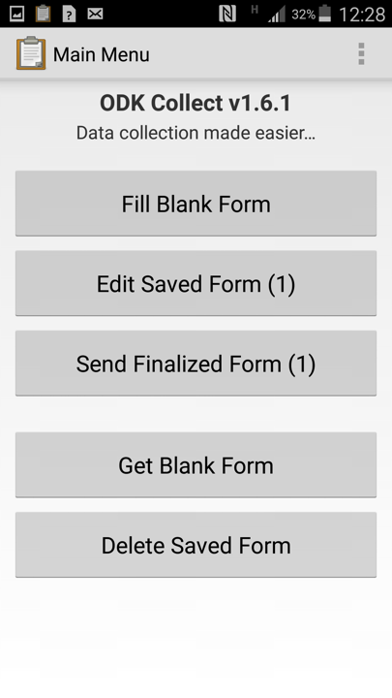
Pressing the save and exit button completes the survey and saves the data locally. It will auto-send to the server when it connects to POSM, then delete the local copy.
If for some reason it doesn’t, you’ll see a number next to “Send finalized forms”. Press this button to manually push them to POSM.

