Slide 1

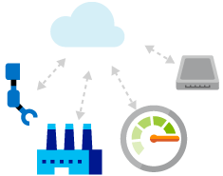
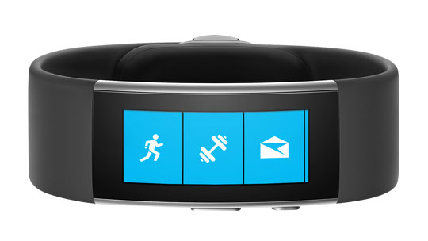
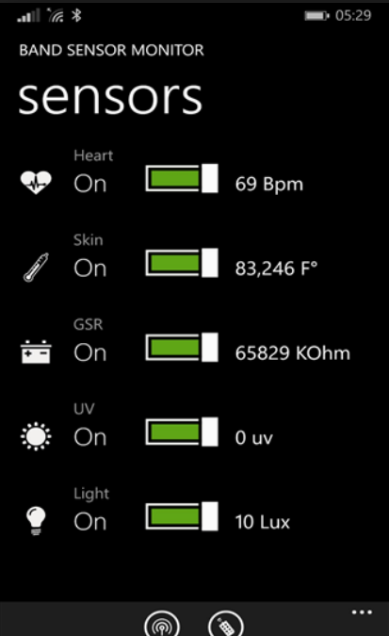

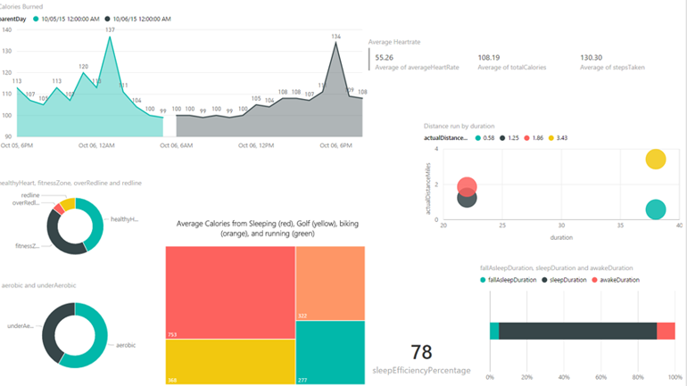



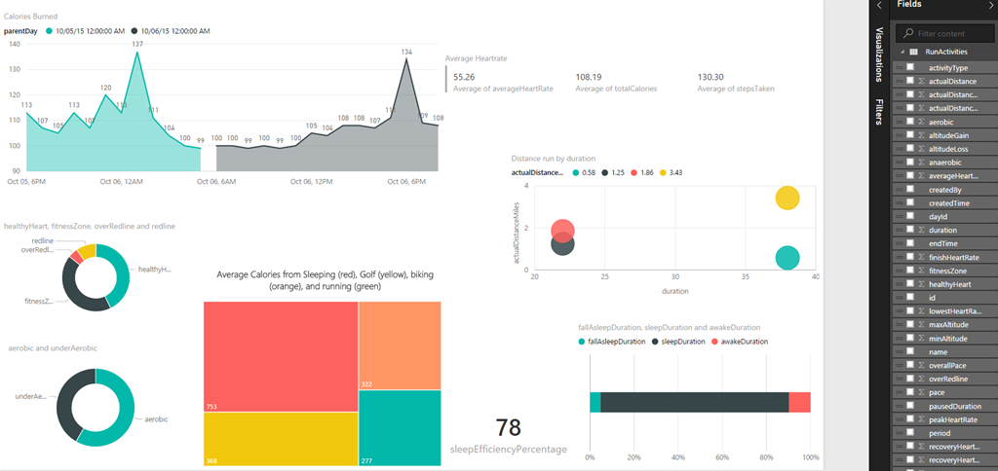

Event owner or visitor guide with mobile phone app.
Other sensors (optional)
Visitors with borrowed
MS Band
Real time sensor data
Real time questionnaires
Bluetooth
Azure IOT Hub
Post-visit feedback: Chat with bot
Big screens with real time dashboards
Azure Stream Analytics
Post event BI for internal marketers
PowerBi

Slide 2


SmartOffice Bot logo

Slide 3
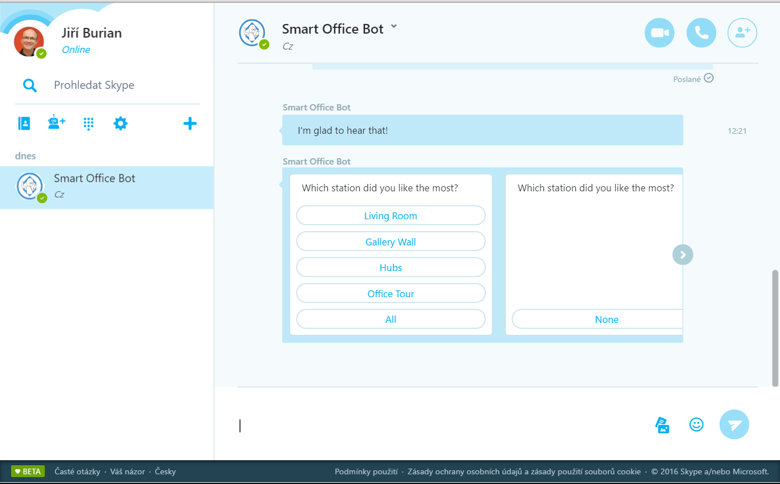

Slide 4
