Slide 1

Mathematical
Technique and Tools For Modeling
Privilege Client Unit at Ramathibodi Hospital

Slide 2


Outline
Introduction
Processing • Collecting data • Distribution • Spline
Simulation • Algorithm • Result
Conclusion

Slide 3

Privilege Client Unit
One server room
Open 6.00 AM - 10.00 PM
Clients come all along the day
Amount of clients are varied
Introduction

Slide 4
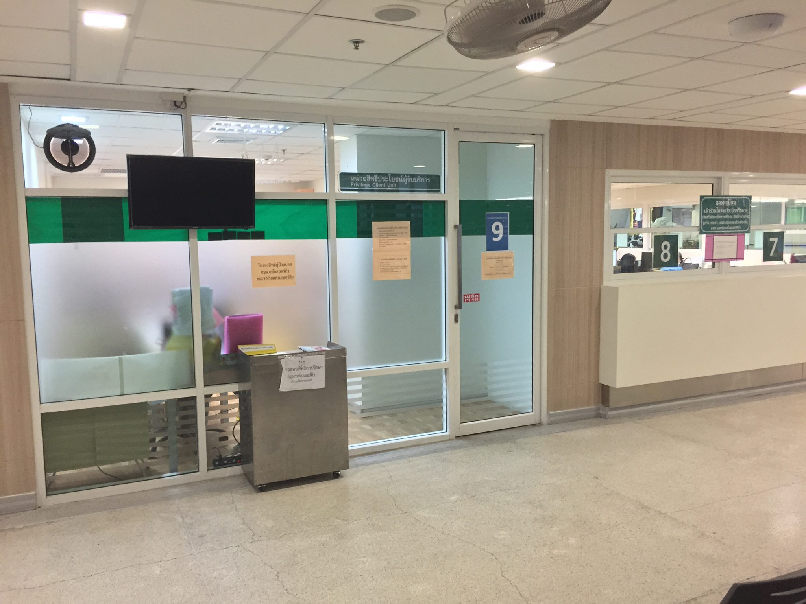
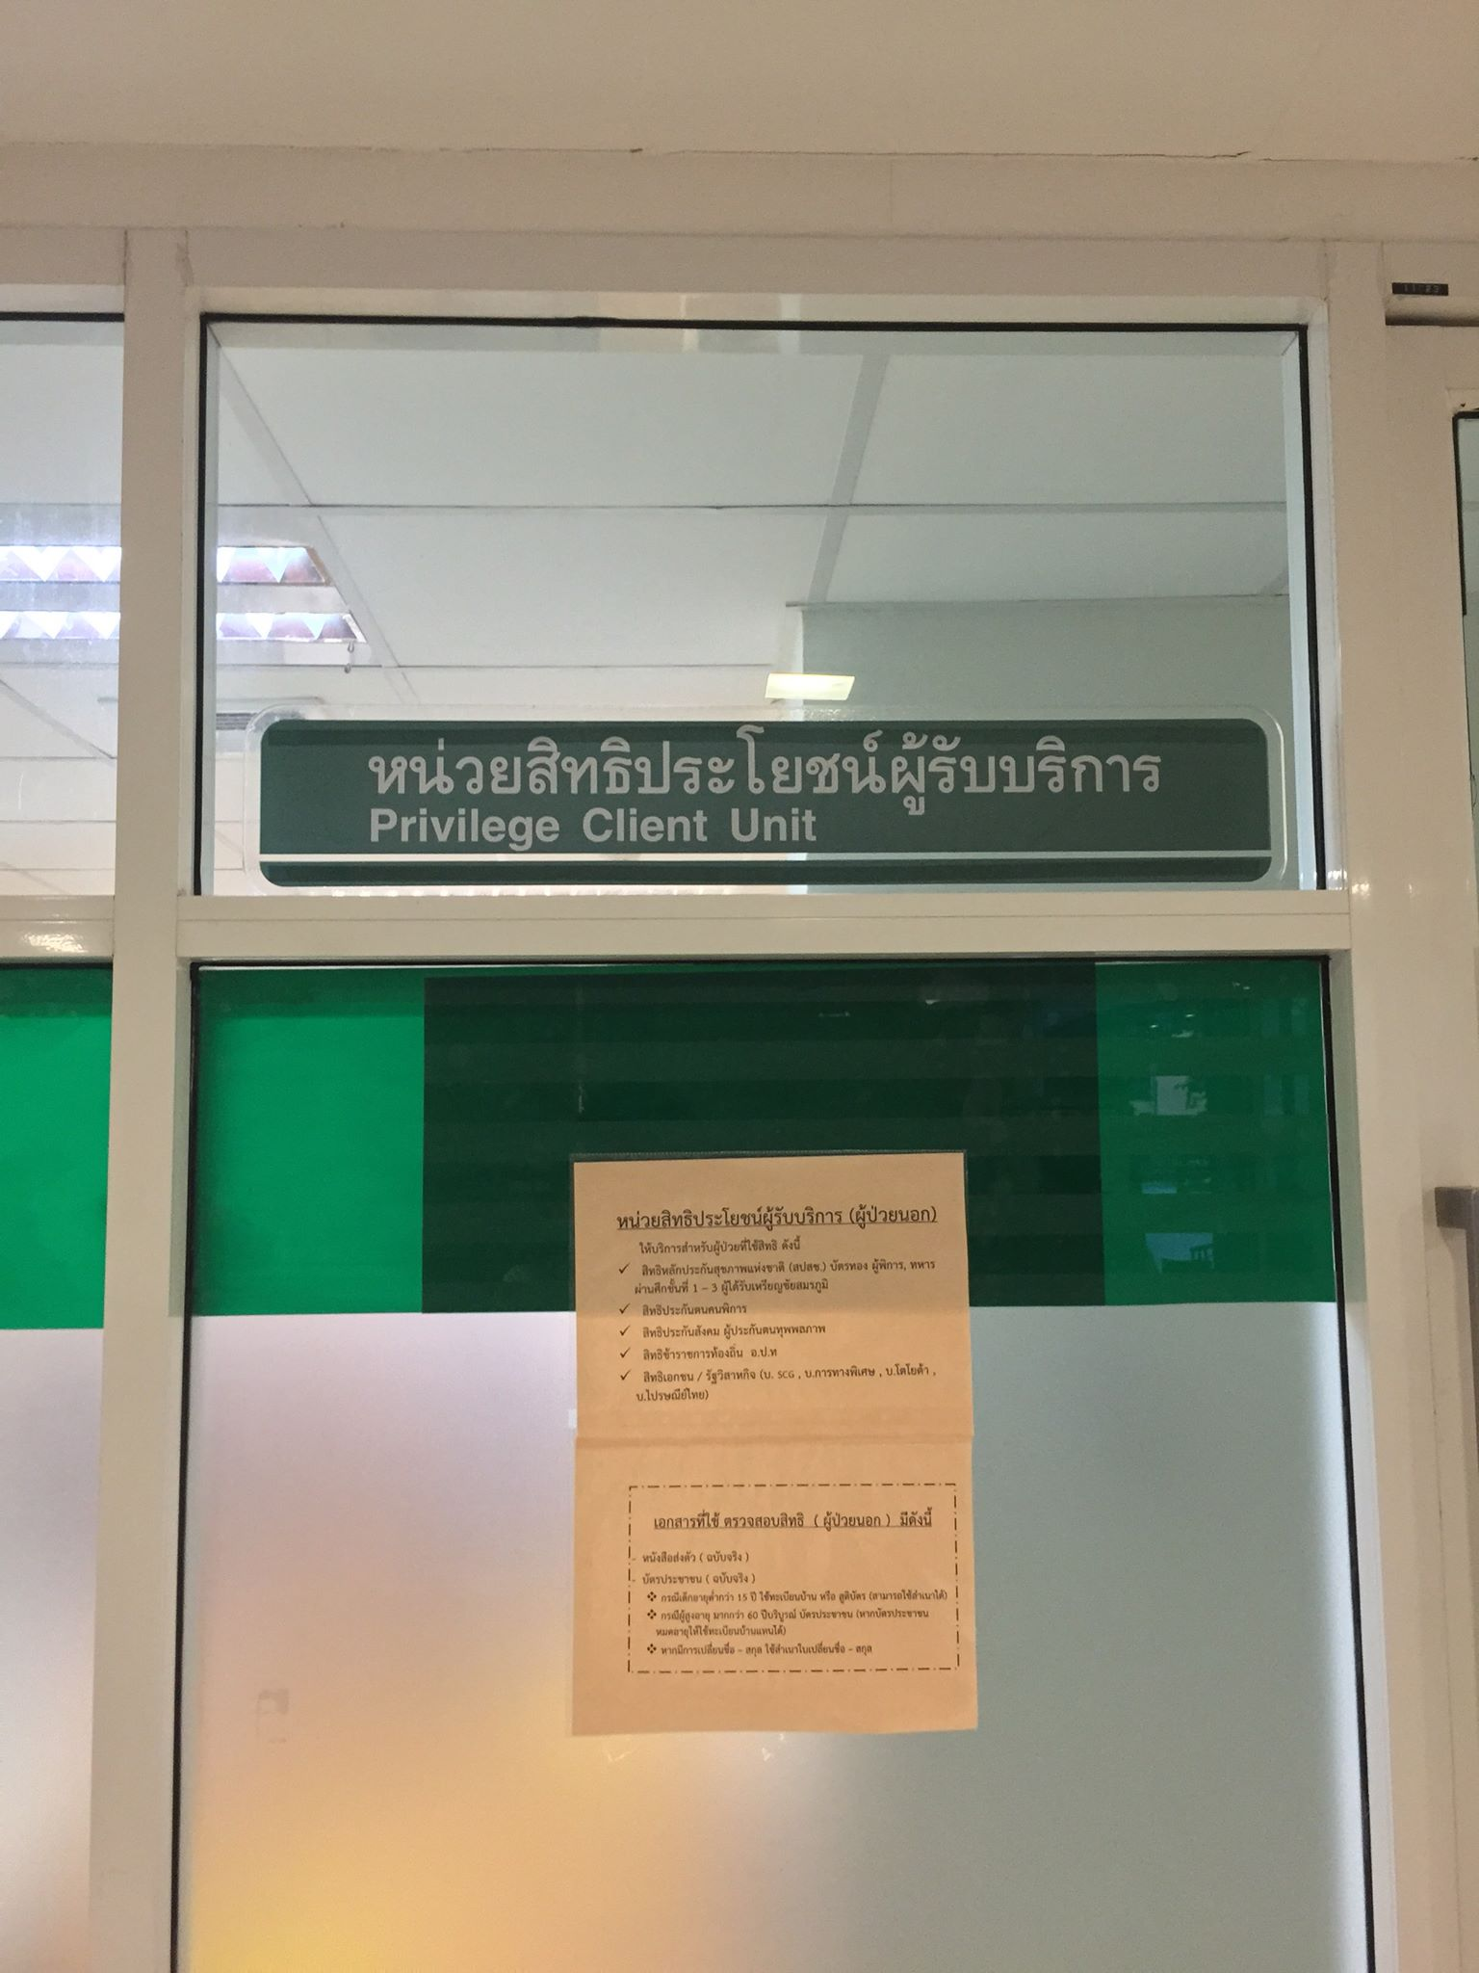
Photo

Slide 5
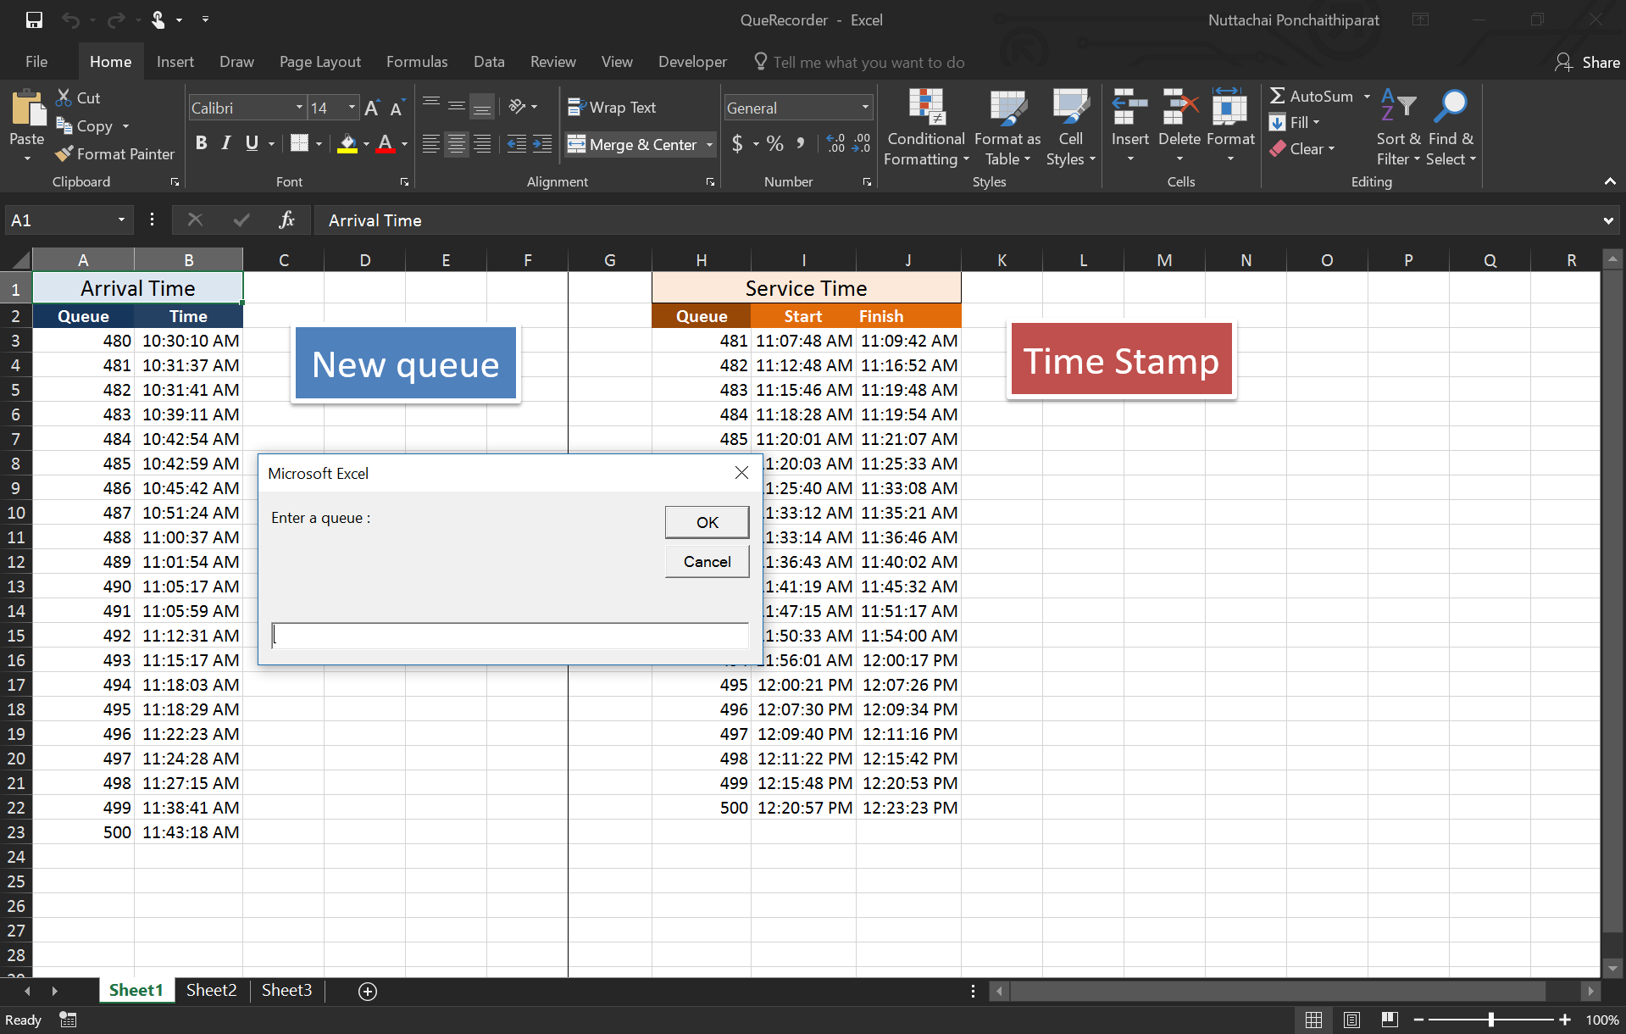
- Using Excel VBA to record the time
Method of Collecting
Processing
Collecting data
Number of observation:
Time Between Arrival = 158
Service Time = 130
Note: The number of observation for time between arrival and service time are not equal because some clients don’t show up when their queues are called.

Slide 6
- Our observations
Time Between Arrival
Processing
Distribution
Mean Time Between Arrival
= 210.7468 or 65 percentile
Bin | Frequency
200 | 101
400 | 27
600 | 18
800 | 8
1000 | 1
1200 | 3
More | 0
Total | 158

Slide 7
- Our observations
Service Time
Processing
Distribution
Mean Service Time
= 190.6692 or 63 percentile
Bin | Frequency
50 | 8
100 | 24
150 | 26
200 | 26
250 | 15
300 | 11
350 | 6
400 | 6
450 | 4
500 | 1
550 | 1
600 | 0
650 | 0
700 | 0
750 | 2
More | 0
Total | 130

Slide 8
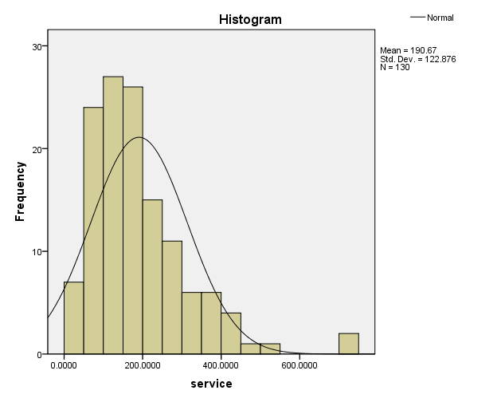
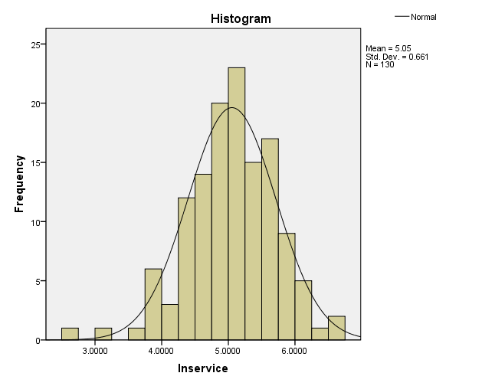
Service Time
Processing
Distribution
Natural log
transformation

Slide 9
- “Ln” transformation
Service Time
Processing
Distribution
Mean Service Time with Ln
= 5.0533 or 46 percentile
Bin | Frequency
2.9 | 1
3.3 | 1
3.7 | 1
4.1 | 6
4.5 | 15
4.9 | 25
5.3 | 35
5.7 | 26
6.1 | 14
6.5 | 4
6.9 | 2
More | 0
Total | 130

Slide 10
- Probability of occurrence
Time Between Arrival
Processing
Spline
Interval of B time between arrival (in seconds) | Frequency of occurrence (number of clients) | Probability of occurrence | Cumulative Probability
0 ≤ B ≤ 200 | 101 | 0.639241 | 0.639241
200 < B ≤ 400 | 27 | 0.170886 | 0.810127
400 < B ≤ 600 | 18 | 0.113924 | 0.924051
600 < B ≤ 800 | 8 | 0.050633 | 0.974684
800 < B ≤ 1000 | 1 | 0.006329 | 0.981013
1000 < B ≤ 1200 | 3 | 0.018987 | 1
 | 158

Slide 11
- Spline
Time Between Arrival
Processing
Spline
Midpoint Interval | Interval of cumulative probability | Linear Spline | Inverse Spline
0 ≤ B ≤ 100 | 0 ≤ p ≤ 0.6392 | 0.006392B | 156.4356p
100 < B ≤ 300 | 0.6392 < p ≤ 0.8101 | 3.2448B - 972.627 | 1170.3704p - 648.1481
300 < B ≤ 500 | 0.8101 < p ≤ 0.9241 | 5.6157B – 2806.9416 | 1755.5556p - 1122.2222
500 < B ≤ 700 | 0.9241 < p ≤ 0.9747 | 15.7549B - 11027.4367 | 3950p - 3150
700 < B ≤ 900 | 0.9747 < p ≤0.981 | 150.5049B - 135453.4335 | 31600p - 30100
900 < B ≤ 1200 | 0.981 < p ≤ 1 | 48.67B - 58403 | 15800p - 14600

Slide 12
- Probability of occurrence
Service Time
Processing
Spline
Interval of S service time (in seconds) | Frequency of occurrence (number of clients) | Probability of occurrence | Cumulative Probability
0 ≤ S ≤ 50 | 8 | 0.061538 | 0.061538
50 < S ≤ 100 | 24 | 0.184615 | 0.246154
100 < S ≤ 150 | 26 | 0.2 | 0.446154
150 < S ≤ 200 | 26 | 0.2 | 0.646154
200 < S ≤ 250 | 15 | 0.115385 | 0.761538
250 < S ≤ 300 | 11 | 0.084615 | 0.846154
300 < S ≤ 350 | 6 | 0.046154 | 0.892308
350 < S ≤ 400 | 6 | 0.046154 | 0.938462
400 < S ≤ 450 | 4 | 0.030769 | 0.969231
450 < S ≤ 500 | 1 | 0.007692 | 0.976923
500 < S ≤ 550 | 1 | 0.007692 | 0.984615
550 < S ≤ 600 | 0 | 0 | 0.984615
600 < S ≤ 650 | 0 | 0 | 0.984615
650 < S ≤ 700 | 0 | 0 | 0.984615
700 < S ≤ 750 | 2 | 0.015385 | 1
 | 130

Slide 13
- Probability of occurrence
Service Time with Ln
Processing
Spline
Interval of ln(S) ln(S) = S’ | Frequency of occurrence (number of clients) | Probability of occurrence | Cumulative Probability
2.5 ≤ S’ ≤ 2.9 | 1 | 0.007692 | 0.007692
2.9 < S’ ≤ 3.3 | 1 | 0.007692 | 0.015385
3.3 < S’ ≤ 3.7 | 1 | 0.007692 | 0.023077
3.7 < S’ ≤ 4.1 | 6 | 0.046154 | 0.069231
4.1 < S’ ≤ 4.5 | 15 | 0.115385 | 0.184615
4.5 < S’ ≤ 4.9 | 25 | 0.192308 | 0.376923
4.9 < S’ ≤ 5.3 | 35 | 0.269231 | 0.646154
5.3 < S’ ≤ 5.7 | 26 | 0.2 | 0.846154
5.7 < S’ ≤ 6.1 | 14 | 0.107692 | 0.953846
6.1 < S’ ≤ 6.5 | 4 | 0.030769 | 0.984615
6.5 < S’ ≤ 6.9 | 2 | 0.015385 | 1
 | 130

Slide 14
- Spline
Service Time with Ln
Processing
Spline
Midpoint interval | Interval of cumulative probability | Spline | Inverse Spline
2.5 ≤ S’ ≤ 2.7 | 0 ≤ p ≤ 0.0077 | 0.0385S – 0.0962 | 26p + 2.5
2.7 < S’ ≤ 3.1 | 0.0077 < p ≤ 0.0154 | 0.0192S – 0.0442 | 52p + 2.3
3.1 < S’ ≤ 3.5 | 0.0154 < p ≤ 0.0231 | 0.0192S – 0.0442 | 52p + 2.3
3.5 < S’ ≤ 3.9 | 0.0231 < p ≤ 0.0692 | 0.1154S – 0.3808 | 8.6667p + 3.3
3.9 < S’ ≤ 4.3 | 0.0692 < p ≤ 0.1846 | 0.2885S – 1.0558 | 3.4667p + 3.66
4.3 < S’ ≤ 4.7 | 0.1846 < p ≤ 0.3769 | 0.4808S – 1.8827 | 2.08p + 3.916
4.7 < S’ ≤ 5.1 | 0.3769 < p ≤ 0.6462 | 0.6731S – 2.7865 | 1.4857p + 4.14
5.1 < S’ ≤ 5.5 | 0.6462 < p ≤ 0.8462 | 0.5S – 1.9038 | 2p + 3.8077
5.5 < S’ ≤ 5.9 | 0.8462 < p ≤ 0.9539 | 0.2692S – 0.6346 | 3.7143p + 2.3571
5.9 < S’ ≤ 6.3 | 0.9539 < p ≤ 0.9846 | 0.0769S + 0.5 | 13p – 6.5
6.3 < S’ ≤ 6.9 | 0.9539 < p ≤ 1 | 0.0256S + 0.8231 | 39p – 32.1

Slide 15
Algorithm of the Program
Simulation
Algorithm
Variables :
OUTPUT
AvgTime = average time which each clients get their service done
MaxTime = maximum time which a client get his/her service done
WaitingTime = average time which each clients wait to get their service done
MaxWait = maximum time which a client wait to get his/her service done
IdleTime = Ratio of idle time and total open time
serv(i) = randomize service time for customer i
between(i) = randomize time between arrival for customer I and customer i-1
start(i) = time that customer i get his/her service start
finish(i) = time that customer i get his/her service done
wait(i) = time that customer i get wait to get his/her service start
idle(i) = time that the counter is idle before customer i ‘s service
cancel(i) = randomize number to determine whether the queue will be cancel or not
tooLong(i) = the duration of time which will the queue cancelation is arise
cancelRate(i) = percentage of cancelation obtained from data collected

Slide 16
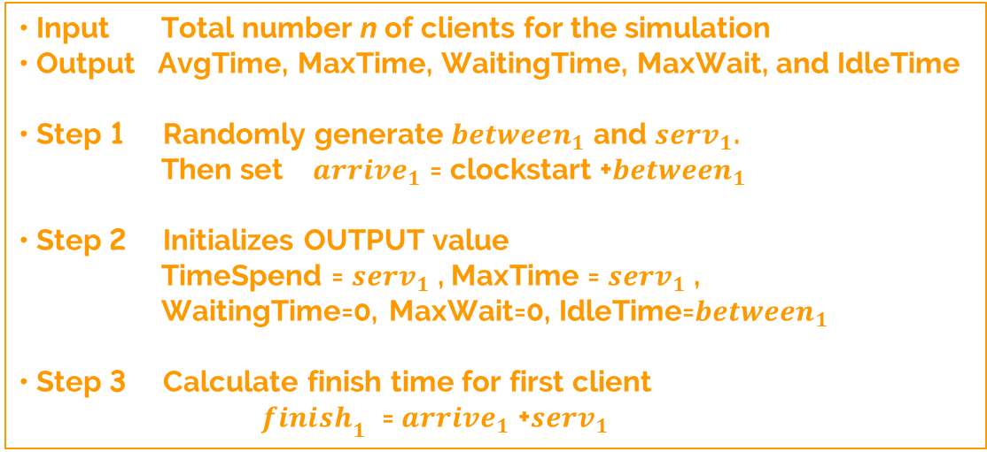
Algorithm of the Program
Simulation
Algorithm

Slide 17

Algorithm of the Program
Simulation
Algorithm
• Step 4 For $i$ = 1,2,3, .... ,n do Step 5-18 • Step 5 Generate a pair of random number ${between}_{i}$ and ${serv}_{i}$ for the respective time interval • Step 6 Calculate the time of arrival for $i^{th}$ client ${arrive}_{i}$ = ${arrive}_{i−1}$ + ${between}_{i}$ • Step 7 Calculate the time difference between the arrival of $i^{th}$ client and the finish time of service of previous client timediff = ${arrive}_{i}$ - ${finish}_{i−1}$

Slide 18

Algorithm of the Program
Simulation
Algorithm
• Step 8 For negative timediff, $i^{th}$ client must wait before he/she can get serviced, ${wait}_{i}$ = -timediff, ${idle}_{i}$ = 0 For nonnegative timediff, service counter is idle, ${wait}_{i}$ = 0, ${idle}_{i}$ = timediff
• Step 9 Check if ${wait}_{i}$ > tooLong or not. Yes - Continue to Step10 No - Go to step 11 • Step 10 Randomly generate ${cancel}_{i}$ Then check if ${cancel}_{i}$ < cancelRate --> Yes-Go to Step5 and start new iteration No-Continue to Step11 • Step 11 Calculate start time for $i^{th}$ client ${start}_{i}$ = ${arrive}_{i}$ + ${wait}_{i}$

Slide 19

Algorithm of the Program
Simulation
Algorithm
• Step 12 Calculate the finish time $i^{th}$ client ${finish}_{i}$ = ${start}_{i}$ + ${serv}_{i}$ • Step 13 Calculate the time that $i^{th}$ client spend to get his/her service timespend = ${wait}_{i}$ + ${serv}_{i}$ • Step 14 Sum ${serv}_{i}$ into AvgTime for averaging • Step 15 If ${serv}_{i}$ > MaxTime, Then set MaxTime = ${serv}_{i}$ Otherwise, leave MaxTime as it is

Slide 20

Algorithm of the Program
Simulation
Algorithm
• Step 16 Sum ${wait}_{i}$ into total WaitTime for averaging • Step 17 Sum ${idle}_{i}$ into total IdleTime for averaging • Step 18 If ${wait}_{i}$ > MaxWait, Then set MaxWait = ${wait}_{i}$ Otherwise, leave MaxWait as it is • Step 19 Set AvgTime = AvgTime/n WaitTime = WaitTime/n IdleTime = IdleTime/n • Step 20 OUTPUT (AvgTime, MaxTime, WaitingTime, MaxWait, IdleTime)

Slide 21
Result of Simulation
Simulation
Result
Number of Clients | 100 | 500 | 1000 | 2000
Average time spend | 1397.045 | 1338.699 | 1217.518 | 1880.756
Max time spend | 2835.84 | 3382.922 | 4908.292 | 5759.162
Average Waiting time | 1226.74 | 1182.315 | 1064.442 | 1724.863
Max Waiting time | 2571.958 | 3184.108 | 4797.299 | 5705.182
Idle time ratio | 0.046172 | 0.204088 | 0.23866 | 0.159266

Slide 22
Conclusion
• By simulation, the average spending time and waiting time are vary even though the sample size is the same, and the variation of time increase as the number of clients increase.
• The idle time ratio is around 4 to 24 percent, it can increase or decrease depend on the arrival rate of the clients, in this case these percentages are acceptable.
• In reality, we need to limit the number of client in one day because there is the close time at 10 PM.
• To reduce the cancelation rate, the hospital need to decrease the waiting time by increase the server in the peak time.

Slide 23
Thank You

