Slide 1

Applied Cryptography Project 2
Professor:
Giovanni Di Crescenzo
BLOCKCHAIN IMPLEMENTATION
Team Members:
Susanna Xu sx563
Chuhan Jin cj1436
Suyash Soumya ss11449

Slide 2
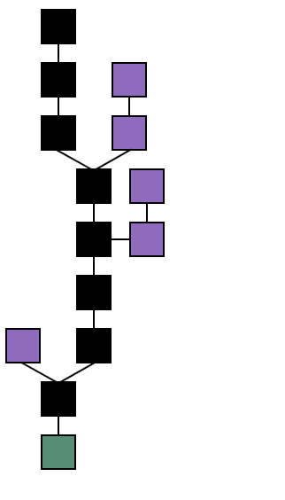
Overview
A blockchain is a growing list of records called blocks, which are linked using some type of cryptographic methodology
Each block contains a cryptographic hash of the previous block, a timestamp, and transaction data.
It is an open distributed ledger that can record transactions between two parties efficiently and in a verifiable and permanent way
Blockchain formation
The main chain (black) consists of the longest series of blocks from the genesis block (green) to the current block.
Orphan blocks (purple) exist outside of the main chain.

Slide 3
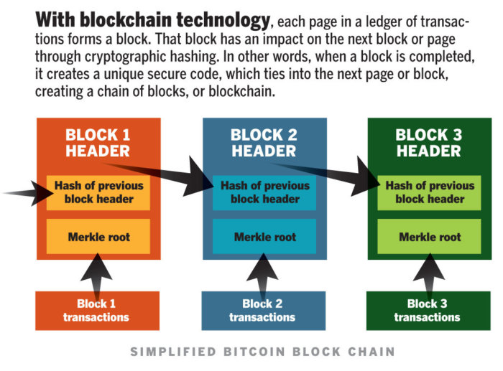
How it Works
A blockchain is typically managed by a Peer to Peer network which follows a distributed timestamping server protocol for inter-node communication and validating new blocks.
Once recorded, the data in any given block cannot be altered retroactively without alteration of all subsequent blocks, which requires consensus of the network majority.
This allows the participants to verify and audit transactions independently and relatively inexpensively

Slide 4
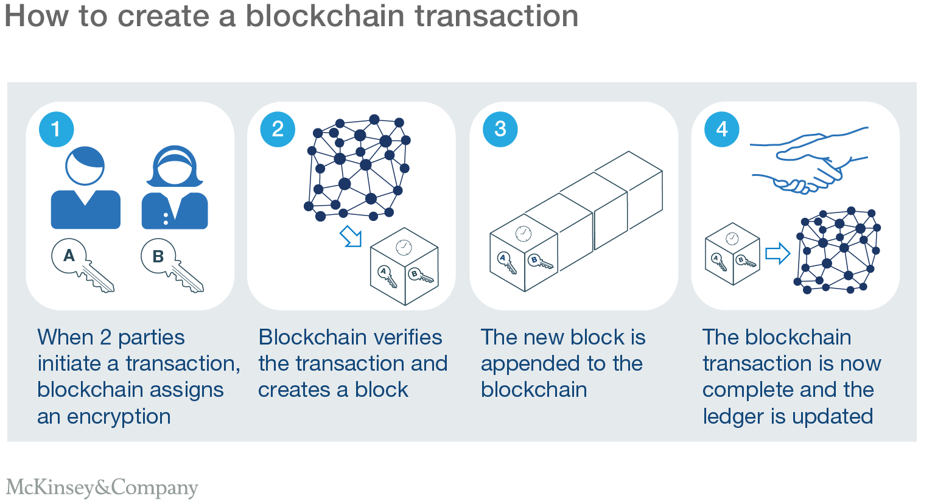
Blocks
Blocks hold batches of valid transactions that are hashed and encoded into a Merkle tree.
Each block includes the cryptographic hash of the prior block in the blockchain, linking the two.
The linked blocks form a chain.
This iterative process confirms the integrity of the previous block, all the way back to the original genesis block.
Sometimes separate blocks can be produced concurrently, creating a temporary fork.
Blocks not selected for inclusion in the chain are called orphan blocks.

Slide 5
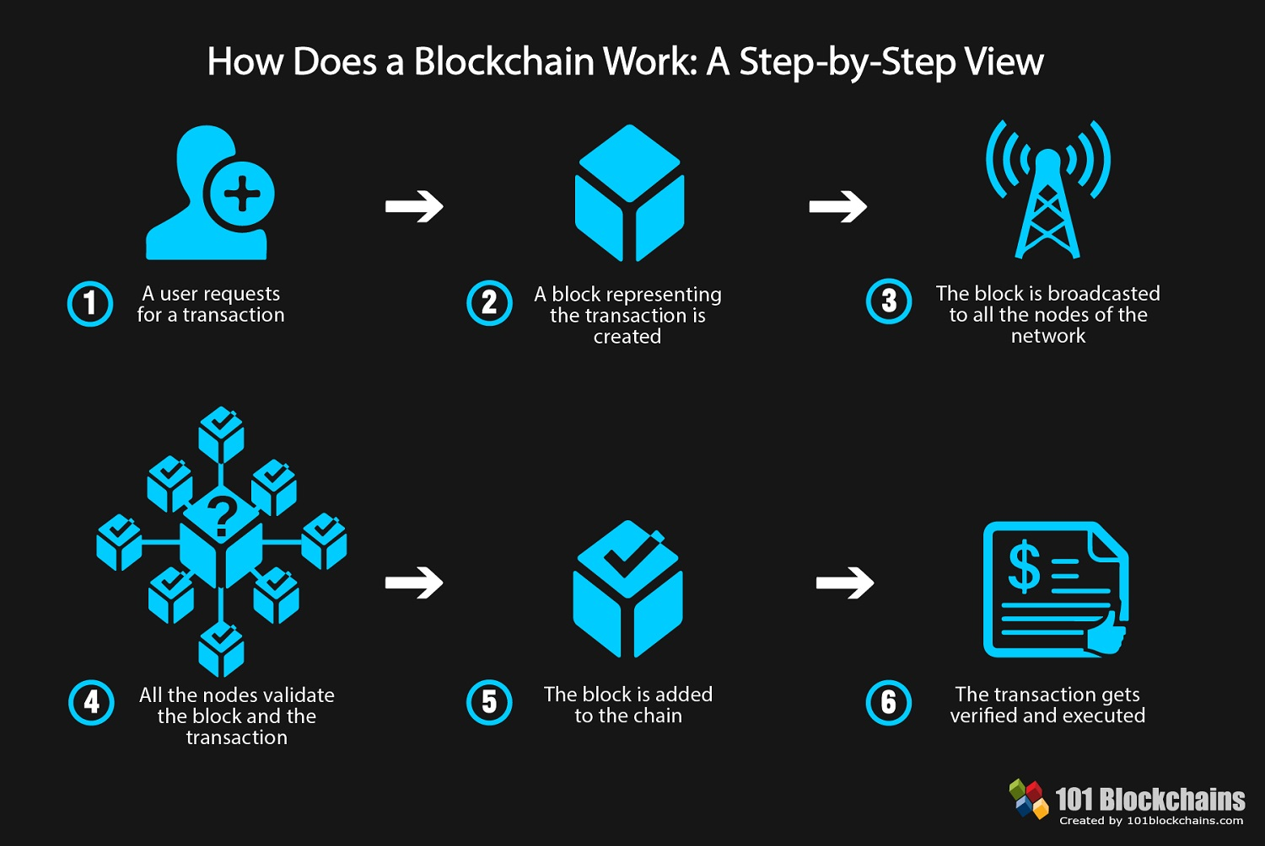
How Does a Blockchain Work?
Peers supporting the database have different versions of the history from time to time. They keep only the highest-scoring version of the database known to them.
Whenever a peer receives a higher-scoring version (usually the old version with a single new block added) they extend or overwrite their own database and retransmit the improvement to their peers
in a blockchain using the proof-of-work system, the chain with the most cumulative proof-of-work is always considered the valid one by the network.

Slide 6
How Does a Blockchain Work?
No centralized official copy exists and no user is trusted more than any other.
Transactions are broadcast to the network using software.
Messages are delivered on a best effort basis.
Mining nodes validate transactions, add them to the block they are building, and then broadcast the completed block to other nodes.
Blockchains use various time-stamping schemes, such as Proof of Work, to serialize changes.

Slide 7
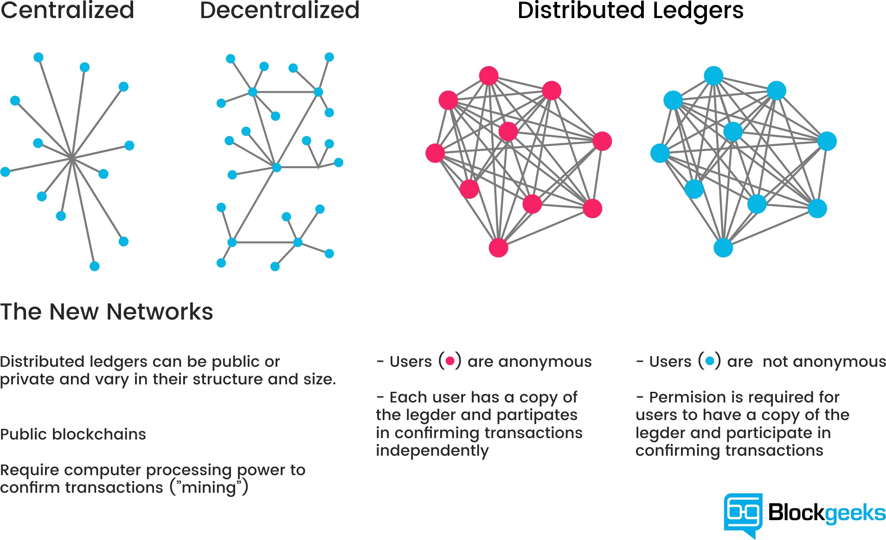

Slide 8
Decentralization
By storing data across its peer-to-peer network, the blockchain eliminates a number of risks that come with data being held centrally.
Peer-to-peer blockchain networks lack centralized points of vulnerability that computer hackers can exploit. In other words, it has no central point of failure.
Every node in a decentralized system has a copy of the blockchain.
Data Quality is maintained by massive database replication and computational trust.

Slide 9
Implementation
Blockchain:
Array of Blocks
Difficulty
Block:
Index
Data
Timestamp
Nonce
Previous Hash
Hash
Digital Signature

Slide 10
Implementation
Methods
Generate Hash
using previous Hash & other Block attributes
use SHA256 to hash
Check Blockchain Validity
check equality
Generate Hash and Hash
Previous Hash and last Block’s Hash
Add new Block to Blockchain
user passes in data, timestamp
get previous hash
mine method (discussed later)

Slide 11
Implementation
Simple TCP network simulates P2P network
Broadcast chain to everyone
Allow everyone on the network post blocks
POW(proof of work)

Slide 12
Parameters in consideration
Difficulty:
affects the mining of new Blocks to add to the Blockchain
mining for blocks: nonce changes
use Generate Hash method
constant as hash is fixed size
validates if Hash matches difficulty requirements
dependent on time it takes to find the right nonce
to satisfy the difficulty of the blockchain

Slide 13
Performance Analysis of Parameters
Average Duration of Block # (milliseconds) | 1 | 2 | 3 | 4 | 5
Difficulty
1 | 0 | 0 | 0 | 0.1992 | 0.1992
2 | 0.1992 | 0.599 | 0.3992 | 0.399 | 0.3986
3 | 1.1428 | 0.9962 | 3.8058 | 2.7056 | 1.2302
4 | 44.4138 | 99.9526 | 123.44 | 22.3982 | 77.1172
5 | 472.3464 | 631.0562 | 590.0138 | 876.5662 | 1182.672

Slide 14
Future Refinements
Put the entire Blockchain system into real network
Introduce Public/Private Key as another cryptography scheme
Be able to gain entire chain through P2P network
Adjust difficulty algorithm to have better performance expectation

Slide 15
End

